Slide 1
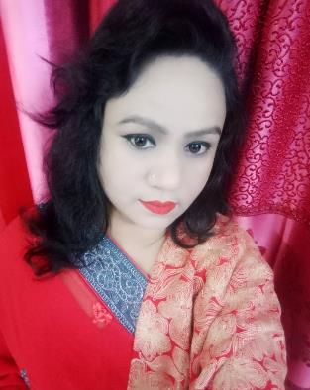
Welcome to
my online class
Nahid Akhtar parvin
Jagodishpur government
primary school.
Ekarchali,taragong,
rangpur
Class : Five
Subject : English
Unit : 1 - Hello
Lesson : 2-3
Page : 2,3

Slide 2
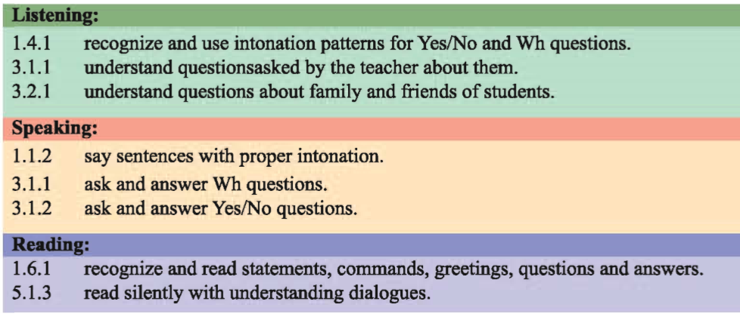
Learning outcomes
By the end of the lesson the students will be able to -

Slide 3
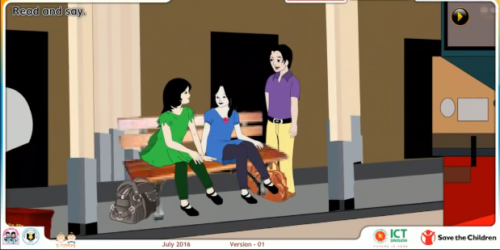
What can you see in this picture?
May be they introduce themselve .
So,may be they are saying HI/HELLO.
ISN’T THEY?

Slide 4
Our Today’s Lesson is
Hello !

Slide 5
New words
WHERE
কোথায়
MEET
সাক্ষাত করা

Slide 6
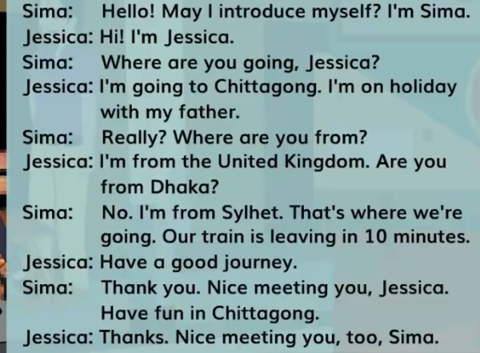
Open your Book point to the page No.02

Slide 7
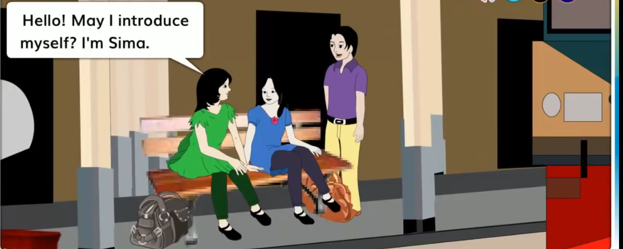
Sima:Hello!May I introduce myself?I’m Sima.

Slide 8
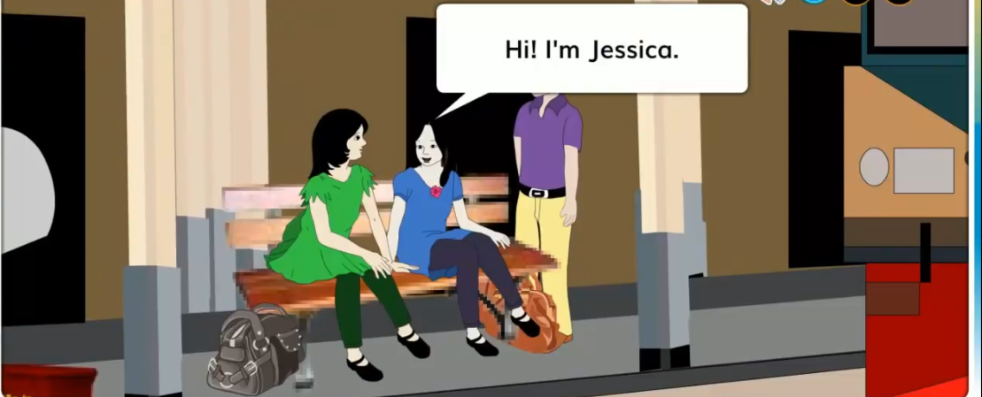
Jessika:Hi! I’m jessica.

Slide 9
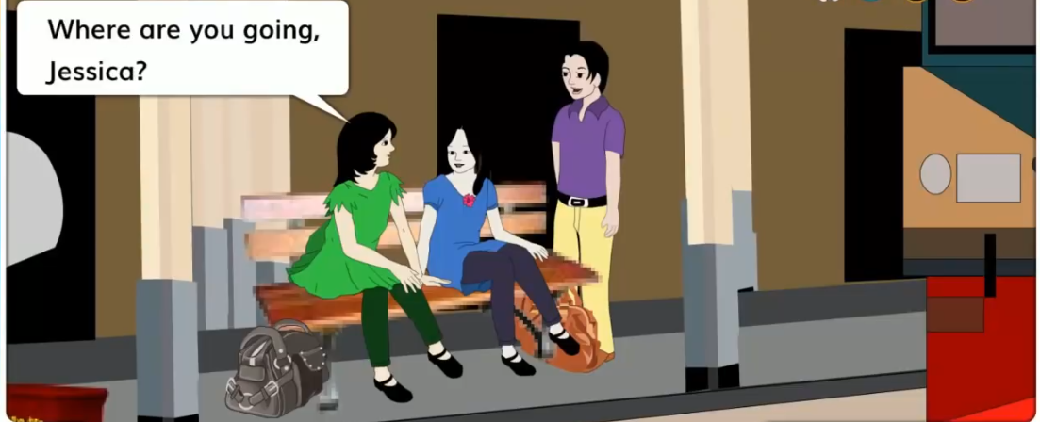
Sima:Where are you going Jessica?

Slide 10
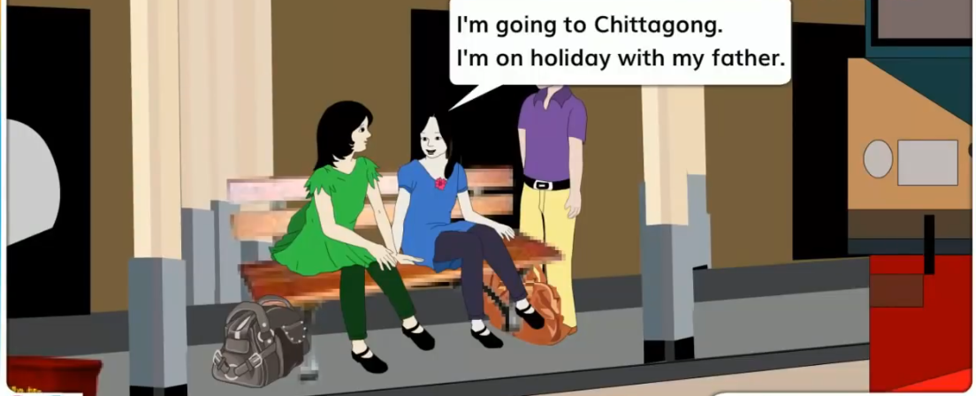
Jessica:I’m going to Chittagong. I’m on holyday with my father.

Slide 11
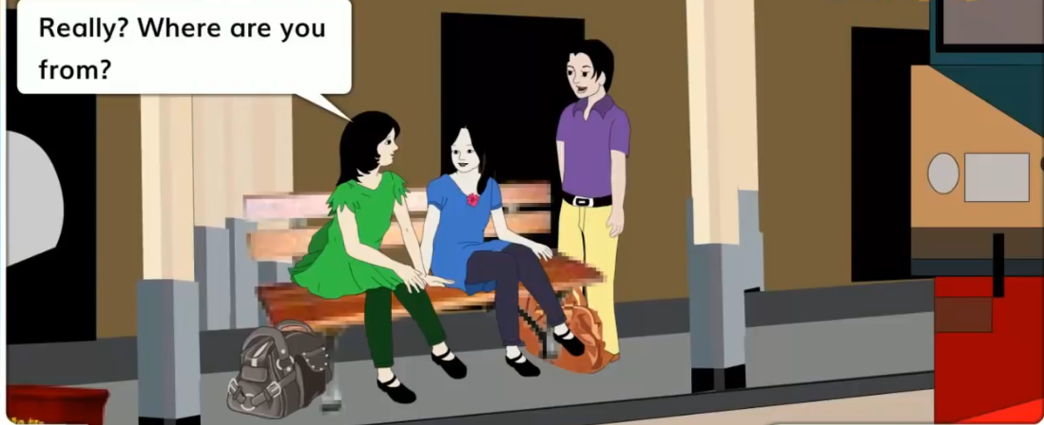
Really?Where are you from?

Slide 12
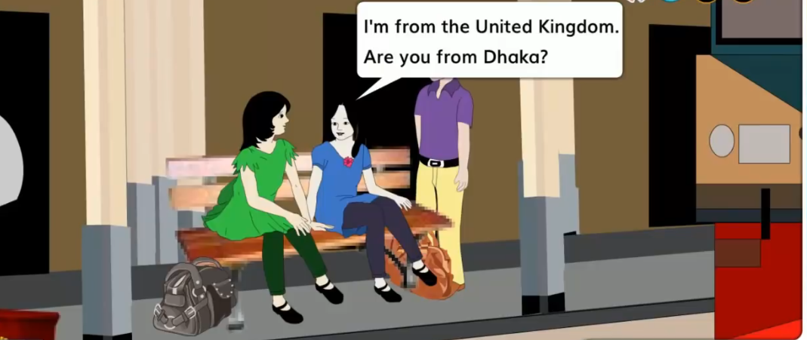
I’m from the United Kingdom.Are you from Dhaka?

Slide 13
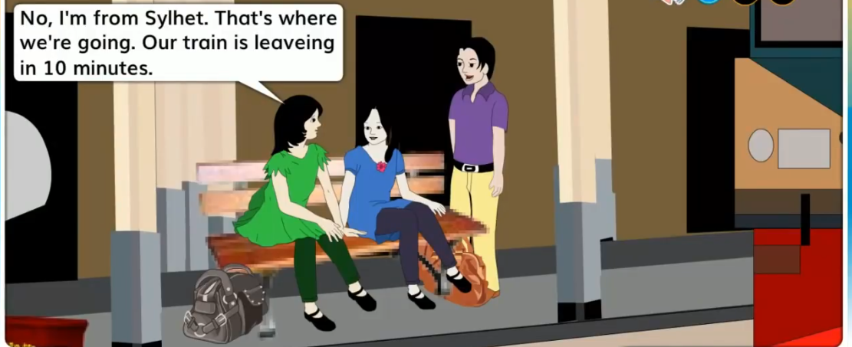
No,I’m from Sylhet.That’s where we’re going.
Our train is leaving in 10 minutes.

Slide 14
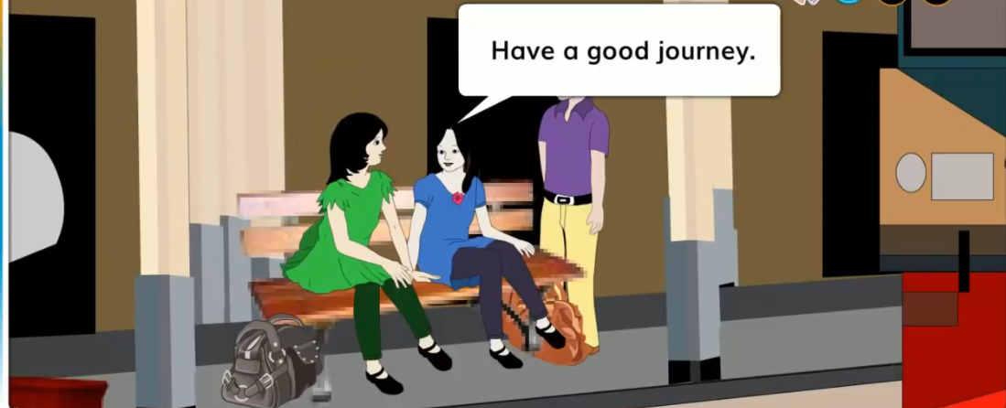
Jessica: Have a good journey.

Slide 15
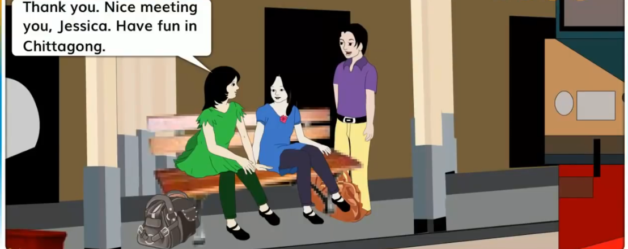
Sima:Thank you .Nice meeting you,Jessika.Have fun in Chittagong.

Slide 16
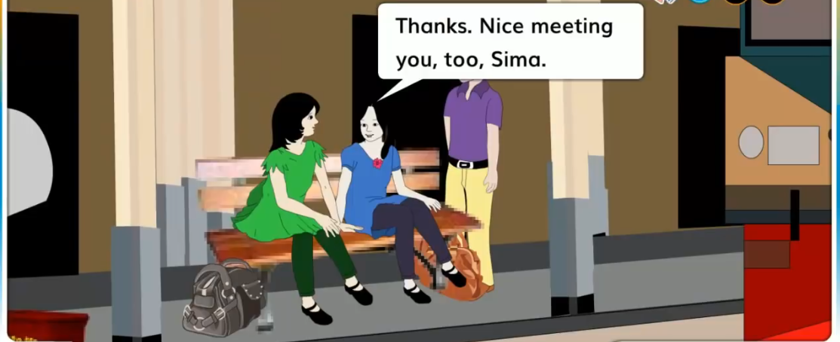
Jessica:Thanks .Nice meeting you,too,sima.

Slide 17
Pronunciation
Train
TRA
IN
TRAIN
Leaving
LEAV
ING
LEAVING

Slide 18
nice
from
Jessica
Jessica
Bingo
Sima
sima
have
Where
Where
Lets play a bingo game

Slide 19
Fill in the blanks.
1.May I introduce ------?.
2.Are you from -------?
3.Have a good -------.
myself
Dhaka
journey

Slide 20
Evaluation
Pronunce and say the words:
nice
where
সুন্দর
কোথায়
meet
go
সাক্ষাত করা
যাওয়া

Slide 21
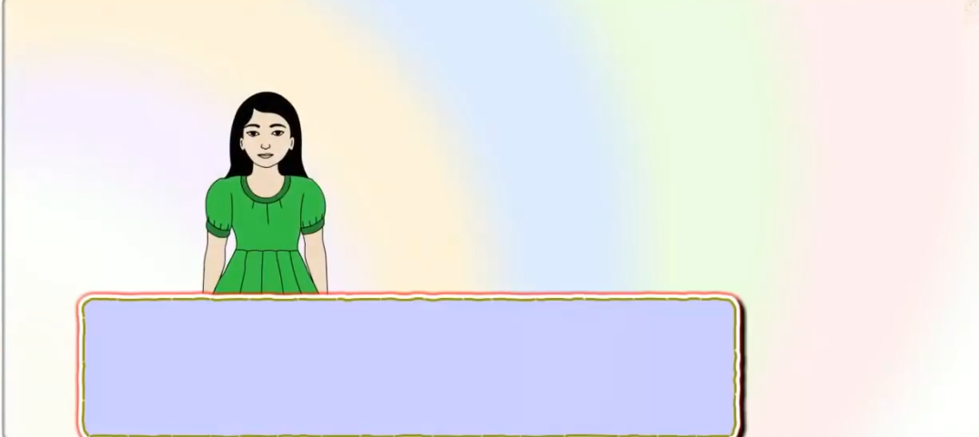
Home work.
Suppose its you.
Write the answer.
1)Where are you from?
Where are you going?
Ans:
Ans:

Slide 22
One day one word
Nice
সুন্দর
My doll is so nice.

Slide 23
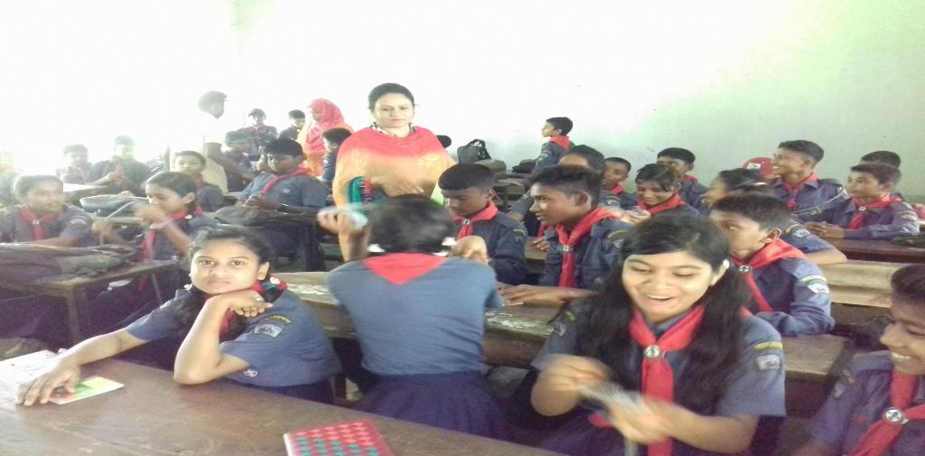
THINK
P
O
S
I
T
I
VE
THANKS ALL
BE
P
O
S
I
T
I
VE.
Thanks be with me.See you next class.

