Slide 2
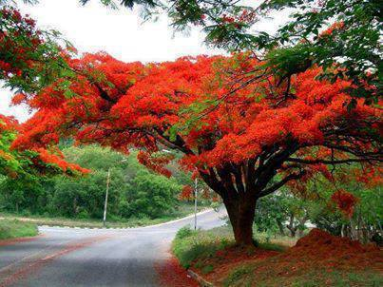
Welcome
to
all
in
my
Class.

Slide 3
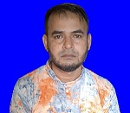
i
Teacher Introducing
Md Shamsunnoor
Head Teacher
Murergaon Govt. Primary school
Companiganj, Sylhet
Mobile : 01712-307039
Email : shadmanheya@gmail.com

Slide 4
Lesson Identity
Class Five
Subject : English for today
Part of the lesson : Activity C
Time : 40 minute

Slide 5
Learning outcomes
At the end of the lesson students will be able to-
Listening
1.3.1 recognize which words in a sentence are stressed.
3.4.1 Understand statements made by the teacher and students.
4.2.1 Undestand and enjoy simple stories.
Speaking
1.1.1 say words, phrases and sentences with proper sound and stress.
6.2.1 talk about people, objects, events etc.
Reading
1.5.1 read words, phrases and sentences in the text with proper
pronunciation, stress and intonation.
1.7.1 read paragraphs, dialogues, stories, letters and other texts .

Slide 6
Let’s we sing a song.
https://www.youtube.com/watch?v=vfg8J_8ZPIs

Slide 7
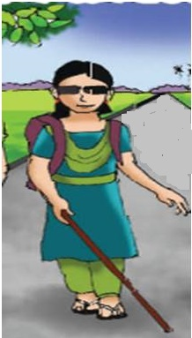
Justifying previous knowledge
Whom do you see in this picture ?
What is the girl doing in the picture ?
A girl walking in the picture.
Why Maria cannot see a beautiful day ?
The problem called is called ‘ visually impaired ’.
What is the problem called ?
She is Maria.

Slide 8
See the picture and think about it for some time.
Do you think a blind student can get admitted to a university ? How ?

Slide 9
After showing picture I will know learners delivery speech and exchange their opinion.
What is Maria doing in the picture ?
What is your impression about this picture ?
How can she operate Computer ?
We are reading about Maria’s dream for the future.

Slide 10
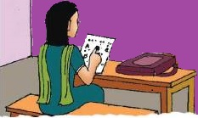
Today’s lesson
Life is Beautiful!
Lessons : 5-6 (5th period)
Maria hopes to…….their lives.
Unit : 20
Page : 80

Slide 11
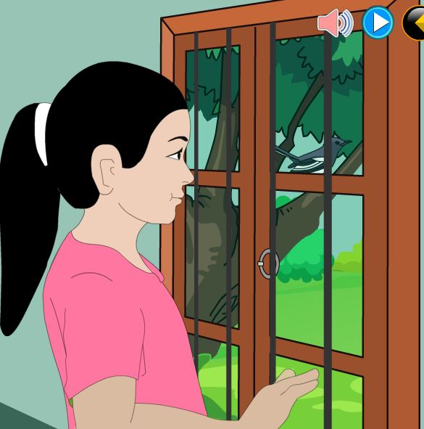
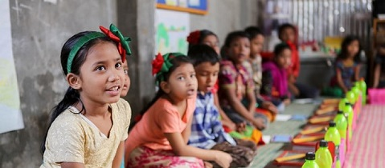
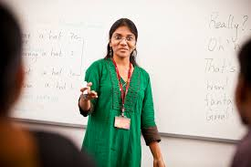
Lesson presentation :
Maria hopes to go to university
one day.
মারিয়ার আশা একদিন বিশ্ব বিদ্যালয়ে পড়বে ।

Slide 12
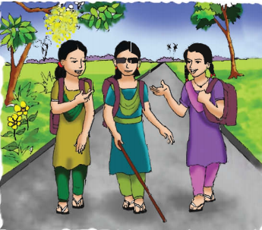
Listen and read-
Her teachers think that she can.
তার শিক্ষকরা মনে করেন সে পারবে ।
Maria

Slide 13
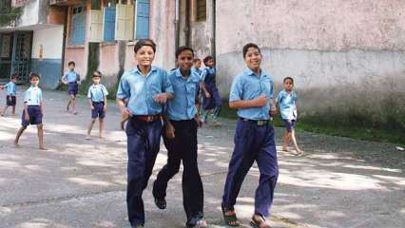
Maria wants to set up a school of her own so that she can teach visually impaired children.
মারিয়া তার নিজে একটি বিদ্যালয় প্রতিষ্ঠা করতে চায় যাতে সে দৃষ্টিহীন ছেলে-মেয়েদের পড়াতে পারে।

Slide 14
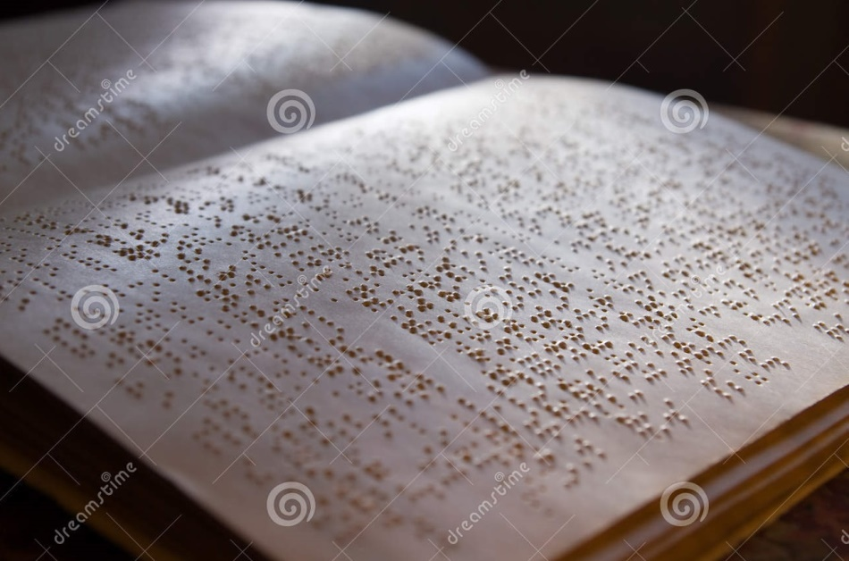
Listen and read-
Before this, Maria wants to be a writer.
তার আগে মারিয়া একজন লেখক হতে চায় ।

Slide 15
She wants to write a book about her feelings and experiences.
সে তার অনুভূতি এবং অভিজ্ঞতাসমূহ সম্পর্কে একটি বই লিখতে চায় ।

Slide 16
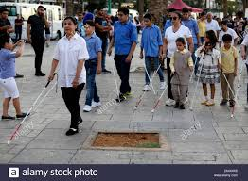
She wants to show other impaired people that they can do amazing things in their lives !
সে অন্যান্য অক্ষম ব্যক্তিদের দেখাতে চায় যে তারা তাদের জীবনে অসাধারণ কিছু করতে পারে ।

Slide 17
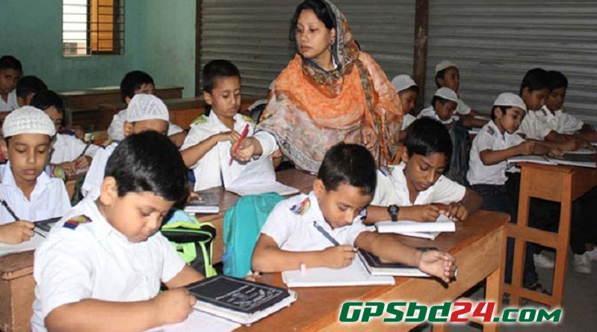
Loud reading & Learning new words

Slide 18
New Words
Meaning in English & Bengali
Hope
আশা করা
To want something to happned.
চাক্ষুষভাবে
Set up
To build or construct something.
প্রতিষ্ঠা করা
amazing
বিস্ময়কর
Very surprising.
প্রতিবন্ধী
জন্মগত
show
দেখানো
অক্ষম
to prove that you can do something.

Slide 19
New Words
Meaning in English & Bengali
Own
Produced by yourself
নিজের
চাক্ষুষভাবে
Teach
শিক্ষা দেওয়া
To give lessons to students.
আগে
before
Earlier than something.
প্রতিবন্ধী
the knowledge and skill that you have gained through doing something for a long period of time.
experience
জন্মগত
অভিজ্ঞতা
অক্ষম

Slide 20
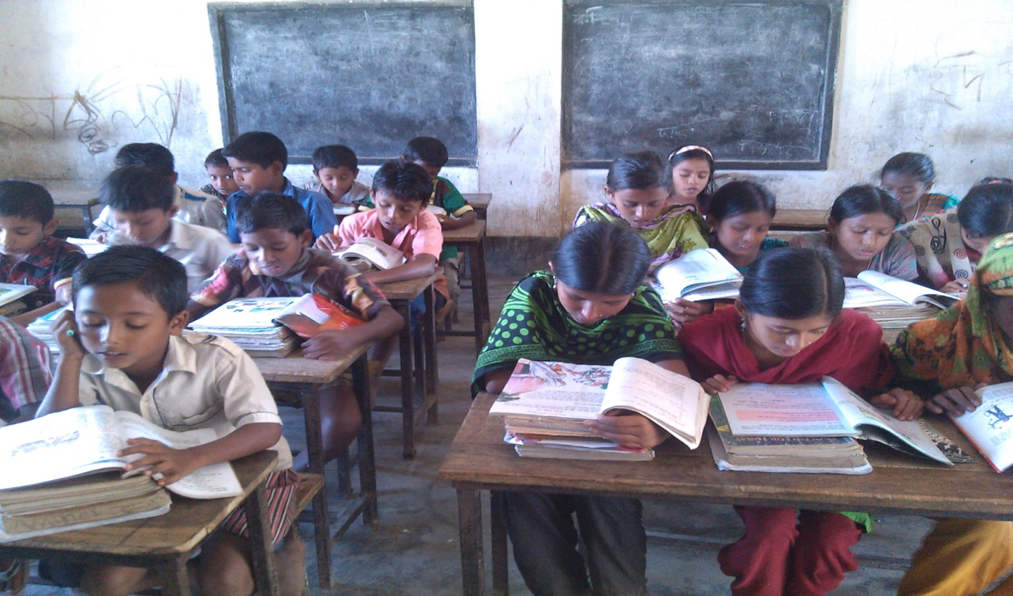
Silent reading

Slide 21
Match the words in column A with their meanings in column B. Two extra meanings are gives in column B.
Column A
Column B
(i) about
(i) Earlier than something.
(ii) feelings
(ii) To become an adult.
(iii) Amazing
(iii) on object of.
(iv) Something felt through mind.
(iv) Set up
(v) Very surprising.
(v) Before
(vi) Feeling or showing pleasure or joy.
(vii) To build or construct something.

Slide 22
Fill in the gaps with the best word from the box. Find the information in the text . There are extra words which you need not use.
black
set up
looks
hopes
children
smell
writer
amazing
(a) Maria ……………she’ll to go to university.
(b) She wants to……………a school of her own.
(c) Maria wants to be a……………...
(d) she can teach visually impaired………......... .
(e) Maria can do ……………things in impaired people lives !

Slide 23
Answer the following questions in a sentences.
(b) Why does Maria want to set up a school ?
(a) What kind of book does Maria want to write ?
(c) Why does she want to write this book ?
Answe : Maria wants to write a book abot her feelings
and experiences .
Answe : Maria wants to set up a school to teach
visually impaired children.
Answe : she wants to write this book to show other impaired people that they can do amazing things in their lives.

Slide 24
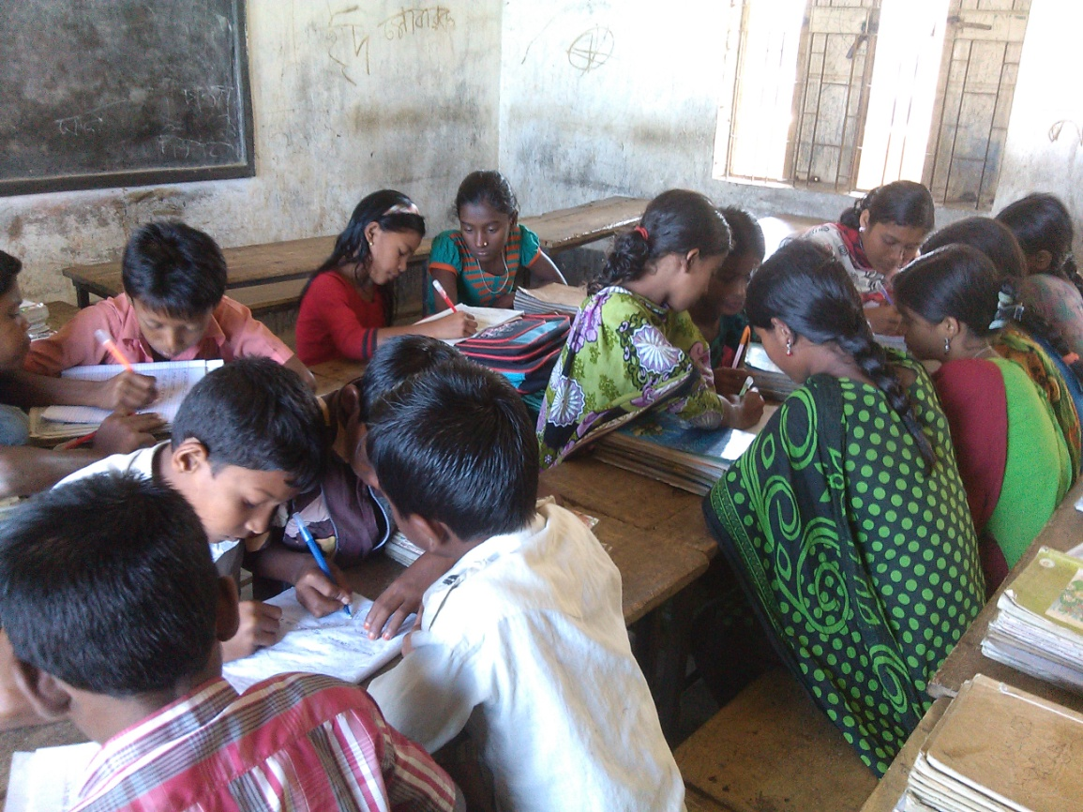
Group work
Write the question answer below.
(a) Why does she want to write this book ?
Answe : she wants to write this book to show other impaired people that they can do amazing things in their lives.
F

Slide 25
Evalution
Choose the best answer and write your notebook.
1. If she goes to unirversity, Maria will probably study--
(a) history.
(b) maths.
(c) science .

Slide 26
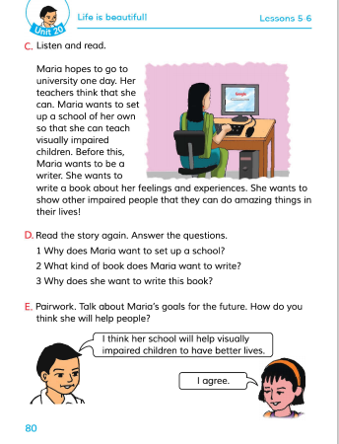
Connection with EFT Book.

Slide 27
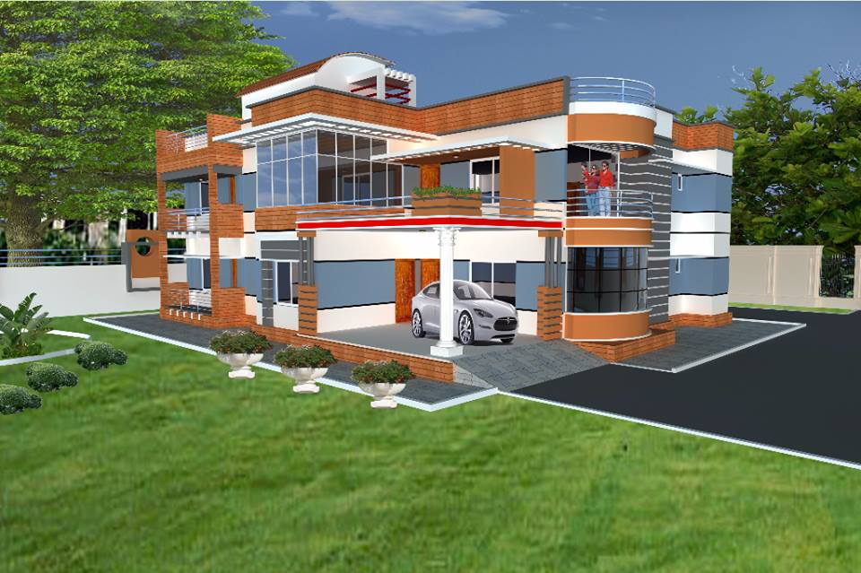
Home work
Write a short composition about ‘ visually impaired people‘.
(At least five sentences).

Slide 28
Thanks everybody.
See you again.
Bye Bye

Slide 29
END
OF
THE
LESSON

