Slide 1
W E L C O M E

Slide 2
Introduction
Md. Khalilur Rahman
Assistant Teacher ( English )
Govt. Girls’ High School , Gaibandha
Mobile No – 01718935913
Email- rkhalilur03@gmail.com
Class - Eight/Nine/Ten
English Second Paper (Grammar)

Slide 3
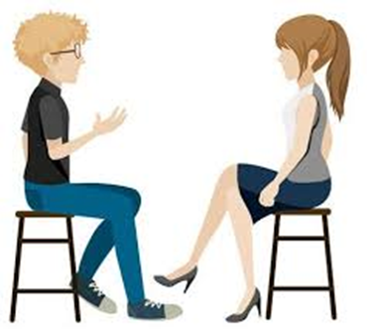
If you come, I will be happy
If you invite me , I will go
What kind of sentences are these?

Slide 4
Today our Topic is
Conditional Sentences

Slide 5
Learning outcomes
After completing this lesson students will be able to ------
make conditional sentences
complete the gaps using conditionals

Slide 6
Read the following sentences very carefully ---
If I get money , I will buy a motor bike.
If you followed my exercise, you could improve your health.
If you had taken exercise regularly, your health would have improved.
The above sentences are conditional sentence because every sentence has a principal clause and a subordinate clause. Again every sub- ordinate clause has started with if.

Slide 7
Conditionals are of three kinds
1st
conditional
2nd conditional
3rd conditional

Slide 8
First conditional
Structure: If + present+ future (Imperative)
Example: a) If you want, I will help you.
b) If you want to shine , work hard.
c) I will go if you come.

Slide 9
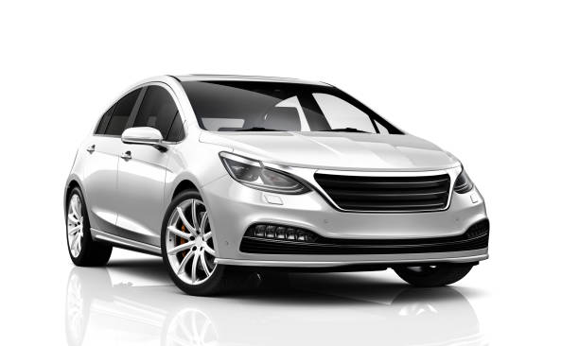
Second Conditional:
Structure: If + Past indefinite + Principal clause ( Subject+ should/would/could/might+ base form of verb+ others)
If I got a visa, I would go to Singapore
b) I would fly if I were a bird.
c) If he had money, he would buy a car.

Slide 10
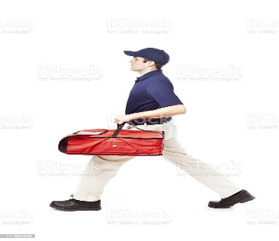
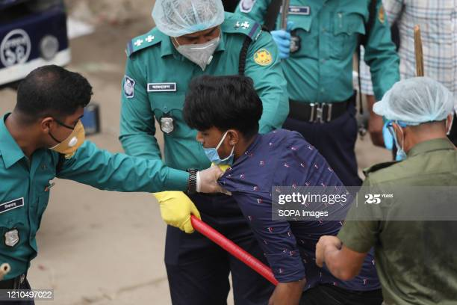
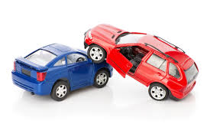
Third Conditional:
Structure: If + Past Perfect tense + Principal clause ( Subject+ should/would/could/might+ have+ Past participle form of verb+ others)
Examples:
If you had walked quickly, you could have caught the bus.
b) If he had not stolen , the police would not have arrested him.
c) The accident could have been avoided if he had driven carefully.

Slide 11
Group Work, (08 minutes)
Write six sentences :
First Conditional 2 sentences
Second Conditional 2 sentences
Third Conditional 2 sentences

Slide 12
Pair Work (05 minutes)
Complete the following sentences using conditionals:
You will know more ----------------------------------------------.
Have a banana -----------------------------------------------------.
If I saw him, -------------------------------------------------------.
------------------------------------------------I would visit you.
-------------------------------------- if you had asked me.
-------------------------------------- I would have come.

Slide 13
Suggested Answers
Complete the following sentences :
You will know more if you read more.
Have a banana if you are hungry.
If I saw him, I would give him the information.
If I had time, I would visit you.
I would have given you the answer if you had asked me.
If you had come, I would have gone.

Slide 14
Home Work
Write 9 conditional sentences from
first conditional 3 sentences
second conditional 3 sentences and
third conditional 3 sentences

Slide 15
Allah Hafez

