Slide 1
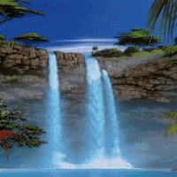

Wellcome
To All

Slide 2

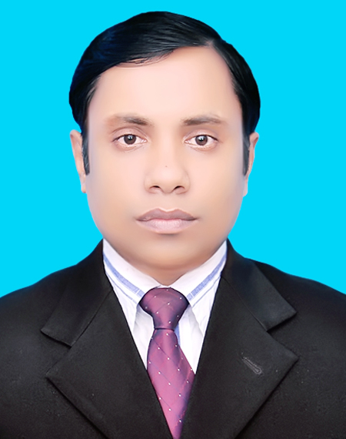
Teacher Identity
Md.Daulat Hossa.
Asist. teacher
Dakkhin Chandla Govt.praimary School.
B-para, Cumilla.

Slide 3
Subject: English
Class: Three
Unit: 32 (Punctuation and capital letters)
Lesson: 1 A (Read and say)
Page: 64
Time: 32 munite
Introduction of lesson

Slide 4
Learning outcome
Reading:
7.1.1- Student will be able to recognize punctuation marks and read accordingly.

Slide 5
Good afternoon students
How are you today?

Slide 6

Lets sing the song

Slide 7

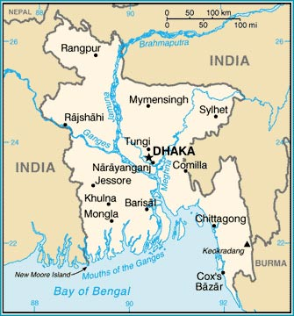
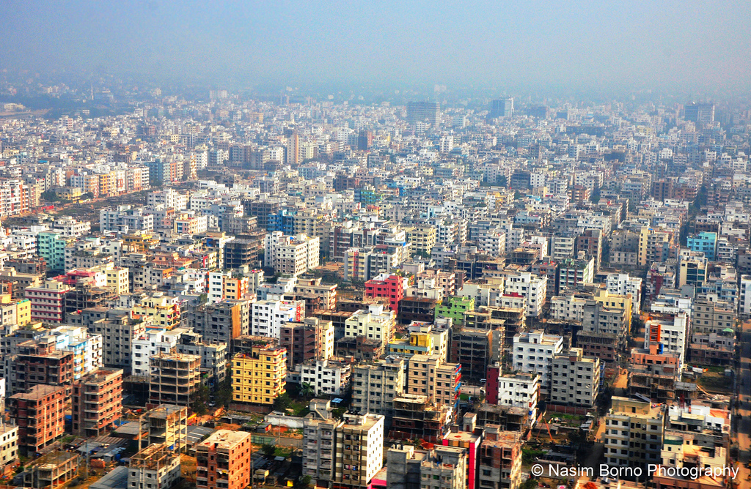
Maliha
Bangladesh
Capital

Slide 8
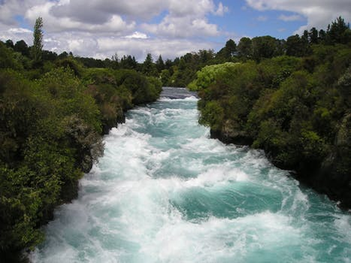
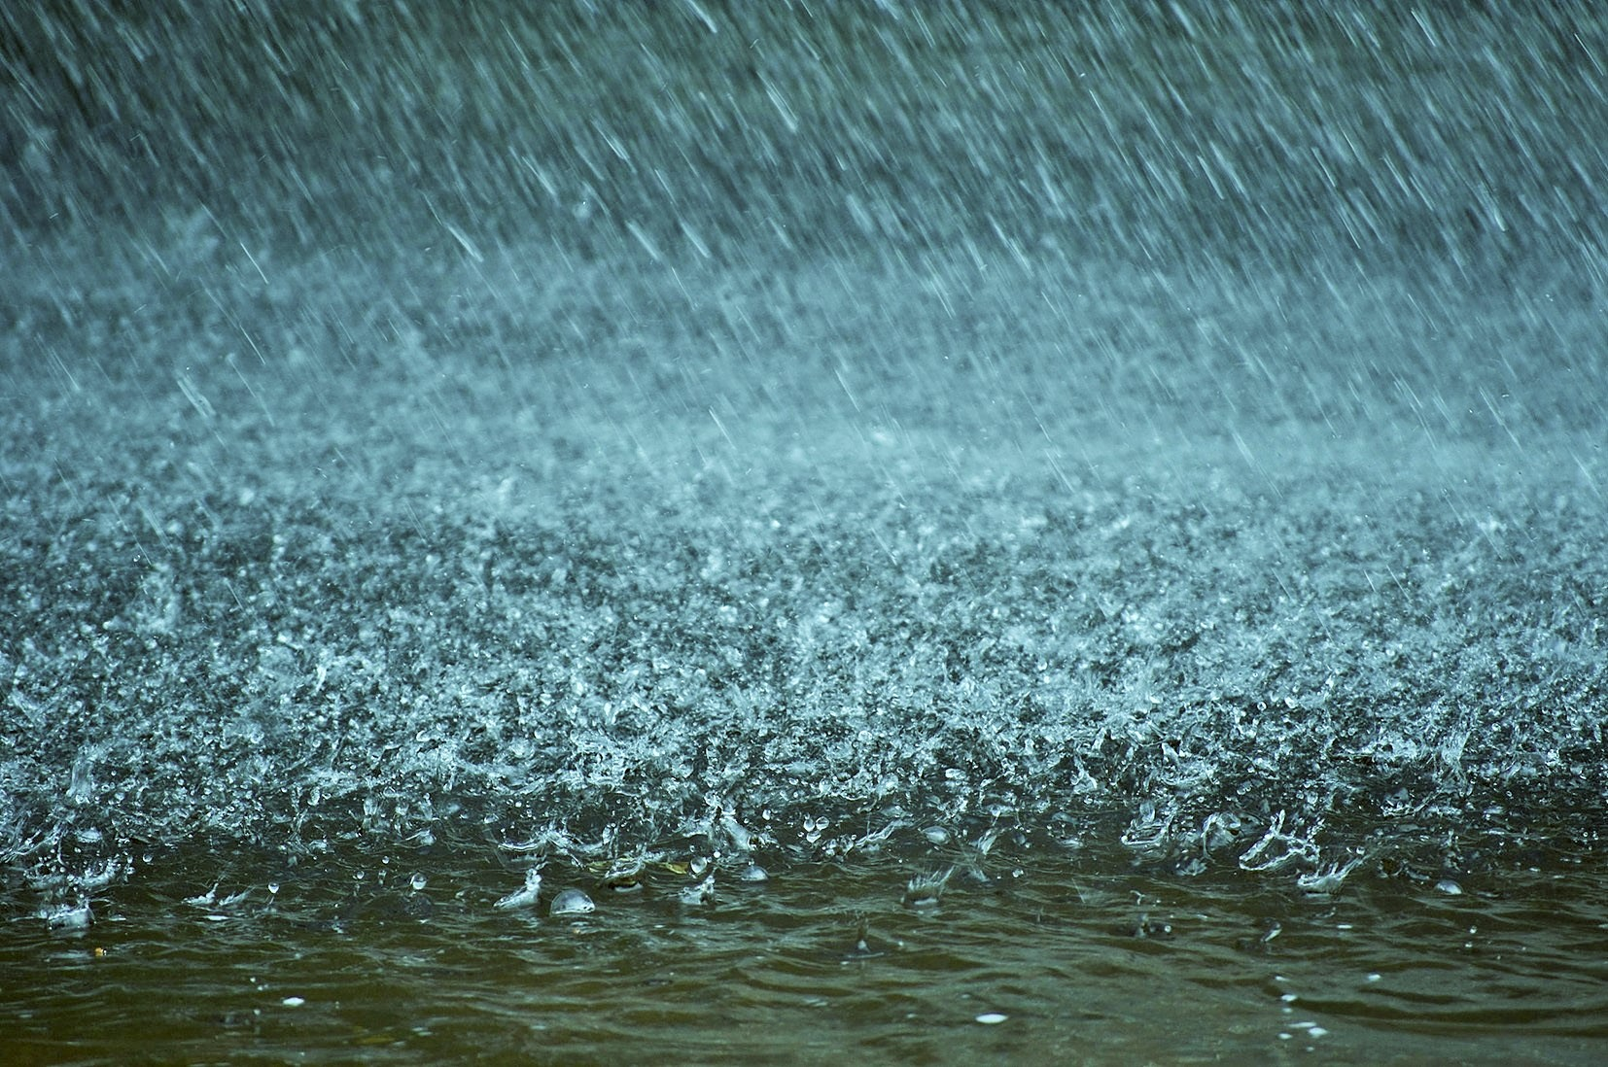
Buriganga River
Rain

Slide 9
Now everybody open your book at page 64 and read with me loudly.

Slide 10
Maliha is Bangladeshi. She comes from Dhaka. Dhaka is the capital of Bangladesh. Maliha lives near the Buriganga River. The river is very big. In June, July and August, there is a lot of rain in Bangladesh.

Slide 11
কোন ব্যক্তির নাম এর ক্ষেত্রে প্রথম বর্ণ Capital letter হবে
Maliha
is a good girl.
Monir
and
Rahim
are best friend.

Slide 12
We have two punctuation mark in this lesson-
1- Fullstop ( . )
2- Comma ( , )

Slide 13
Maliha
Bangladeshi
Live
Dhaka
Buriganga River
Rain

Slide 14
Pair Work
Read the lesson with correct punctuation with your partner

Slide 15
Whole class work
What is Maliha?
What is the capital of Bangladesh?
Which river is very big?
Ans. Bangladeshi
Ans. Dhaka
Ans. Buriganga

Slide 16
Individual Work
Make simple sentence with the below word:
Live-
Big-
Rain-

Slide 17
Homework
Read the lesson properly

Slide 18
Thank you!

Slide 19
Good bye

