Slide 1
WELCOME
TO
ALL

Slide 2
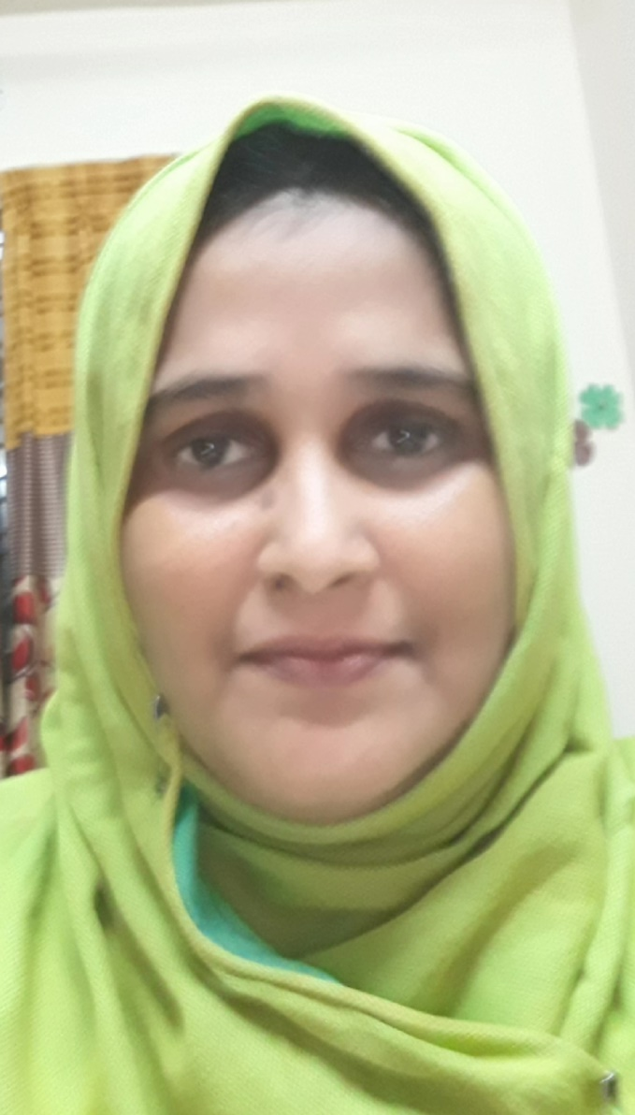
IDENTITY
HASINA MOMOTAJ
ASSISTANT HEAD TEACHER
RAJA GC HIGH SCHOOL
SYLHET
Email-
hasinalovely76@gmail.com

Slide 3
LESSON INFORMATION
English Grammar & Composition
Class - Ten
Unit - 5
Lesson – 5
Present Students – 40
Time – 50 min

Slide 4
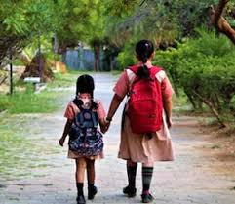
Look at the pictures & tell what do you see in the pictures?
We must obey our elders.
We need go to school in time.

Slide 5
Todays Our Topic
On
Must, Must not / Musn’t,Need

Slide 6
Learning Outcomes
At the end of the lesson students will be able to say -
What is modals ?
Name of modals.
Use of must ,need , mustn’t.
Making sentences with modals.

Slide 7
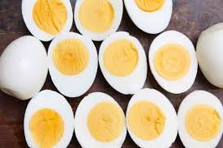
Read the following texts:
a : He ate a dozen eggs at a time ! He must be crazy!
: You must be joking ! I don’t believe you,
b :My mark – sheet shows that I’ve failed in English ! There must
be some mistake . English has always been my storng subject.
It simply can’t be !
c :The teacher says to her students , ”You must submit your essays
tomorrow .I won’t accept any after that .And you must not copy
from any book or from anyone else’s writing.

Slide 8
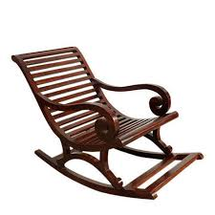
e : When you go for an interview you need to make a good
impression as soon as you enter the room. You need to give the impression of being polite and at the same time of being confident and pleasant . Here are just a few things you
should remember.
You mustn’t move about in your chair , you must and relax;
You needn’t wear new or fashionable clothes,but must wear
clean and neat clothes.
You need to speak loudly and clearly,but mustn’t interupt
when they are speaking.

Slide 9
Use
We can use must and can’t to assert something that we infer or conclude
to be the most logical possibility of a situation or an event . For example,
He must be crazy to eat a dozen eggs at a time .
Or, as the examinee is confident that he just cannot fail in English since it
is his strong subject, he uses ‘can’t’ to express the most logical possibility
of the situation:
It simply can’t be.
There must be some mistake in the mark-sheet.

Slide 10
Use
We use must and to express obligation and mustn’t to express prohibition or something that is not allowed
You must submit your essays tomorrow.
(obligation )
Delegates must finish registration
( obligation )
You must not copy from any book or anyone else’s writing.
( prohibition )
Volunteers mustn’t leave before ……..
(prohibition )
You mustn’t move about in your chair .
(not allowed )

Slide 11
Use
We use need to talk about something that is necessary:
When you go for an interview ,you need to make a good impression.
(necessary )
You need not to speak loudly and clearly.
(necessary )
We use needn’t or need not (without ‘to’ ) to talk about something that is not necessary;
You needn’t wear new or fashionable clothes.
You needn’t smile all the time , but you need to look relaxed and confident.

Slide 12
Evaluation
Fill in blanks in the following sentences with must ,mustn’t / need ,needn’t
a) The bank manager tells Manzoor ,who wants to open an account ,that he ------ sign his name at the bottom of the
form. The manager then gives Manzoor a new cheque
book and says that he ------ lose it .
b) Sagar wants to go to the computer fair with his friends
and tells his father so. His father says,” Well ,you can go
but you ------- be home by 9 o’clock.”

Slide 13
Home
work
Write ten sentences use must ,mustn’t/ need ,needn’t.

Slide 14
THANKS
TO
ALL

