Slide 1
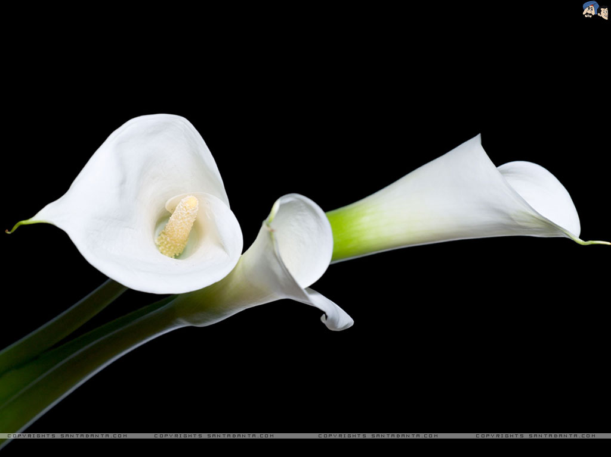
Welcome dear students.
Notes:
This is a welcome slide.

Slide 2

INTRODUCTION
ABUL KASHEM
Asst. Teacher (English)
Pabna Cadet Collegiate School
Mobile: 01718-996445
Email:kashemsir87@gmail.com
Class- Nine
English 1st Paper

Slide 3
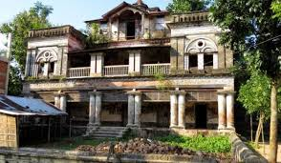
Grandfather built this house.
Now I am living here.
It is my heritage. I get it from my father and I will pass it for my future generation.
Notes:
Suspension to advance the lesson.

Slide 4
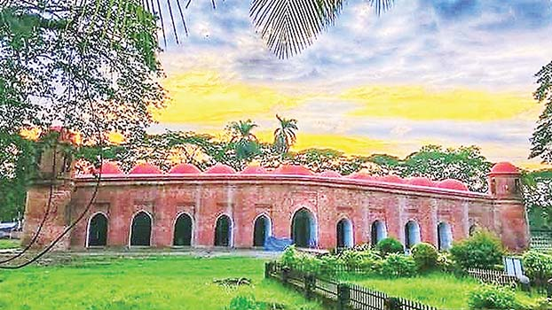
What do you see now ?
Shat Gambuj Mosque
Notes:
Advance to the lesson declaration.

Slide 5
Our today’s lesson is.
The Shat Gambuj Mosque
Unit-8
Lesson-1
Notes:
Lesson declaration.

Slide 6
Learning outcomes
After we have studied this lesson , we will be able to---
** know about Shat Gambuj Mosque.
** read and understand texts.
** ask and answer question.
** describe a place.
Notes:
Both the four skills will be achieved from this lesson.

Slide 7
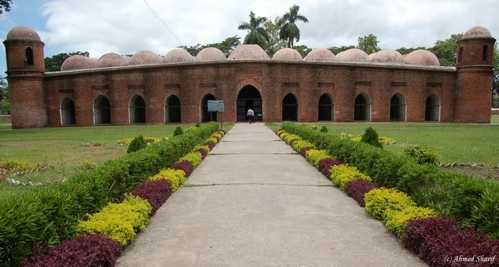
A. look at the picture. Work in pair Talk about the picture and ask and answer the following questions with your partner.
What is this building?
Do you have a building like this in your town/village?
3. What do we call it?
4. What is it used for?

Slide 8
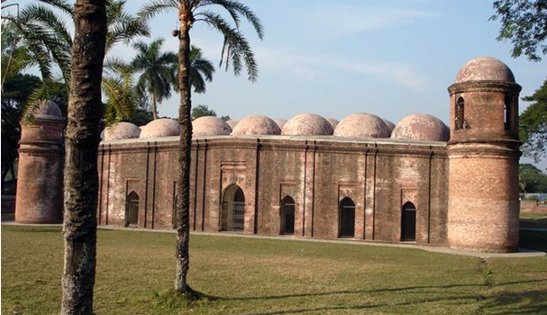
Let us introduce with some new words/key words.
Unique
Meaning : Uncommon, Extraordinary
Shat Gambuj Mosque is a unique world heritage.
Notes:
If you have enough time, you can show this option.

Slide 9
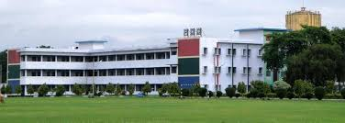
Outskirts
Meaning : The outer part of a town or city.
Pabna Cadet College is the outskirt of Pabna city.

Slide 10
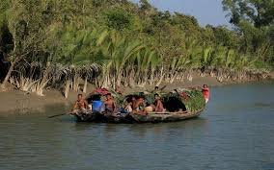
Mangrove
Meaning : A tropical forest with trees that have roots which grow from their branches.
The Sunderban is one of the biggest mangrove forests.

Slide 11
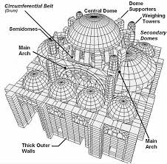
Infrastructure
Meaning : Base, framework
The infrastructure of the mosque is very strong.

Slide 12
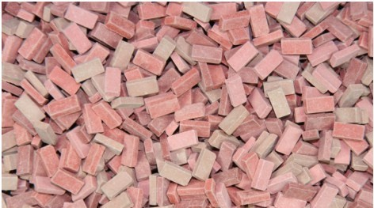
Baked brick
Meaning : Hard, burned
Shat Gambuj Mosque was built with baked brick.

Slide 13
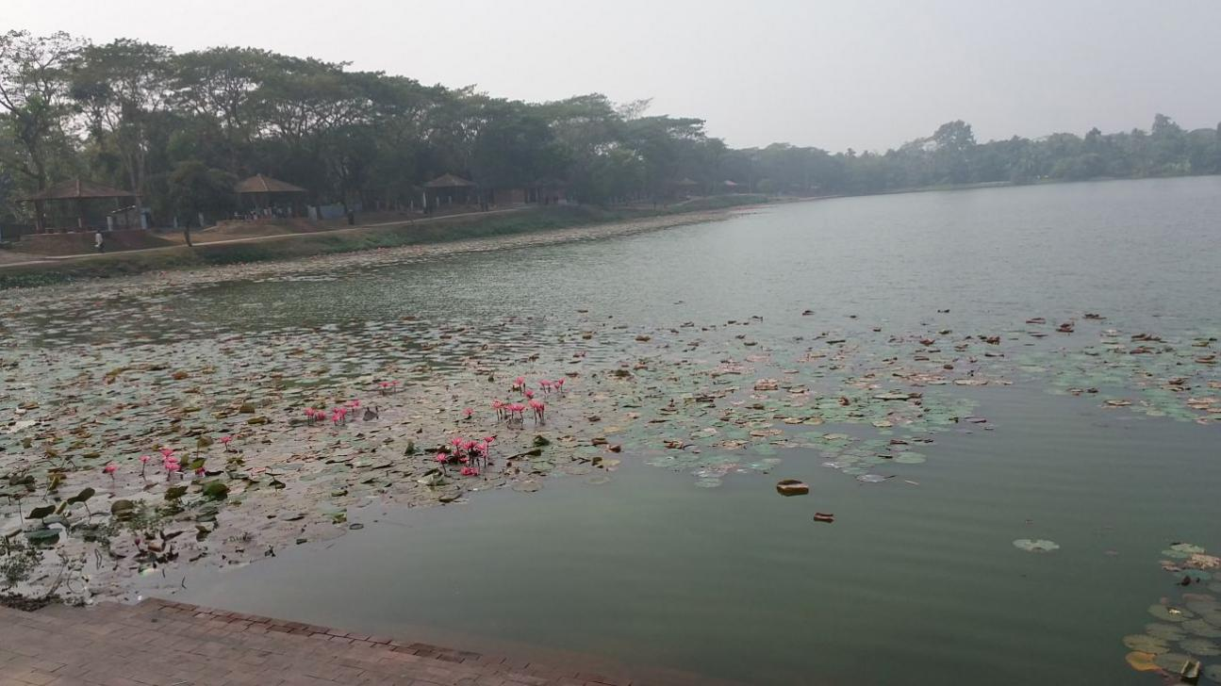
Reservoirs
Meaning : Water body, pool
Khan Jahan Ali made many reservoirs for people.

Slide 14
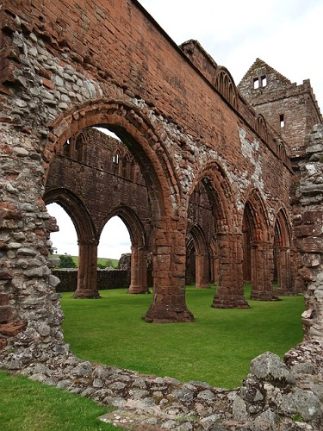
Arches
Meaning : A masonary construction
There are 11 arched doors in Shat Gambuj Mosques.

Slide 15
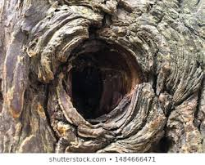
Hollow
Meaning : Empty space inside
The interior part of the mosque is a big hollow.

Slide 16
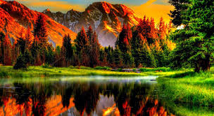
Remarkable
Meaning : Mentionable, notable
The scenery is really remarkable.
Notes:
Word meaning.

Slide 17
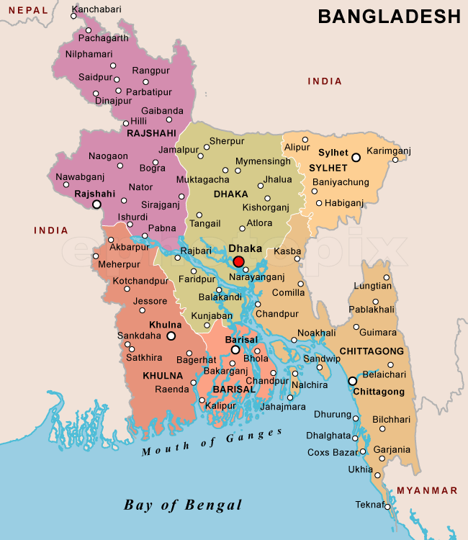
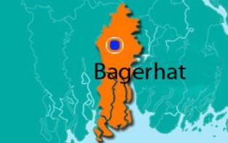
What is Bagerhat famous for?
It is famous for Shat Gambuj Mosque.
Notes:
About Bagerhat.

Slide 18
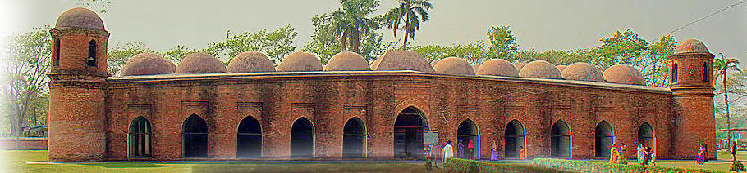
Smaller domes in 4 corners
77 low height domes
1
2
3
4
5
6
7
8
9
1o
11
11 Arched doorways on east
Notes:
In the eastern side of the mosque 11 arched doors are shown.

Slide 19
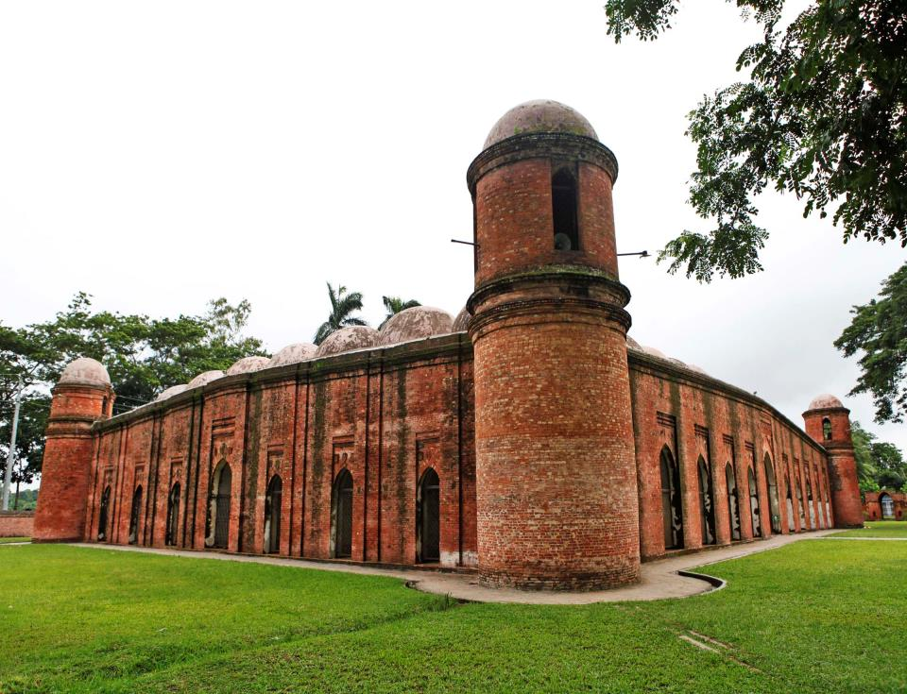
East of the mosque
South of the mosque
7 Arched doors in both south & north
Notes:
Location of 7 arched doors.

Slide 20
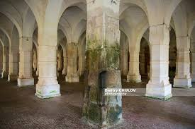
Inside the mosque
Notes:
How the inner side of the mosque built.

Slide 21
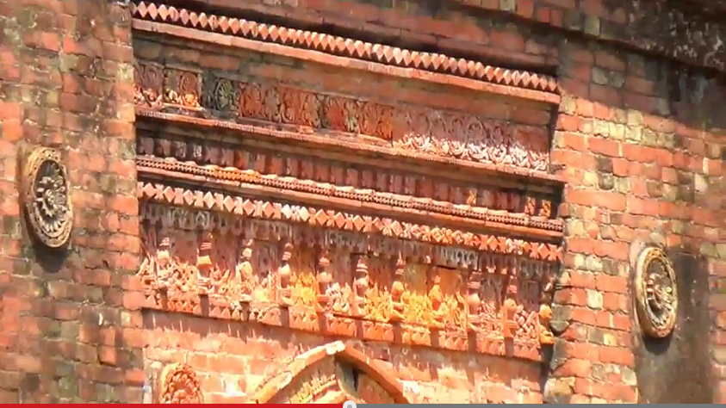
The interior western wall of the mosque is beautifully decorated with terracotta .
Notes:
A description shown here.

Slide 22
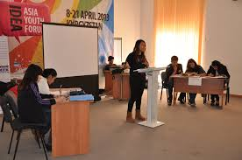
Group Work
Why is Shat Gambuj Mosque called World Heritage Site?
Notes:
Teacher can arrange the debate next class but today h/s will give dictation about the debate.

Slide 23



Evalution
Choose the correct answer from the alternatives.
Q: a) What is the closest meaning of the word ‘Heritage’ ?
Cor. Ans:
Cor. Ans:
i. history
ii. parentage
iii. ancestry
iv. tradition
Q: b) Khalifatabad was known as the colony of the---------
Cor. Ans:
Cor. Ans:
i. Hindus
ii. Buddhists
iii. Christians
iv. Muslims
iv. Muslims

Slide 24
Q: c) The decorations of the mosque involved-------architecture.
Cor. Ans:
i. Mughal
ii. Indian
Cor. Ans:
iii. Turkish
iv. Both ( I ) & ( iii)
iv. Both ( I ) & ( iii)
Q: d) How many mosques are there in Bagerhat city?
Cor. Ans:
iii. 630
iv. 260
Cor. Ans:
i. 306
ii. 360
ii. 360
Q: e) How many arch doors are there in the mosque ?
Cor. Ans:
i. 25
ii. 11
iii. 14
iv. 7
Cor. Ans:
i. 25

Slide 25
HOME WORK
Write a paragraph about the central mosque of your locality in ten sentence.
Notes:
Assignment at home.

Slide 26

THANKS TO ALL

