Slide 1
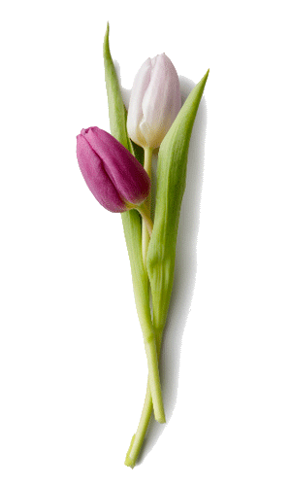
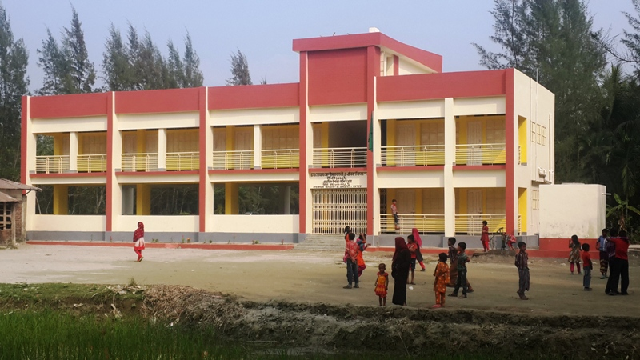
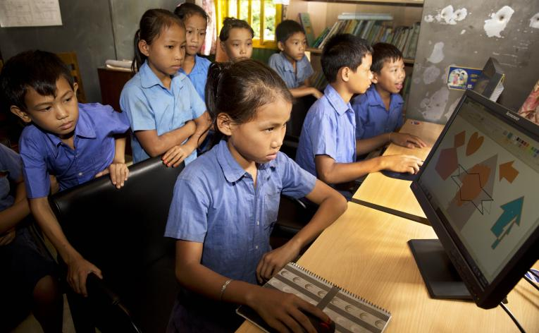
Welcome my
dear students

Slide 2
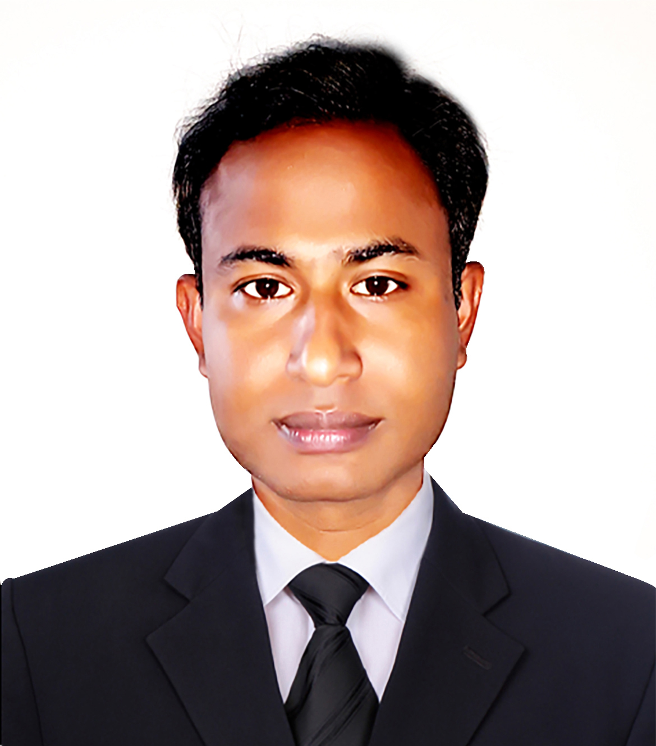
 Prepared By 
Md. Sultan-ul Arefin
Assistant Teacher
Gurudaspur Model Govt. Primary School
Gurudaspur, Natore.

Slide 3
 Lesson Detail 
Class: Five
Subject: English
Unit: 20, Lesson: 1-2
Title: Life is beautiful

Slide 4
Let’s watch the picture
and
try to answer the questions.

Slide 5
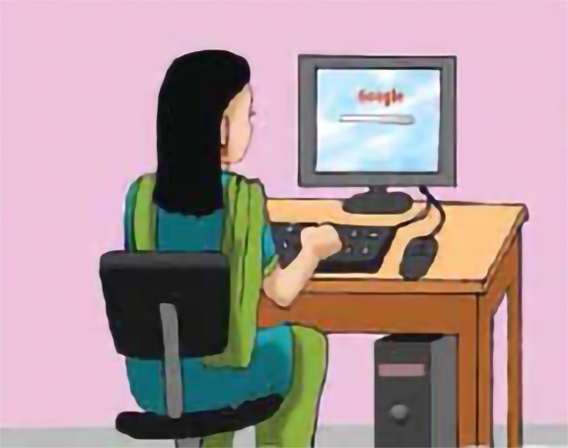

Slide 6
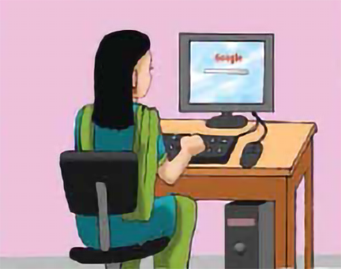
Questions:
1. What do you see in the picture?
2. What is the girl doing?
Well, my dear student, just think what we are going to read today.
Possible solutions:
2. The girl is doing something in computer.
A girl is sitting in front of a computer.

Slide 7
Lesson Declaration
Well, To day we are going to read-
Life is beautiful
-Maria hopes-----------------their lives. Part -4

Slide 8
Learning outcomes--
Listening:
3.4.1: understand statements made by the teacher and students.
4.2.1: understand and enjoy simple stories.
Speaking:
1.1.1: say words ,phrase and sentences with proper sounds and stress.
6.2.1: talk about people, objects, events etc.
Reading:
1.5.1:Read words ,phrases and sentences in the text with proper pronunciation stress and intonation.
1.7.1: read paragraphs, dialogues ,stories ,letters and other texts.

Slide 9
Teaching Vocabulary
Do you know the meaning of these following words?
Hope, University, think, Set up, Experience, Amazing
.

Slide 10
Information
facts provided or learned about something or someone
Similar meaning
:
Data
We have to know a lot of information.

Slide 11
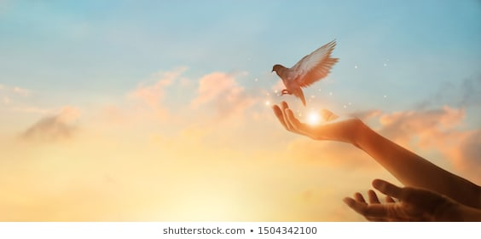
Hope
a feeling of expectation and desire for a particular thing to happen.
Similar meaning
:
Wish, Desire, aim
I hope you are well.

Slide 12
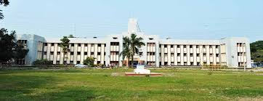
University
a high-level educational institution
Similar meaning
:
College, academy
I want to read in a university.

Slide 13
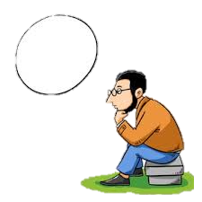
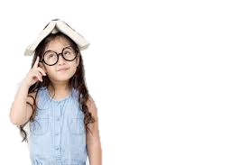
Think
have a particular belief or idea.
Similar meaning
:
Ponder, muse
I think you will do it. .

Slide 14
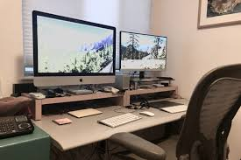
Set up.
the way in which something, especially an organization or equipment, is organized, planned, or arranged.
Similar meaning
:
Framework, structure
I want to set up a school of my own.
.

Slide 15
Experience.
practical contact with and observation of facts or events.
Similar meaning
:
Incident, event
I is a great great experience to me.
.

Slide 16
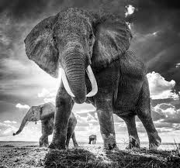
Amazing
causing great surprise or wonder; astonishing.
Similar meaning
:
astonishing, surprizing
It was amazing to me.

Slide 17
PRACTICE
Playing Game
Dear students, now we are going to play a game. It is called “Bingo Game”. Listen the instruction carefully.
After playing the game I will rewards the winner(s).

Slide 18
Let’s play the bingo game.
Hope
University
Think
Own
Teach
Amazing
Feeling
Show

Slide 19
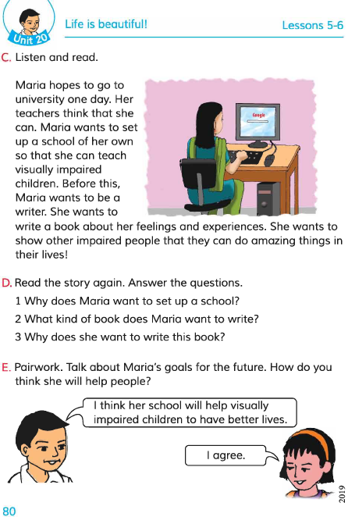
Teacher’s Model Reading
Dear students, open your English book at page 78. I am reading the text loudly, please put your fingers on the text.

Slide 20
Group Reading
In this stage the students will read the text in group.

Slide 21
Pair Reading
In this stage the students will read the text in pair.

Slide 22
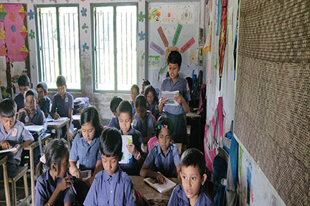
Student’s reading
In this stage one student reads the text and others listen.

Slide 23
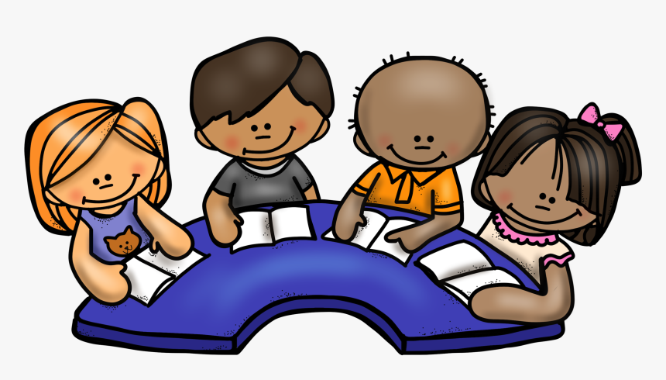
Silent Reading
Dear students, please read the
text silently and try to understand.

Slide 24
Group work
:
Group A
What things does Maria want to do?
Answer
1. Maria wants to set up a school of her own.
:
Answer
Group B
2. Why does Maria want to be a writer?
2. Maria wants to write about her feeling and experiences.
:
Group C
3. Where does Maria hope to go one day?
Answer
3. Maria hopes to go to university one day.

Slide 25
Solution to the question:
1. Maria can learn information through Braille.
2. Braille is script that is made from dots.
3. Maria is a good learner.

Slide 26
Pair work
Think
Personal
School
Wonderful
Own
Desire
Amazing
Imagine
Hope
Academy

Slide 27
Evaluation
Solution:
Write true/ false.
Maria likes to go to school.
Maria is not happy at all.
The first letter is made from dots.
Maria is a good student.
Maria’s enjoys novel and history.
True
False
False
True
False

Slide 28
Evaluation
Solution:
Fill in the gaps with the provided word word.
school
writer
hopes
think
Maria to go to university.
Her teachers that she can.
Maria wants to set up a .
Maria wants to be a .

Slide 29
Task
Make five sentences about “What you would like to do in future”
in your own words.

Slide 30
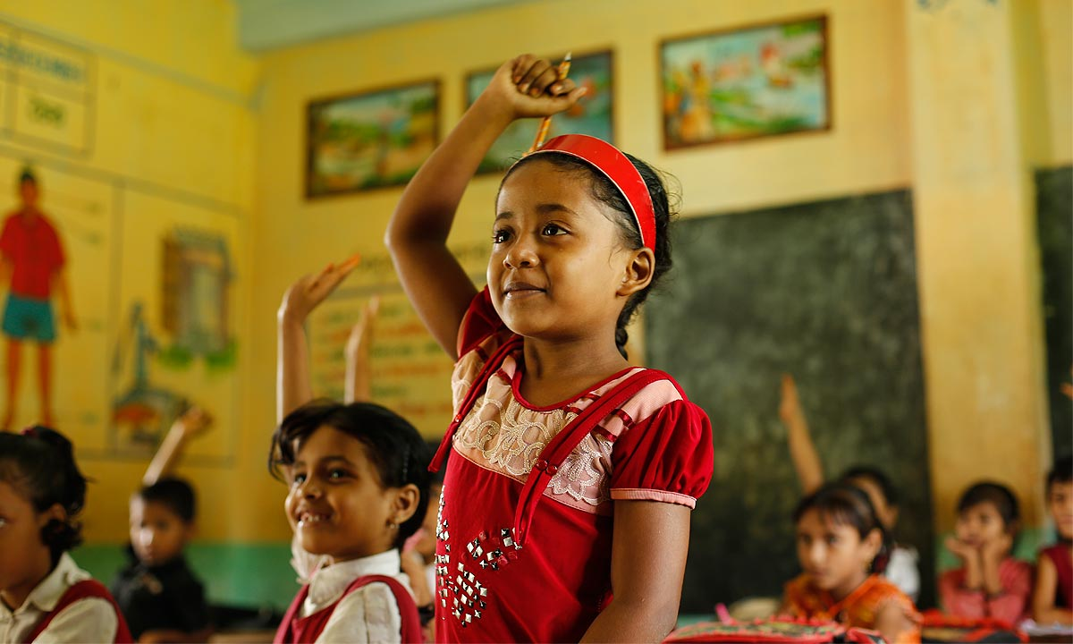
My dear students, thank you very much for
your nice co-operation.

