Slide 2
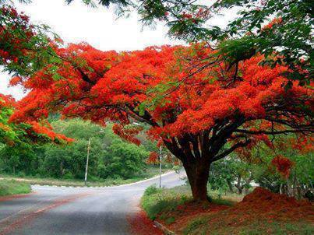
Welcome
to
all
in
my
Class.

Slide 3
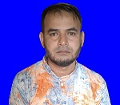
Teacher Introducing
Md Shamsunnoor
Head Teacher
Murergaon Govt. Primary school
Companiganj, Sylhet
Mobile : 01712-307039
Email : shadmanheya@gmail.com

Slide 4
Lesson Identity
Class Five
Subject : English for today
Part of the lesson : Activity D & E
Time : 40 minute

Slide 5
Learning outcomes
At the end of the lesson students will be able to-
Listening
3.1.1 Understand questions and asked by the teacher about them.
3.4.1 Understand statements made by the teacher and studen.
Reading
1.5.1 read words, phrases and sentences in the text with proper pronunciation, stress and intonation.
1.6.1 recognize and read, statements, commands, greetings, questions and answers.
1.7.1 read paragraphs, dialogues, stories, letters and other texts .
5.1.1 read silently with understanding paragraph.
5.1.2 read silently with understanding Stories.
Speaking
1.1.1 say words, phrases and sentences with proper sound and stress.
3.1.1. ask and answer wh questions.
6.2.1 talk about people, objects, events etc.
8.1.1 take part in conversations on appropriate topics.
writing
3.1.1 write words, phrases and sentences using non-cursive capital letters.
3.1.2 write words, phrases and sentences using non-cursive small letters.
8.1.1 make sentences using words and phrases given in the textbook.

Slide 6
Let’s we sing a song.
https://www.youtube.com/watch?v=6oXNAoF8Zzs

Slide 7
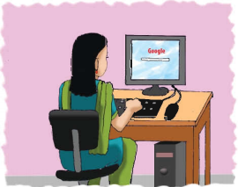
Justifying previous knowledge
What is your impression about this picture ?
What is Maria doing in the picture ?
How can she operate Computer ?
We know about Maria’s dream for the future by questions.

Slide 8
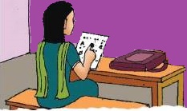
Today’s lesson
Life is Beautiful!
Lessons : 5-6 (6th period)
Activity D & E (Read the story---agree)
Unit : 20
Page : 80

Slide 9
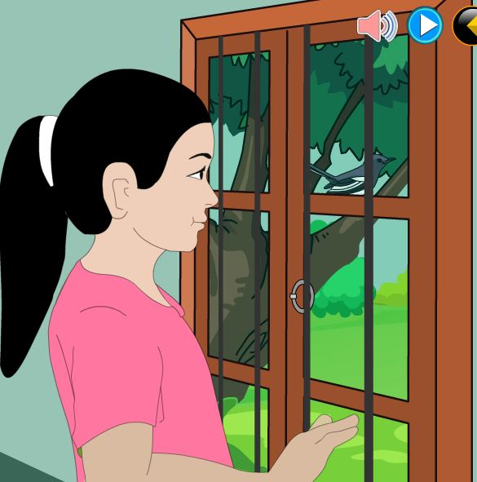
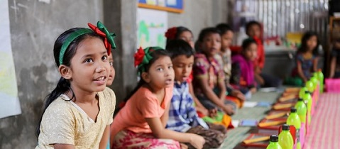
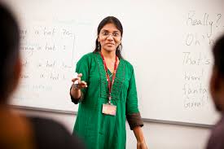
Lesson presentation :
Maria hopes to go to university
one day.
মারিয়ার আশা একদিন বিশ্ব বিদ্যালয়ে পড়বে ।

Slide 10
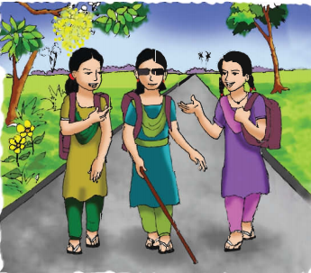
Listen and read-
Her teachers think that she can.
তার শিক্ষকরা মনে করেন সে পারবে ।
Maria

Slide 11
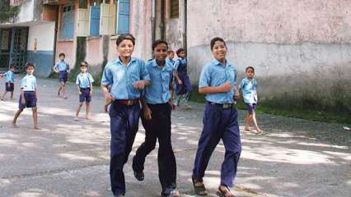
Maria wants to set up a school of her own so that she can teach visually impaired children.
মারিয়া তার নিজে একটি বিদ্যালয় প্রতিষ্ঠা করতে চায় যাতে সে দৃষ্টিহীন ছেলে-মেয়েদের পড়াতে পারে।

Slide 12
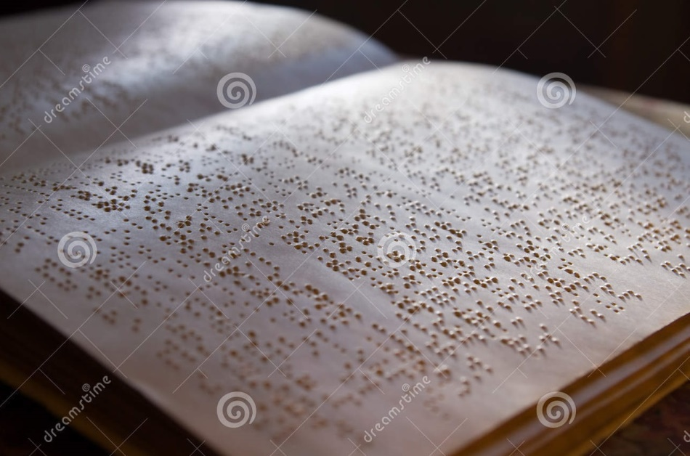
Listen and read-
Before this, Maria wants to be a writer.
তার আগে মারিয়া একজন লেখক হতে চায় ।

Slide 13
She wants to write a book about her feelings and experiences.
সে তার অনুভূতি এবং অভিজ্ঞতাসমূহ সম্পর্কে একটি বই লিখতে চায় ।

Slide 14
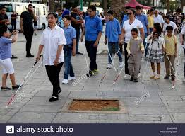
She wants to show other impaired people that they can do amazing things in their lives !
সে অন্যান্য অক্ষম ব্যক্তিদের দেখাতে চায় যে তারা তাদের জীবনে অসাধারণ কিছু করতে পারে ।

Slide 15
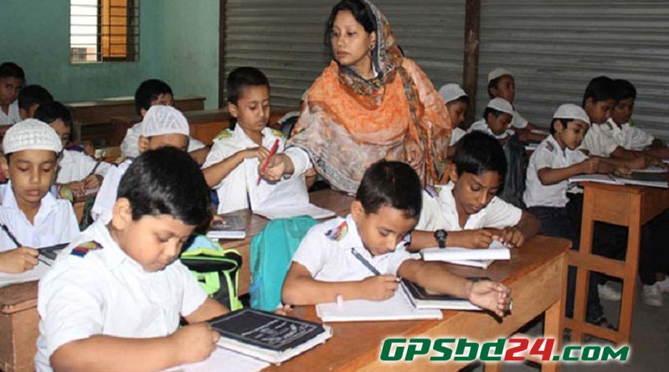
Loud reading & Learning new words

Slide 16
New Words
Meaning in English & Bengali
hope
To want something to happned.
আশা করা
goals
Target.
লক্ষ্য
চাক্ষুষভাবে
Future
coming.
ভবিষ্যত
show
দেখানো
to prove that you can do something.
প্রতিবন্ধী
জন্মগত
agree
রাজি হওয়া
proposal.
অক্ষম

Slide 17
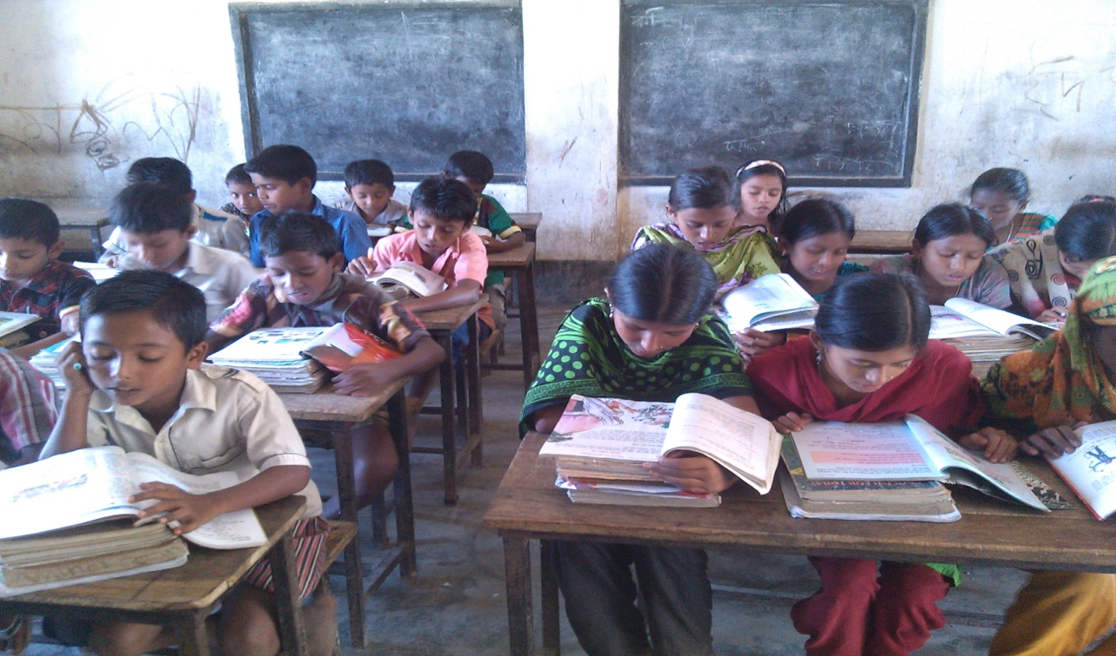
Silent reading

Slide 18
Match the words in column A with their meanings in column B. Two extra meanings are gives in column B.
Column A
Column B
(i) hope
(i) proposal.
(ii) goals
(ii) To become an adult.
(iii) show
(ii To want something to happned i) .
(iv) targe.
(iv) future
(v) To prove that you can do something.
(v) agree
(vi) Feeling or showing pleasure or joy.
(vii) coming.

Slide 19
Answer the following questions in a sentences.
(b) Why does Maria want to set up a school ?
(a) What kind of book does Maria want to write ?
(c) Why does she want to write this book ?
Answe : Maria wants to write a book abot her feelings
and experiences .
Answe : Maria wants to set up a school to teach
visually impaired children.
Answe : she wants to write this book to show other impaired people that they can do amazing things in their lives.

Slide 20
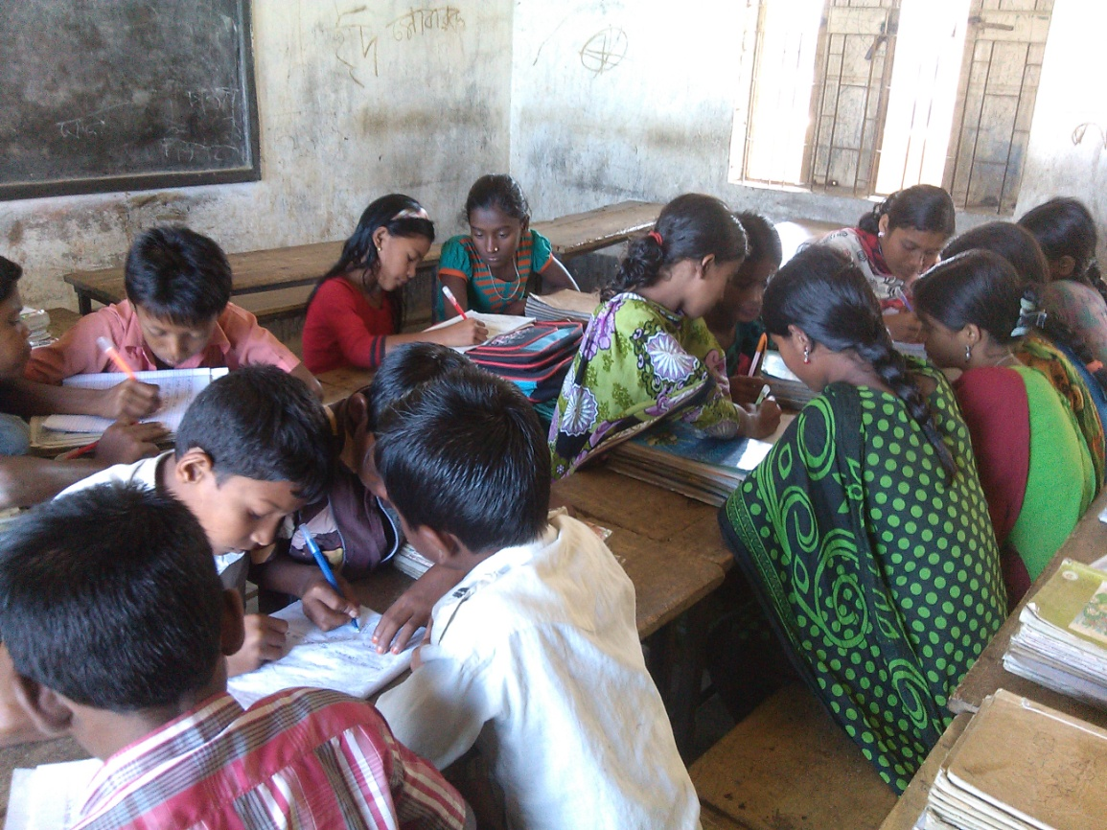
Group work
Write the question answer below.
(a) Why does she want to write this book ?
Answe : she wants to write this book to show other impaired people that they can do amazing things in their lives.
F

Slide 21
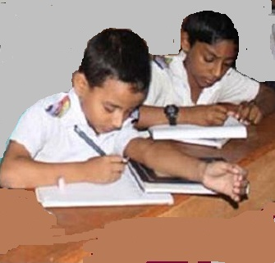
pair work
Conversation between two students
Students will talk about Maria’s goals for the future and how she will help people ?
F

Slide 22
Evalution
(a) Why does she want to write this book ?
Answe : she wants to write this book to show other impaired people that they can do amazing things in their lives.

Slide 23
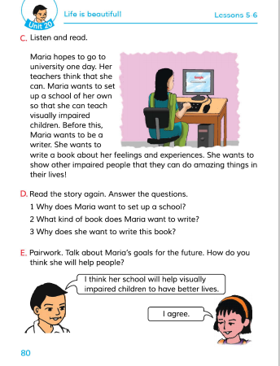
Connection with EFT Book.

Slide 24
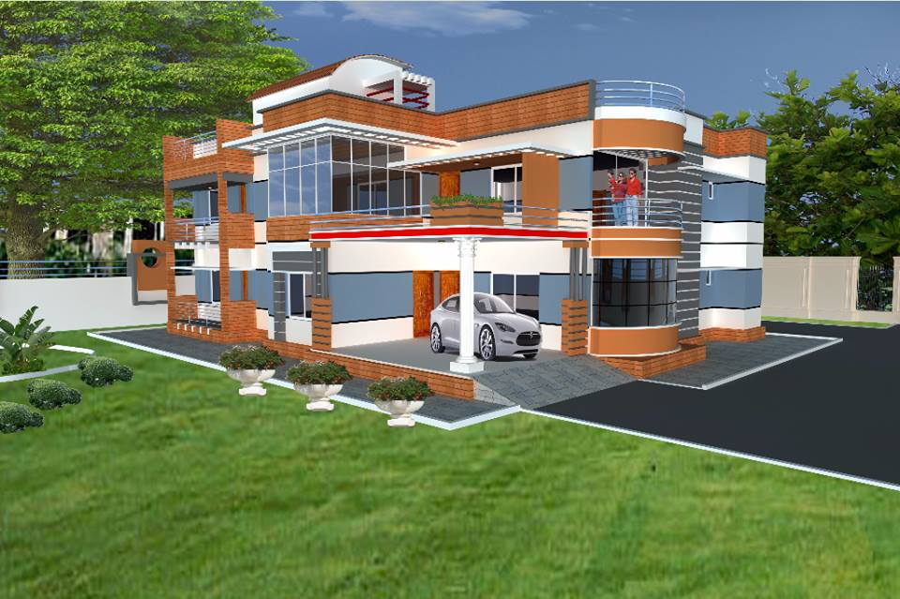
Home work
Write a short composition about ‘ Maria’s goals for the future‘.
(At least five sentences).

Slide 25
Thanks everybody.
See you again.
Bye Bye

Slide 26
END
OF
THE
LESSON

