Slide 2
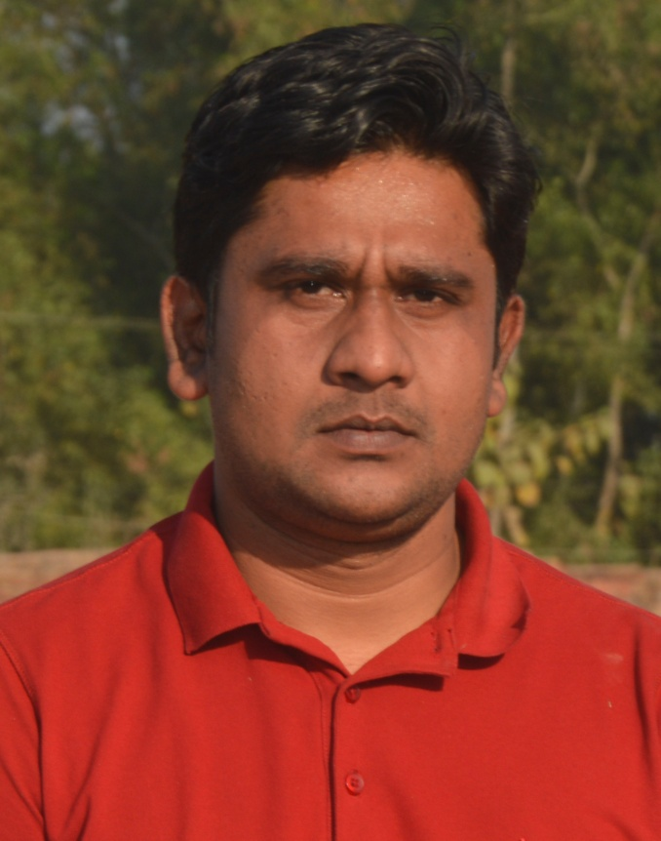
Chowdhury Razu Ahamed
Lecturer

Slide 3
English For Today
Seen Passage
Model Question
Part- 03

Slide 4
Question
A & B

Slide 5
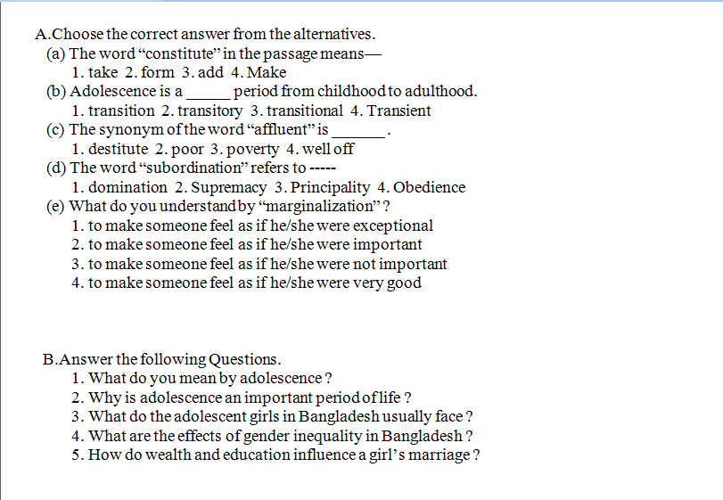

Slide 16
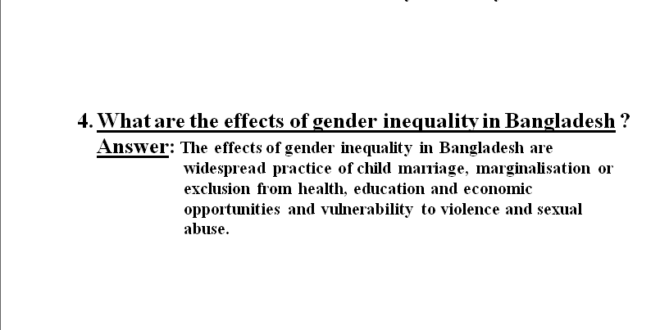

Slide 17
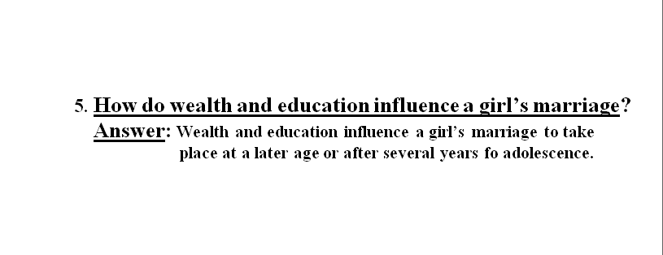

Slide 18
Revise the practice of Quesetion No- A &B again and again

