Slide 1
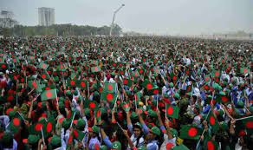
Welcome

Slide 2
Identity
Samiul Islam
BA(Hons) & MA in English, B.Ed, M.Ed
Asst. Teacher(English)
Halimunnessa Chowdhurani Memorial Girls’ High School
Bhaluka, Mymensingh
samiul48@gmail.com
Class : Ten
Subject : English For Today
Unit : Five
Lesson : Three

Slide 3
Let us enjoy a video

Slide 4
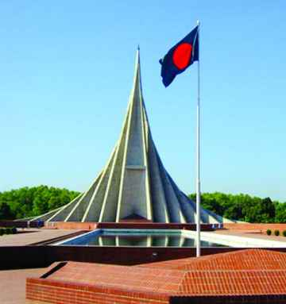
What can you see in the picture?

Slide 5
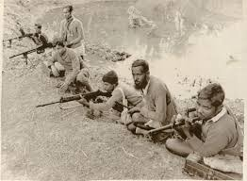
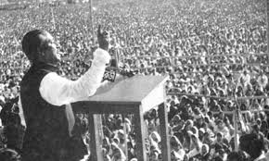
Look at the pictures
The speech of Shiekh Muzibur Rahman
Freedom Fighters

Slide 6
Our Today’s Topic is
Independence Day

Slide 7
Learning Outcomes
After studied this lesson, we will be able to---
1. Read and understand the text.
2. Talk about Independence day.
3.Understand new words.
4. Writing a Paragraph.

Slide 8
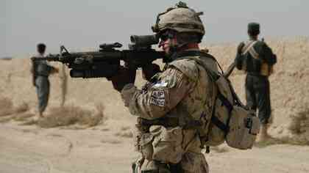
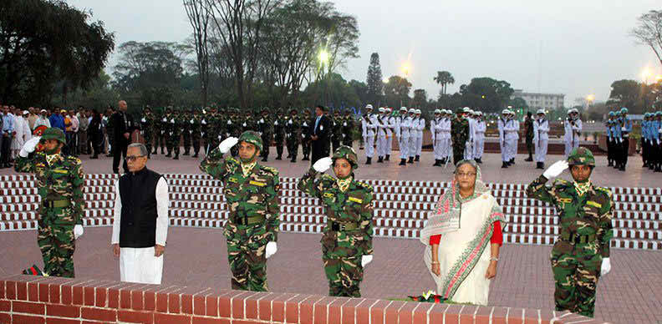
The day begins at 31 gun shots.
Early in the morning the president and the prime minister on behalf of the nation place floral wreath at the at the national mausoleum at savar.

Slide 9
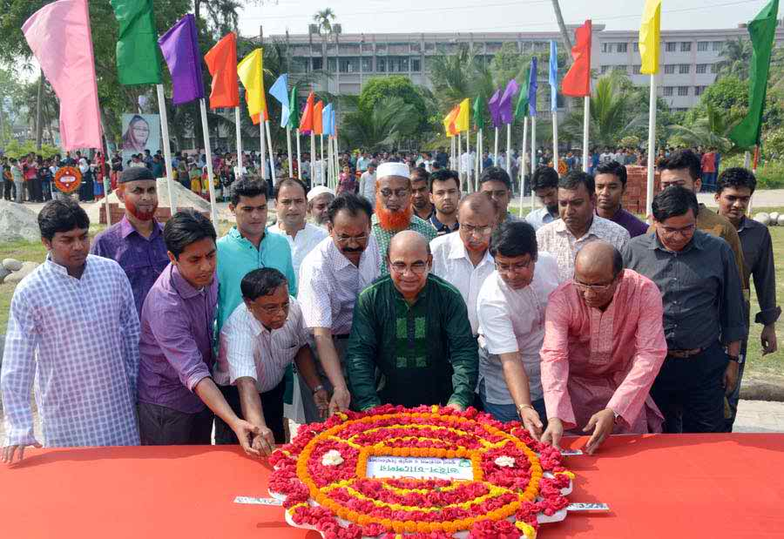
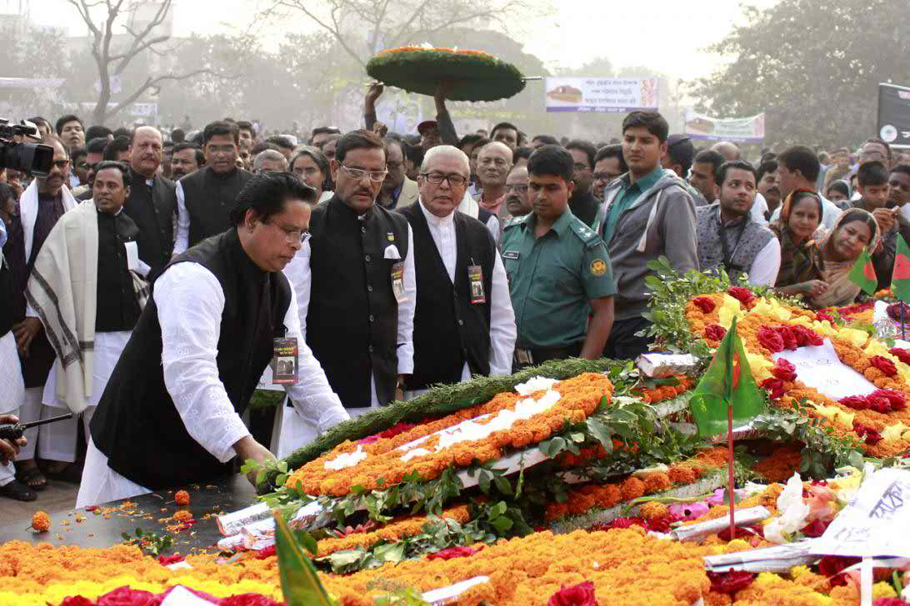
Different Political and cultural organizations pay homage to the martyrs.

Slide 10
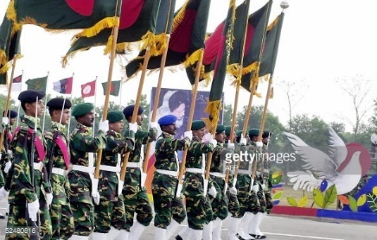
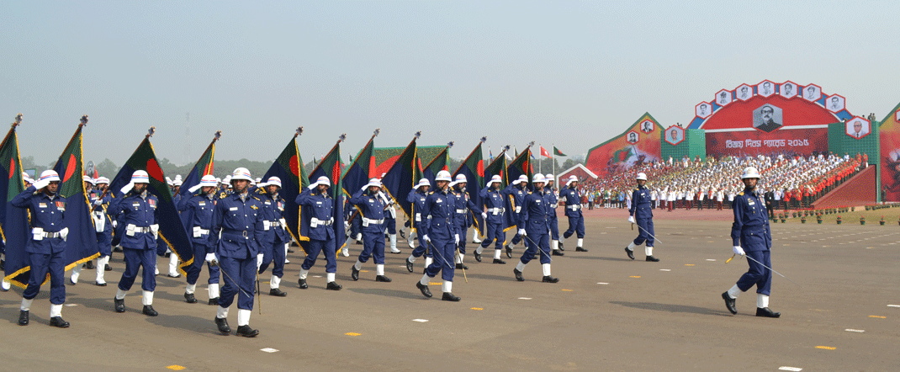
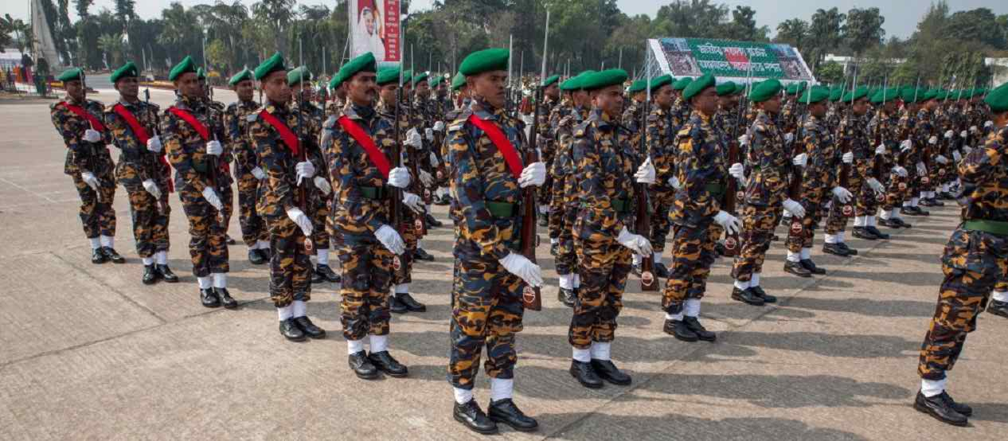
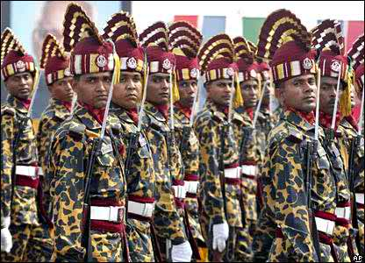
People witness dressed parade of different defense forces.

Slide 11
Individual Work
1. What does the country witness at the National parade ground this day ?
2.How is 26 march celebrated every year in the country ?
3. What is remembered on this day ?
4. Who take part in the national parade ground ?
5. Who offers flower wreath in the National Mausoleum on behalf of the nation ?

Slide 12
Key Words
Word | Meaning
Festival | A day or period of celebration.
Struggle | Fight
Freeom Fighter | A person who fought for the independence of the country.
Fervour | A strong feeling of excitement.
Alike | In a similar way.
Spectator | a person who is watching an event.
Display | Acts of performing skills.
Illuminate | To decorate a building with bright lights.

Slide 13
Let’s enjoy a video

Slide 14
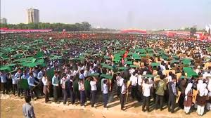
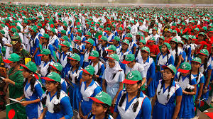
In Bangabondhu Stadium, Bangladesh scouts, girls guide and students take part in various display to entrain the spectators.

Slide 15
Group Work
How should we observe the Independence Day?
If you were young then what would you do?

Slide 16
Evaluation
1 . Our biggest festival is …
Pahela Baishakh . b)Victory day.
c )Independence day . d) 21st February
3. The Independence day is celebrated with-----
Due solemnity and fervor b) zeal and fatality
d) Emoiton and pride d) fame and fratility
2 .The celebration of Independence day begins with ……..
a) Procession b)gunshots.
c) Placing wreaths at national memorial. d) The display of parade by defense foresees.
4.The National Masuleum of Bangladesh is---------
Shahbag b) Gazipur
c) Mymensingh d) Savar
5. What is the positive form of ‘biggest’?
big b) bigger
c) Bigest d) bigg

Slide 17
Home Work
Write a paragraph about Independence Day

Slide 18
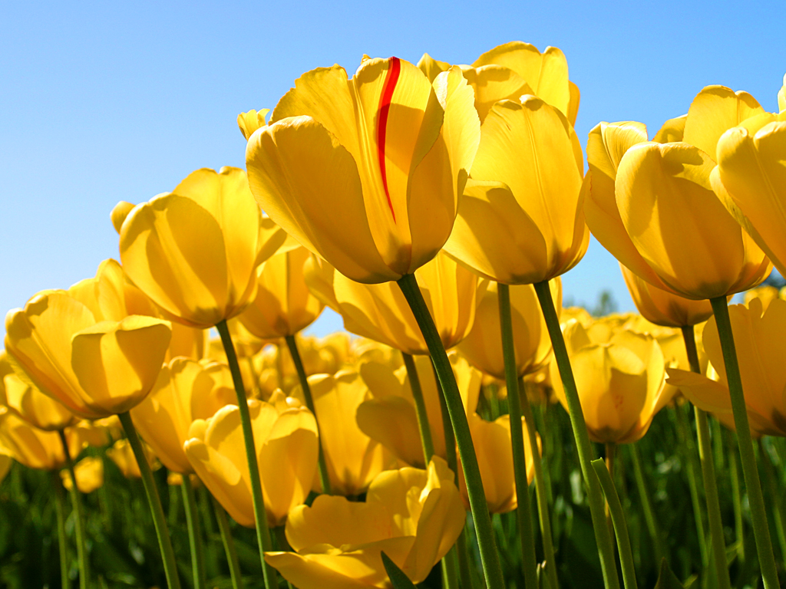
Allah Hafez

