Slide 1
WELCOME

Slide 2
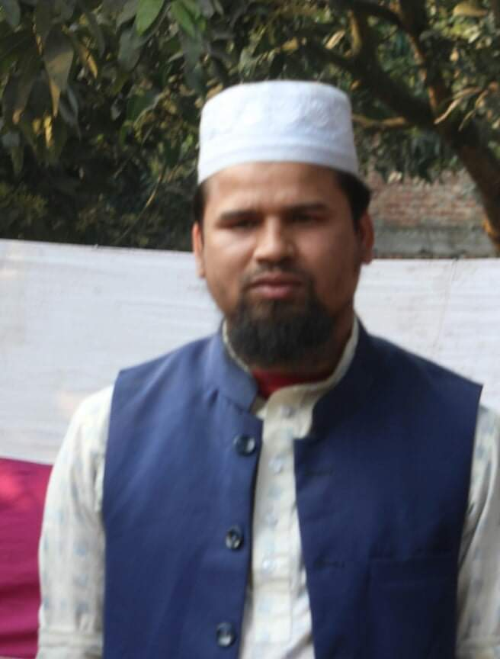
Introduction
Md.Farid Uddin
Assistant Teacher
Dupchanchia D.S Fazil Madrasah.
Presentation made for class
Nine & Ten
English 2nd paper
Grammar

Slide 3
Let’s see some images and texts
& guess

Slide 4
They said, “We are teachers”
They said that they were teachers.
He says, “ I like playing”
He says that he likes playing.

Slide 5
What do you guess by seeing these images and conversations?
What changes do you notice here?
Yes, I think you can guess.

Slide 6
So,
Our Today’s
Lesson
is
So,
Our Today’s
Lesson
is
NARRATION/Speech

Slide 7
Learning outcomes
After the end of this lesson, learners will be able to---
define speech.
classify speech.
change speech from direct to indirect.

Slide 8
What is Speech?
Speech is an expression which is
expressed by the speaker.

Slide 9
We may report the words of a speaker in two ways.
So
There are two kinds of speech.
They are :-
1. Direct Speech
&
2. Indirect Speech

Slide 10
What is Direct Speech?
We may quote his actual words . This is called Direct Speech.
What is Indirect Speech?
We may report what he said without quoting his actual words . This is called indirect Speech.

Slide 11
Sukumar said to me , “ I ate bread and butter.”
Reporting Speech
Reported Speech
Direct Speech
Indirect Speech
Sukumar said to me that he had eaten bread and butter.

Slide 12
The speech which is under Quotation marks or Inverted commas in writing is called Direct Speech and the verb by which it is expressed, is called Reporting Speech .
There are three features of Direct Speech-
In writing, the Direct Speech is put within Inverted Comma (“……”) to mark off the exact words of the speaker.
Comma is used after Reporting Speech.
The first letter of the Direct Speech is a Capital letter.
He said, “ I am ill.”

Slide 13
Now Look at the following table.
Rafiq said, ‘’ I am very busy”
Direct Speech
Speaker | Reporting verb | Direct Speech
Rafiq | said | “I am very busy”
Indirect Speech
Reporter/ Speaker | Reporting verb | Linker | Reported Speech
Rafiq | said | that | He was very busy
It will be noticed that in changing the Direct Speech into Indirect certain grammatical changes have been made.
1. We have used ‘that’ before the Reported Speech or Indirect Speech.
2. Pronoun ‘I’ is changed to ‘he.’
3. The verb ‘am’ is changed to ‘was’.

Slide 14
If we want to change a Direct Speech into Indirect , we have to change three or more changes --
Tense
Person
Certain words
If the Reporting Speech is in the Past Tense, we must make the following changes--
Change of Tense
Direct |  | Indirect
a. Present | Becomes | Past
b. Present continuous | Becomes | Past continuous
c. Present perfect | Becomes | Past Perfect
d. Past Indefinite | Becomes | Past Perfect
e. Past perfect | Becomes | Past Perfect
f. Past continuous | Becomes | Past Perfect continuous
g. Future | Becomes | Future in the past Subject + should/ would+ v1

Slide 15
Example
Reported speech of Direct Narration | Reported speech of Indirect Narration
Present Indefinite Tense He said, “I write a letter” | Past Indefinite Tense He said that he wrote a letter.
Present Continuous Tense He said, “ I am reading a book.” | Past Continuous Tense He said that he was reading a book.
Present Perfect Tense He said, “I have done my duty.” | Past Perfect Tense He said that he had have done his duty.
Present Perfect Continuous Tense They said, “We have been working for two hours” | Past Perfect Continuous Tense They said that they had been working for two hours.
Past Indefinite Tense He said, “I wrote letters.” | Past Perfect Tense He said that he had written letters.
Past Continuous Tense He said, “I was writing letters.” | Past Perfect Continuous Tense He said that he had been writing letters.
Past Perfect Tense He said, “I had passed the examination.” | Past Perfect Tense ( No change) He said that he had passed the examination.
Future Tense She said to me, “I shall help you.” | Future in the past Tense She said to me that she should/would help me.

Slide 16
If the Reporting Speech is in the Past Tense, some words of Time expression and place expression are changed. (Change Of Certain Words)
 | Becomes
Now | ‘’ | then
Ago | ‘’ | before
Today | ‘’ | that day
Tonight | ‘’ | that night
Tomorrow | ‘’ | the next day
Yesterday | ‘’ | the previous day
Last + time | ‘’ | the previous +time
Here | ‘’ | there
This | ‘’ | that
These | ‘’ | those
Thus | ‘’ | that way/ so
come | ‘’ | go

Slide 17
Change Of Person
If the subject of Reported Speech is 1st person, it will be changed , followed by the subject of Reporting Speech.
He said to me, “ I have done my duty” He said to me that he had done his duty.
If the subject of Reported Speech is 2nd person, it will be changed , followed by the object of Reporting Speech.
He said to me, “ You have done your duty” He said to me that I had done my duty.
If there is no object in Reporting Speech,2nd person will be changed into 3rd person.
He said, “ You have done your duty” He said that he had done his duty.
If the subject of Reported Speech is 3rd person, there will be no changed.
He said, “ He has done his duty” He said that he had done his duty.
If the subject of Reported Speech is 1st person ‘We’ Which means Whole Mankind , there will be no changed.
Teacher said, “ We are mortal” Teacher said that we are mortal.

Slide 18
Some basic changes
 | Reporting Verb | Conjunction
For Assertive Sen. | Say/ Said/ Tell/Told/ Also say/said | That
For Assertive Sen. | Also tell/told/ again said/further said
For Assertive Sen. | Add/ Added
For Interrogative Sen. | Ask/Asked | If/Whether/ WH-Q
For Imperative Sen. | Ordef/ordered, | not + verb +to
For Imperative Sen. | command/commanded,
For Imperative Sen. | request/requested,
For Imperative Sen. | advise/advised,
For Imperative Sen. | forbid/forbade | to
For Imperative Sen. | Propose/proposed | that
For Optative Sen. | wish/wished | that
 | Pray/prayed | that
For Exclamatory Sen. | Exclaim/exclaimed in/with joy | that
For Exclamatory Sen. | Exclaim/exclaimed in/with sorrow | that
For Exclamatory Sen. | Exclaim/exclaimed in/with wonder | that

Slide 19
If there is in direct speech “ wish, would, rather, sooner, it is time’ It would be unreal past Tense in the Indirect speech.
Example:
The girl said, “ I wish I sang.” The girl said that she wished she sang.
When the reporting or principal verb is in the Past Tense, all Present Tenses of the Direct are changed into the corresponding Past Tenses. Thus:
A simple present tense becomes simple past
Example:
He said, “ I am unwell.” He said that he was unwell.
A present continuous tense becomes a past continuous tense
Example:
He said, “ My master is writing a letter.” He said that his master was writing a letter
A present perfect tense becomes a past perfect tense
Example:
He said, “ I have passed the exam.” He said that he had passed the exam
Note- The shall of the Future Tense is changed into should, the will is changed into would
As a rule, the simple past tense becomes the past perfect tense in the Indirect.
He said, “ The horse died last night.” He said that the horse had died the previous night.
Example:

Slide 20
The tense may not change if the statement is universal truth. We may only change the verb according to the subject’s number and person.
Example:
Direct:
The teacher said, “ The earth moves round the sun.”
Indirect:
The teacher said that the earth moves round the sun.”
If the reporting verb is in the Present Tense, the tenses of the Direct Speech do not changed.
Example:
He says, “ He has passed the exam.” He says that he has passed the exam.
The pronoun of the Direct Speech are changed where necessary, so that their relations with the reporter and his hearer, rather than with the original speaker, are indicated.
Example:
He said to me, “I do not believe you.” He said that he did not believe me..

Slide 21
Interrogative/Questions
In changing a direct speech into indirect , we used ask/ asked instead of the reporting verb say/ said.
When the direct speech is introduced by an auxiliary verb ‘If/ whether’ is used instead of inverted comma.
Example :
He said to me, “ Do you know me?”
He said to me, “ Do you know me?”
He asked me if I knew him
But, when the direct speech is introduced by WH-Q
We have to use WH-Q which is in the sentence instead of inverted comma.
Example :
He said to me, “ What do you want?”
He asked me what I wanted.
Example :

