Slide 2
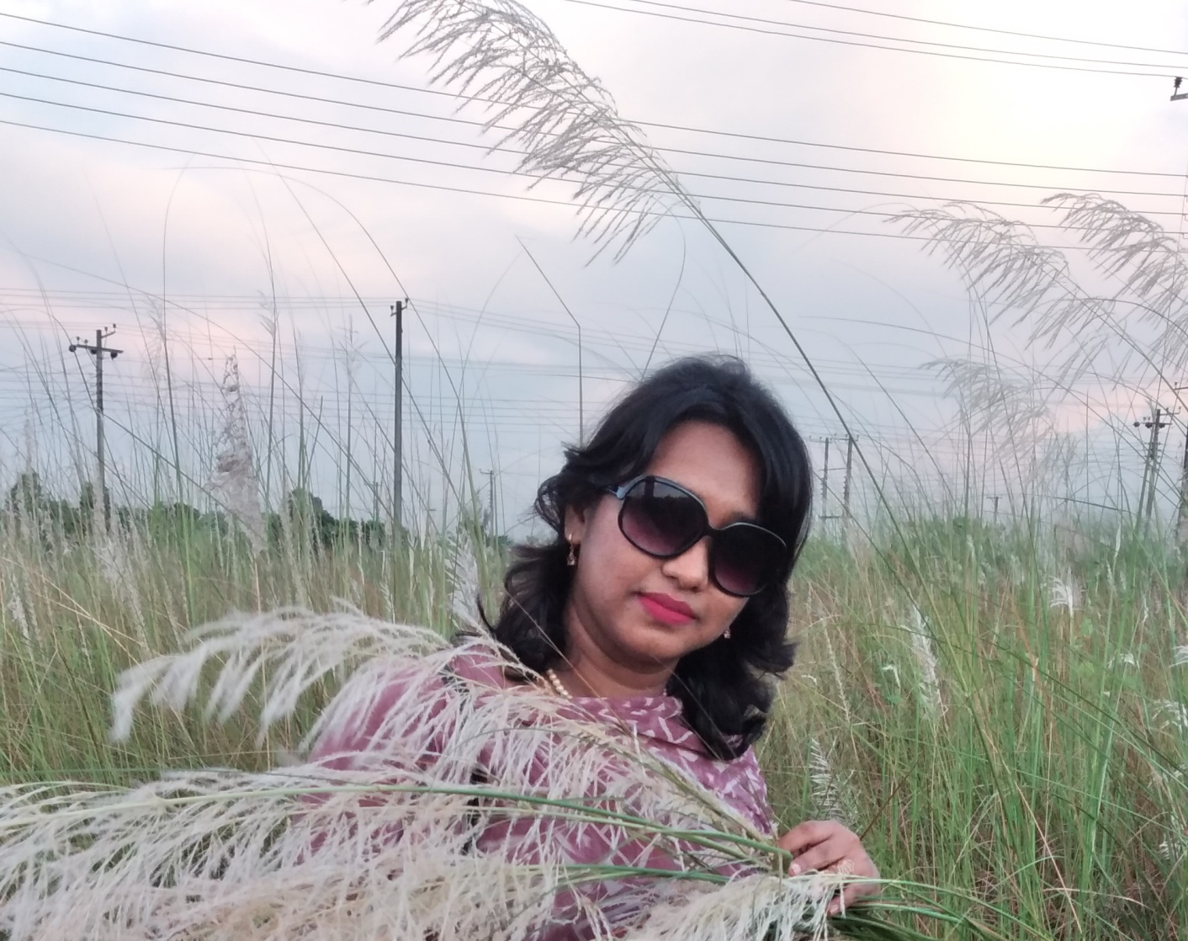
Shuvra Al Amin
Assistant Teacher
Uttar Fatehabad Government Primary School
Hathazari, Chattogram

Slide 3
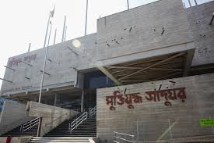

Slide 4
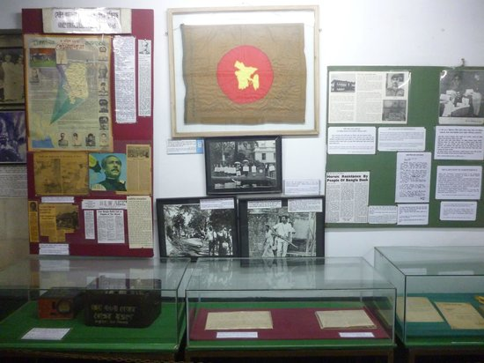
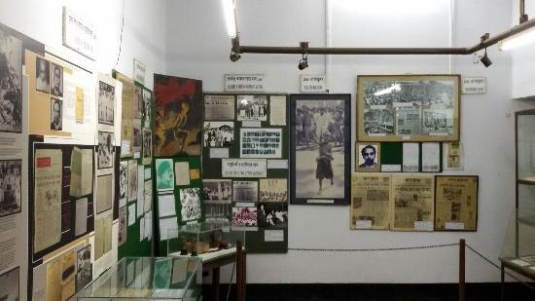
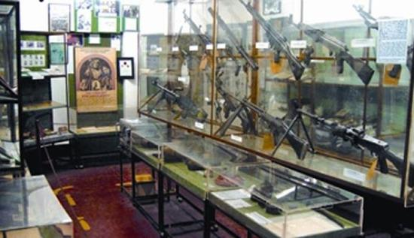

Slide 9
HOME WORK

