Slide 1
INDEX
SLIDE : 02
WELCOME
SLIDE : 10
READ THE TEXT
SLIDE : 03
INTRODUCTION
SLIDE : 11
READ THE TEXT
SLIDE : 04
MENTAL PREPARATION
SLIDE : 12
PAIR WORK
SLIDE : 05
LESSON DECLARATION
SLIDE : 13
GROUP WORK
SLIDE : 06
LEARNING OUTCOME
SLIDE : 14
GRAMMAR FOCUS
SLIDE : 07
WORD MEANING
SLIDE : 15
HOME WORK
SLIDE : 08
WORD MEANING
SLIDE : 16
THANKS
SLIDE : 09
READ THE TEXT

Slide 2
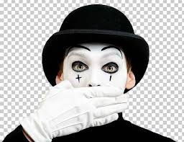
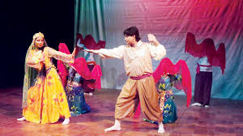
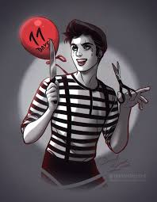
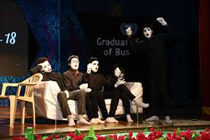
Welcome

Slide 3
INTRODUCTION
ABDUL AZIZ
B.A(HON’S), M.A(ENGLISH)
MADHAIA BAZAR SADIM HIGH SCHOOL
Unit : 07, Lesson : 02

Slide 4
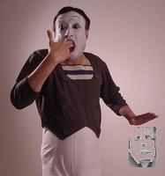
Look at the pictures
What can you see in the pictures?
In the first picture he keeps his two fingers into his mouth in a way as if he were going to shoot himself and in the second picture he seems to be showing any number.

Slide 5
So, our today’s topic is
The art of silence

Slide 6
After the end of the lesson, students will be able to -
01
describe mime art
02
Ask and answer questions
03
Infer vocabulary

Slide 7
Word & meaning
Fascinate
to interest someone a lot
মুগ্ধ করা
skilled
দক্ষ
Master
body parts
অঙ্গপ্রতঙ্গ
limb
single
এ কক
Solo
Audience
viewers
দর্শনার্থী
Scholarship
grant
বৃত্তি

Slide 8
Word & meaning
Keen
very strong and sensitive
তীব্র
Legendary
very famous
কিংবদন্তী
Maestro
a great performer
সুদ্ক্ষ শিল্পী
Enthusiastic
eager, keen
প্রচন্ড আগ্রহী
Impress
to have a great effect,
মোহিত করা
Air
broadcast
প্রচার করা

Slide 9
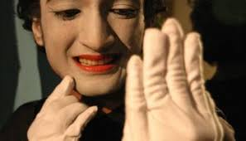
Read the text.
Before the beginning of human language, communication took place between humans trough signs and gestures. As humans began to use their vocal chords, these silent gestures were no longer used as the primary means of communication. But these did not completely disappear. They evolved as a form of art, which came to be known as ‘mime
In a Bangladeshi village, a little boy came to know about mime as he watched a performance in his village. He was so fascinated by the show that he was determined to master this art. The name of that little boy was Partha Pratim Majumder

Slide 10
Read the text.
Majumder is undoubtedly a forerunner in the field of mime in Bangladesh. He started as a musician and his keen sense of rhythm helped him to let his limbs move and express his thoughts through gestures. Partha Pratim Majumder is the first Bangladeshi to take up mime as a profession. He performed in a number of television shows in Bangladesh and gained popularity. In his mimes, Majumder depicted the day –to-day life of the people –their sadness, tears as well as their happiness and laughter.

Slide 11
Read the text.
Majumder’s turning point came in 1979, when he was asked to give a solo performance at Bangladesh Shilpakala Academy. The French ambassador to Bangladesh at the time, Mr. Loic Moreau happened to be among the audience. Mr. Moreau noticed the talent in Majumder. In 1981, the French Government offered him a scholarship so that he could get professional training in mime. This was granted a French scholarship in mime. Majumder started his training under the legendary maestro, Ftiene Decroux. Through Decroux, he met another celebrated mime artist named Marcel Marceau. Marceau has transformed modern mime by taking it to an unimaginable height.

Slide 12
Pair Work
Work in pair and choose the best answer
1. Before the use of speech, communication took place through ______
written b) sign c) spoken d) art
2. In what form have the silent gestures evolved into?
drama b) cinema c) mime d) dance
3. In olden times the actors who performed mime used to put white paint on their –
limbs b) body c) face d) hair.
4. In the sententence “It touched a little boy’s heart he was watching a performance in his village” Here ‘touched’ means_
a) appealed b) requested c) taught d) broke
5. The word “fascinated’ means____
a) enchanted b) encouraged c) silenced d) upset

Slide 13
Group Work
1. What is ‘mime’?
Ans: Mime is an art of signs and gestures. It is a silent performance.
2. What helped Partha to express himself clearly while performing mime?
Ans: Partha’s keen sense of rhythm helped him to express himself clearly while performing mime.
3. What did he depict through his performance at the beginning?
Ans: Through his performance at the beginning, he depicted the day-to-day life of the people.
4. Why was the French Ambassador impressed?
Ans: When the French ambassador saw Majumder’s performance, he was impressed by noticing the talent in Majumder.

Slide 14
Grammar Focus
So----that
Structure : Subject + verb + so +adjective/adverb+Ext. + that + clause
Example:
He was so fascinated that he was determined to master this art.
The old man is so weak that the can not walk.
She was so sick that she could not go to school yesterday?
So that
Structure :
Clause + so that + subject + may/can/might/could + verb +Ext.
Example :
The French Government offered him a scholarship so that he could get professional training in mime.
We eat so that we may live.
He is studying attentively so that he can make a good result.

Slide 15
Do you know anyone who has skills to perform as a special feat? Write about the person?

