Slide 1
WELCOME

Slide 2
INTRODUCTION OF TEACHER
HABIBULLAH
ASSISTANT TEACHER
VITIPARA KAJOLDIGHI GPS

Slide 3
INTRODUCTION OF LESSON
CLASS:FIVE
SUB:ENGLISH UNI:TEN LESSON:1;2

Slide 4
STUDENTS WILL BE ABLE TO
1.2 To recognize which syllable in a word is stressed
6.2 To Talk about people, objects events,etc.
4.1To read aloud poems with proper sounds,stress and intonation.

Slide 5
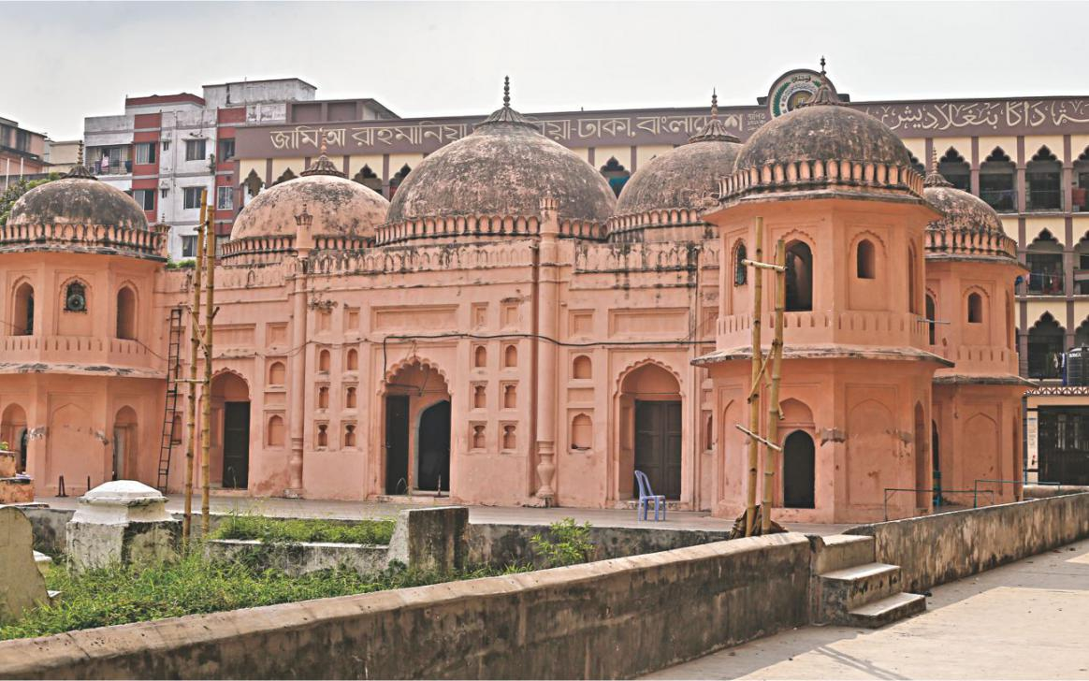
LOOK AT THE PICTURE

Slide 6
DICLARATION OF LESSON

Slide 7
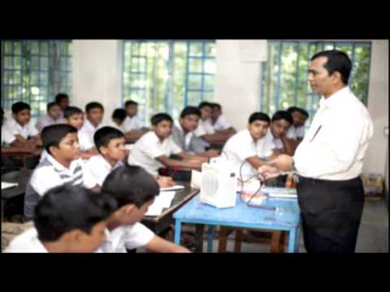
TEACHER’S READING

Slide 8
EVERY TWO STUDENT MAKE A PEER

Slide 9
EVALUATION
ANSWER THE QUESTION 1.Who is Zainul Abedin?
2.What is your home district?
3.Where is shah Muhammad mosque?

