Slide 1
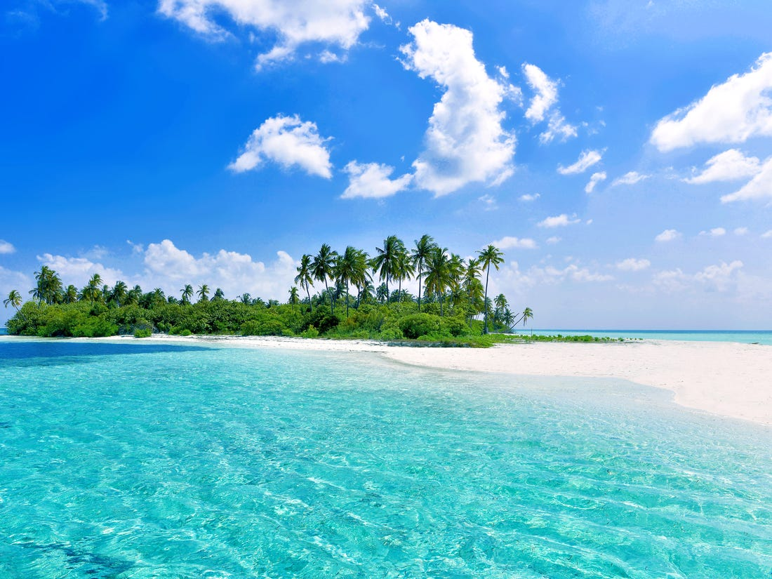
Welcome

Slide 2
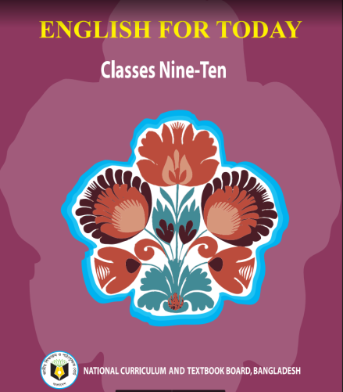
Md. Saiful Islam Chowdhury
Senior Teacher
C. J. M High School,
Mohara , Chandgaon , Chattogram.
saifulcjm@gmail.com Mob: 01991945882
ENGLISH FOR TODAY
Class : Nine-Ten
Unit-six, Lesson-3
Time: 40 minute

Slide 3
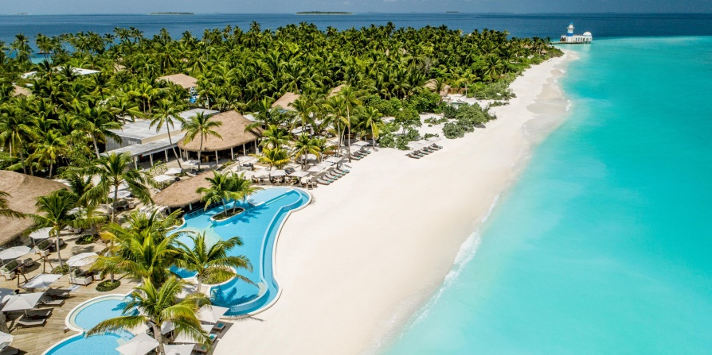
T: Have you ever visited any island or seen any island on TV ?
S: No, I have not visited any island , but I have seen many island on TV.

Slide 4
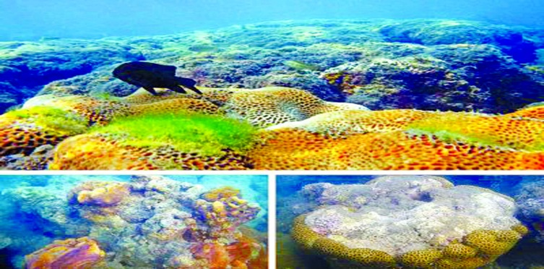
T: Have you ever heard of a coral island?
Is there any coral island in Bangladesh?
S: Yes, I have heard of a coral island.
There is a coral island in Bangladesh.
It is Saint Martin’s island.

Slide 5
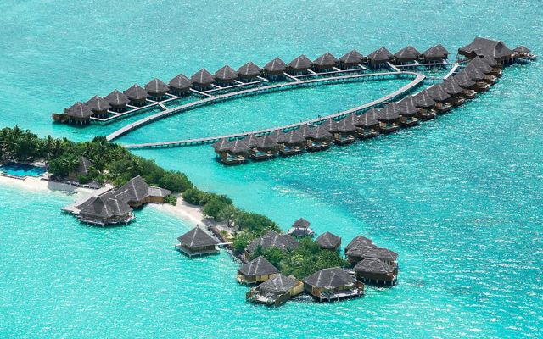
Look at the picture
T: Do you know any country of island?
S: Maldives is a country of island.

Slide 6
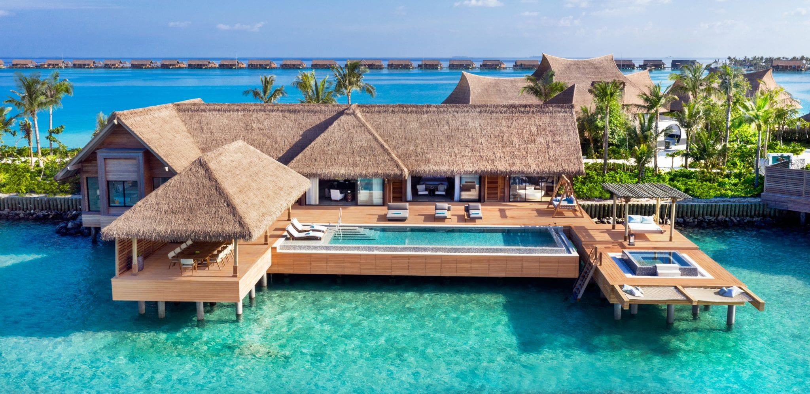
Today our Lesson is
The Maldives
Unit-Six ; Lesson – Three

Slide 7
Learning outcomes
After completing the lesson students will be able to -
1. Read, comprehend and summaries texts;
2. Ask and answer questions;
3. Read travel ads and talk about them;
4. Select and write headings;
5. Write letters to friends describing places of interest.

Slide 8
Read the text below and answer the questions that follow.
The Republic of Maldives is an island country in the Indian Ocean. It has 1199 islands that are clustered into 26 major atolls. An atoll is a ring-shaped coral reef or a string of closely spaced coral islands. The natural coral reefs of the Maldives are surrounded by the sea all around and stand out as a pearl in the Indian Ocean. The Maldives is the eighth smallest country in the world with an area of only 300 square kilometers . It is the smallest Asian country in terms of population and size. People have been living on the islands of the Maldives for nearly 3000 years. They set sail from different parts of the world-Asia, Arabia, Europe and America-to come to these islands. The earliest settlers of the Maldives were probably from southern India and Sri Lanka who came to these islands in the fourth and fifth centuries BC. In the 12th century AD, sailors from East Africa and Arab countries came to the Maldives.

Slide 9
As a result, the Maldivians who were originally Buddhists were converted to Sunni Islam in the mid- 12th century. In 1344 Ibn Batuta, a famous Arab historian and scholar travelled around the Maldives. In the 16th century, the Portuguese conquered the Maldives and ruled the country for 15 years. Although governed as an independent Islamic sultanate for most of its history from 1153 to 1968, the Maldives was a British colony from 1887 to 1965. Following independence from Britain in 1965, the sultanate continued to operate for another 3 years. On November 11, 1968, the sultanate was abolished and replaced by a republic and the country assumed its present name. The Maldives is famous as a tourist destination because of its pleasant weather, heavenly beaches and lagoons, luxurious holiday resorts and the peace-loving people. The Maldives was ranked as the best country for beautiful beaches and facilities for recreation in 2008.

Slide 10
The Maldives is well known for being the lowest country in the world. Unfortunately, this small country with idyllic natural beauty is under threat from rising sea levels due to global warming. Most of the country is just 1.5 meters above sea level with the highest point of 2.3 meters! Many predictions have been made with respect to Maldives being swept away by the rising water level in the Indian Ocean, when the power tsunami of 2004 hit the island nation, many of the island's dry parts were flooded by the sea water. The government of the Maldives has begun to purchase land from nearby countries for resettling its people in case the islands go under water! In order to highlight the threats of global warming to its low lying islands, the government of Maldives held a cabinet meeting underwater in 2009.
That was the first ever underwater cabinet meeting in the world. The meeting took place about 5 meter underwater, in a blue- green lagoon on a small island. While underwater, the cabinet signed a document calling on all nations to cut their carbon emissions.

Slide 11
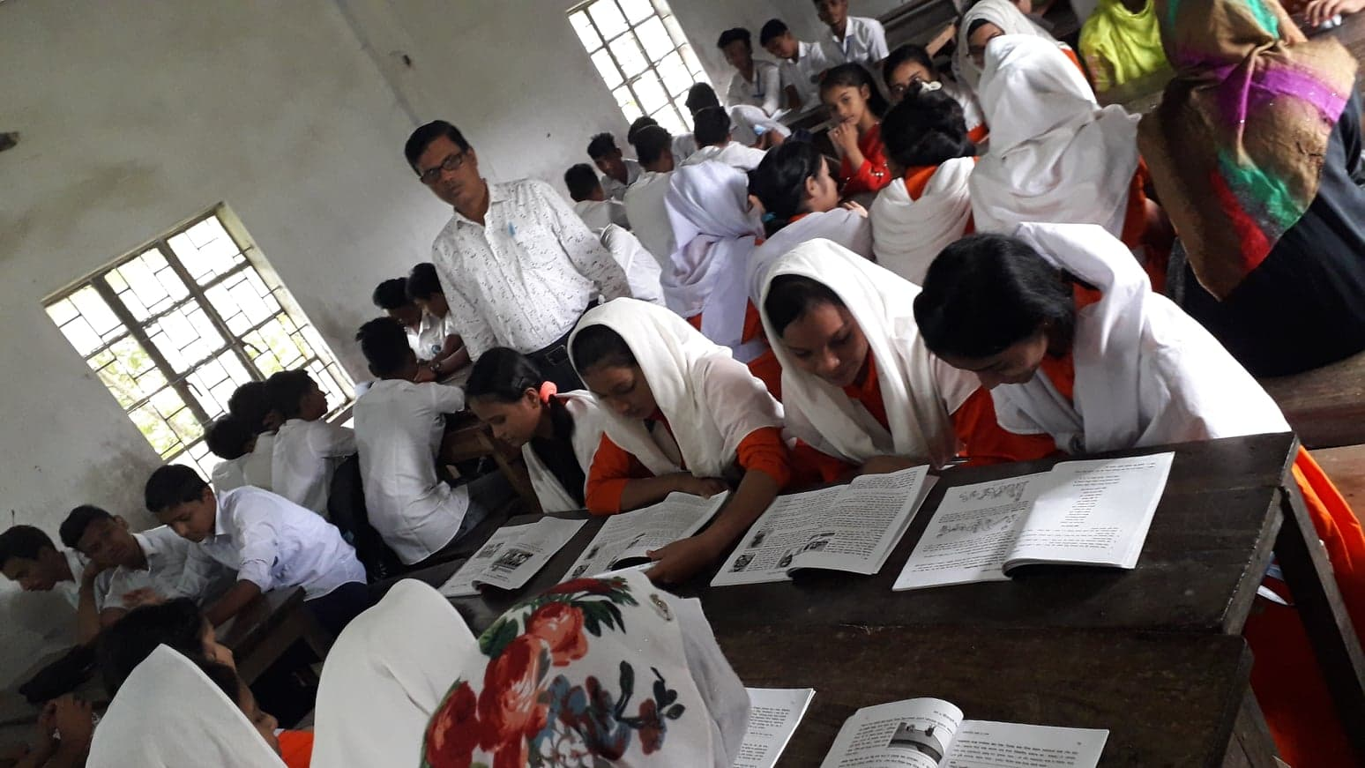
Student’s Model reading.
Go to the section “B” and start silent reading.

Slide 12
Vocabulary
Key word
Cluster
Meaning:
Bunch, clump
This is a cluster of flowers.

Slide 13
Vocabulary
Key word
Settler
Meaning:
Colonist, colonizer
This house is owned by an Italian settler .

Slide 14
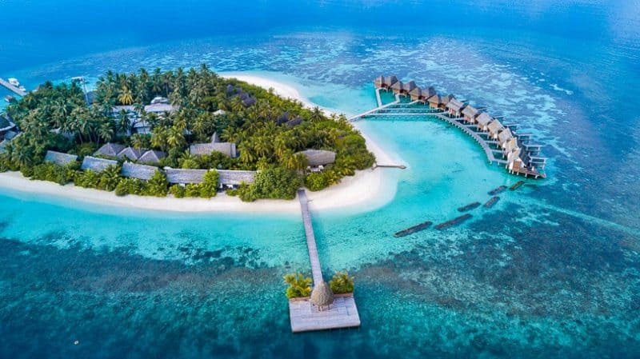
Vocabulary
Key word
Republic
Meaning:
Self-governed, democratic state
The Republic of Maldives is an island country.

Slide 15
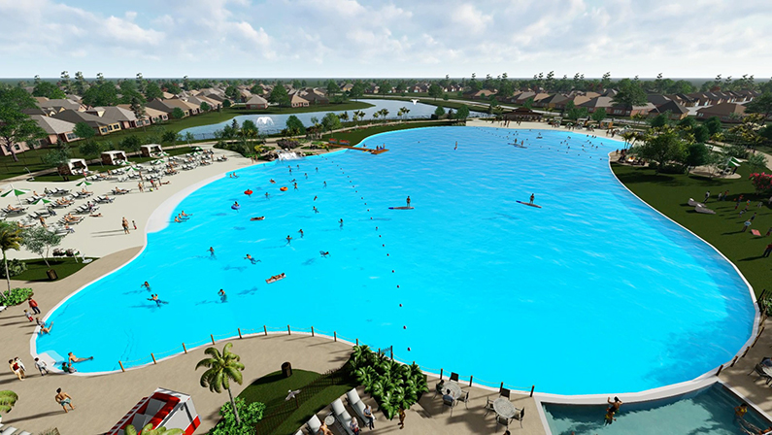
Vocabulary
Key word
Lagoon
Meaning:
Pool, pond
The largest crystal clear lagoon is in Texas.

Slide 16
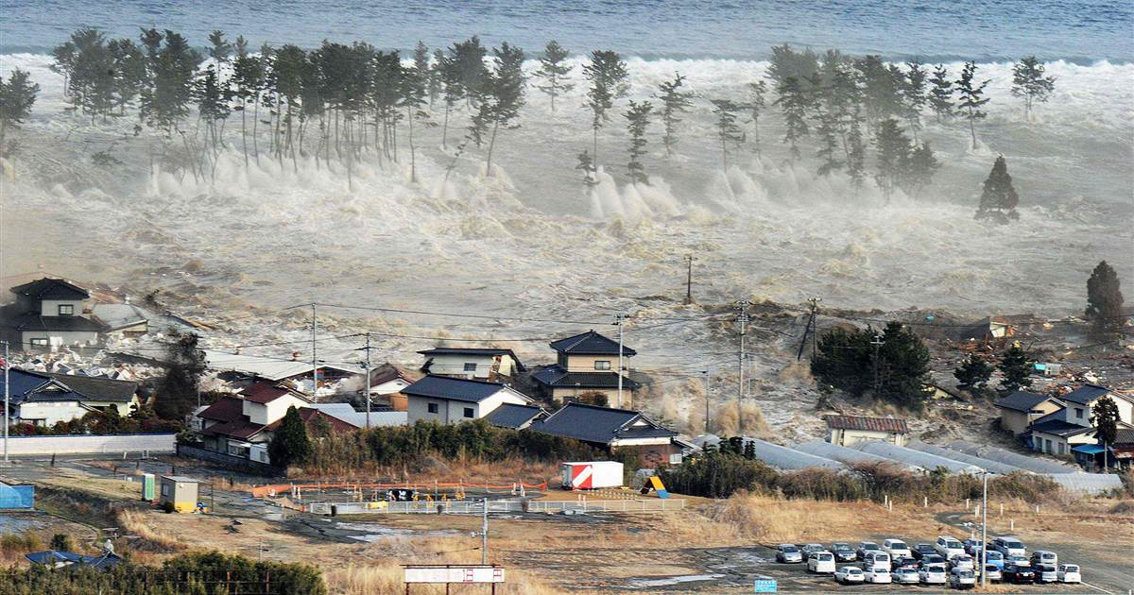
Vocabulary
Key word
Prediction
Meaning:
Prophecy, foreshadowing
Many Predictions have been made with respect to Maldives being swept away by the rising water level.

Slide 17
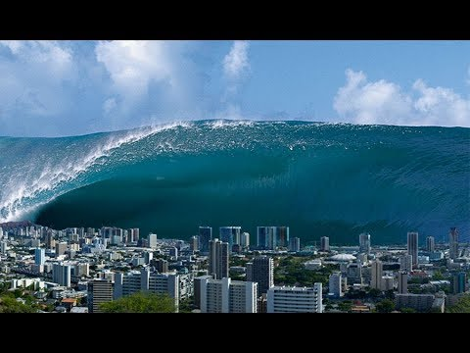
Vocabulary
Key word
Tsunami
Meaning:
A large wave
Tsunami is caused by extreme condition such as an earthquake.

Slide 18
Choose the correct answer from the alternative.
Individual work
1.Which of the following has the closest meaning to the word ‘prediction’ used in the passage?
Prophecy.
Soothsaying .
Anticipation.
Telling fortunes.
2. 1.Which of the following is not a feature of the Maldives?
An island state
Blessed with beautiful beaches
Plenty of recreation facilities
A hilly region

Slide 19
Choose the correct answer from the alternative.
3.What does the under water meeting symbolize ?
The rising sea level
The ultimate future of the Maldives
Unique way of holding meeting
It is a modern style
4 What might happen to Maldives if the emission of carbon could not stop?
The Maldives will be submerged by sea water
The atmosphere of Maldives will be damaged
The people of Maldives will die
There will be no effect on Maldives

Slide 20
Choose the correct answer from the alternative.
5. What is the meaning of the word ‘lagoon’ ?
A shallow body of the water
Small water boat
Shallow sea truck
A small sea beach
6. The text is about -
Natural beauty of Maldives
Effects of global warming on Maldives
Global warming
Under water meeting

Slide 21
colonial
beginning
rulers
Complete the table with no more than two words and/or numbers
In 1344
1965
replaced
Time | Facts
4th and 5th centuries BC | The early inhabitants of the Maldives arrived and settled from Southern India
12th Century | The sailors from African and Arab counties started to settle in the islands. Buddhism was ------------- by Islam.
------------ | A famous scholar and historian named Ibn Batuta visited the islands of the Maldives.
16th century | The Portuguese occupied the Maldives and became the ------------ of the country for 15 years.
1887 | Beginning of the British ----------------- era.
--------- | The Maldives became independent from the British rule.
1968 | End of Islamic sultanate and ---------------- of the Republic of Maldives.

Slide 22
Read the following statement . Write true or false beside the statements . Give correct information for the false statements
Group Work.
1.The islands of the Maldives were inhabited in the 12th century.
False
1.The islands of the Maldives were inhabited in the 4th and 5th centuries.
2. Only seven countries in the world are smaller than the Maldives .
True
3.The Maldives was ranked as the second best country for natural beauty in 2008.
3.The Maldives was ranked as the best country for natural beauty in 2008.
False
4. The Maldives was an independent Islamic sultanate from 1153 to 1968.
True
5.No other South Asian country has a population smaller then that of the Maldives.
True

Slide 23
Read the passage carefully and answer the following questions.
1.What is an atoll?
Individual/pair work
2.What makes the Maldives an ideal place for the tourists?
3.What dangers of climate change might affect the Maldives?
4.Do you think the Maldives is at risk? Why/Why not?
5.Do you find any similarities between the Maldives and Bangladesh?

Slide 24
Compare with your answer
1.An atoll is a ring-shaped coral/reef or a string of closely spaced coral islands.
2.Its enjoyable weather, heavenly beaches and lagoons, luxuries holiday resorts and the peace loving people make the Maldives an ideal place for the tourists.
3.The dangers of climate change, which might affect the Maldives are-the rising of the sea level and floods caused by it which will sweep the islands in the Indian ocean.
4.Yes, I think so. The Maldives is the lower country in the world. This country may go under water by rising of sea levels due to global warming. So, definitely the Maldives is at risk.
5.Like the Maldives, Bangladesh is a small seaside lower county filled with natural beauty. If the sea levels rise due to global warming, like many other lower countries, Bangladesh will go under water. Rising of the sea levels is a great threat to both of these countries.

Slide 25
Fill in the blanks with the correct words
consisted
Which / that
clustered
sailors
Attracted
The Maldives,(a) ----------------------- is an island country in the
Indian Ocean , is one of the smallest countries of the world.
It has (b) -------------------- of small islands (c) ------------- -- --- in to 26
Major atolls. Travellers are (d)----------------------by its natural beauty.
The Arabian(e)-----------------came to this country in the 12th century.

Slide 26
Evaluation
1. What do you know about the Maldives?
About the Maldives -
I know that it is a country of island.
It is a very small country.
It is situated in south Asia.
It is a Muslim country.

Slide 27
Home Work
Write a paragraph with in ten sentences about
The Maldives.

Slide 28
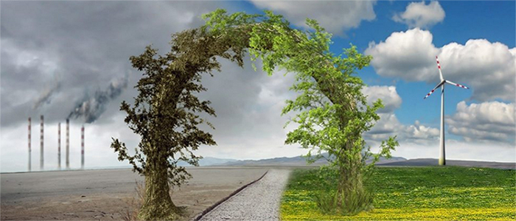
We have the knowledge, power and ability to stop climate change.
Thank you all

