Slide 1
Welcome To My Class
Good Morning
Dear Students

Slide 2
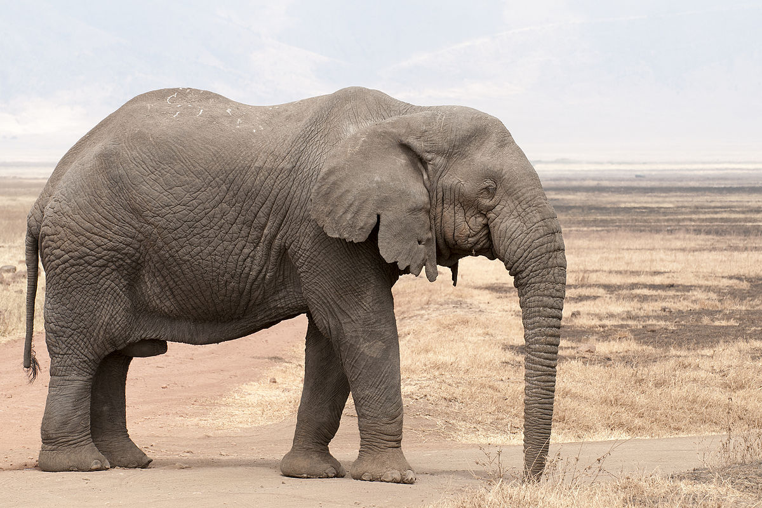
This is an elephant.The elephant is a big.

Slide 3
Our todays Class is on
Articles
English 2nd paper
Class:Seven
Unit: 09

Slide 4
Learning outcomes
Objectives: After the lesson, students will be able to identify correct and incorrect use of articles in writing samples.
Articulate when and why indefinite articles should be used in particular contexts.

Slide 5
Articles
Indefinite Articles
Definite Article
The (in the sense of “this” and “that”)
A , An (in the sense of “one” and “any”)

Slide 6
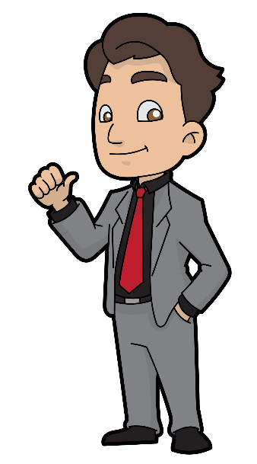
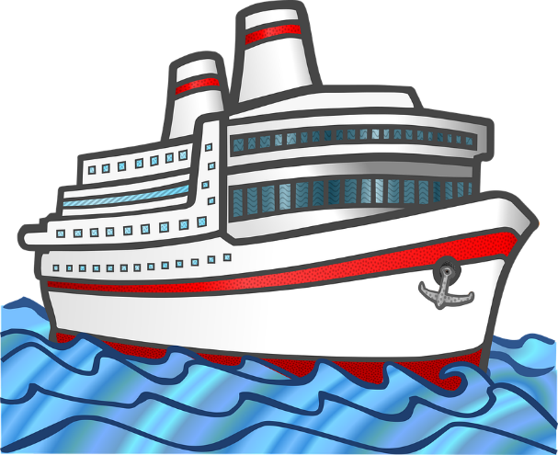
Indefinite Articles
A and An are called Indefinite articles.
Because they are used in front of singular countable nouns
Which are not specific.
one person one things one animal

Slide 7
Different uses of A / An :
Rule-1: Use “A” before all consonant sound.
Use “An” before all vowel sound.
EXAMPLE :
………………..dog
………………..girl
………………..apple
………………..umbrella
……………….university
……………….european
……………hour
……………honest man
……………heir
……………M.A
…………...B.A
……………F.R.C.S

Slide 8
Answers
A dog
A girl
An apple
An umbrella
A university
A European
An hour
An honest man
An heir
A B.A
An M.A
An F.R.C.S

Slide 9
Rules 2 : Use A / An before the names
Of unknown persons to the speaker.
Example :
…………… Akbar was looking for you. ……….Mamun also
came but you were not at home.
Answer: An A

Slide 10
Rules 3: Use A / An to denote likeness. Here the proper noun has been used as a common noun.
Example :
………….. Nazrul is a great poet. (proper noun)
You are …………. Nazrul.(Common noun)
She is …….. Begum Rokeya, I see.(Common noun)
Answer :
No article
A
A

Slide 11
Rules 4 : Use “A” before “O” sound.
Here “O” sounds like “W” .
Example :
……….. One taka note
……….. One eyed man
Answer :
A
A

Slide 12
Rules 5 : Use A / An only with singular countable
noun , to mention someone's job, to talk about
nonspecific things or persons, to denote Quality with
numbers and expression of price/rate; speed.
Example:
This is …………….. Car.
This is ……………..elephant.
He worked as ……… cashier for two years.
He is ………teacher.
Do you have ……. pencil ?
If you are feeling sick , you should go and see ……… doctor .
Rice is sold 60 taka ……..kg.
I earn ten thousand ………. Month.
The train runs 35km …………..hour.
Answer :
A
An
A
A
A
A
A
An

Slide 13
Evaluation:
What do you understand by articles?
How many kinds of articles are there?
When we use “ A” sound?
How many vowels ? What are they?
When we use “An” sound?

Slide 14
Home task:
Use articles (A / An).
I want ……….orange.
This is ……… chair.
She is ……… student.
She is ………..excellent student.
I saw …… old woman and ……….dog in the park.
Salam is ………farmer.
I have ……..one taka note.
………student should respect their teachers.
……….. Idle brain is the devils workshop.
I see , she is ……….Begum Rokeya .
He is ………….honorable person.
She is ……… B.A.
Milk is sold 50 taka ………… kg.

