Slide 1
Welcome

Slide 2
Presented By
Bibi Fatema
Assistant Teacher
Noapara High School,
Raozan, Chattogram.
Class Six
English Second paper

Slide 3
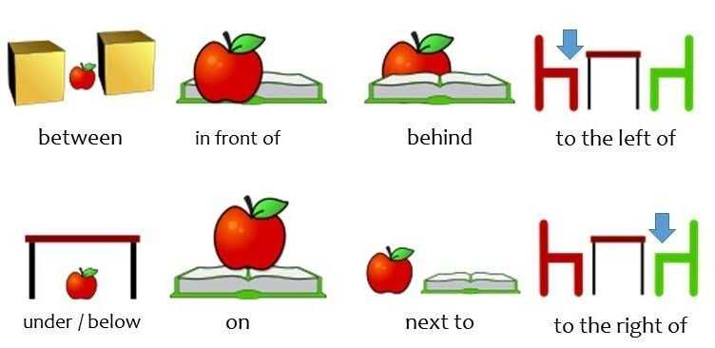

Slide 4
Title of the Lesson

Slide 5
Learning Outcomes
After completing this lesson students will be able to
know about preposition ;
know about the classification of preposition;
Identify general preposition- under, on, in……etc.

Slide 6
Preposition

Slide 8
Classification of Preposition
Preposition
Disguised
Simple
Double
Phrase
Participle
Compound

Slide 9
1. Simple Preposition : at, in of, for, from, by, to, on, off, after etc.
Put the cup the table .
The cows are the field.
2. Double Preposition : up+ on =upon
in + to = into
with + in = within
on +to = onto
He went the room.
on
in
into

Slide 10
3. Compound Preposition : by (=be) + hind = behind
on (=a) + long = along
by (=be) + side = beside
There is a bridge the two villages.
4. Phrase Preposition : by dint of, in course of, on account of, by means of, in front of. etc.
There is a big tree his house.
between
in front of

Slide 11
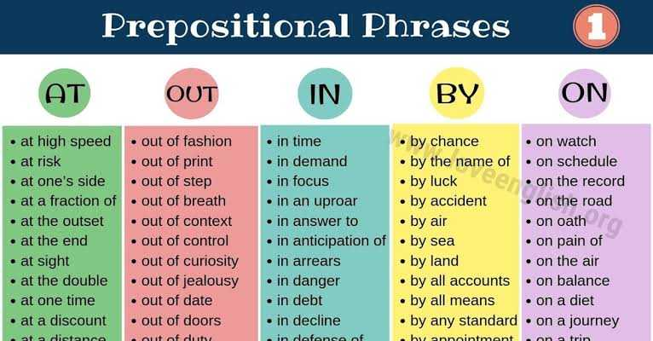

Slide 12
5. Participle Preposition:
Present participle (verb + ing)
Past participle (past participle of verb)
Regarding
Considering
Past
Can you tell me something regarding this matter?

Slide 13
6. Disguised Preposition:
The king went a (on) hunting.
He comes here once (in) a day.
Detached Preposition
Where has he come from?
What is Jashore famous for?
What are you looking for?

Slide 14
Preposition
Preposition
1. Simple
2. Double
3. Compound
4. Phrase
5. Participle
6. Disguised

