Slide 1
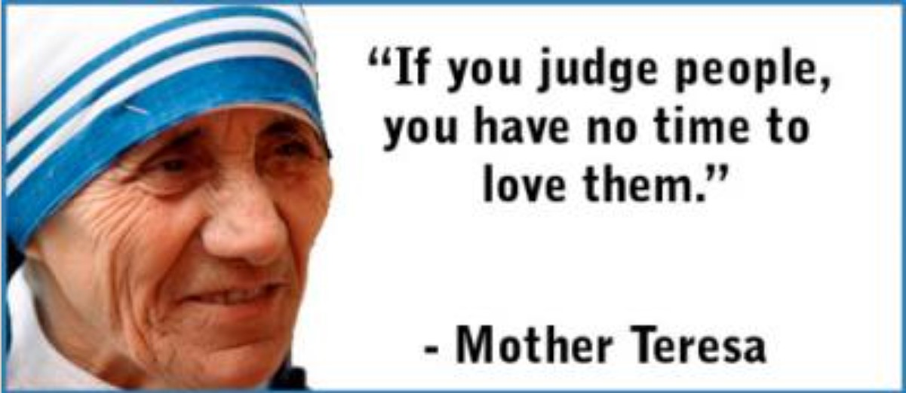

Slide 2
You are welcome.

Slide 3
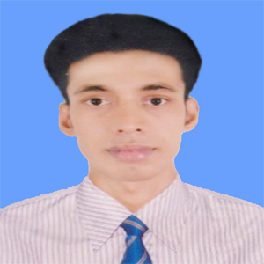
My introduction
Swandip Banerjee
Assistant Teacher (English)
Pallimangal Secondary School, Khulna.
E-mail: swandipb1@gmail.com
Mobile: 01718503573

Slide 4
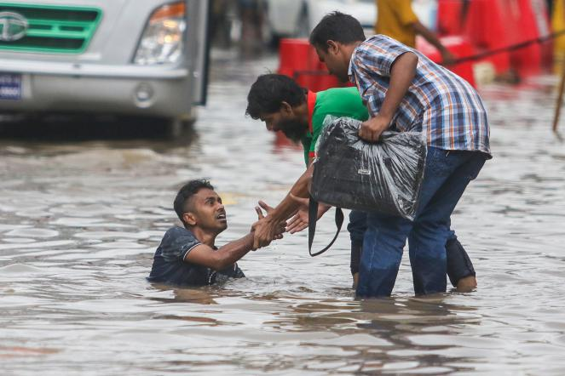
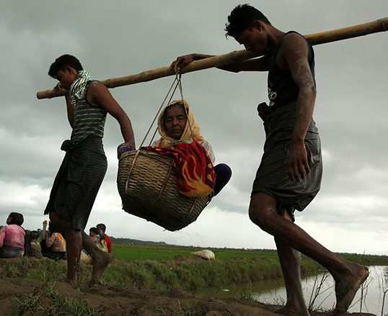
A: Look at the pictures.

Slide 5
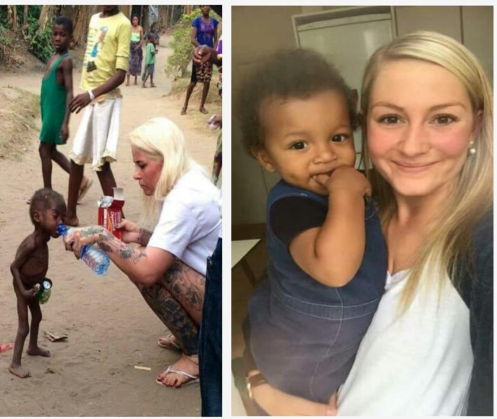
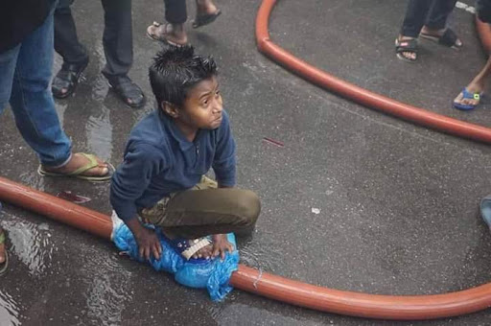
A: Look at the pictures.

Slide 6
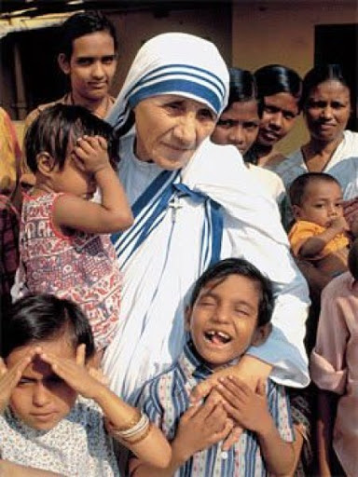
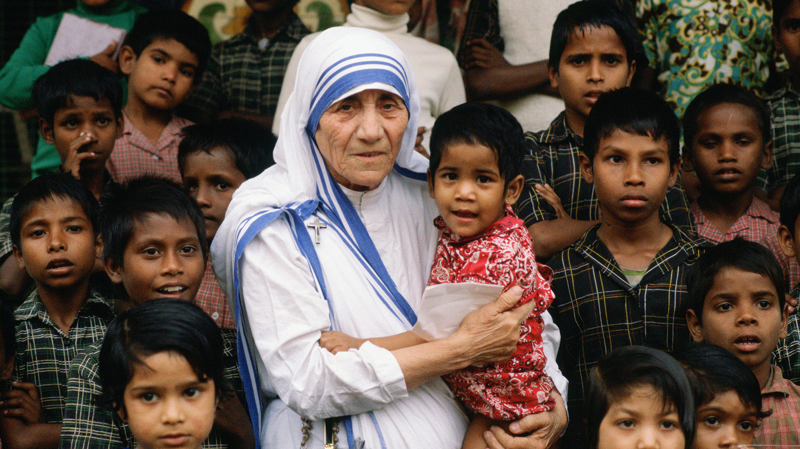
A: Look at the pictures.

Slide 7
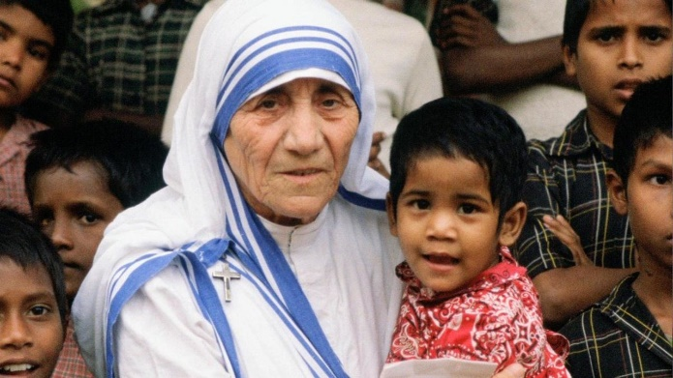
Today, our topic is …….???
Love for humanity
Unit : 07
[People who stand out]
Lesson : 06

Slide 8
Learning outcomes
After we have studied this lesson, we will be able to ………………
read and understand text for specific information.
ask and answer questions.

Slide 9
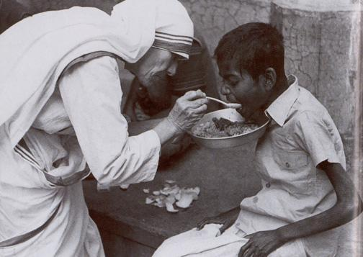
New Word
Destitute (adj)
Having no food, money and shelter.
Syn.: poor, helpless

Slide 10
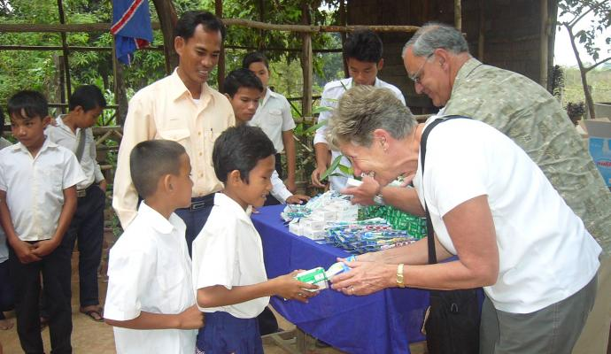
New Word
Charity (n)
An organization that helps people giving money, food, medicine etc. in need.
Syn.: Kindness and sympathy towards other people.

Slide 11
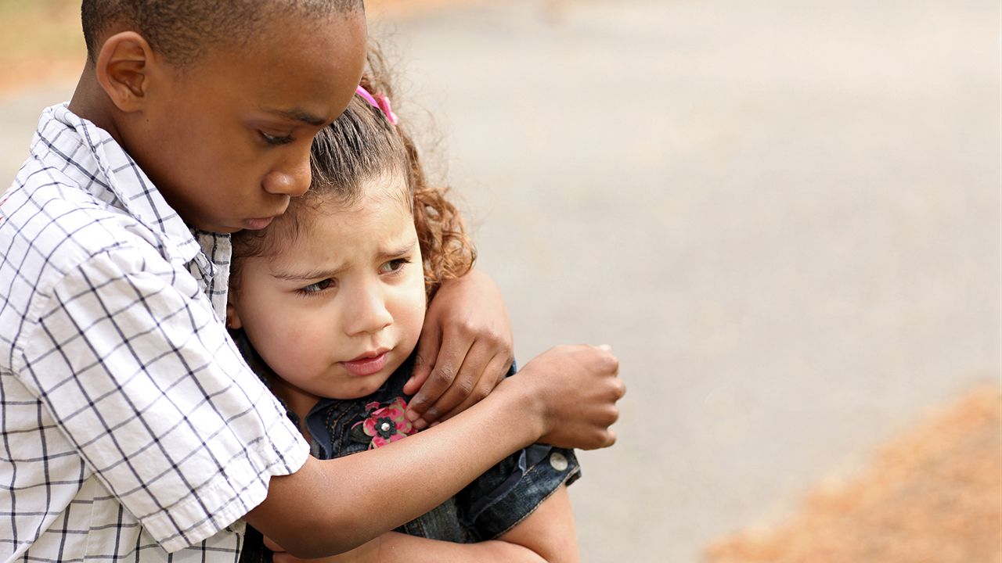
New Word
Compassion (n)
Having deep feeling of pity for the suffering of others.
Syn.: sympathy, empathy

Slide 12
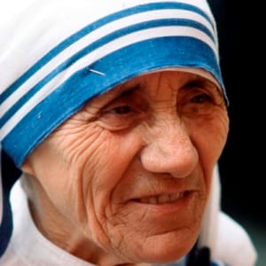
New Word
Wrinkled (adj)
Having small fold or line in the skin especially caused by age.
Syn.: Crumpled

Slide 13
A: Look at the picture and talk about it in pairs.

Slide 14
B. Read more about Mother Teresa.
Mother Teresa was moved by the presence of the sick and dying on the streets of Kolkata. She founded the home for the dying destitute and named it ‘Nirmal Hriday’, meaning ‘Pure Heart’. She and her fellow nuns gathered the dying people off the streets of Kolkata and brought them to this home. They were lovingly looked after and cared for. Since then men, women and children have been taken from the streets and carried to Nirmal Hriday. These unloved and uncared for people get an opportunity to die in an environment of kindness and love. In their last hours they get human and Divine love, and can feel they are also children of God. Those who survive, the Missionaries of Charity try to find jobs for them or send them to homes where they can live happily for some more years in a caring environment. Regarding commitment to family, Mother Teresa said, “ Maybe in our own family, we have somebody, who is feeling lonely, who is feeling sick, who is feeling worried. Are we there?
Click here for question

Slide 15
Are we willing to give until it hurts in order to be with our families, or do we put our interest first? We must remember that love begins at home and we must also remember that future of humanity passes through the family”.
Mother Teresa's work has been recognised throughout the world and she has received a number of awards. These include the Pope John XXIII Peace Prize (1971), the Nehru Prize for Promotion of International Peace & Understanding (1972), the Balzan Prize (1978), the Nobel Peace Prize (1979) and the Bharat Ratna (1980).
Mother Teresa died at the age of 87, on 5 September 1997.The world salutes her for her love and compassion for humanity. She has taught us how to extend our hand towards those who need our love and support irrespective of creed, caste and religion. Draped in a white and blue-bordered sari, wrinkled face, ever soft eyes and a saintly smile, is the picture of Mother Teresa in our mind.
Click here for question

Slide 16
C: Now say whether the following statements are true or false.
If false, give the correct information.
1. Mother Teresa was moved to see the diseases that spread in the streets of Kolkata.
2. She opened a home for the orphans.
3. She and her group brought in the dying people from the streets of Kolkata.
4. ‘Nirmal Hriday’ was founded so that the poor people who are dying can get love and care before death.
5. Mother Teresa said that humanity passes through charitable organization.
6. We have learnt how to come forward to help only those who belong to a special caste.
1. False. Mother Teresa was moved by the presence of the sick and dying on the secrets of Kolkata.
2. False. She opened a home for the dying destitute.
3. True
4. True
5. False. Mother Teresa said that humanity passes through family.
6. False. We have learnt from Mother Teresa how to come forward to help all irrespective of creed, caste and religion.

Slide 17
D: Read the text in B again and write the answer to the following questions in your exercise book in group.
Click here for text
Why do you think Mother Teresa won so many awards?
What does ‘Nirmal Hriday’ stand for?
Why do you think the home is named ‘Nirmal Hriday’?
Why did Mother Teresa want the dying people to feel that they deserve care and love too?
What are things that we have learnt from Mother Teresa?

Slide 18
Evaluation.
When did Mother Teresa received Nobel Peace Prize?
What is the general picture of Mother Teresa in our mind?
What prize did she receive in 1972?
Why does the world salute her?
What has she taught us?
When did she die?
Evaluation
Notes:
Dear Teacher, slide no 18 has been kept hide. For evaluation there are two slides one is 18 and another is 19. So, you can choose any of them.

Slide 19
Evaluation
E. Choose the best answer from the alternatives.
a) Which of the following has the closest meaning of the word ‘dying’ in line 1?
(i) Dead (ii) Colouring (iii) Death (iv) Expiring
b) What does the phrase ‘Missionaries of Charity’ mean?
(i) The donating preachers (ii) The donors (iii) The preachers (iv) The poor
c) How many prizes did Mother Teresa receive?
(i) Three (ii) Four (iii) Five (iv) Six
d) ‘They were lovingly looked after and cared for’ here ‘they’ refers to----
(i) Mother Teresa & other nuns (ii) the Missionaries
(iii) the dying people (iv) the survivors
e) Mothers Teresa’s work has been --------- all over the world.
(i) prohibited (ii) neglected (iii) ignored (iv) acknowledged
f) What did Mother Teresa and her fellow nuns do?
(i) Gathered the dying people (ii) Brought them to Nirmal Hriday
(iii) Looked after and cared for them (iv) Did all these

Slide 20
D: Write a paragraph on “Mother Teresa.”

Slide 21
Thank you all.
“Your true character is most accurately measured by how you treat those who can do ‘Nothing’ for you.”
Mother Teresa.
“No colour, no religion, no nationality should come between us, we all are children of God.”
Mother Teresa.

