Slide 1
Welcome

Slide 2
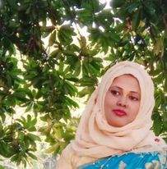
Teacher’s Introduction
Mst.Sharmin Akter
Assistant teacher
Matoin Govt. Primary School
Hajigonj, Chandpur
E-mail:
mstsharminakter1985@gmail.come

Slide 3
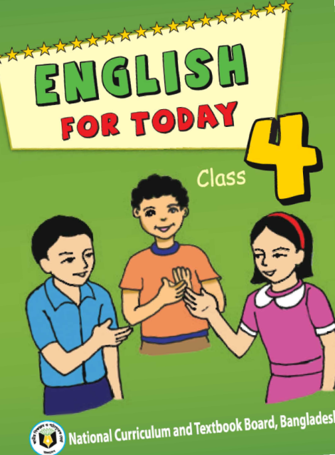
Lesson Identity
Class :Four
Subject : English
Lesson : 1-2(A)
Unit:34
Time : 40 min

Slide 4
Learning Outcomes
Student’s will be able to-
Listening:1.1.1-become familiar with English sounds by listening to common English word.
Speaking:1.1.2-say simple words and phrases with proper sounds and stress.
Reading:1.4.1-read words and phrases with the help of visual clause (about 30 new words) and simple sentences.

Slide 5
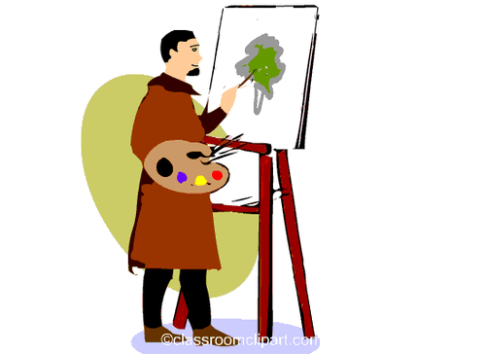
What will be our todays lesson topic ?

Slide 6
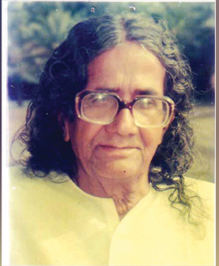
Todays lesson topic
SM Sultan

Slide 7
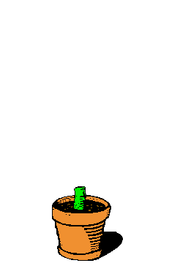
Input

Slide 8
painter
famous
exhibit
travel
born
establish
N
E
W
W
O
R
D
S

Slide 9
artist
painter

Slide 10
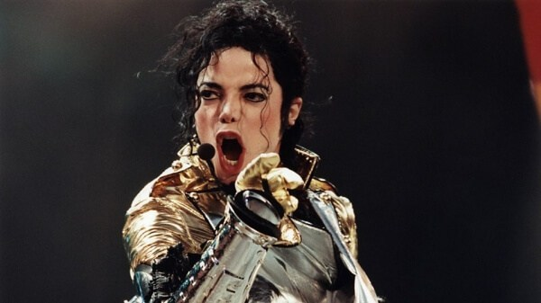
Well known
famous

Slide 11
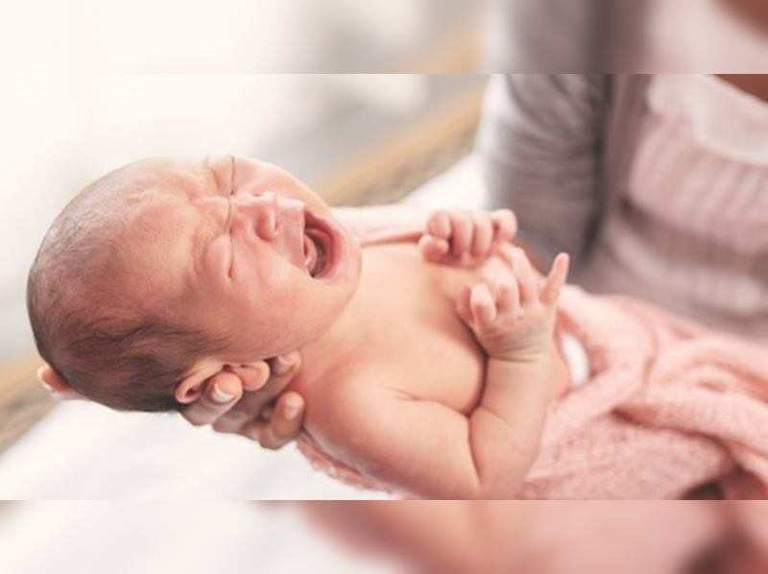
birth
born

Slide 12
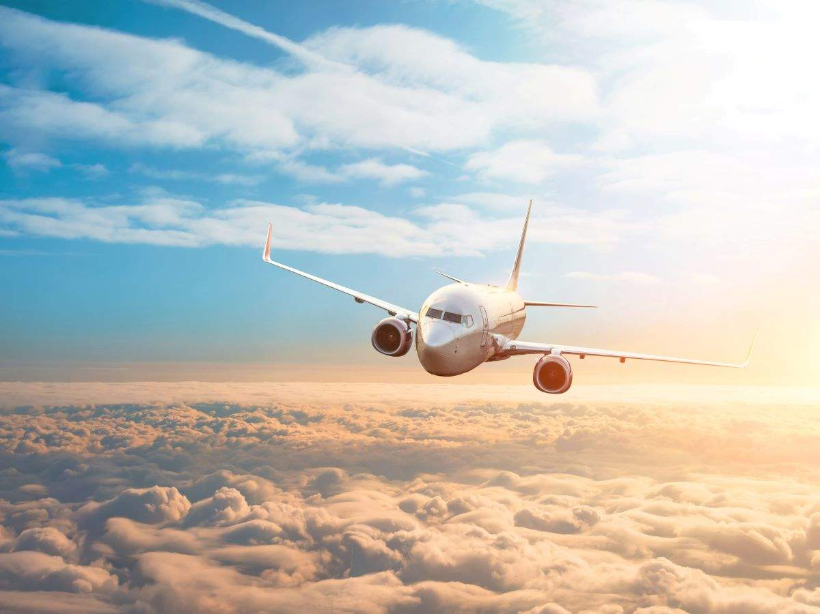
tour
travel

Slide 13
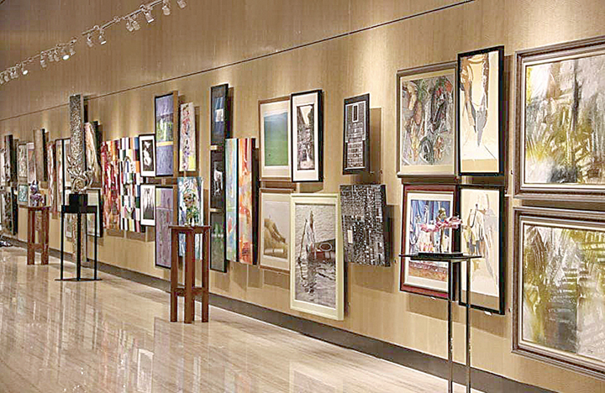
display
exhibit

Slide 14
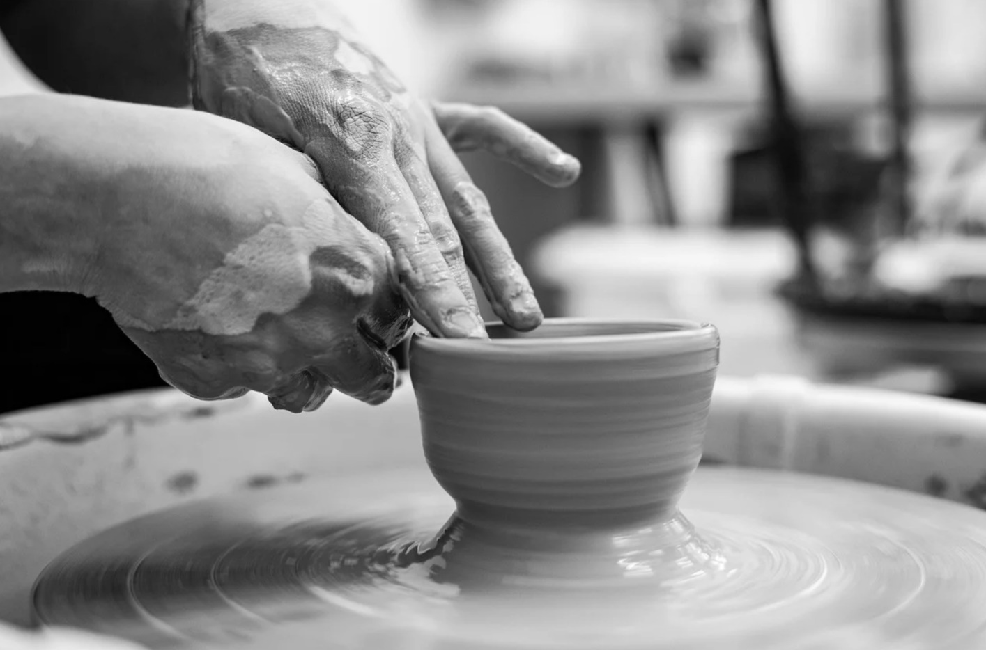
make
establish

Slide 15
Open at page 68.

Slide 16
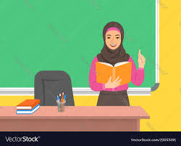
Teacher’s reading

Slide 17
Practice

Slide 18
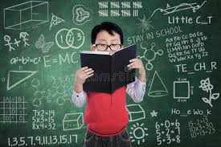
Student`s reading

Slide 19
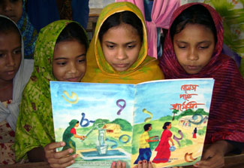
Group reading

Slide 20
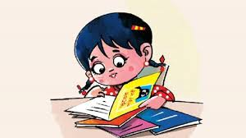
Silent Reading
5 minutes

Slide 21
Questions
1When was Sultan born?
2.Where was he born
3.What did he do for children?
4.When did he die?

Slide 22
Answer `s
Sultan was born in 1923.
He was born in Narail.
He established Nandocanon and Shishuswargo for children.
He died in 1994.

Slide 23
Now we will play “BINGO” game
garment
stich
Work
accident
factory
cinema
erosion
extra

Slide 24
task
Write five sentences about your father’s occupation.

Slide 25
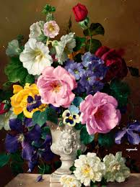
thanks

