Slide 1
Welcome to The Lesson

Slide 2
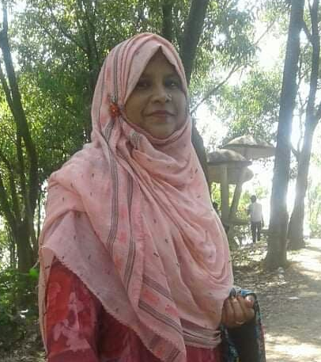
Presented By
Mst. Taslima Nasrin
Head teacher
Joymongalpur Govt.
Primary School
Chouddagram,
Cumilla.

Slide 3
Our Todays Lesson is
English For Today
Class:5
Unit:11
Lesson:1-3
Time:35 min.

Slide 4
One day one word
Our todays one day one word is
Word
Bangla Meaning
Sentence
Straight
সোজা
Go straight and
then turn left
on road 12.

Slide 5
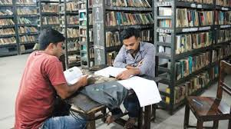
Think about the pictures
Where is the girl?
Where are these men?
Yes, they are in a library.

Slide 6
Today we are going to
read
Where’s the library?

Slide 7
Learning Outcomes
At the end of the lesson the students will be able
to,
1.Understand and use the new vocabulary
(straight, continue, toward, nearby, corner etc.) in
their daily activities.
2.Learn how to recognize places from a map.
3. Write the summery of the dialogue.

Slide 8
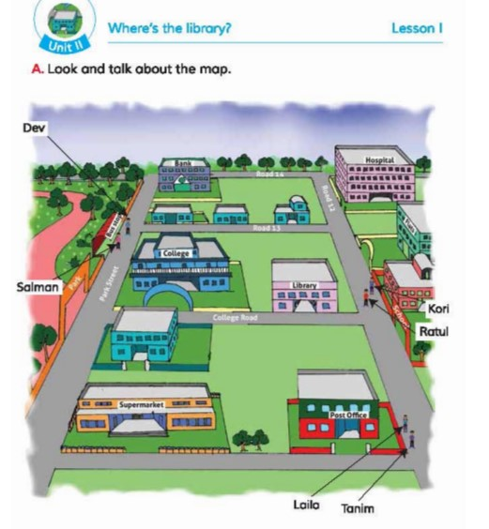
Think about the map
Discuses about the
following questions
with your partner.
1.How many people
are there in the map?
Where are they?
2.What kinds of
institute are there in
the map?

Slide 9
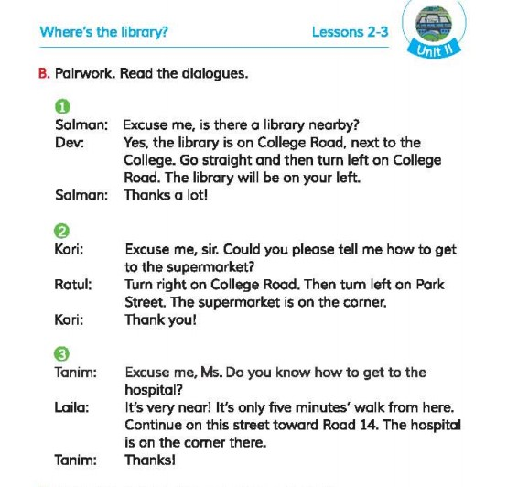
Now open your book at page 43
Lets read the text

Slide 10
Word Meaning
Word
Bangla Meaning
Similar Word
1.Nearby কাছাকাছি Neighbor
2.Straight সোজা Direct
3.Continue চালিয়ে যাওয়া Hold down
4.Toward দিকে Unto
5.Corner কোণে Nook

Slide 11
Pair Work
Ask and answer the questions.
1.Where is the school?
Ans: The school is on the road 12 and beside the flats.
2.Where is the post office?
Ans: Post office is beside the supermarket.
3.Where is the bank?
Ans: The bank is on the corner of the park street road.
4.Where is the bus stop?
Ans: Bus stop is on the park street road.

Slide 12
Group Work
Act the dialogue in your group.

Slide 13
Evaluation
Write the summery of the dialogue.
Ans: In the first dialogue, Dev is giving the location of the library
that it is in college road.In the second dialogue, In reply to Kori’s
question Ratul is giving the location of how to get to the super
market. In the last dialogue Tanim is asking for how to go to the
Hospital. Laila gives the location of the hospital.

Slide 14
Task
Write a directions from your home to your school.

Slide 15
Thank you and goodbye

