Slide 2
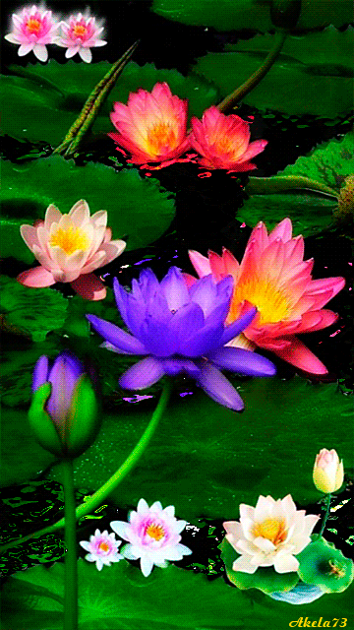
Welcome

Slide 3
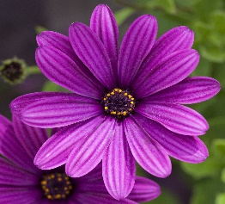
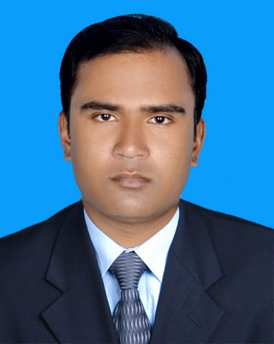
Presented by
Sujan Garja
Assistant teacher
Guimara Govt. Primary School
Guimara,Khagrachri

Slide 4
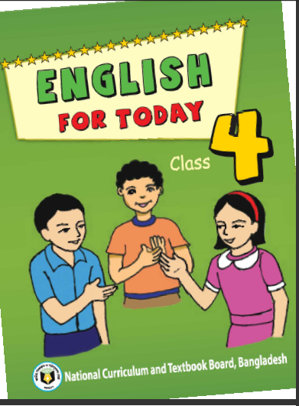
Lesson Identity
Class :Four
Subject:English
Unit:My trip
Lesson: A

Slide 5
Learning outcomes
Students will be able to -
Listening:
3.2.1 understand questions about family and friends of students.
3.3.1 understand questions about objects around them.
3.4.1 understand statements made by the teacher and students.
Speaking:
1.1.1 Repeat after the teacher and say words,phrases and sentences with proper sounds,stress and intonation.
Reading:
1.4.1 read words,phrases and sentences in the text with proper pronunciation,stess and intonation.
1.7.1 read short paragraphs dialogues and simple letters.
5.1.1 read silently with understanding paragraphs,stories and other text materials.

Slide 6
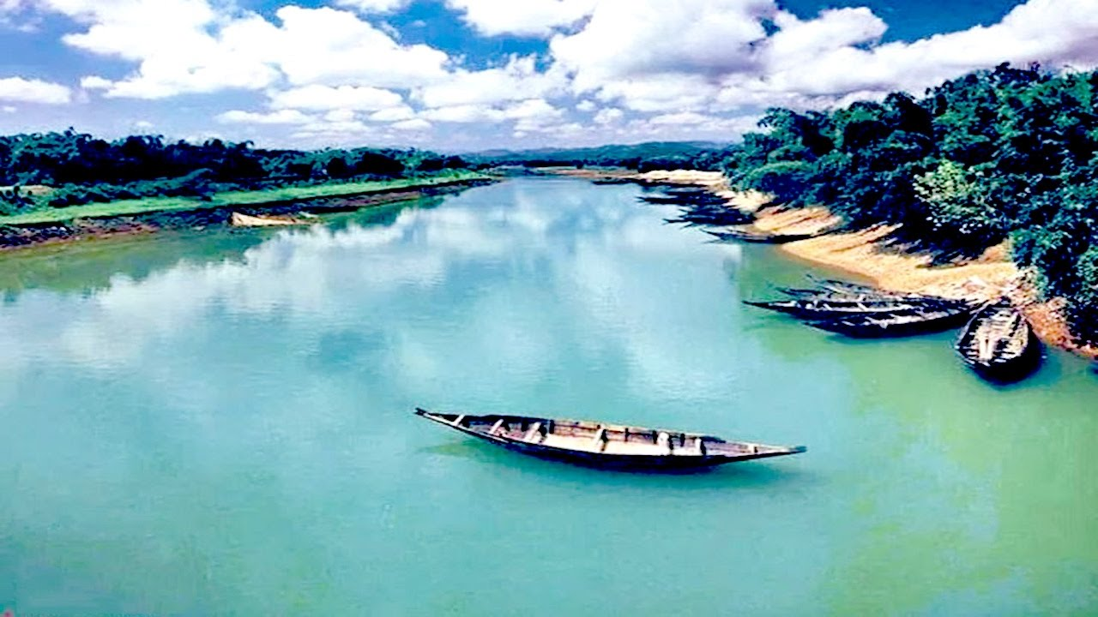
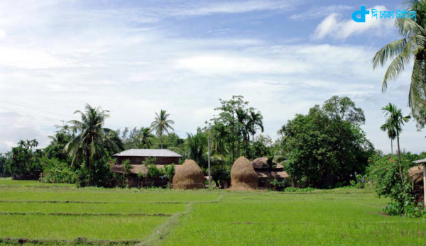
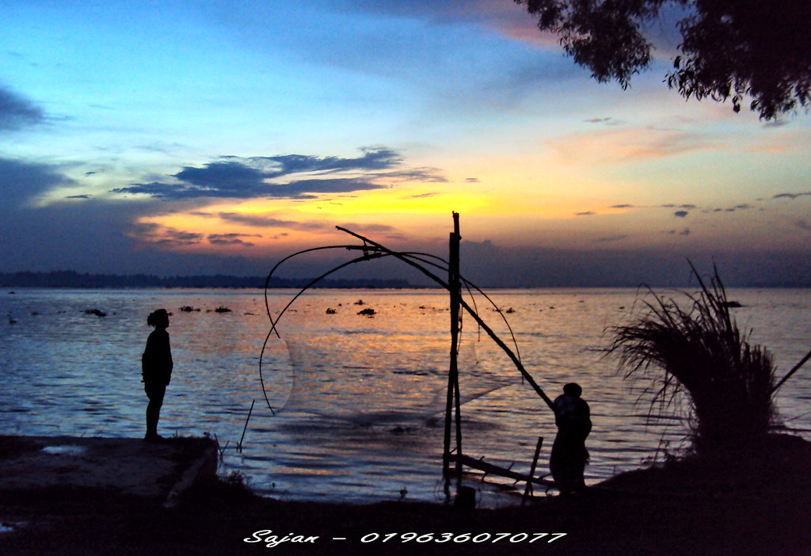
Look at the picture.
What can you see in this picture?

Slide 7
Answer the following questions:
Where are you live?
Did you go anywhere?
Where did you go?
What did you do there?

Slide 8
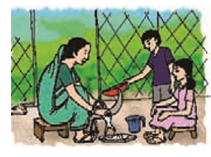
Today our new lesson is-
My Trip

Slide 9
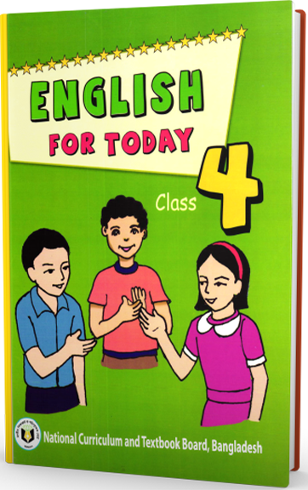
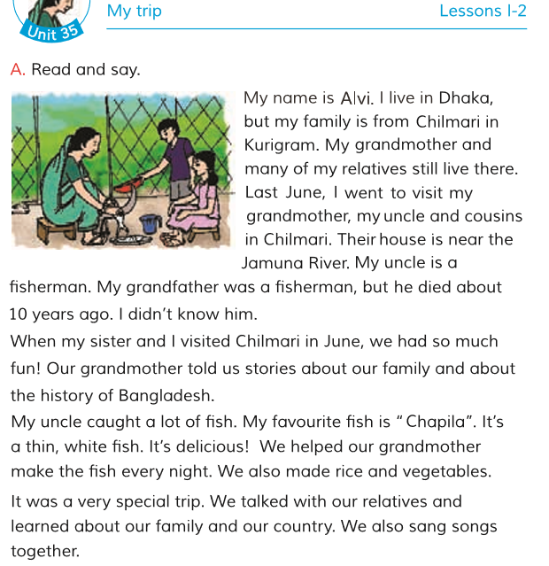
Open your book at page 70 .

Slide 10
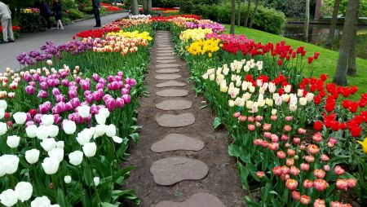
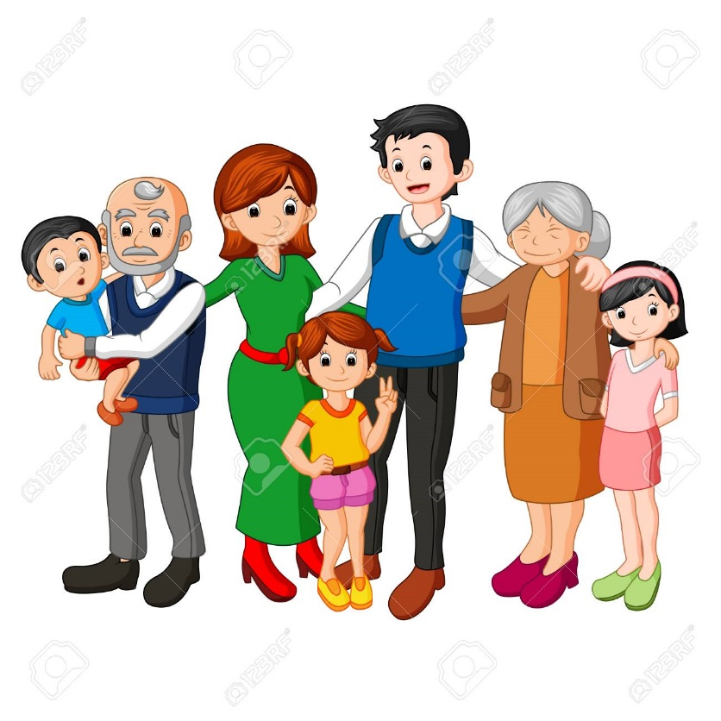
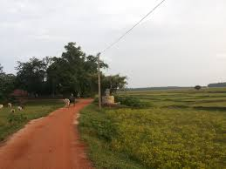
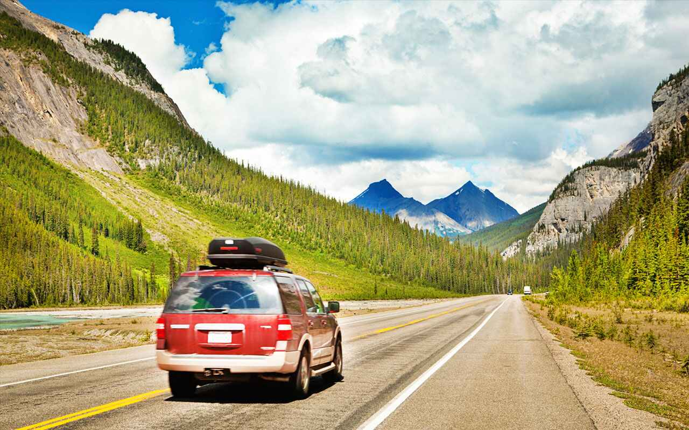
New word
Many
a large number
a lot of
Relatives
Persons connected by blood or marriage
Trip
a journey for a short time
Skip
Relations
There are many flower in the garden .
They are my relatives.
It was a special trip.

Slide 11
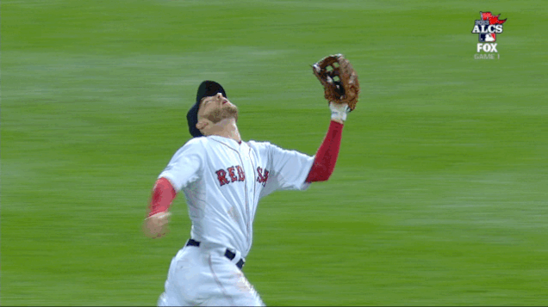
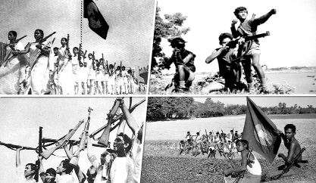
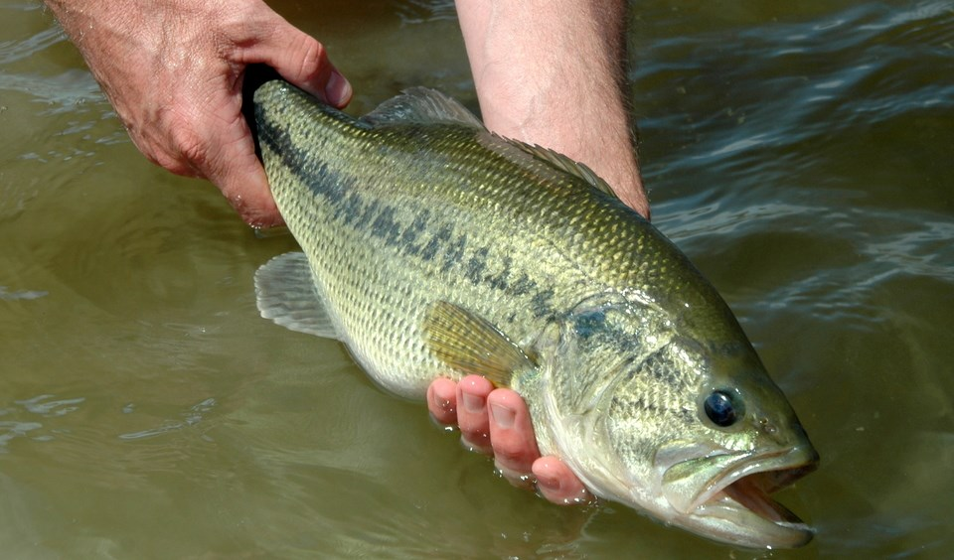
New word
The whole series of past events of a country,subject or person
History
Catch
hold
Together
In a body
We sang a song together.
My uncle catches fish.
She talked us about the history of Bangladesh.

Slide 12
Teacher’s reading
Students will listen the text .

Slide 13
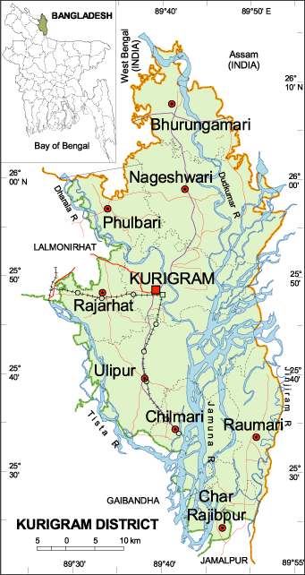
I am Alvi. I live in Dhaka but my family is from Chilmary in Narail.
My grandmother and many of my relatives still live there.
I went to visit my grandfather,my uncle and cousins in Chilmari.
Jamuna River

Slide 14
Look at the picture.
My uncle is a fisherman.
My grandfather was a fisherman but he died about 10 years ago.
Their house is near the Jamuna River.

Slide 15
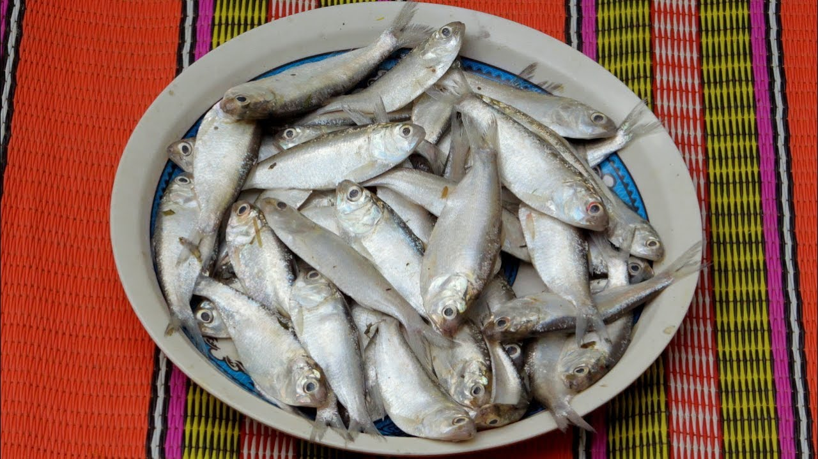
Look at the picture.
My uncle caught a lot of fish.
My favourite fish is “Chapila”.It’s a thin,white fish.It’s delicious!
We helped our grandmother make the fish every night.We also made rice and vegetables.

Slide 16
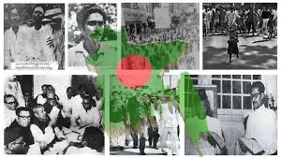
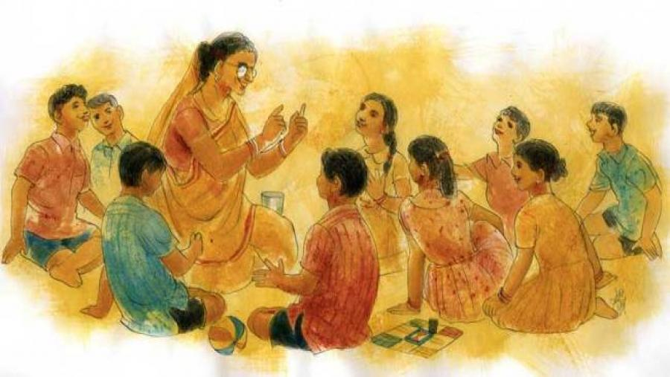
Look at the picture.
My grandmother told us stories about our family and about the history of Bangladesh.

Slide 17
It was a very special trip.
We talked with our relatives and learned about our family and our country.
We also sang song together.

Slide 18
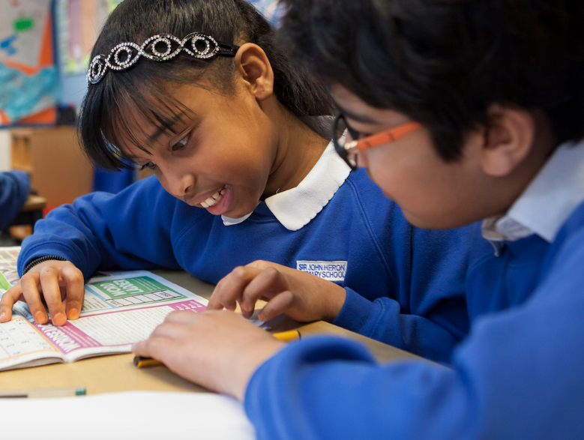
Pear work
Student reads the text in pear

Slide 19
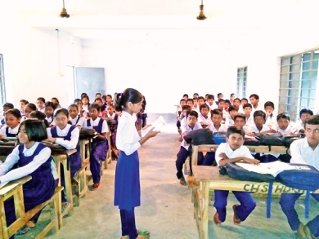
Student’s loud reading individually

Slide 20
Evalution
Answer the questions.
1. Where does Alvi live?
6. Ans. It was a very special trip because they talked with their relatives and learned about their family and their country.
3. Ans. He saw there his grandfather,his uncle and cousins .
2. Where did Alvi go?
5.Ans.He had so much fun! they listened story and they sang song together.
4. Ans. He went there with his sister.
3. Who did he see there?
2. Ans. Alvi went to Chilmari in Kurigram.
1.Ans. Alvi lives in Dhaka.
4. Who did he go with?
5. What did he do there?
6. What was special about this trip?

Slide 21
One day one word
Relatives
আত্বীয়
Many of my relatives live in village.

Slide 22
Home work
Write a paragraph about your trip.

Slide 23
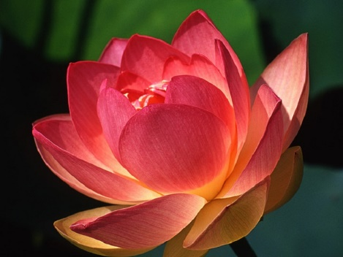
Thank you
Good bye….

