Slide 1
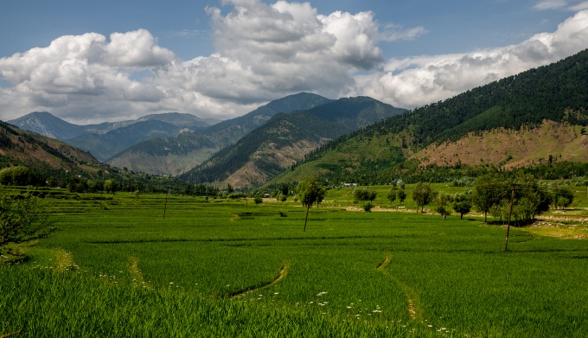
You are welcome

Slide 2
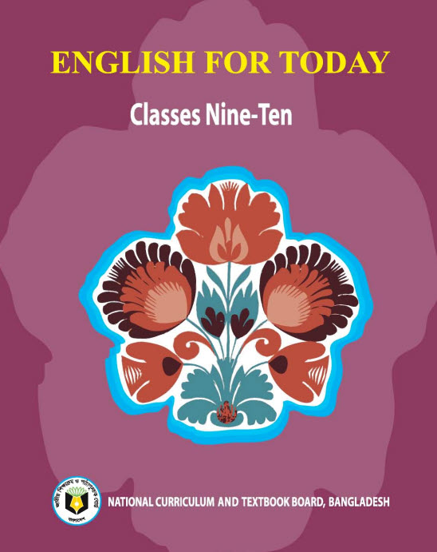
My introduction
Swandip Banerjee
Assistant Teacher (English)
Pallimangal Secondary School, Khulna.
E-mail: swandipb1@gmail.com
Mobile: 01718503573

Slide 3
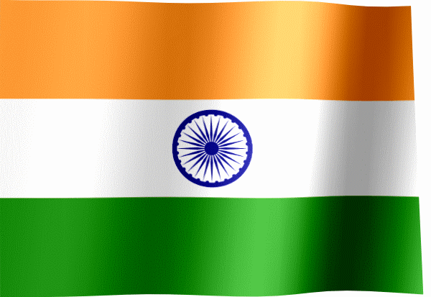
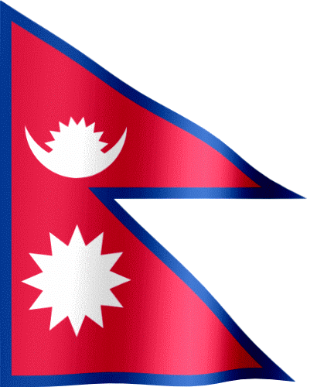
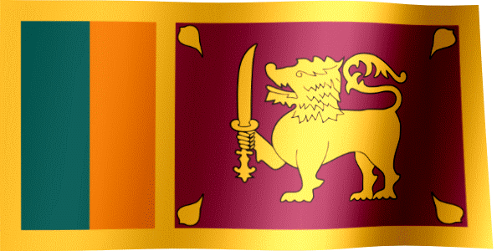
Let us see some national flags.
Of which countries’ flags are these?
Nepal
India
Maldives
Bhutan
Srilanka
They are our neighbour countries.
Notes:
There is trigger in each image. So, ask your students the name of the flags. If they fail, then click on the flag that u want to show.

Slide 4
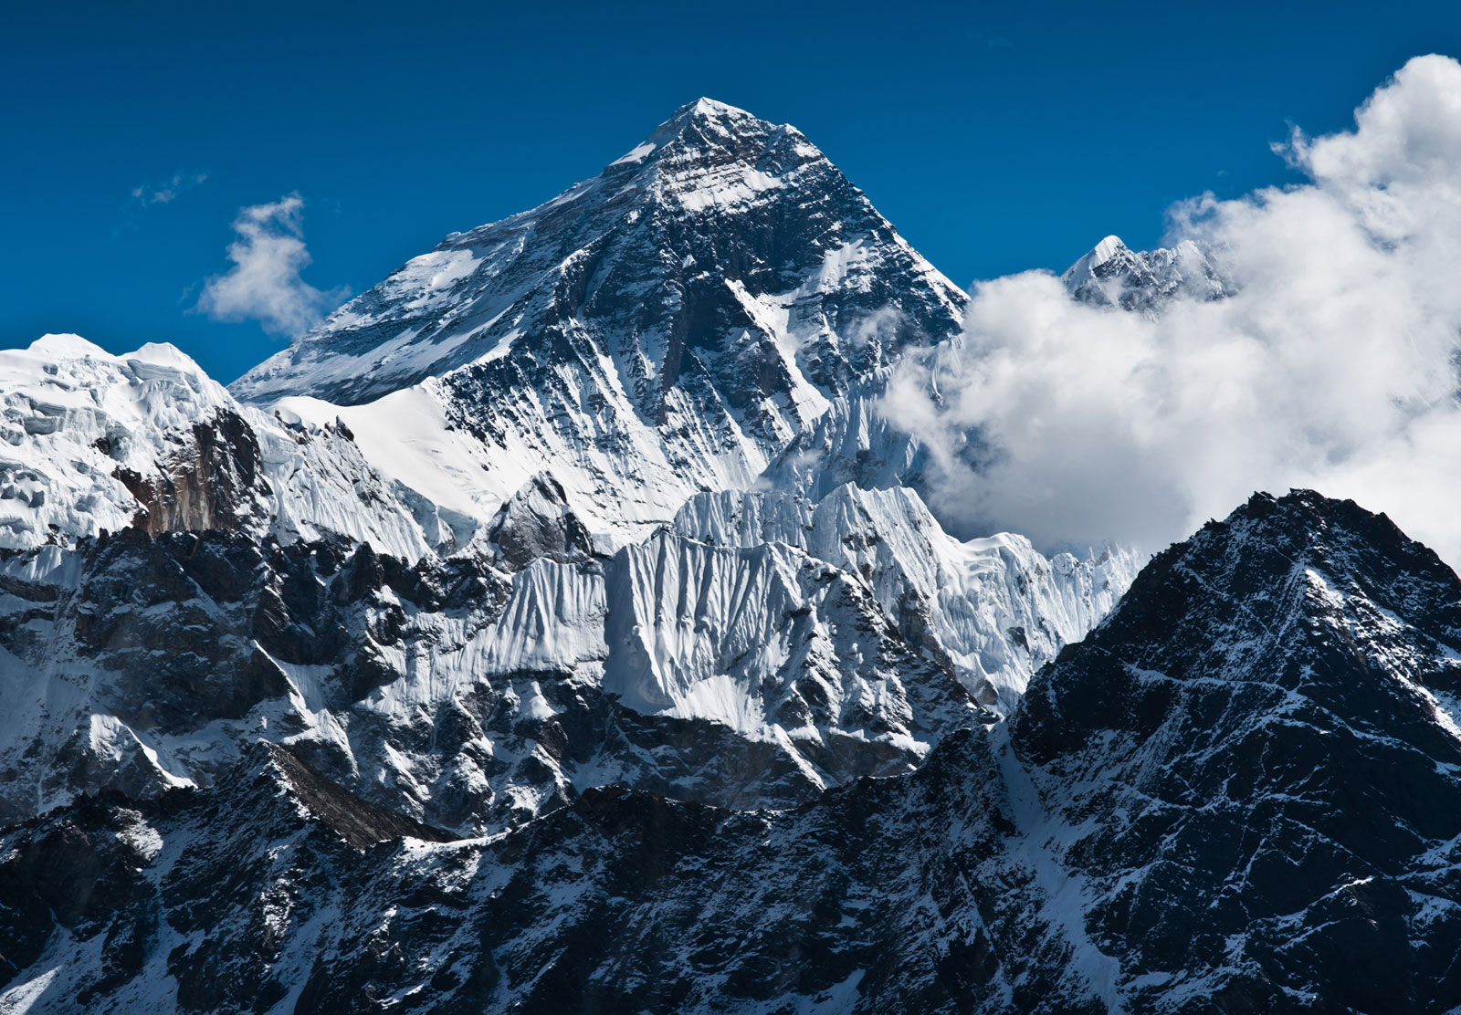
Look at this picture
Do you know the name of the highest peak of the world?
Mount Everest.
Where is it located?
In Nepal.

Slide 5
Our today’s topic of the class is…..???
Nepal, the land of Everest
Unit : 06
[Our Neighbours]
Lesson : 01

Slide 6
Learning outcomes
After the students have studied the lesson, they will be able to…………
read, comprehend and summaries texts.
ask and answer questions.
read travel ads and talk about them.
select and write headings.
write letters to friends describing places of interest.

Slide 7
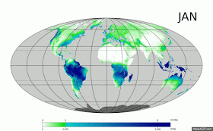
New word
Monsoon
A wind which blows in South Asia, bringing heavy rains in the summer.
Syn.: A periodical wind of the Indian Ocean
Notes:
At first teacher will show the words then ask his/her students to tell the meaning and making sentences. If they fail teacher will show the picture again. For feedback click on meaning button.

Slide 8
New word
Ethnic
Relating to a particular racial or tribal group of people.
Syn.: tribal

Slide 9
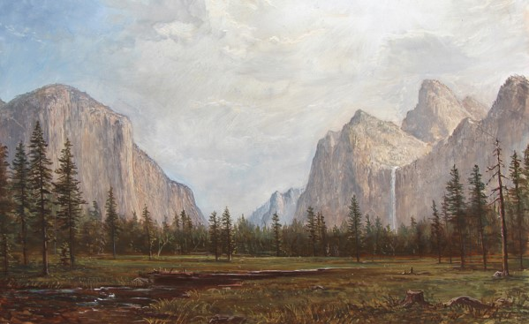
New word
Sublime
Any thing that looks at the best or most excellent kind.
Syn.: majestic, lofty
Notes:
At first teacher will show the words then ask his/her students to tell the meaning and making sentences. If they fail teacher will show the picture again. For feedback click on meaning button.

Slide 10
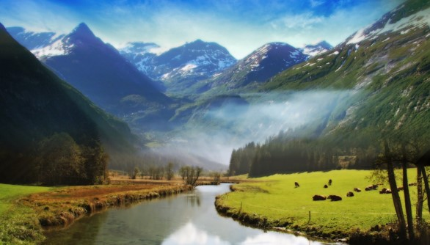
New word
Valley
Low land between hills or mountains often with a river.
Syn.: canyon

Slide 11
New word
Charming
Very pleasant and attractive.
Syn.: wonderful, pleasant
Notes:
At first teacher will show the words then ask his/her students to tell the meaning and making sentences. If they fail teacher will show the picture again. For feedback click on meaning button.

Slide 12
A. Read the following passage on Nepal.
a) Known as the Land of Everest, Nepal is one of the most charming countries in Asia. It is also known as the only Hindu Kingdom in the world. The Kingdom of Nepal is a small land of sublime beauty. It has some of the world’s best and very important temples. It is a country that is rich in scenic beauty and cultural heritage.
B
C
D

Slide 13
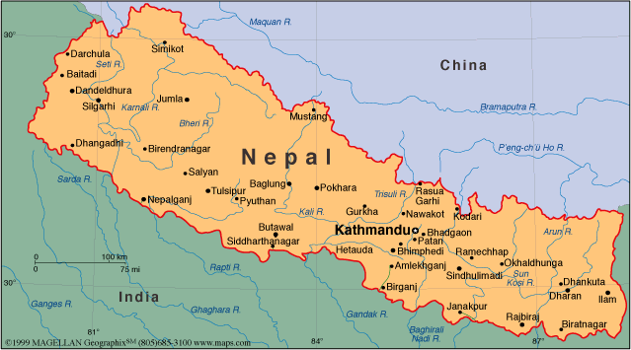
b) Nepal lies between India and the Tibetan part of China. This small country has an area of 147,181 square kilometers. Southern Nepal is tropical lowland known as the Tarai Plain. This part of Nepal has hot summers and warm winters. Here the temperatures reach up to 40°C in April and May and monsoon rains drench this region from June to. September. The central
hill-lands including the Kathmandu and Pokhara valleys have a temperate climate and are also influenced by the monsoon. North of that is the slope of the main section of the Himalayan range. This part of Nepal has some of the highest peaks of the world including Everest.
B
C
D

Slide 14
c) Nepal is home to nearly 29,000,000 people. The population is primarily rural. Kathmandu, the capital city, has less than one million inhabitants. Nepal's demographic features are complicated not only by dozens of ethnic groups, but by different castes. In total, there are 103 castes and ethnic groups living in this small country. The two largest of such groups are known as Chetri and Bahun. Others include Magar, Tharu and Tamang, Newar, Muslim, Gurung and Damai. About 48 percent of the people speak Nepali. Among other languages spoken are Maithali, Bhojpuri, Tharu and Tamang.
d) Nepal is the holy land of Lord Pashupatinath and Gautam Buddha where the Hindus and Buddhists have lived together in harmony for centuries. The Temple of Pashupatinath is the most sacred Hindu shrine and one of the four most important cities in the world for Shiva worshippers. Lord Buddha, the light of Asia, was born in Lumbini in Nepal’s southern plains, which makes this a scared pilgrimage destination for the Buddhists as well. In fact, many Nepalese combine Hindu and Buddhist practices; many temples and shrines are shared between the two faiths, and some deities are worshipped by both Hindus and Buddhists.
B
C
D

Slide 15
e) The Kathmandu Valley is the rich cultural heritage centre of Nepal. The three ancient cities of the Valley- Patan, Kathmandu and Bhaktapur- represent an epitome of harmony in urban design, elegant architecture and refined culture. These cities are famous for religious monuments unequalled in the world. The seven monument zones situated within the Valley have been named as World Heritage Sites by UNESCO.
f) Adding dazzling colour to Nepal’s vibrant culture are the many festivals that are celebrated throughout the year. Dasain or dusherra is celebrated nationwide in October. Thes is the most important of all Nepalese celebration and includes the biggest animal sacrifice of the year. Tihar is celebrated in November. Other festivals include the Holi and Chaitra Daisan. Some Hindu festivals are the Haribodhini Ekadashi, Maha Sivaratri and the Krishna Jayanti. There are Buddhist celebration too and those include Mani Rimd, Buddha Jayanti and Losar which marks the Tibetan New Year.
B
C
D

Slide 16
B. The passage has six paragraphs (a-f). Choose the most suitable headings for paragraphs (a-f) from the list of headings below. There are more headings in the box than the paragraphs, so you will not use all of them.
List of headings.
1. Climate that varies from place to place
2. A land of religious coexistence
3. A land of high peaks and Everest
4. A small country with huge population
5. A blend of natural beauty and cultural heritage
6. The temples of Nepal
7. Many occasions to celebrate
8. A rich spot of cultural heritage
9. A small population with huge diversity
B . Climate that varies from place to place
D . A land of religious coexistence
In short.
(a ➔ 5)
(a ➔ 5)
(a ➔ 5)
(a ➔ 5)
(a ➔ 5)
A . A blend of natural beauty and cultural heritage
F . Many occasions to celebrate
E . A rich spot of cultural heritage
C . A small population with huge diversity
Text

Slide 17
c) For each phrase below choose the meaning that is closest to the meaning used in the passage.
1. tropical lowland
a) an area of land having humid climate
b) a land situated on the hill
c) a low-land close to river
d) a land that lies at the foot of a hill
2. temperate climate
a) a weather condition of high temperature
b) a moderate climate
c) a climate with high rainfall
d) a climate that is uncomfortable to live in
a) an area of land having humid climate
b) a moderate climate
Text

Slide 18
3. Ethnic groups
a) groups based on their religious faiths
b) groups of people living in the hills-tracts
c) groups having distinct racial and cultural features
d) groups who believe in Buddhism
4. pilgrimage destination
a) a sacred place where people travel to perform religious rites.
b) a historical place with many old buildings.
c) a tourist spot of great scenic beauty.
d) the birthplace of a famous person.
5. elegant architecture
a) temples of gods
b) graceful work of building crafts
c) buildings of historical importance
d) well-designed area of cultural acts
c) groups having distinct racial and cultural features
a) a sacred place where people travel to perform religious rites.
b) graceful work of building crafts
Text

Slide 19
D. Answer the following questions in group.
1. How many ethnic groups are there in Nepal?
2. What do you know about the weather of Nepal?
3. “Many Nepalese combine Hindu and Buddhist practices.”- Explain this statement with example from the passage.
4. Which three cities of Nepal will you visit in order to see the rich samples of Nepal’s cultural heritage sites of Nepal?
5. Make a list of the festivals that are celebrated in Nepal.
6. Give at least three reasons why you might be interested to visit Nepal. Also make a list of the places you would love to visit in Nepal.
Text

Slide 20
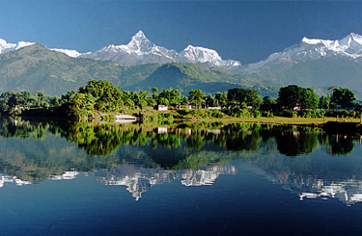
E. Look at the advertisement of a package tour to Nepal.
Dhaka-Kathmandu-Pokhara Package Tour
Price: BDT 39,999/
Duration: 4 nights and 5 days
Package Includes:
Return Air Ticket with Bangladesh Airport taxes & Kathmandu departure taxes.
2 nights accommodation in Kathmandu
2 nights accommodation in Pokhara
Buffet: Daily Breakfast and Lunch
Both way Airport transfers in Kathmandu
Kathmandu-Pokhara-Kathmandu by A/C Bus
Half day sightseeing in Kathmandu Valley

Slide 21
Now, discuss if the statements are true/false. Give the correct information if a statement is false.
Chart
a. The package includes the cost of travelling from Kathmandu airport to the hotel in Kathmandu.
b. The tourists will be provided with breakfast, lunch and dinner.
c. The tourists do not have to pay extra for a half-day sightseeing in Pokhara.
d. The tour operators will bear all visa related costs.
e. The tourists will go to Pokhara from Kathmandu by domestic flights.
A. True
B. False. Only breakfast & launch will be provided.
C. False. The tourists do not have to pay extra for a half- day sightseeing in Kathmandu.
D. False. The operators will bear Bangladesh air port taxes and Kathmandu departure taxes.
E. False. They will go by AC bus.

Slide 22
Evaluation
How many castes and ethnic groups live in Nepal?
How many people live in Kathmandu?
What is the total area of Nepal?
Where does Nepal lie?
What is the capital of Nepal?

Slide 23
HOME WORK
F: Imagine that you have chosen the package tour shown in E to visit Kathmandu and Pokhara. Now, write a letter to you friend highlighting the main attractions offered by the package. In your letter you should cover the following points:
Duration of travel
Means of transports used:
1) Dhaka-Kathmandu-Dhaka
2)Kathmandu-Pokhara-Kahtmandu
Accommodation facilities
Breakfast, lunch and dinner
Total cost of the package
Any other cost that is not covered by the package offer

Slide 24
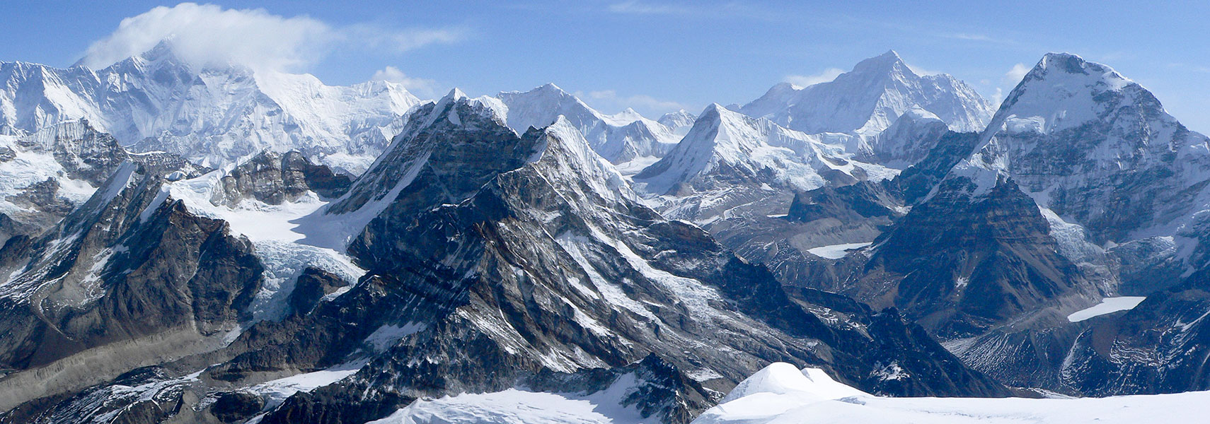
Thank you all.

