Slide 2
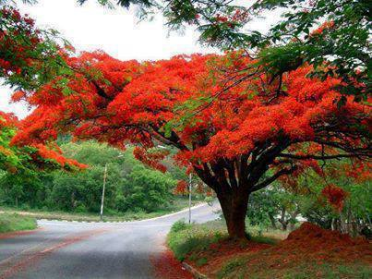
Welcome
to
all
in
my
Class.

Slide 3
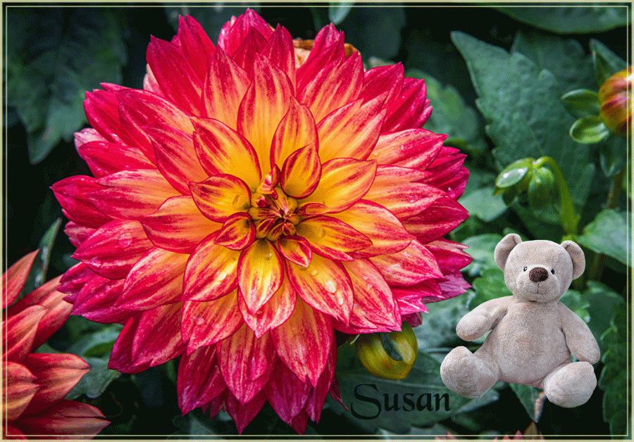
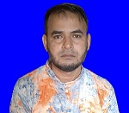
Teacher Introducing
Md Shamsunnoor
Head Teacher
Murergaon Govt. Primary school
Companiganj, Sylhet
Mobile : 01712-307039
Email : shadmanheya@gmail.com

Slide 4
Lesson Identity
Class Five
Subject : English for today
Part of the lesson : Activity F
Time : 40 minute

Slide 5
Learning outcomes
At the end of the lesson students will be able to-
5.1.4 read silently with understanding personal letters and other texts meterials.
Reading
8.1.1 make sentences using words and phrases given in the textbook.
writing

Slide 6
Greetings
Good morning, students.
How are you all ?

Slide 7
Warm up activity
what is your aim in life ?
what is your plan to reach there ?

Slide 8
Let’s we sing a song.
https://www.youtube.com/watch?v=ih54sv4CG3s

Slide 9
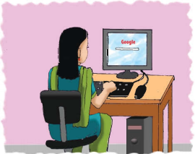
Justifying previous knowledge
What is your impression about this picture ?
What is Maria doing in the picture ?
How can she operate Computer ?
We know about Maria’s dream for the future by questions.

Slide 10
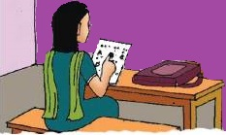
Today’s lesson
Life is Beautiful!
Lessons : 7-8 (7th period)
Part of the lesson : Activity F
Unit : 20
Page : 81

Slide 11
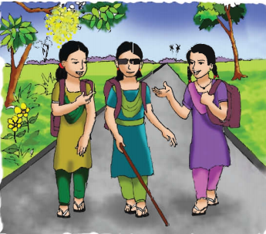
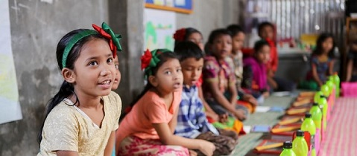
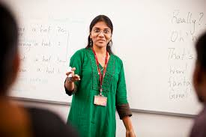
Presenting the lesson
Activity F :
Read the job descriptions . Complete the sentences with a word from the box.
Maria

Slide 12
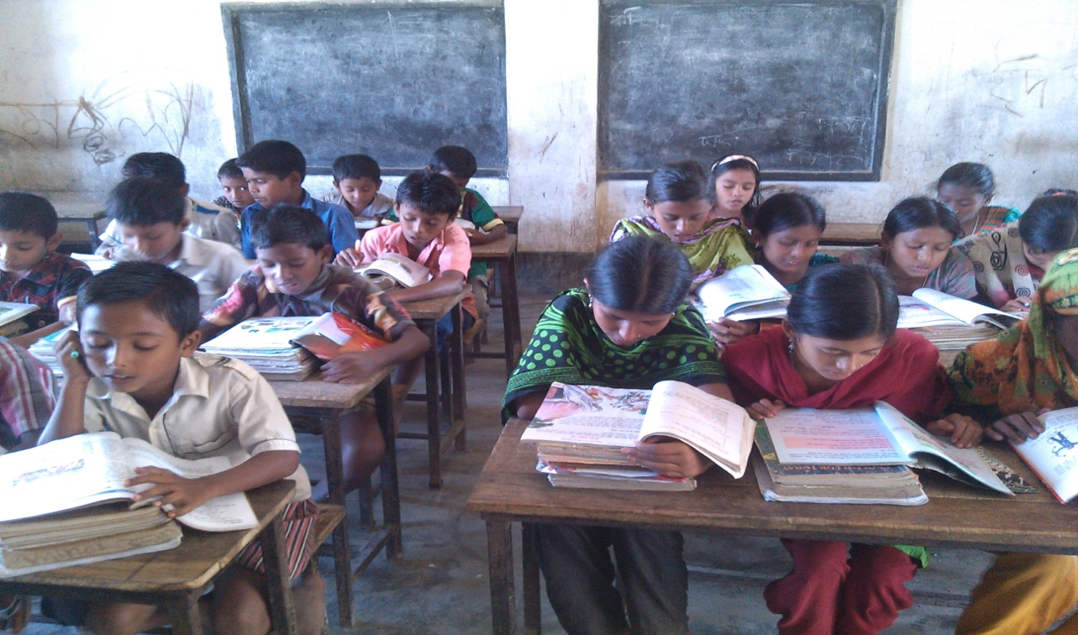
Silent reading

Slide 13
New Words
Meaning Bengali
Business person
ব্যবসায়ী ব্যক্তি
Computer engineer
কম্পিউটার প্রকৌশলী
Doctor
চিকিৎসক
farmer
কৃষক
Pilot
বৈমানিক
Teacher
শিক্ষক

Slide 14
Business person
Computer engineer
Doctor
Farmer
Pilot
teacher
(1 A) ……………works in a school. Children learn how to read and
write from this person
(2 A) ………………..…………studies computer science and can fix
computers.
(3 A) ……………...looks after ill people and helps them to
become healthy.
(4 A) ……….flies planes. He or she travels around the world.
(5 A) ……………grows crops, such as rice. We get our food from this
person.
(6 A) ……………………buys and sells things in Bangladesh or in
other countries.

Slide 15
Match the words in column A with their meanings in column B. Two extra meanings are gives in column B.
Column A
Column B
(i) hope
(i) proposal.
(ii) goals
(ii) To become an adult.
(iii) show
(ii To want something to happned i) .
(iv) targe.
(iv) future
(v) To prove that you can do something.
(v) agree
(vi) Feeling or showing pleasure or joy.
(vii) coming.

Slide 16
Re-arrange the words in the appropriate order to make meaningful sentences.
(e) gets, early, Maria, up
(a) Cannot, beautiful, day, Maria, the, spring, see
(b) beautiful, day, spring, it’s, a
Answer : Maria cannot see the beautiful spring day.
(c) smell, outside, home, she, flowers, can, her, the
Answer : Maria gets up early.
(d) cannot, new, on, trees, the, she, leaves, see, the, green
Answer : It’s a beautiful spring day.
Answer : She can smell the flowers outside her home.
Answer : She cannot see the new green leaves on the trees.

Slide 17
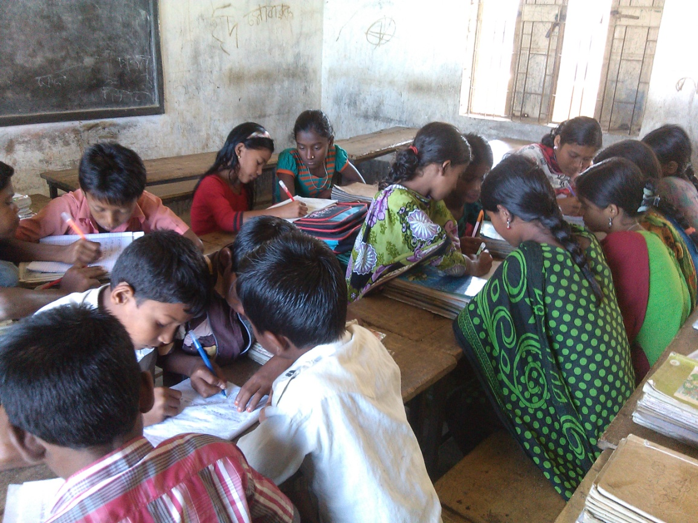
Group work
Re-arrange the words in the appropriate order to make meaningful sentences.
(a) Cannot, beautiful, day, Maria, the, spring, see
(b) beautiful, day, spring, it’s, a
(c) smell, outside, home, she, flowers, can, her, the
(d) cannot, new, on, trees, the, she, leaves, see, the, green

Slide 18
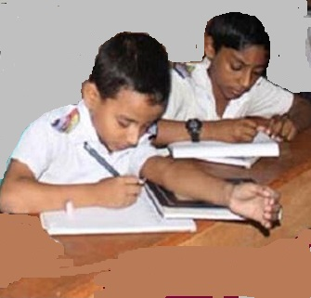
pair work
Business person
Computer engineer
Doctor
Farmer
teacher
Pilot
(1) ……………works in a school. Children learn how to read and
write from this person
(2) ………………..…………studies computer science and can fix
computers.
(3) ……………...looks after ill people and helps them to
become healthy.
(4) ……….flies planes. He or she travels around the world.

Slide 19
Evalution
(a) to, Why, this, want, does, she, write book
(b) beautiful, day, spring, it’s, a

Slide 20
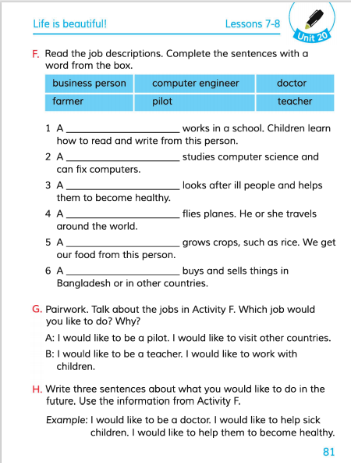
Connection with EFT Book.

Slide 21
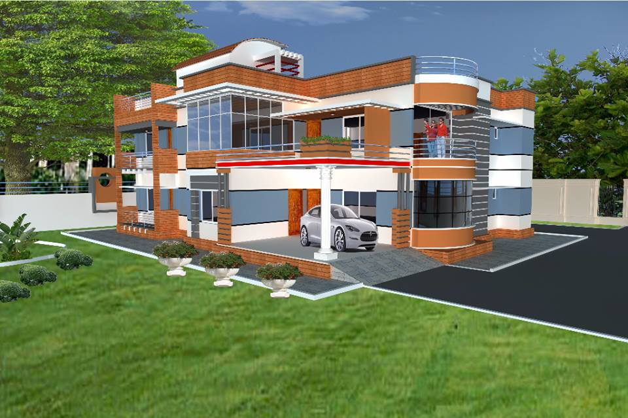
Home work
Write a short composition about ‘ Your’s goals for the future‘.
(At least five sentences).

Slide 22
Thanks everybody.
See you again.
Bye Bye

Slide 23
END
OF
THE
LESSON

