Slide 2
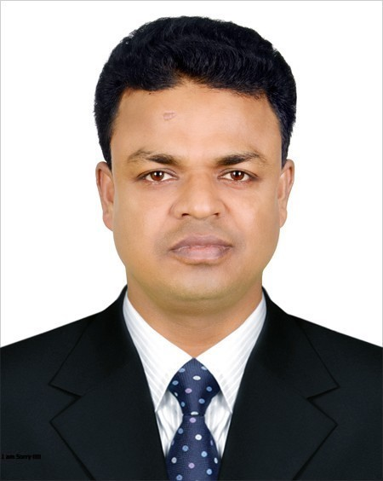
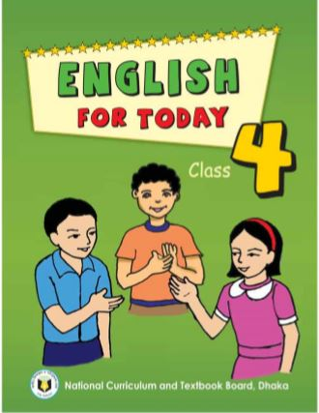
INTRODUCING
Md. Shakhawat Hossen
Assistant Teacher
Pakuria Government Primary School
Singra, Natore
E-mail: shakhawathossengps@gmail.com
Mobile: 01724025641
Class – Four
Subject: English For Today
Heading of the lesson: A garment worker’s day
Reshma…………other things.

Slide 3
Learning Outcomes...
Students will be able to...
L
1.1.1
recognize sound differences in the context of words.
S 3.1.1
ask and answer Wh questions.
R 1.4.1
read words, phrases and sentences in the text.
W 10.2.1
write a short composition about oneself, friends, family and other familiar topics.

Slide 4
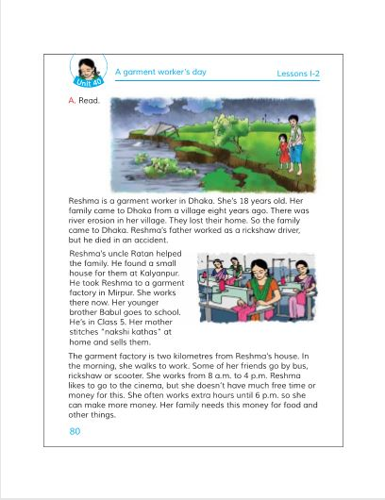
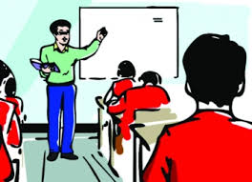
Teacher’s reading

Slide 5
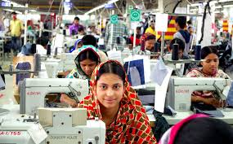
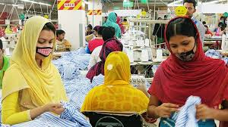
Reshma is a garment worker in Dhaka. She is 18 years old.

Slide 6
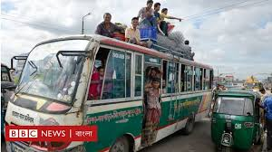
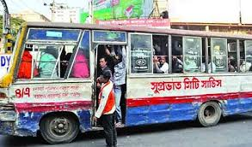
Her family came to Dhaka from a village eight years ago.

Slide 7
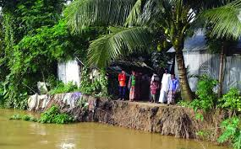
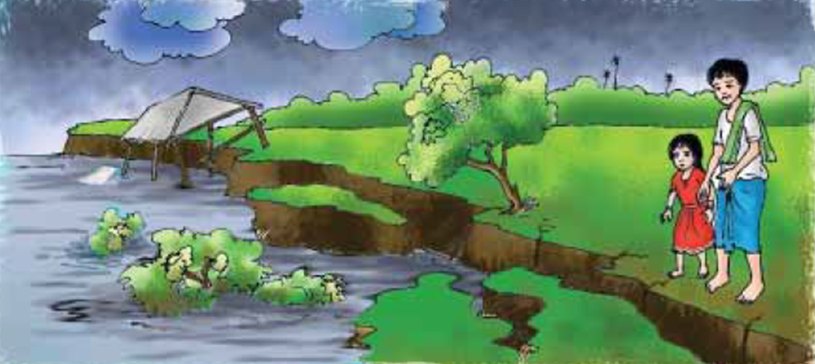
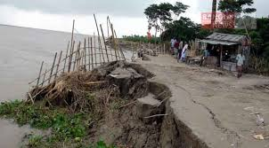
There was river erosion in their village. They lost their home. So the family came to Dhaka.

Slide 8
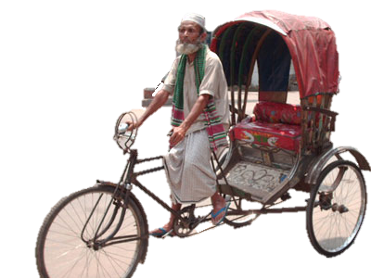
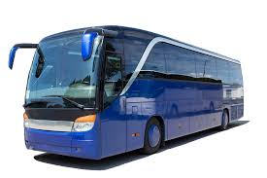
Reshma’s father worked as a rickshaw driver,
but he died in an accident.

Slide 9
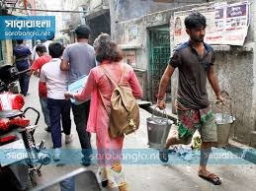
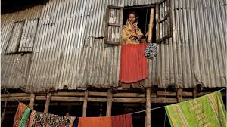
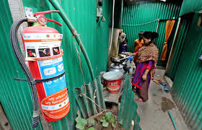
Reshma’s uncle Ratan helped the family. He found a small house for them at Kalyanpur.

Slide 10
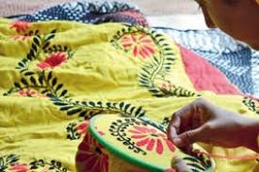
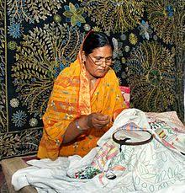
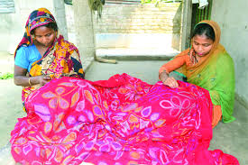
Her mother stitches “Nakshi kathas” at home and sells them.

Slide 11
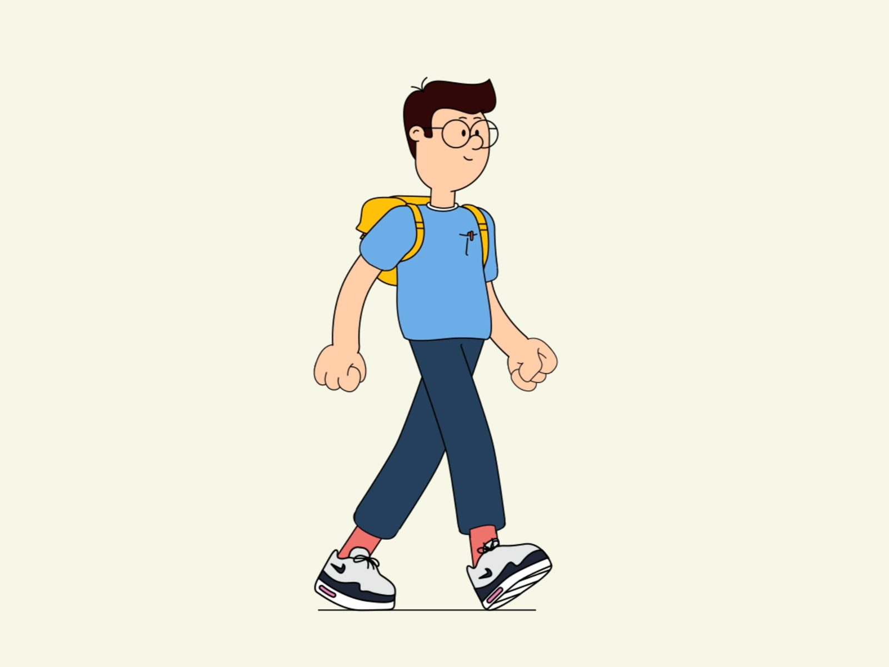
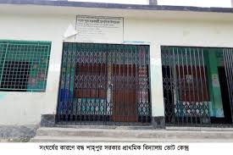
সরকারি প্রাথমিক বিদ্যালয়
Her younger brother Babul goes to school. He’s in class 5.

Slide 12
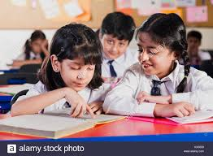
Students’s reading

Slide 13
Let’s watch a video

Slide 15
Group Work
Ans:
1. Who is 18 years old ?
2. Who helped the family ?
3. What does her mother stitch at home ?
Wh Questions:
1. Reshma is 18 years old.
2. Ratan helped the family.
3. Her mother stitches “Nakshi Kathas” at home.

Slide 16
Mention True or false:
1. Reshma is a student.
True
Your answer is correct
False
Your answer is incorrect
2. Reshma lives in a small house at Kalyanpur.
True
False
Your answer is correct
Your answer is incorrect
3. Babul is in class 4.
Your answer is correct
True
False
Your answer is incorrect

Slide 17
Composition Writing:
*Write a short composition about “A boy” in your locality by answering the following questions .
What is his name?
When does he get up?
What does he do in the morning?
Why does he do it?
Do you respect him?

Slide 18
Home work
1. Write a short composition about “A garment worker”.

