Slide 1

Wellcome to
My class

Slide 2
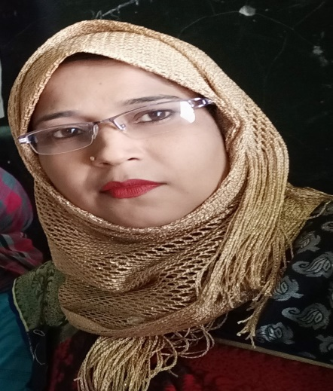

Lesson Identity
Class:two
Subject: English
Lesson:4-6
Unit:Five ( c )
Presented by
Nasima Akter
Assistant Teacher
Chatia Chala Govt.Primary school.
Sakhipur,Tangail.

Slide 3
Let,s see the video

Slide 4


Today’s Lesson
Alphabet
(Uu-Zz)

Slide 5
Learning Outcomes
By the end of the lesson the students will be able to----------------
Say simple words and phrases with proper sounds and stress.
Read word and phrases with help of visual clues(about 30 new words) and simple sentences.
.Write non-cursive small letters.

Slide 6
One day one word:
Today’s word is -
Family=
পরিবার
Sentence: I live my family.

Slide 7
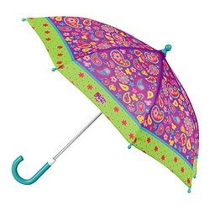
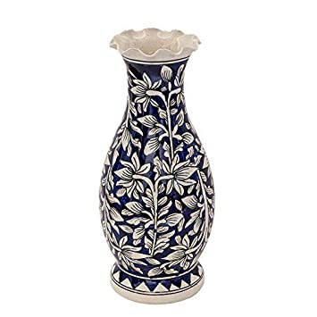


Now look at the picture.Say loudly
Umbrella
Vase

Slide 8

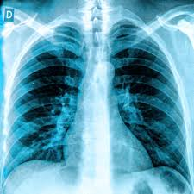
Now look at the picture.Say loudly
window
X-ray

Slide 9

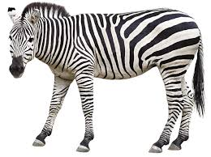
Now look at the picture.Say loudly
Yo-yo
zebra

Slide 10
Dear students,open at page 11 of your book and look activity c.

Slide 11

Loud reading by the teacher
U
X
umbrella
X-ray
V
vase
Y
Yo-yo
Z
W
window
zebra

Slide 12






I W
Look at the picture and fill in the gaps.
zebra
vase
umbrella
Yo-yo
X-ray
window

Slide 13
Match the words with the letter
Pair Work
Uu
vase
Vv
X-ray
Ww
umbrella
Xx
Yo-yo
Yy
window
Zz
zebra

Slide 14




Evaluation
What is this?
What is this?
What is this?

Slide 15


Evaluation
Fill in the blank.

Slide 16
Evaluation
Fill in the blanks by small letter.
U
,V
,W
,X
,Y
,Z

Slide 17
Home work
The students will write
umbrella,vase,window,
X-ray,yoyo,zebra.

Slide 18

Good bye students.

