Slide 1
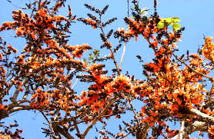
WEL COME

Slide 2
INTRODUCTION
Md. Juyel Ahmed
Assistant Teacher Sreekrishnapur Dilalpur Gps
Chhatak Sunamgonj
Class: Five
Subject: English
Unite: 7, Lesson: 1-2
Time: 45 minutes

Slide 3
Learning outcomes
By end of the lesson students be able to--
1.2.1 Recognize which syllable in a word in stressed.
1.3.1 Recognize which words in a sentences are stressed.
1.1.1 Say words, phrases and sentences with proper sound and stress.
1.5.1 Read words, phrases and sentences in the text with proper pronunciation, stress and intonation.

Slide 4
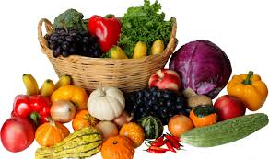
Now try to say about the bellow picture
Why do we eat this food?
If we eat this food, we will be healthy.

Slide 5
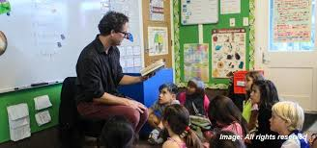
Teacher’s reading and discuss about the lesson.
Open your EFT book at page 26

Slide 6
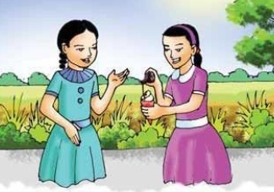
I am putting some chocolate on my ice-cream. Ice-cream is delicious with chocolate
What are you doing, Nasreen?
Sima
Nasreen

Slide 7
Of course! I don’t eat them regularly.
Well, it looks good, but you shouldn’t eat a lot of chocolate or ice-cream
Sima
Nasreen

Slide 8
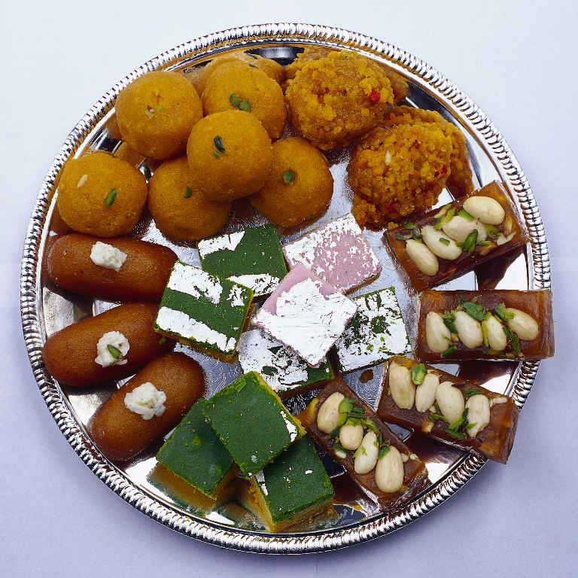
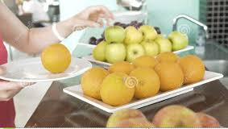
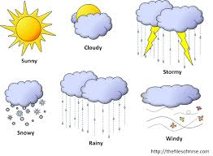
Individual work
Some new words and meaning
Delicious
Tasty
Putting
Placing
Weather
Climate

Slide 9
Pair work
Answer to the following questions-
1.What is Sima’s favourite food?
2.What does Nasreen eat a lot?

Slide 10
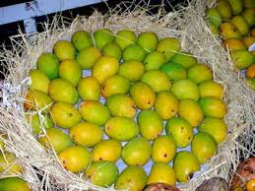
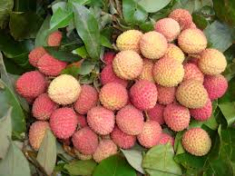
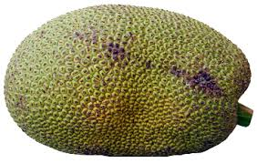
Group work
Group mango
Group lichi
Group jackfruit
Write 10 foods name of each group.

Slide 11
Evaluation
Fill in the blanks
1. What are you doing, -----------?
2. I love pineapples and ---------.
3. I eat ------ and vegetables everyday.
4. We should ----- it quickly.
5. Carrots and ----- are my favourite.

Slide 12
Thank you

