Slide 1

Welcome
to
everybody

Slide 2

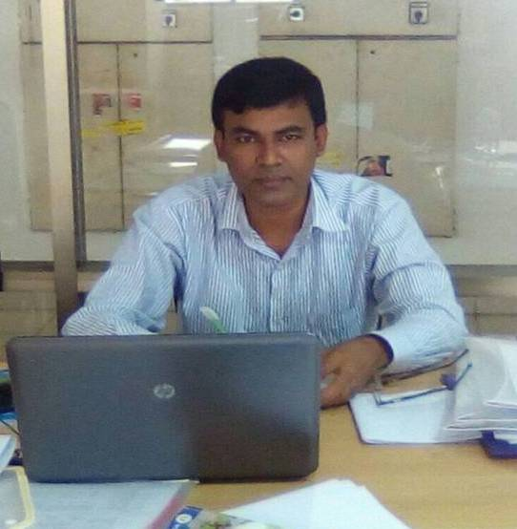
Mohammad Faruk Ahmed Mazumder
Assistant teacher
Malora Government Primary School
Shahrasti,Chandpur.
01715458523
E-mail:farukt1979@gmail.com

Slide 3
Identity of the lesson
Subject: English For Today
Class 3
Unit: 15- Names of the days and months
Lesson: 4-5(Names of the days and months)
Date: 16-06-2019
Time:40 minutes
Page: 30

Slide 4
Look at the picture
What can you see in the picture?

Slide 5
Today we are going to start a new lesson.
Names of the days and months

Slide 7
What do you see in the calendar ?
Answer: At first the name of the month and then the name of the day.

Slide 8
Names of the days
Saturday
Sunday
Monday
Tuesday
Wednesday
Thursday
Friday

Slide 9
Names of the month
January
February
March
April
May
June
July
August
September
October
November
December

Slide 10
Months as ordinals
1st
January
7th
July
2nd
February
8th
August
3rd
March
9th
September
4th
April
10th
October
5th
May
11th
November
6th
June
12th
December

Slide 11

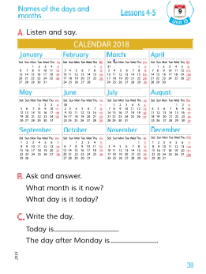
Everybody take your EFT book
and
open page at 30

Slide 12
Rearrange the months
July
December
March
January
June
September
November
May
October
February
April
August

Slide 13
What day is today ?
What day is today ?
Today is Sunday.
What day is today ?
Today is Sunday.
Today is Sunday.
Chain drill

Slide 14
What month is it now?
What month is it now?
What month is it now?
Now it is June.
Now it is June.
Now it is June.
Chain drill

Slide 15
What month is it now?
Now it is June
It’s July
What month comes after it ?
Pair work

Slide 16
Oneday one word
Month
মাস
There are twelve months in a year.

Slide 17

Goodbye

