Slide 2
Md. Mominul Islam
Head Teacher
Ishanpur GPS.
Kaharol. Dinajpur
01717977443
mominict9@gmail.com

Slide 3
Class : Five
Subject : English
Unit : 20
Lesson : 1-2 A
(It’s a – for school)

Slide 4
Learning outcomes:
After finishing the lesson students will be able to……..
1.5.1 read words, phrases and sentences in the text
with proper pronunciation, stress and intonation.
3.3.1understand questions about objects around them.
3.4.1 understand statements made by the teacher and
Students.
5.1.1 read silently with understanding paragraph.
3.1.2 write, words, phrases and sentences using
non-cursive small letters.

Slide 5
What can we see at the picture..

Slide 7
Life is beautiful.
Tday’s
lesson

Slide 8
Open your book at page 79.

Slide 9
New words:
Word | Meaning
Spring | Name of the season
Smell | Flavor
Dressed | Wearing
Warm | Hot

Slide 10
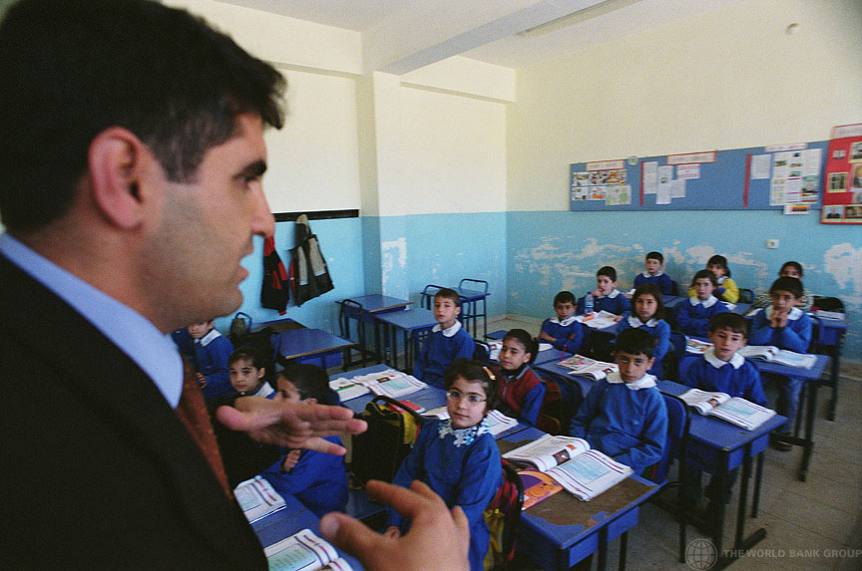
It’s a beautiful spring day. Maria gets up early. She feels happy. She knows that it’s a nice day because she puts her hand on the glass of the window. It is very warm. She opens the window and the singing of the birds fills the room. She can smell the flowers outside her home. They smell sweet and fresh. After Maria gets dressed and has her breakfast, she puts her books in her bag. She is ready for school.
Teacher’s
reading.

Slide 11
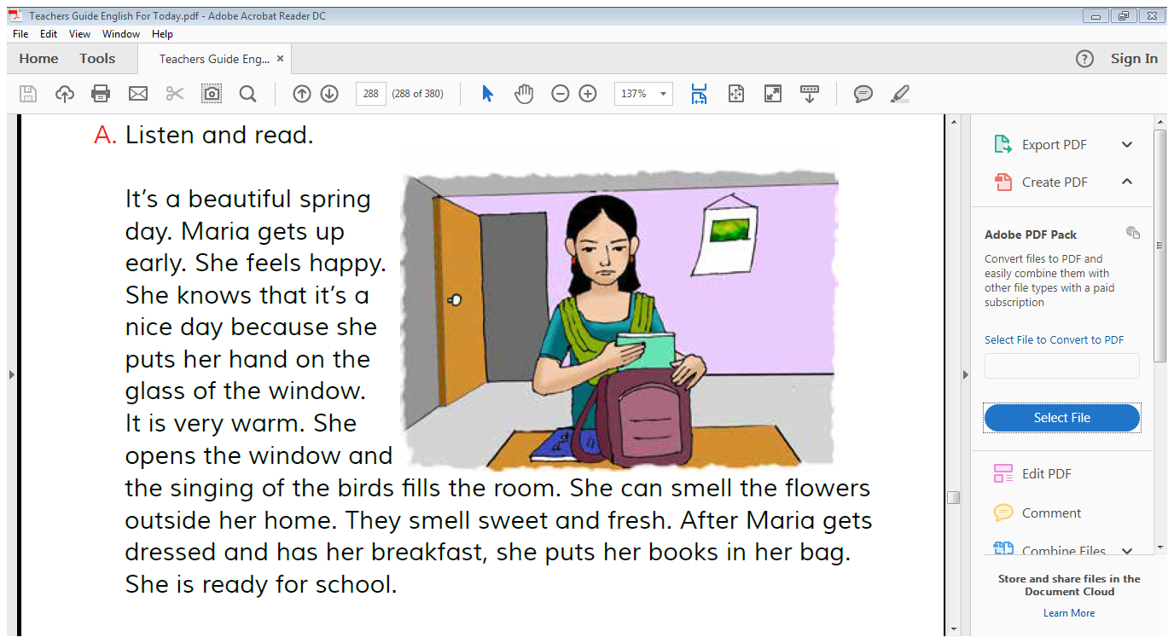
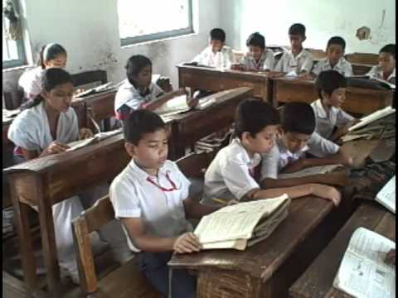
Student’s loud reading.

Slide 12
Student’s silent reading.

Slide 13
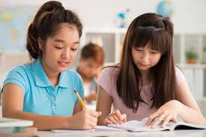
Pair work.
It’s a beautiful summer day. Maria gets up late. She feels happy. She knows that it’s a nice day because she puts her hand on a glass of water.

Slide 14
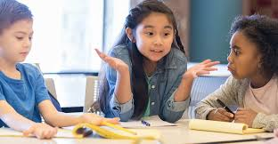
Spring, hot, puts, feels
Group work.
It’s a beautiful __________ day.
spring
Maria ______ her books in bag.
puts
It is very ______ .
hot

Slide 15
Evaluation:
1. When does Maria get up?
2. How does she feel?
3. What does she open?

Slide 16
Home work.
Write five sentences
about Maria.

Slide 17
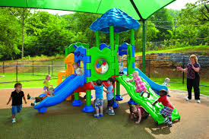
Thanks a lot.

