Slide 1
Welcome

Slide 2
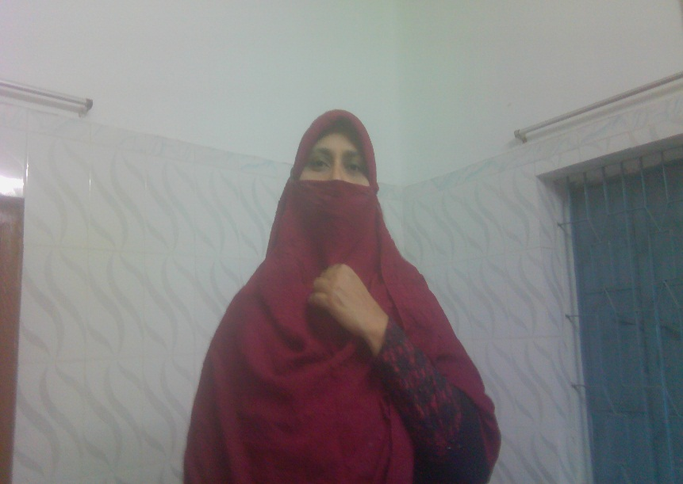
Introduction
Mafuza Akter
Lecturer (English)
Kushtia City Collge,Kushtia
Presentation made for
Class-Xi-Xii
English 2nd Paper
Grammar item
Notes:
Identity of the presenter and the class.

Slide 3
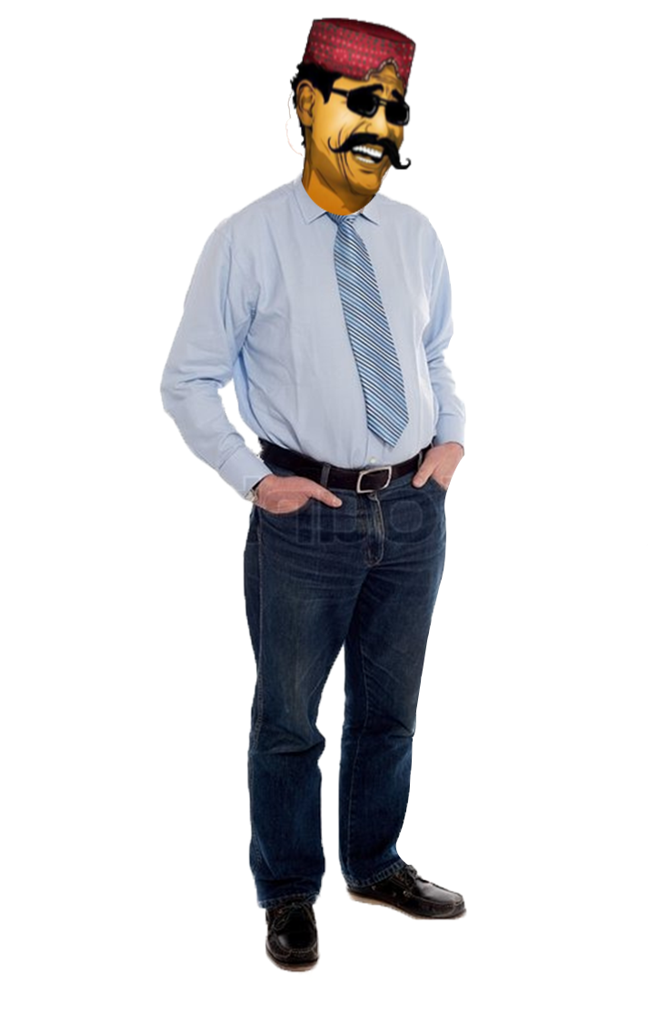
Do you find any mistake here, what are they?
What kind of mistakes have you followed in the passage?
I am Mr. Kirikichi. I am an English man. I lived into London to 10 years. I came under London at 2005.One day I went from Queen Elizabeth for meet her. I made a long discussion above her. She advised me in tell English correctly.
Mistakes on prepositions.
Let us discuss preposition today.
Continuation from content-1
Notes:
Suspension to lead the lesson.

Slide 4
Learning outcomes
After we have completed this lesson, we will be able to…
identify prepositions
fill in the blank with prepositions.
Notes:
Target.

Slide 5
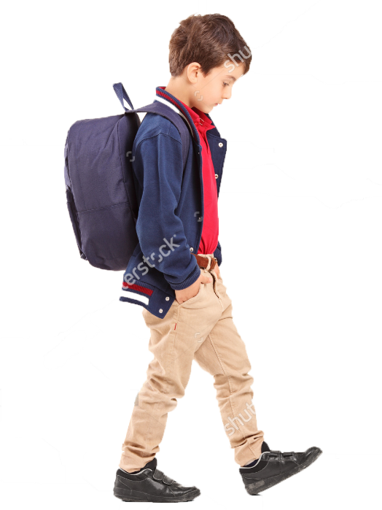
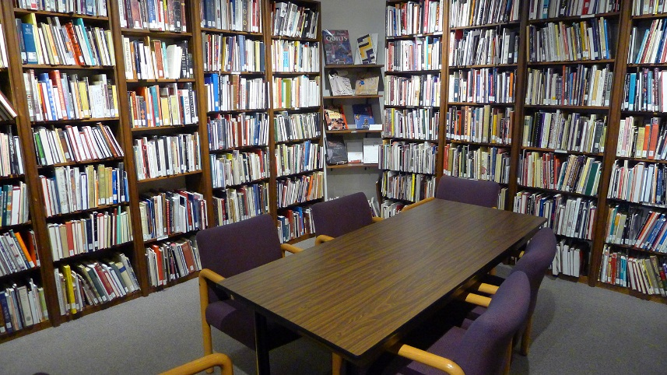
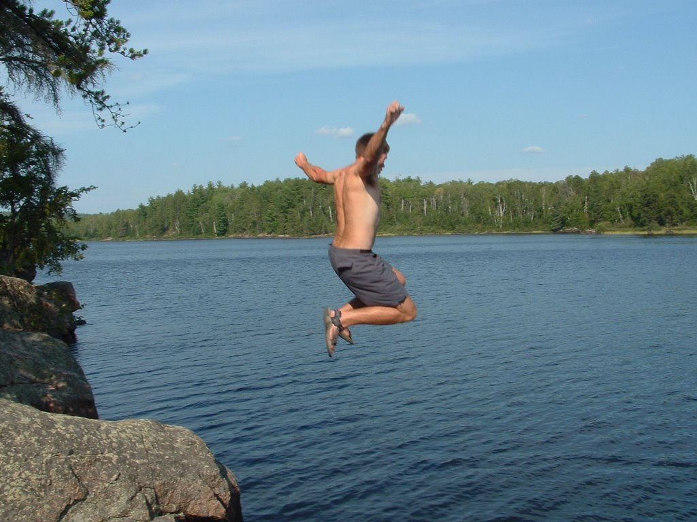
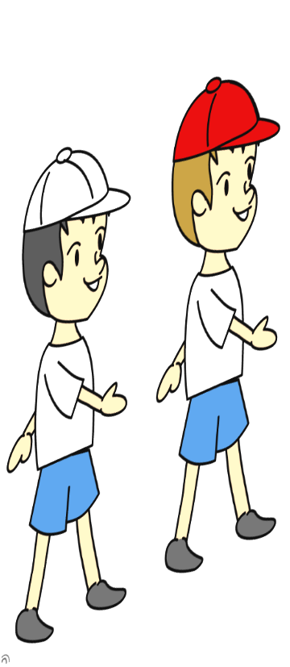
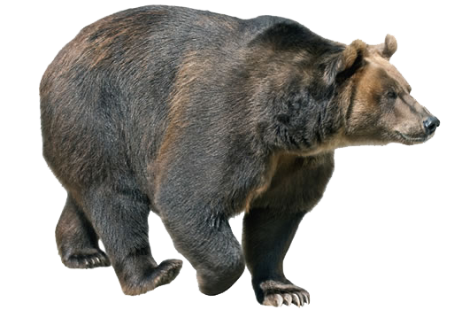
He is going __ the library.
to
The man is jumping ____the river.
into
They saw a bear coming ________ them.
towards
Notes:
Use of to, into and towards.

Slide 6
through
They are passing _______forest.
Notes:
Sample of using through.

Slide 7
What do we guess by ‘to’ into, towards and through’?
Directions
directions
So, they are preposition for__________
Now fill in the blanks of the following passage with to, into and towards.
I was going (a)_________ school yesterday. On the way I saw some boys passing (b) ________ a bushy place. After a while I saw them entering (c)_______ a bush. When I reached school, a student of class 6 came (d)_______ me and asked if I had seen some one advancing (e)________ me. At the time of my entering (f)________ the class, another student asked me the same question.
Notes:
Preposition for direction shown here.

Slide 8
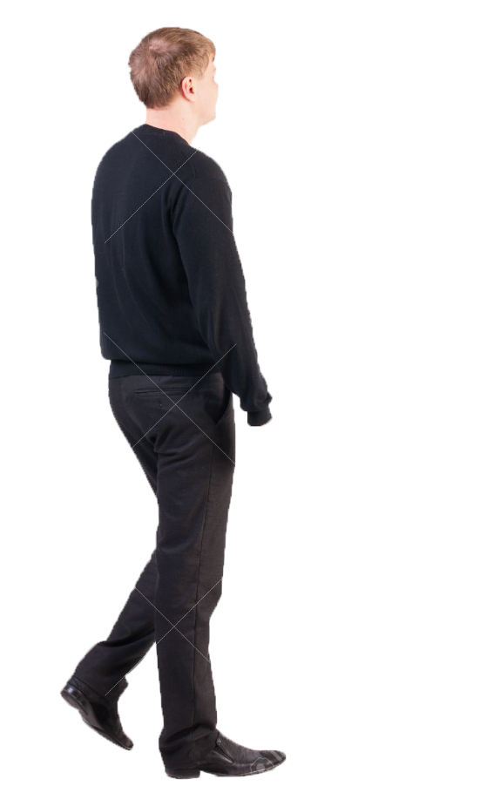
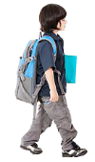
Follow
The boy is going to school.
The man is going towards the school.
To destination
Towards direction
Notes:
Difference between ‘to’ and ‘towards’ shown here.

Slide 9
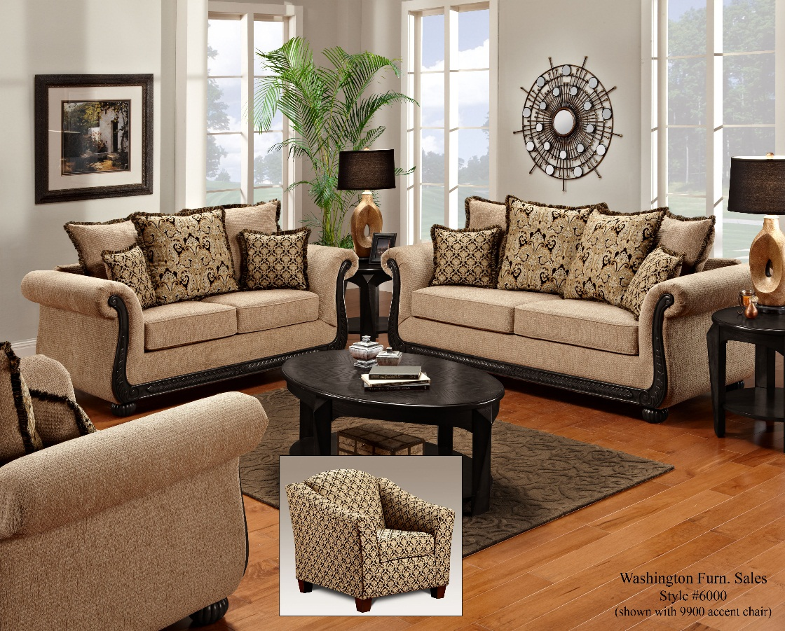
by
This drama is written___Shakespeare.
by
The room was decorated ___her.
with
The bottle is filled _____ water.
When something is done by someone or something is normally called preposition
for agent. By, with etc. are the examples of this kind of preposition.
Notes:
Preposition for agent shown here.

Slide 10
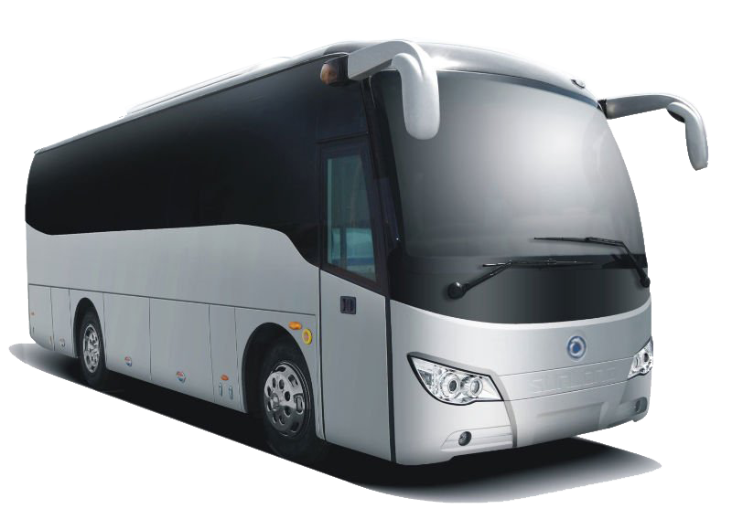
by
He comes __ bus regularly.
We open lock _____key.
with
He plays _____ violin.
with
Preposition for device, instrument or machine.
Different preposition are used for different devices,
by, with, on etc. are used as such type of prepositions.
Notes:
Preposition for machine,, instrument and device shown here.

Slide 11
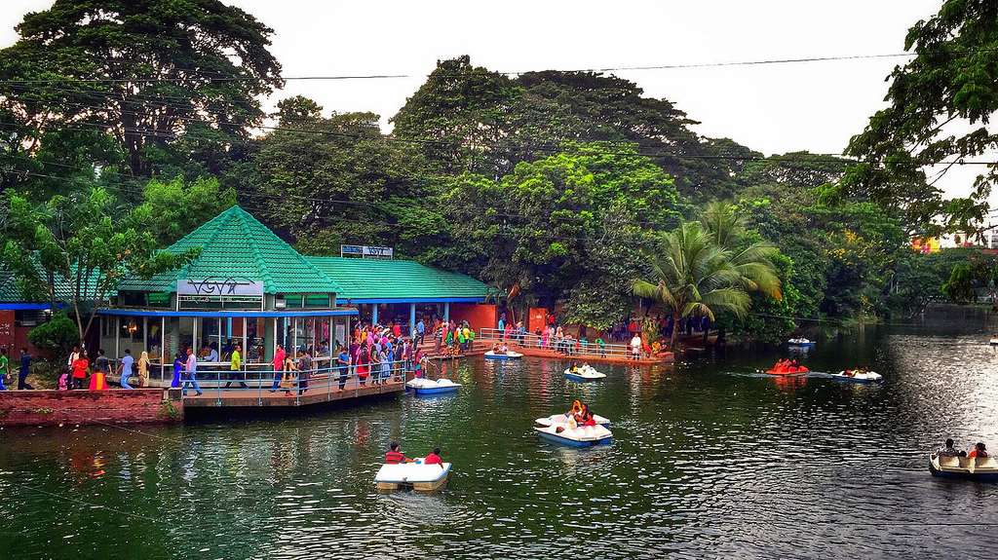
Dhanmondi Lake
Activities
Fill in the blank of the following passage with prepositions.
Mr. Kamal works (a) _________ Bangladesh Secretariat. He lives (b) _________ Dhanmodi (c) _________ Dhaka. Every day he wakes up early (d) _________ the morning and takes a one hour’s walk (e) _________ Dhanmondi Lake. (f) _________ 7:30am he comes back (g) _________ his residence. When it is 8, he enters (h) _________ his wash room and completes his bath. He goes (i) _________ his office (j) _________ a car of his own at 9am.
Notes:
Class activities given here as evaluation.

Slide 12
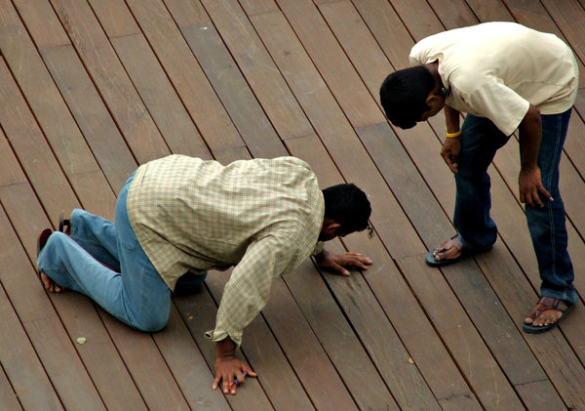
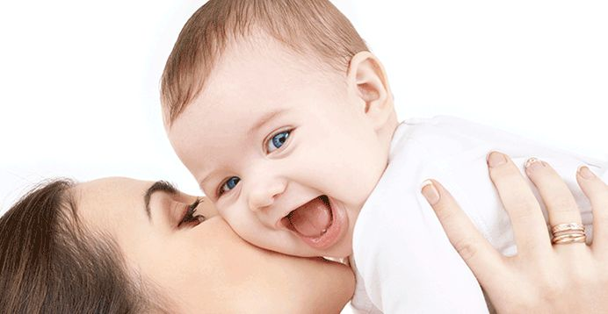
They are looking for something.
The baby laughs at his mother.
The man is knocking at the door
Look for = verb + preposition
Laughs at = verb + preposition
Knock at = verb +preposition
Prepositional verb
A verb followed by a preposition is called a prepositional verb.
Notes:
Prepositional verbs shown here.

Slide 13
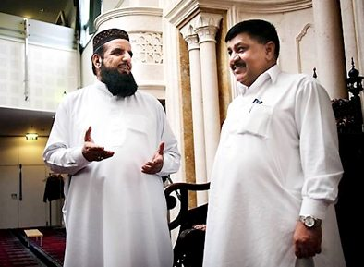
Some of the frequently used prepositional verbs are, laugh at, knock at, listen to,
look at, look for, look after, wait for, agree to, agree with, talk about, talked to etc.
Fill in the blank of the following passage with prepositional verbs.
I looked (a)________ the house. I went there and knocked (b) ________ the door. A man opened the door and talked (c) ________ me. He asked me if I was looking (d) ________ someone or something. I answered that I was just listening (e) ________ a sweet recitation of Quran. He said to me, “We believe (f) ________ Allah.” I said (g) ________ him that I also. We always should abide (h) ________ Allah and should rely (i) ________ him in any situation. I agreed (j) ________ the man.
Notes:
Evaluation on prepositional verbs shown here.

Slide 14
Follow
We agree to participate in the event.
verb
Appropriate preposition
We agree with participate in the event.
verb
Not appropriate preposition
Sometimes certain verbs, nouns and adjectives are followed by certain
prepositions. These prepositions are known as appropriate prepositions.
Without these appropriate prepositions sentences do not make sense.
Notes:
Students will be advised to read appropriate preposition from the grammar book.

Slide 15
See you again in the third content
Notes:
This is the last slide of this content. Teacher should inspire the students to attend the next content.

