Slide 1
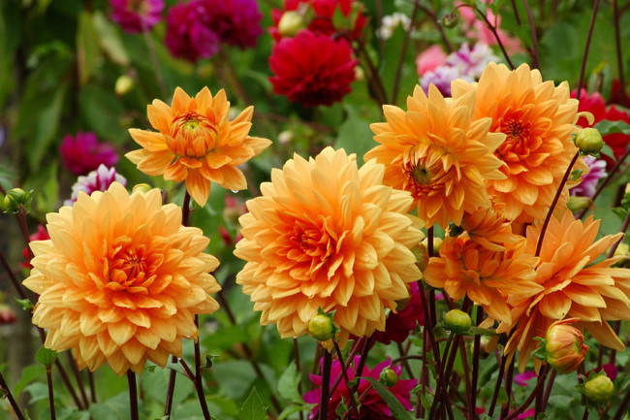
Welcome

Slide 2
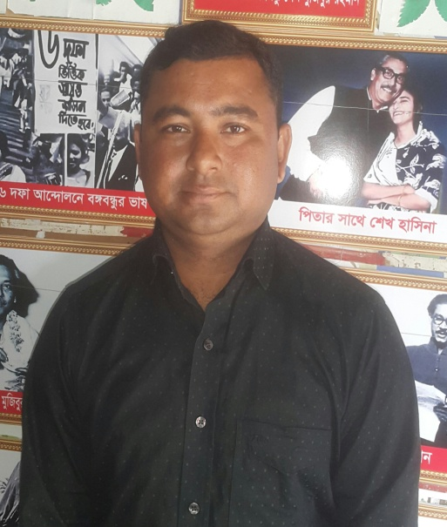
Teacher’s Identity
Pankaj Datta
Assistant teacher
Shyamnogor government primary school.
Chhatak, Sunamgonj.
Subject: English
Class: Five
Unit: 6
Lesson: Occupations
Parts of lesson: What food……good choices.
Time: 40 min

Slide 3
Learning outcomes
1.4.2: recognize and use information patterns for greetings and statements.
3.3.1: understand questions about objects around them.
3.4.1: understand statements made by teacher and students.
1.1.1: say words phrases and sentences proper sounds and stress.
1.1.2 say sentences with proper information.

Slide 4
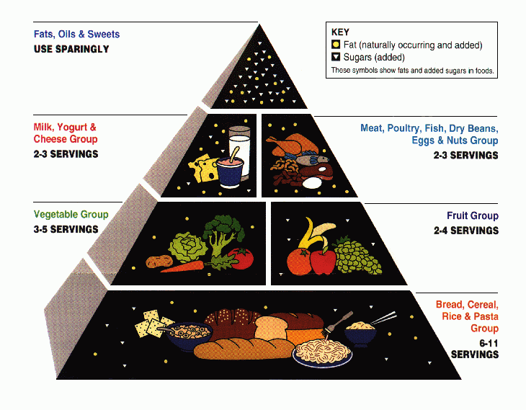
Look at the picture

Slide 5
Occupations

Slide 6
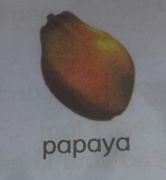
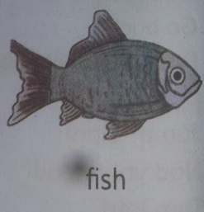
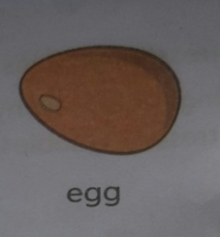
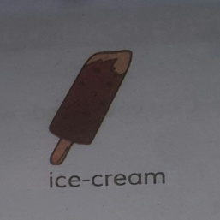
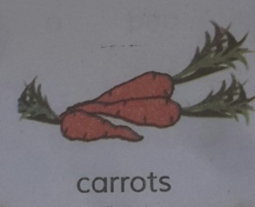
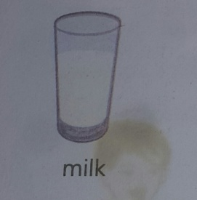
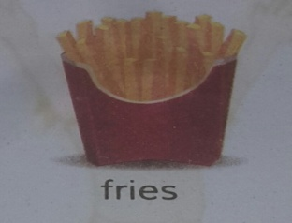
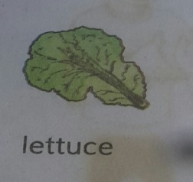
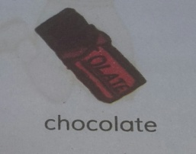
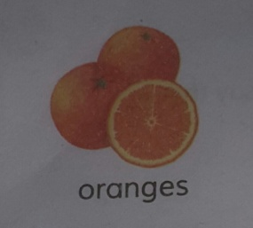
Look at the picture
Papaya
Fish
Egg
Ice-cream
Carrots
Milk
Fries
Lettuce
Chocolate
Orange

Slide 7
New Word
Different Not the same.
Bottom Lowest level.
Energy Power.
Food The things we eat.
Important Having a great value

Slide 8
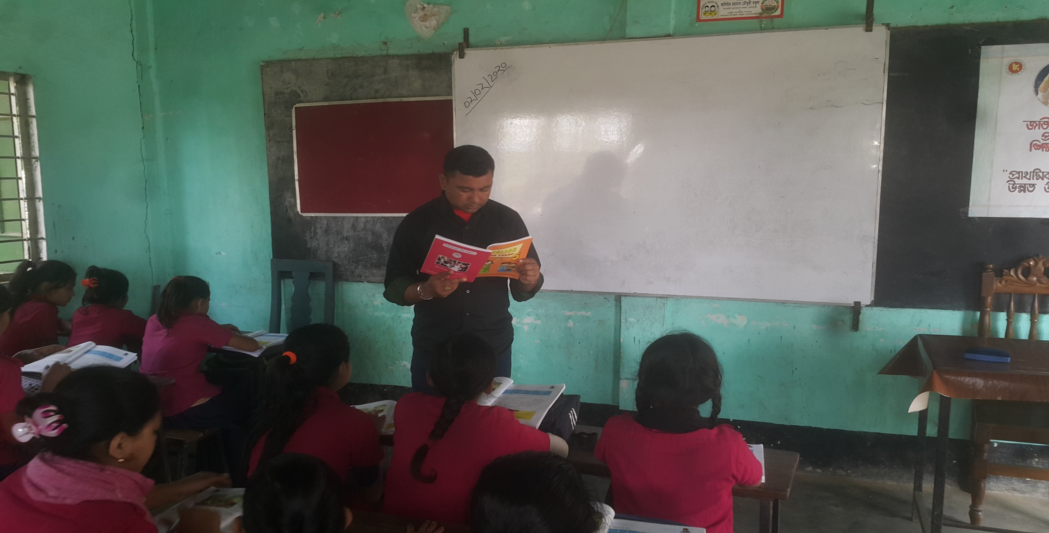
Teacher reading loudly

Slide 9
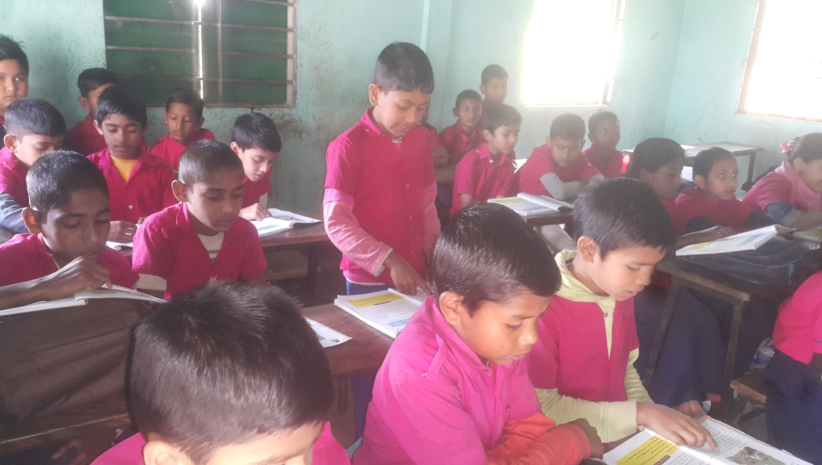
Student’s reading

Slide 10
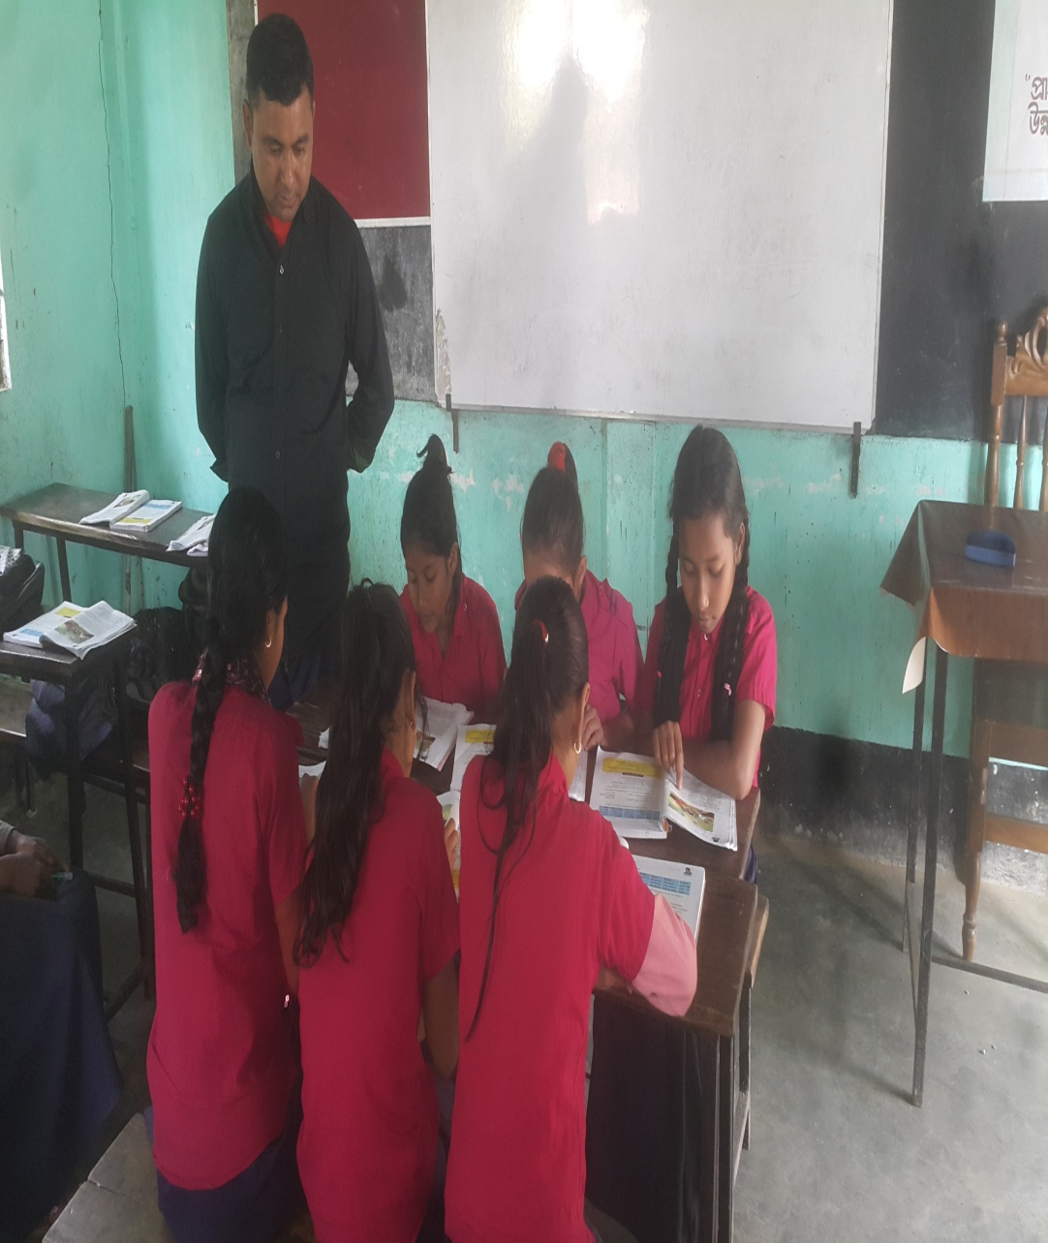
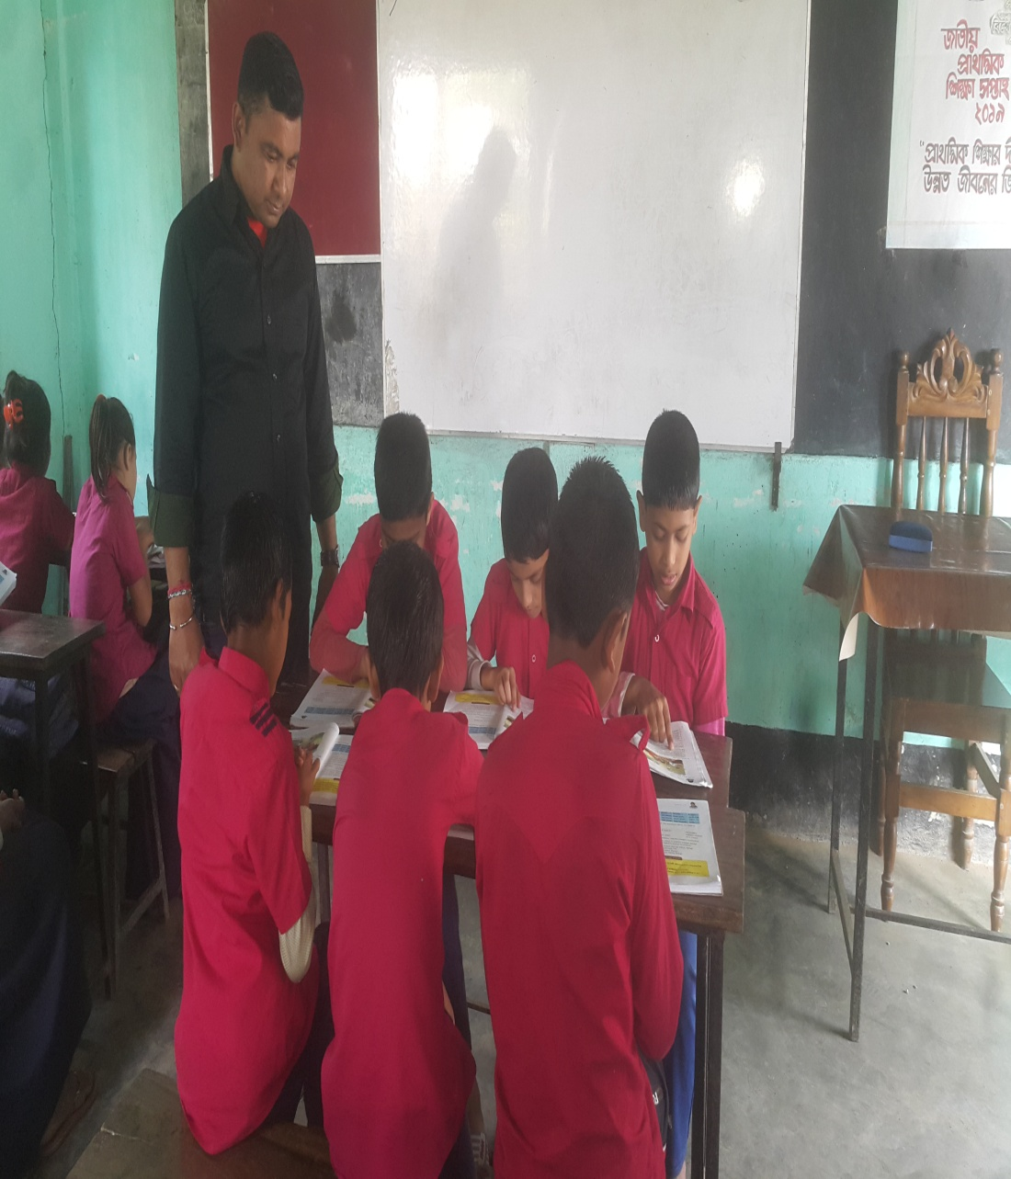
Group Work

Slide 11
Group Red
Which food helps to make us strong?
What do foods made of grain give us?
How does protein help us?
Group Green
Why are fruit and vegetables important for us?
What are the dairy products?
What makes our food delicious?

Slide 12
Task:
Write five sentences about “Food Pyramid”

