Slide 1
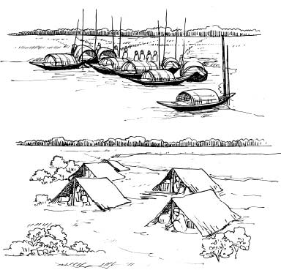
Welcome.

Slide 2
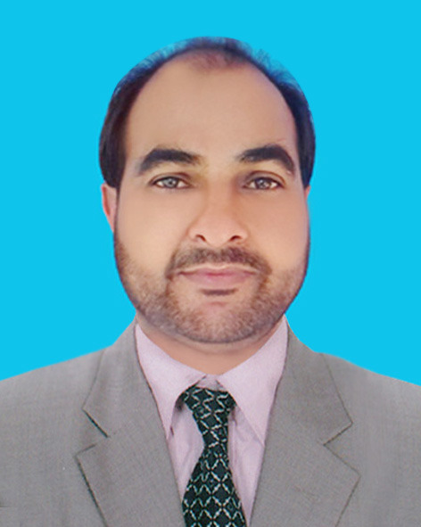
Introduction
Amzad Hussain Rasel
At Teacher
Amria Islamia Alim Madrasah
Dakshin Sunamgonj.
E-mail : amzadhrasel1981@gmail.com

Slide 3
Introduction of lesson
English First Paper
Class - viii
Unit - 07
Lesson - 03

Slide 4
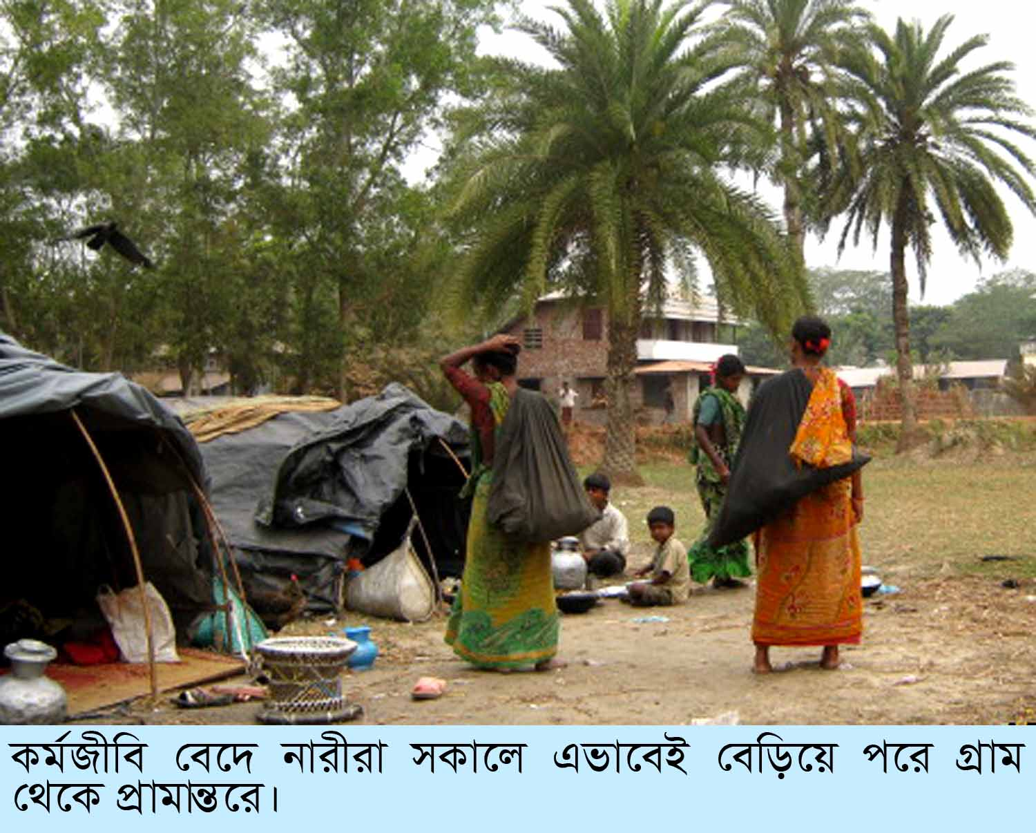
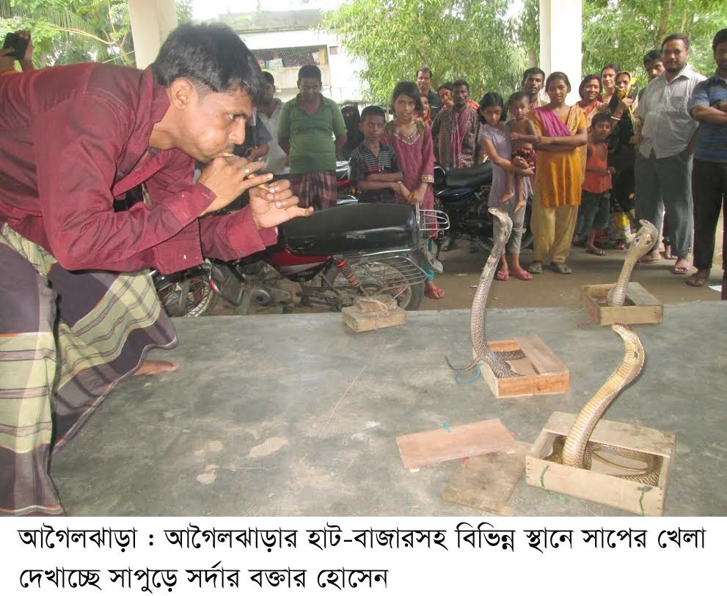
Gypsy

Slide 5
Our Today’s Lesson
River Gypsies in Bangladesh
Unit-7, Lesson-3

Slide 6
Learning outcomes--
After studied this lesson. we will be able to---
Ask and answer the questions.
2. Read and understand the text.
3. Participate them in a short paragraph

Slide 7
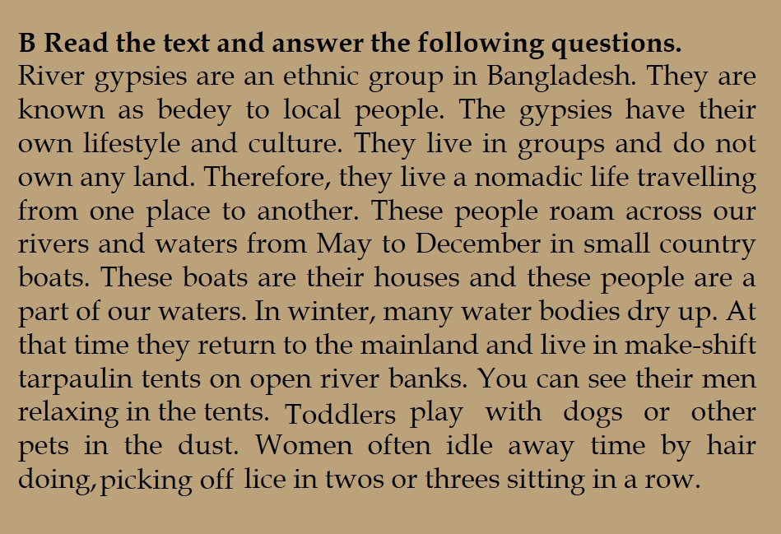
A Look at the pictures and discuss with your mate what you see.
Read in the Text

Slide 8
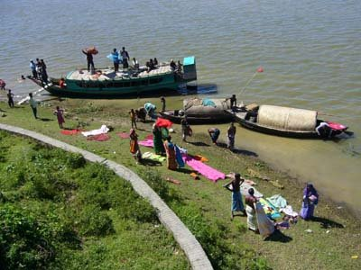
Gypsies
Meaning : Nomads, travelers
The gypsies are in the habit of nomadic life.

Slide 9
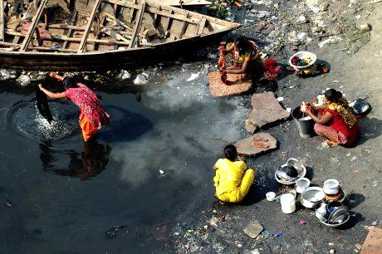
Lifestyle
Meaning : existence/way of daily life
The way of life they lead!

Slide 10
Culture
Meaning : Arts/beliefs, Special way of show.
We have our own culture to proud.

Slide 11
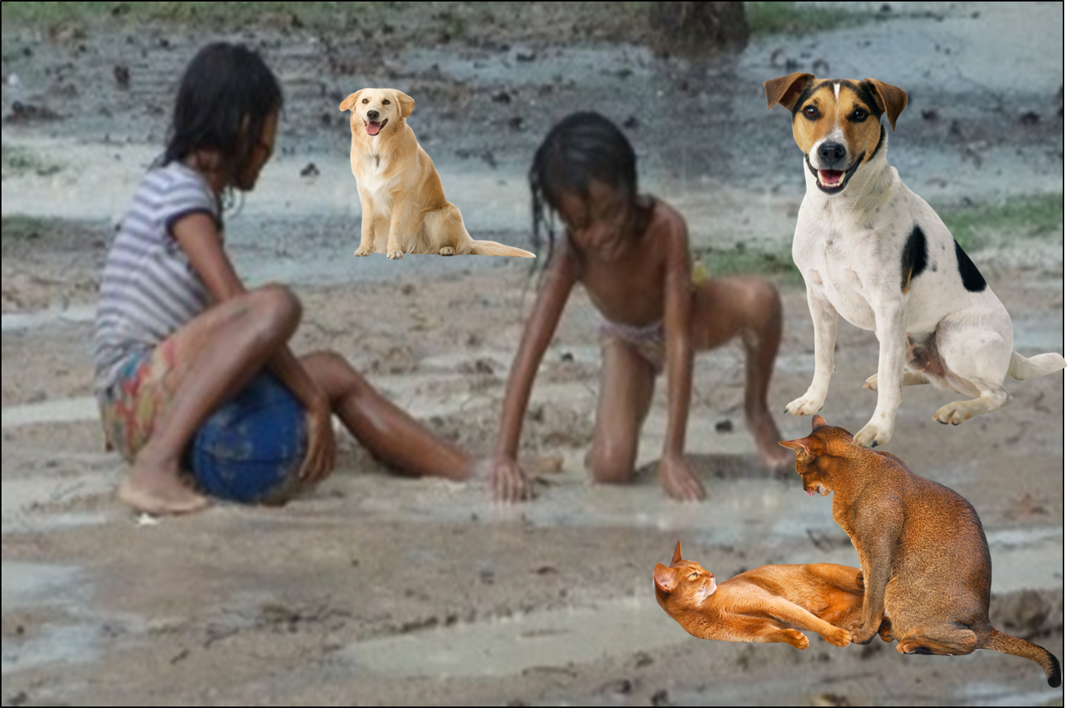
Toddlers
Infant, baby, kid.
Toddlers play with toys or dogs or other pets in the dust.

Slide 12
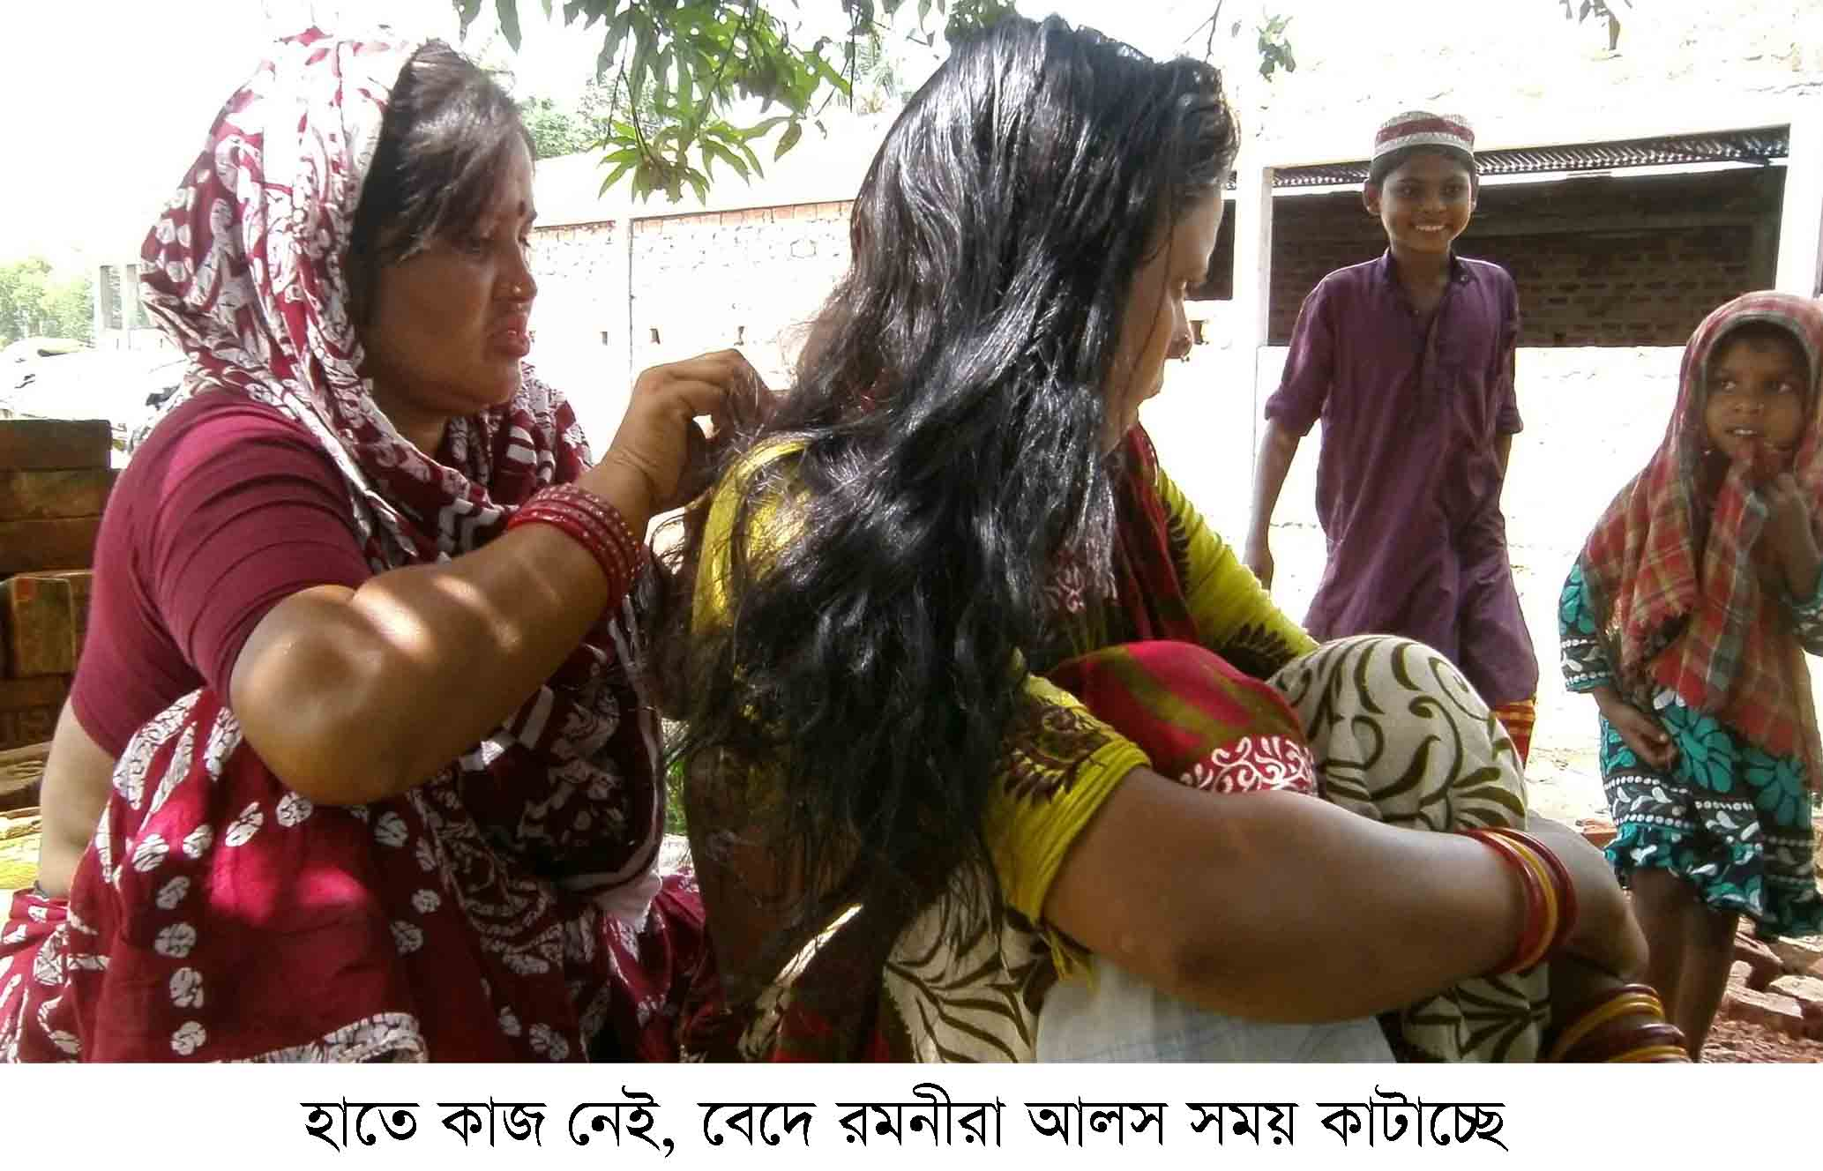
Lice
Meaning : One kind of Parasites.
Village women pick up lice sitting in yard.

Slide 13
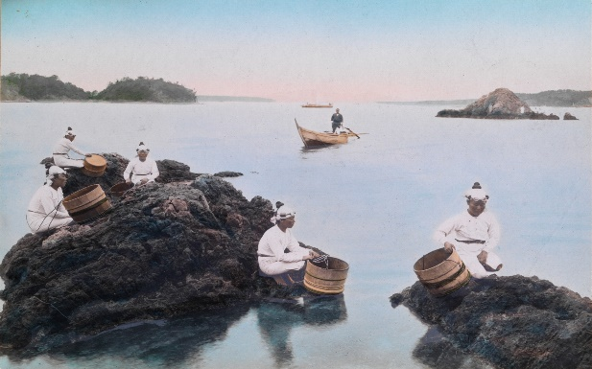
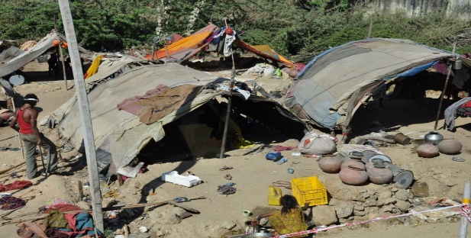
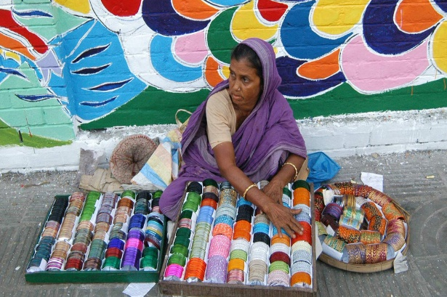
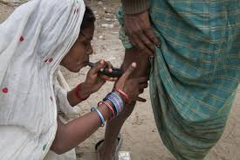
They also dive for natural pearls in waters.
Sometimes, they camp for a couple of weeks.
Women go from door to door to sell bangles, cosmetics and other things.
They also try to heal pains of old people often by sucking out blood from their body.

Slide 14
Answer the following questions
1 Who are river gypsies?
2 How do they live?
3 What do river gypsies do in winter?
4 What do river gypsy men do for a living?

Slide 15
Discuss with your partner and circle the right answer.
1. The term ‘ethnic’ is connected with
a people. b plants.
c animals. d fishes.
2. River gypsies roam around on their boats about .......months a year.
a six b seven
c eight d nine
3. River gypsies live in tents in
a summer. b winter.
c monsoon. d spring.

Slide 16
Home Work
You seen river gypsies in your area. Now write a paragraph on Life style of river.

Slide 17
MAY
ALLAH
BLESS
YOU.

Slide 18
Acknowledgement
GOOGLE
NATIONAL CURRICULUM & TEXTBOOK BOARD, BANGLADESH.
TEACHER`S OF AMRIA ISLAMIA ALIM MADRASA.

