Slide 1
Welcome

Slide 2
Identity
Md. Senamul Islam
Assistant Teacher
Malson GPS
Adamdighi
Bogura
SUJEET:ENGLISH
CLASS: Five
UNIT: 6
LESSON: 1
PAGE:50
TOPIC: Eat Healthy

Slide 3
Learning outcomes: Listening : 3.3.1- Understand questions about objects around them. 3.4.1- Understand statements made by teacher and students. Speaking : 1.1.1- say words, phrasess and sentences with proper sounds and stress. 6.2.1- Talk about people,objects, events etc. 8.1.1- Take part in conversation or appropriate topics. Reading : 1.5.1- Read words,phrases and sentences in the text with pronunciation,stress and intonation.

Slide 4
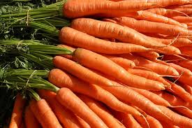
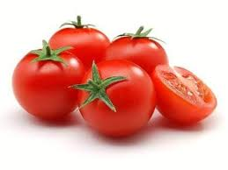
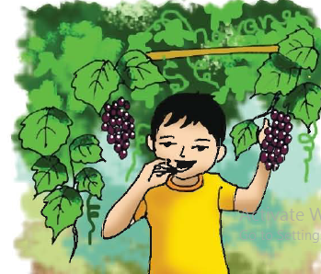
Lets enjoy some pictures.
What are these?
What are these ?
What is this ?
These are Tomatoes.
These are Carrots.
What is he doing?
This is Grapes.
He is eating.

Slide 5
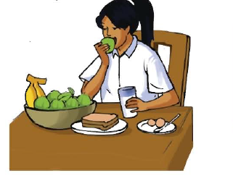
Today, we will know about- Eat healthy

Slide 6
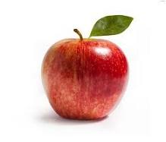
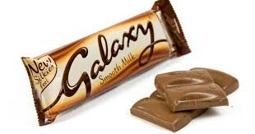
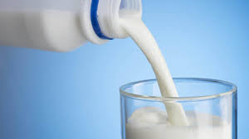
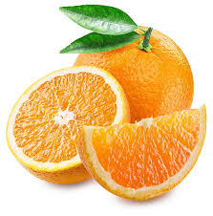
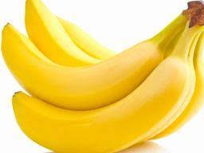
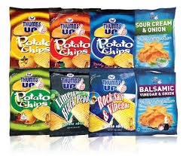
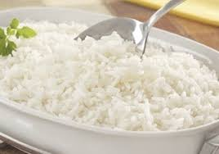
Orange
Apple
Chocolate
Milk
Ice-cream
Rice
Banana
Chips

Slide 7
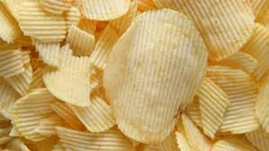
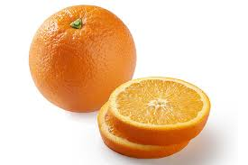
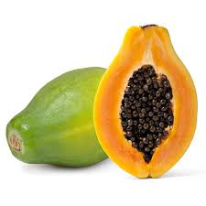
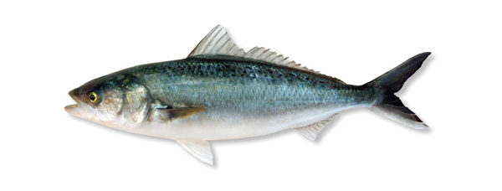
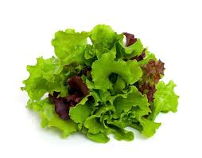
Lets listen to an audio and follow the pronunciation

Slide 8
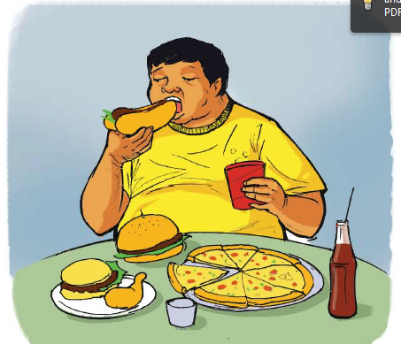
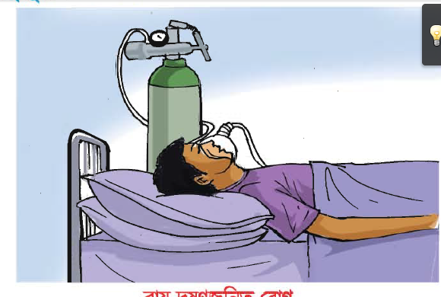
If someone eats like this unhealthy foods -
HE/SHE MAY
Fat
Sick

Slide 9
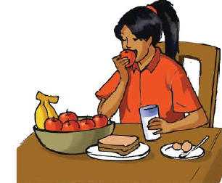
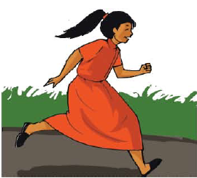
If someone eats like this healthy foods -
HE/SHE WILL
HEALTHY

Slide 10
Healthy foods
Papya
Apple
Tomato
Fish
Milk
Banana
Egg
Carrots

Slide 11
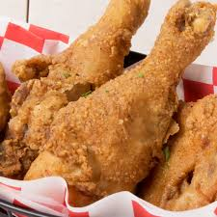
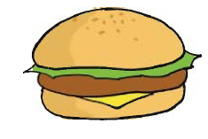
Unhealthy foods
Chips
Choclate
Ice cream
Fried Chicken
Barger

Slide 12
G - (1) – Find out the healthy foods.
G - (2)–Find out the unhealthy foods.

Slide 13
Evaluation:
1. Tell the name of five healthy foods.
2. Tell the name of five unhealthy foods

Slide 14
See you tomorrow
Bye
Bye

