Slide 1
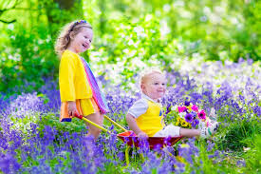
Welcome

Slide 2
Personal details
Ferdous Ara Begum
Assistant Teacher
Birinchi Sufia Nuria Senior Madrasah
Class : 6
Sub : English
Lesson : 5
Time : 45m

Slide 3
Todays Topic
Thanks for your work

Slide 4
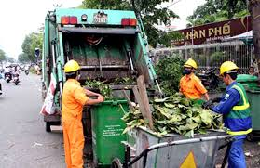
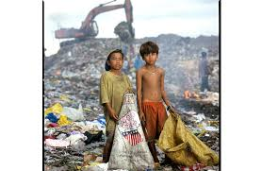
Look at the pictures below . Talk about what things you see and what are happening.

Slide 5
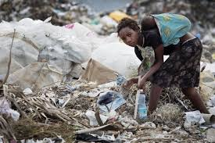
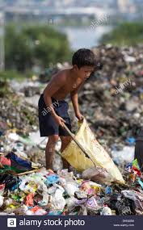

Slide 6
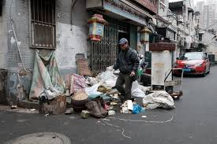

Slide 7
* * Open your English book – page no 14 & 15. ** Read the text.
Do the pair work.
Make a group consisting of 6 members.
Discuss the issue with each other.
Share your views and thoughts.

Slide 8
Word dissection
Street = road , avenue
Rubbish =Wastage, unavailable thing
Realize = guess , assemble
Unhygienic =insanitary , dirty room
Bin =Basket
Fall Sick =Get ill
Dirty = polluted , grubby

Slide 9
1. Choose the best answer from the alternatives.
Bulbul collects --------
Money
Tickets
Rubbish
Ice cream
(b)Bulbul collects rubbish at --------
Mirpur
Uttara
Sankar
gulsan
Rubbish
Sankar

Slide 10
Choose the best answer from the alternatives.
(c) Bulbul wakes up at ---------
4 o’clock
6 o’clock
7 o’clock
5 o’clock
(d) Bulbul wakes along the --------
Park
Side of the river
Home
Streets
5 o’clock
Streets

Slide 11
Choose the best answer from the alternatives.
(e)Bulbul was sick for ---------
5 days
4 days
3 days
2 days
(f) The word collect means --------
Add
Sum
Gather
together
2 days
Gather

Slide 12
(g)People put their rubbish in ------- bins.
Soil
Plastic
Metal
normal
Plastic
Answering the following questions.
What does Bulbul do?
What time does Bulbul wakes up?
How does Bulbul collect rubbish?
Why does Bulbul works hard?
Why did not Bulbul come to collects rubbish?

Slide 13
Answering questions`
Ans.(a)Bulbul collects rubbish from Sankar area in Dhaka.
Ans.(b)Bulbul wakes up at 5 o’clock everyday.
Ans.(c)Bulbul walks door to door to collect rubbish.
Ans.(d)Bulbul works hard to keep the area clean.
Ans.(e)Bulbul did not come to collect rubbish because he was sick.

Slide 14
Homework
Write a summary of the passage in no more than 90-100 words.

Slide 15
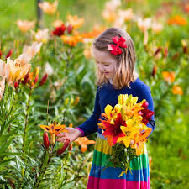
Thank you everyone

