Slide 1
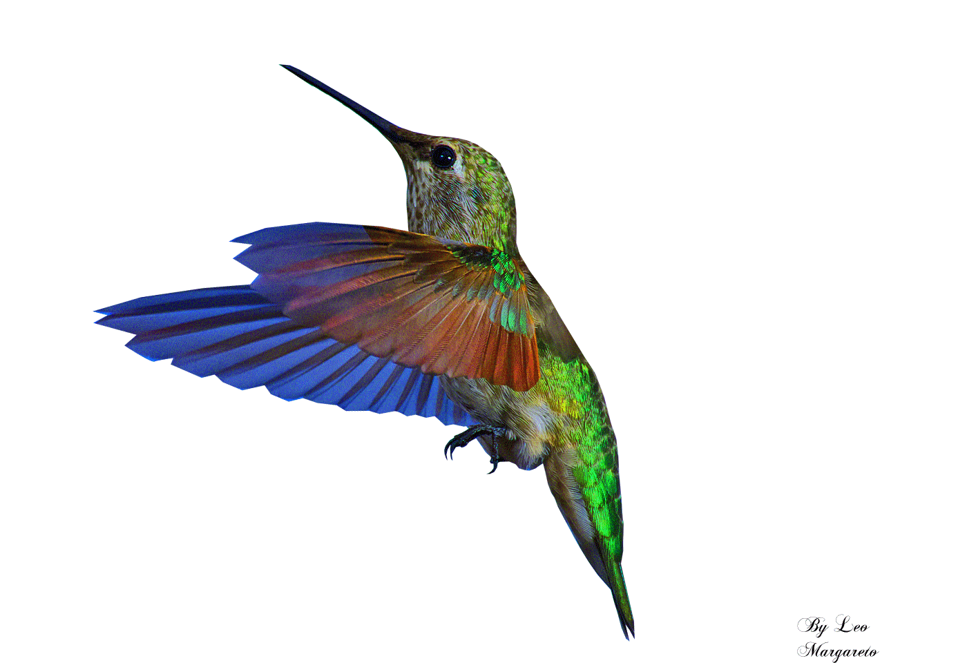
Welcome To All

Slide 2
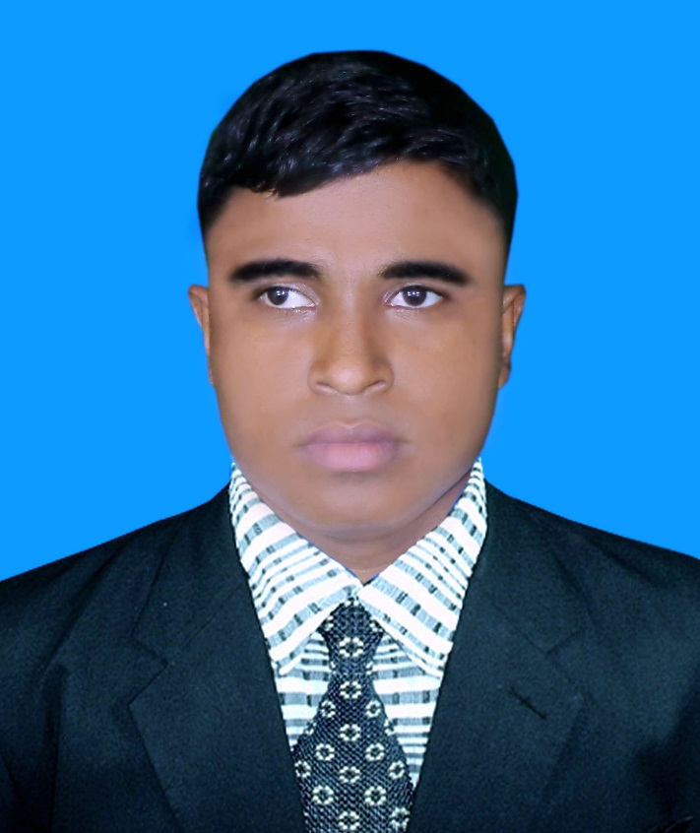
Teacher’s Identity A. Sukur Ali Khan B.A hons.M.A In English Assistant Teacher(English)
Naldha Secondary School
Naldha,Fakirhat,Bagerhat.
Class:Nine
Sub: English 1stpaper
Unit: 3, Lesson: (03)
Topic : International Mother Language Day-1
Time:50 minutes

Slide 3
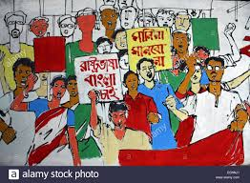
What do you see in the picture ?

Slide 4
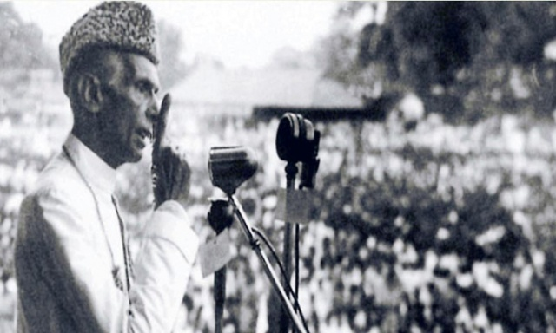
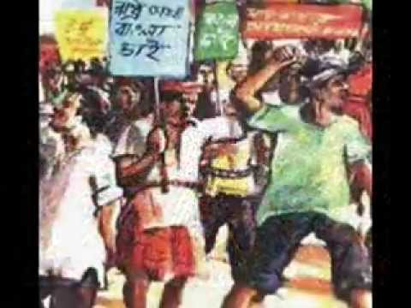
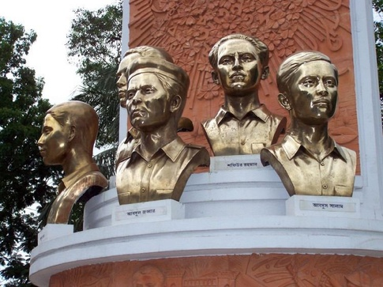
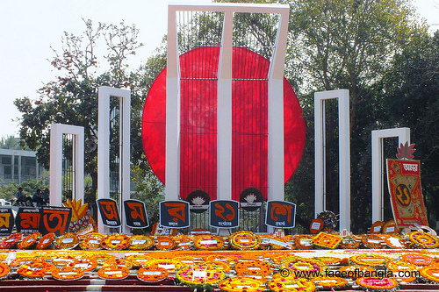
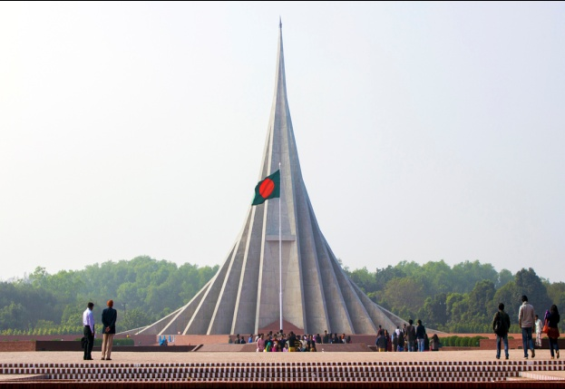
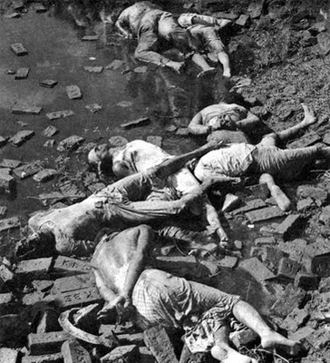
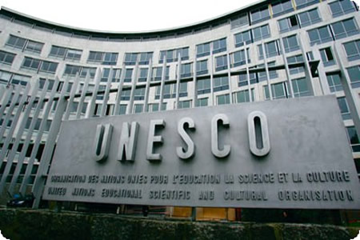
Speech of Ayoub Khan of Pakistan
Language movement for State Language
Embodies & dead bodies of language martyrs
Shaheed Miner & National Memorial

Slide 5
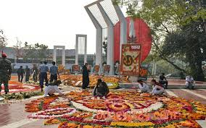
Look at the picture and talk about it .

Slide 6
Our today’s lesson is
International Mother Language Day-1

Slide 7
LEARNING OUTCOME
At the end of the lesson, the students will be able to ….
Read the text
Understand & practise “The vocabularies.”.
Match table with words & phrases.
Answer the multiple choice questions.
Ask & answer questions.
Write paragraph with Creativity.

Slide 8
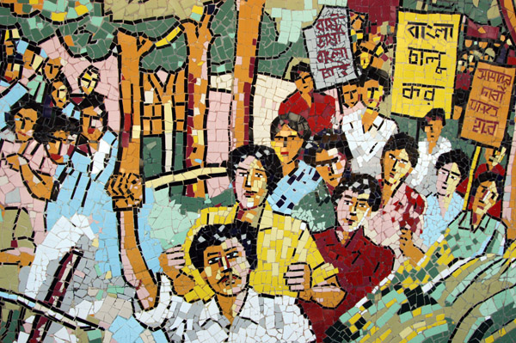
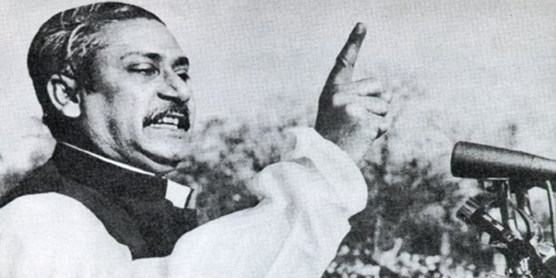
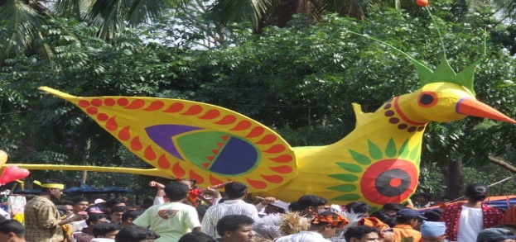
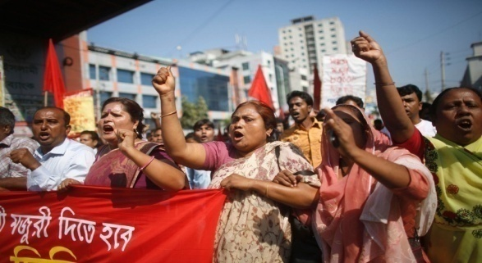
Vocabularies
Movement
To raise for something/struggle
Announce
Declare
Observe
Celebrate
A group of people moving in an orderly manner
Procession
Pay
To give (something)

Slide 9
Reading test
10 minutes

Slide 10
Individual work
Time
What happened
1947
Ans : (a) Division of India & Pakistan
1948
(b) The seed of language movement was shown
1952
(c) Killed several students like Salam ,Rafiq & Jabber for their procession.

Slide 11
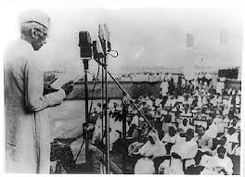
21 March 1948 Mohammad Ali Zinnah declared Urdu would be the only official language of Pakistan.

Slide 12
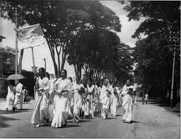
The declaration raised a storm of East Pakistan

Slide 13
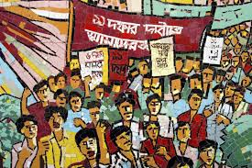
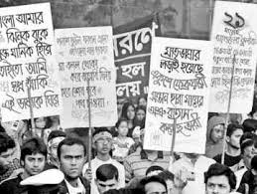
The student of Dhaka university defied the law

Slide 14
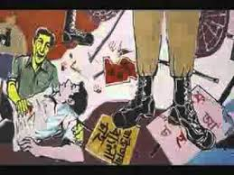
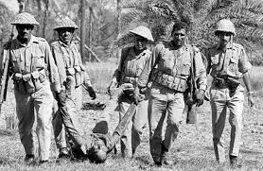
The police opened fire on the students

Slide 15
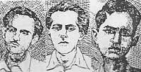
Killing Salam, Rafiq, Barkat & Jabbar

Slide 16
Multiple choice questions:
Pair work
Read the text and answer the following items:
(a) 21 february is a…………day in our national day. (i)gala (ii) religious (iii) festival (iv) memorable
Memorable
(b) The seed of the Language Movement was shown on……march in 1948.
21 (ii) 26 (iii) 25 (iv) 16
21
(c) There raised a storm of protest in the......part of the country(Pakistan).
(i) Western (ii) eastern (iii) southern (iv) northern
eastern
(d)Many students were........in the procession of movement.
(i) Suicided (ii) died (iii) killed (iv) arrested
killed
(f) Bangla is declared as ………..
(i)National (ii) international (iii) internal (iv) 2nd language
international

Slide 17
Groupwork
(1) Why do we observe 21 February as the International Mother Language day?
(2) “The seed of independence was sown in 21 February 1952”. Do you agree with comment? Why?
(1) Ans: We observe the day as International Mother Language day for the remembrance of the martyrs of language movement of 1952.

Slide 18
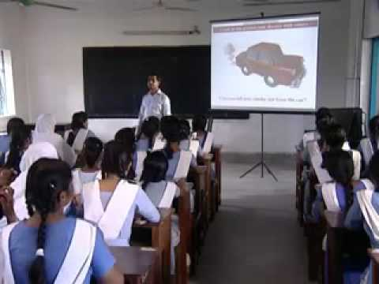
Evaluation
What does the abbreviation ENESCO stands for ?
Ans: United Nations Educational, Scientific and Cultural Organisation.
(2) Which day is “International Mother Language Day?”
Ans: 21 February is “ International mother language day.
”
(3) What is the another name of 21 February?
Ans: Shaheed Dibosh

Slide 19
Home work
Write a paragraph on “International Mother Language Day”.

Slide 20
Thanks
To All

