Slide 1
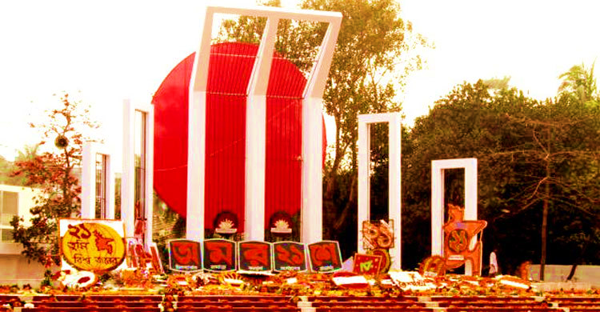
Welcome to all

Slide 2
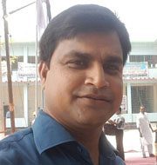
INTRODUCTION
Md. Soriful Islam
Assistant teacher
Chowrapara Fazil Madrasha
Niamatpur, Naogaon.
Mobile no: 01715637638
Email:soriful03@gmail.com
Class : Nine
Subject : English 1st paper
Unit : Three
Lesson : 3
Time : 50 min.
Date : 10/02/2020

Slide 3
Let’s enjoy the video
Have you hear the song?
The song we hear in the video is the subject of our discussion today.
When is the song sung?
What is the title of the lesson?

Slide 4
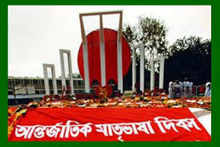
International Mother Language Day-1

Slide 5
Learning Outcomes
After studying the lesson we will be able to…
1. talk about event;
2. ask and answer questions;
3. infer meanings from the context.

Slide 6
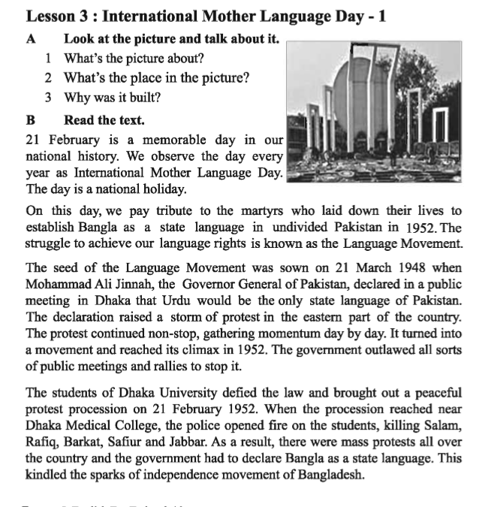
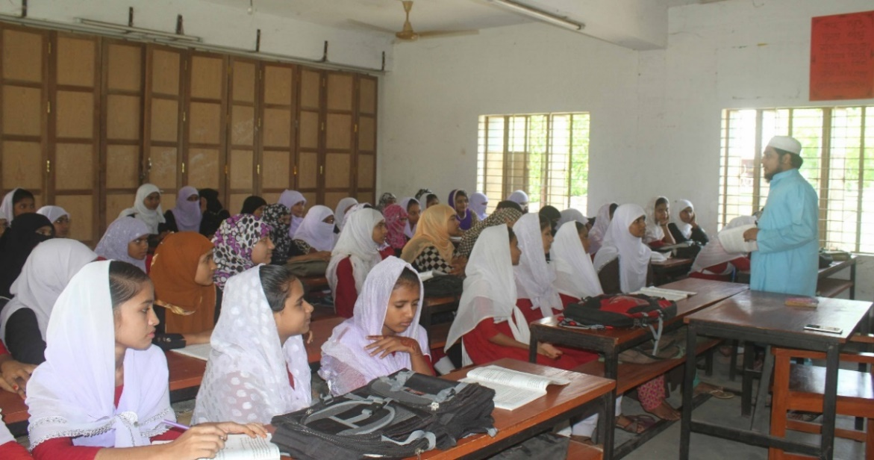
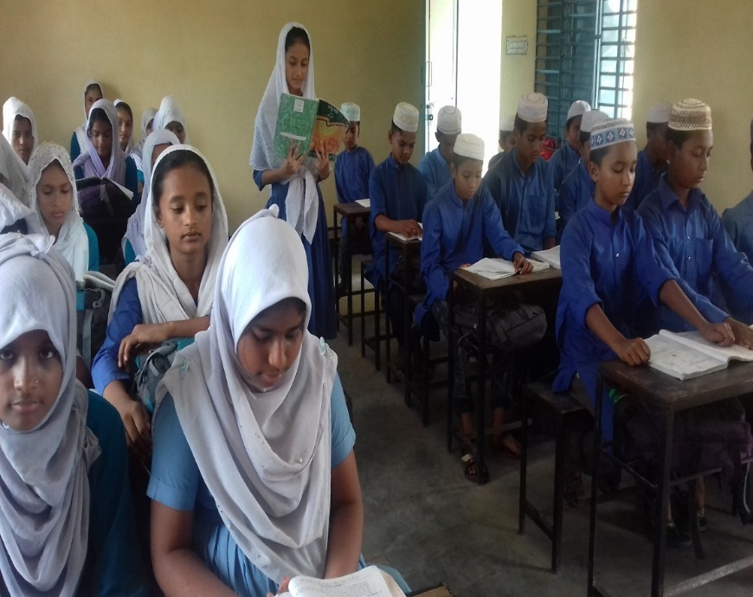
Loud reading
Proper learning
Dear students open your English book page no 33 & read any one.

Slide 7
Individual work
1. What’s the picture about?
2. Why was it built?

Slide 8
Silent reading
Dear students open your English book page no 33 & read attentively.

Slide 9
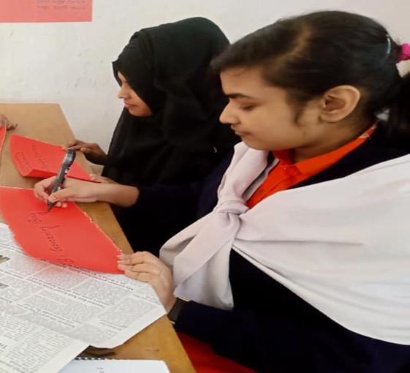
Pair work
1.Why do we observe 21 February as the International Mother Language Day?
2.What happened when Urdu was declared as the only state Language of Pakistan?
3.What was the result of the language movement?

Slide 10
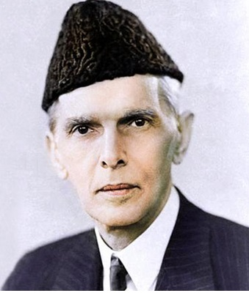
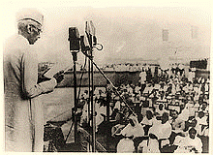
Let's know the history of the language movement
“Mohammad Ali Jinnah” The Governor General of Pakistan
21 March 1948 when Mohammad Ali Jinnah The Governor General of Pakistan, declared in a voiceless voice in the rally of the student teachers at the Curzon Hall of Dhaka University that "Urdu" would be Pakistan's only state language.

Slide 11
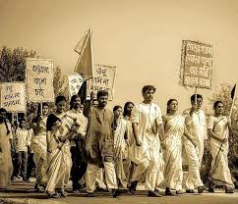
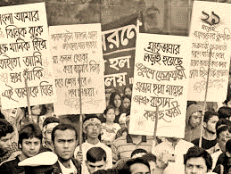
Let's know the history of the language movement
Students of Governor General Mohammad Ali Jinnah's announcement immediately protested.

Slide 12
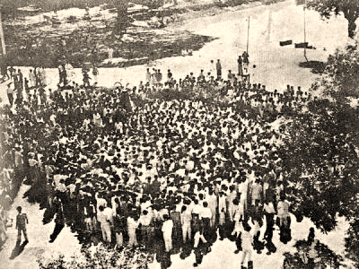
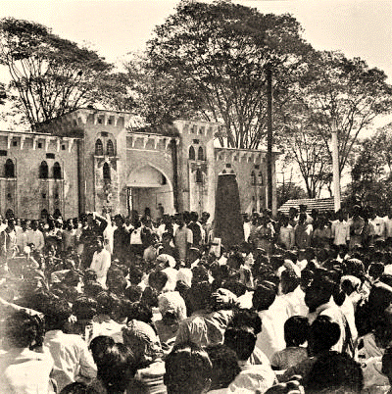
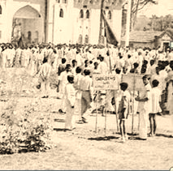
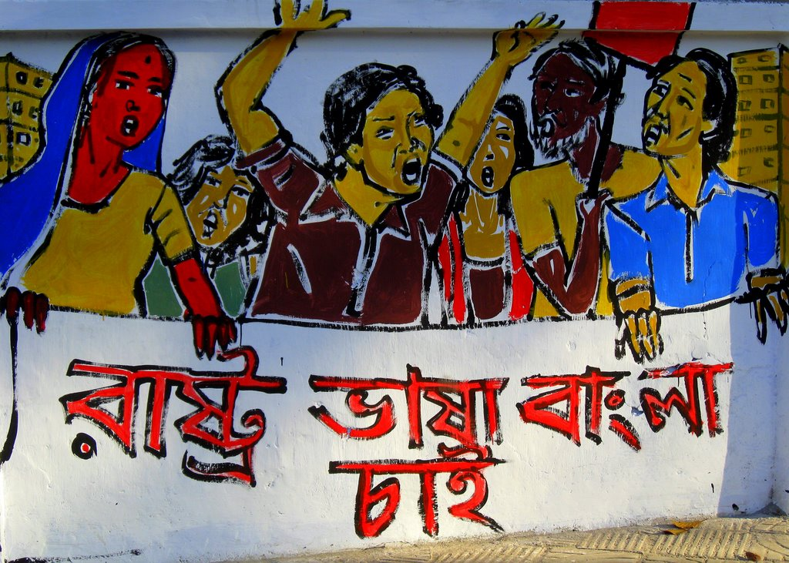
Let's know the history of the language movement
Peaceful protest of the students of Dhaka University.

Slide 13
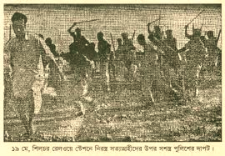
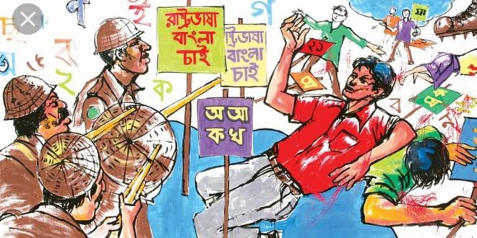
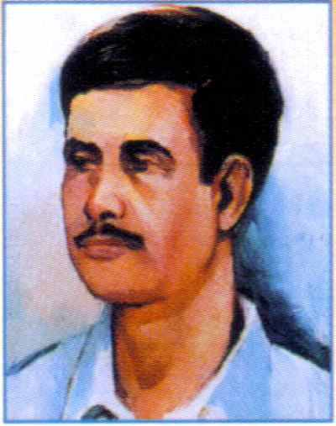
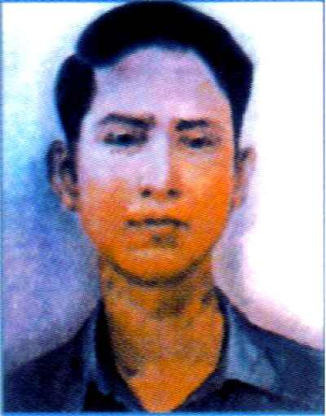
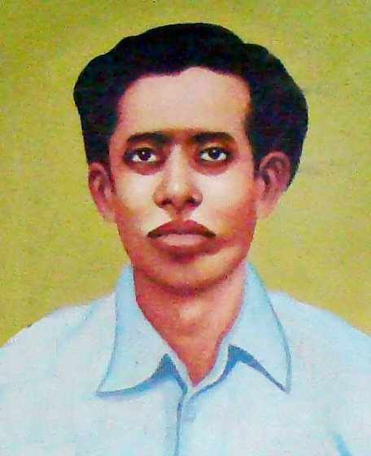
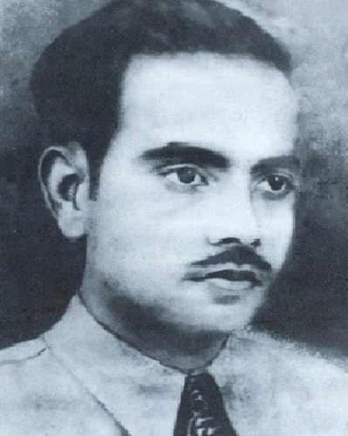
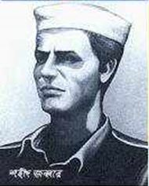
Let's know the history of the language movement
Police opened fire on students who were protesting for Bangla language.
Salam, Barkat, Rafiq, Jabbar, Shafiur and many others were killed in police firing.

Slide 14
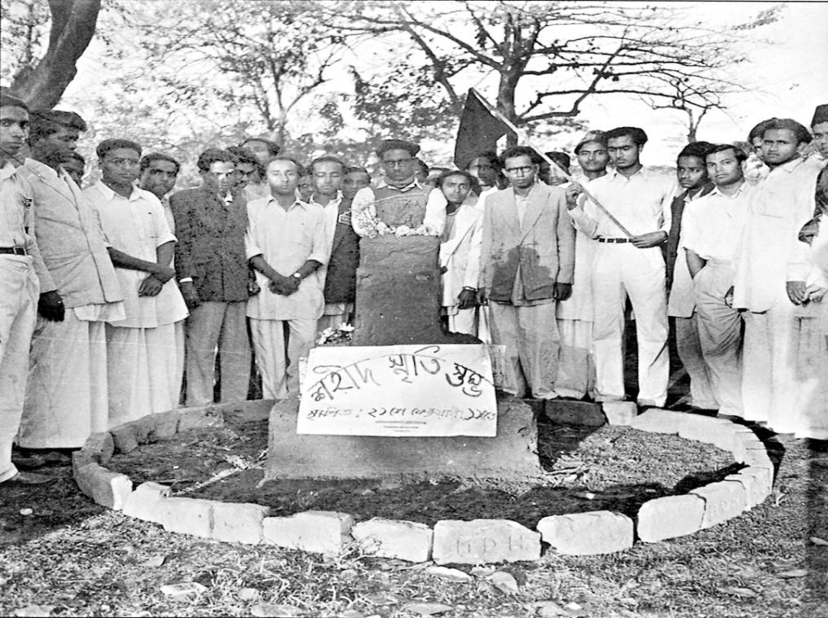
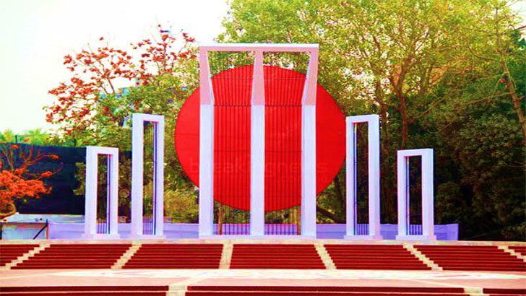
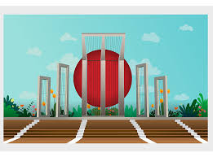
Let's know the history of the language movement
This is the central Shaheed Minar.
অ
আ
As a result of the language movement, both Bangla and Urdu gained the status of the official language of Pakistan.

Slide 15
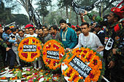
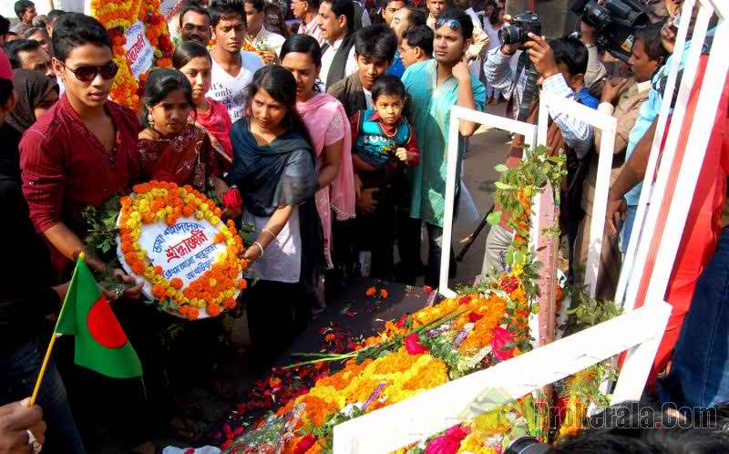
Follow the pictures
People are paying homage to the language martyrs.

Slide 16
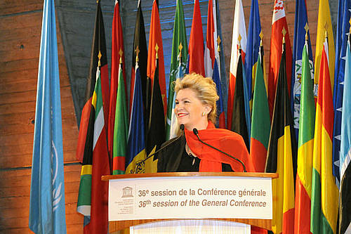
Follow the pictures
UNESCO
Announcement of 1999 of 17 November 21 February as The International Mother Language Day.

Slide 17
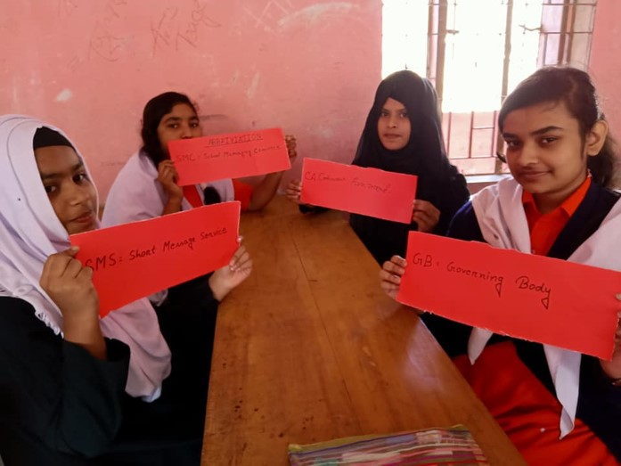
Group work
Write a summary of the text in your own words.

Slide 18
Evaluation
Try again
Answer is right
1. The than Government-----all sorts of public meeting to prevent the protest?
a. permitted
b. agreed
c. allowed
d. banned
2.What does the word “climax” mean in the passage?
a.The most exciting point in time
b.The most exciting point in time
c. Natural situation
d. Success
3. The spark of the independence movement was ---by the Language Movement.
a. protested
b. aroused
c. prohibited
d. lessened
4. The protest against the declaration of Jinnah was going on---
i. powerfully
ii. slowly
iii. continuously
Which of the following is correct?
a. i
b. ii
c. i & iii
d. i, ii & iii
Notes:
Note: Click on the answer for the Tigger.

Slide 19
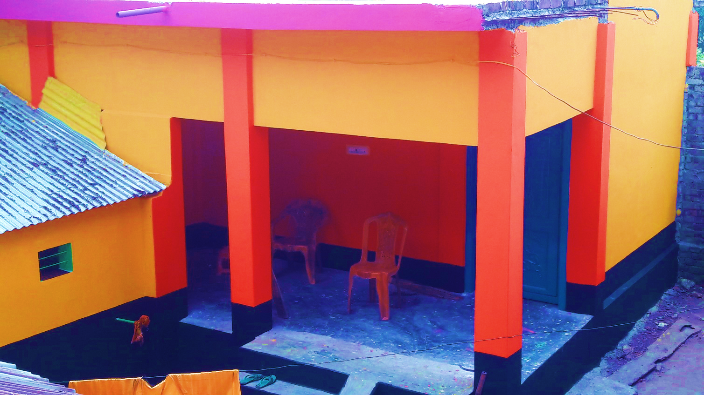
Home work
Write briefly how you will observe this year 21 February at your Madrasha?

Slide 20
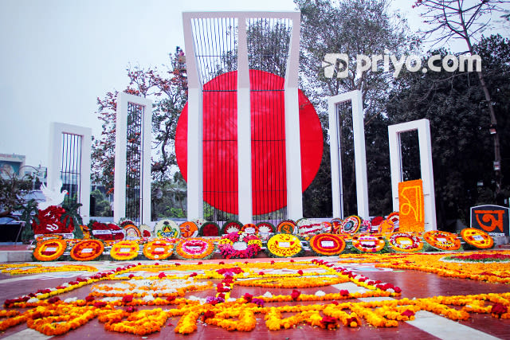
Thank’s to all

