Slide 1
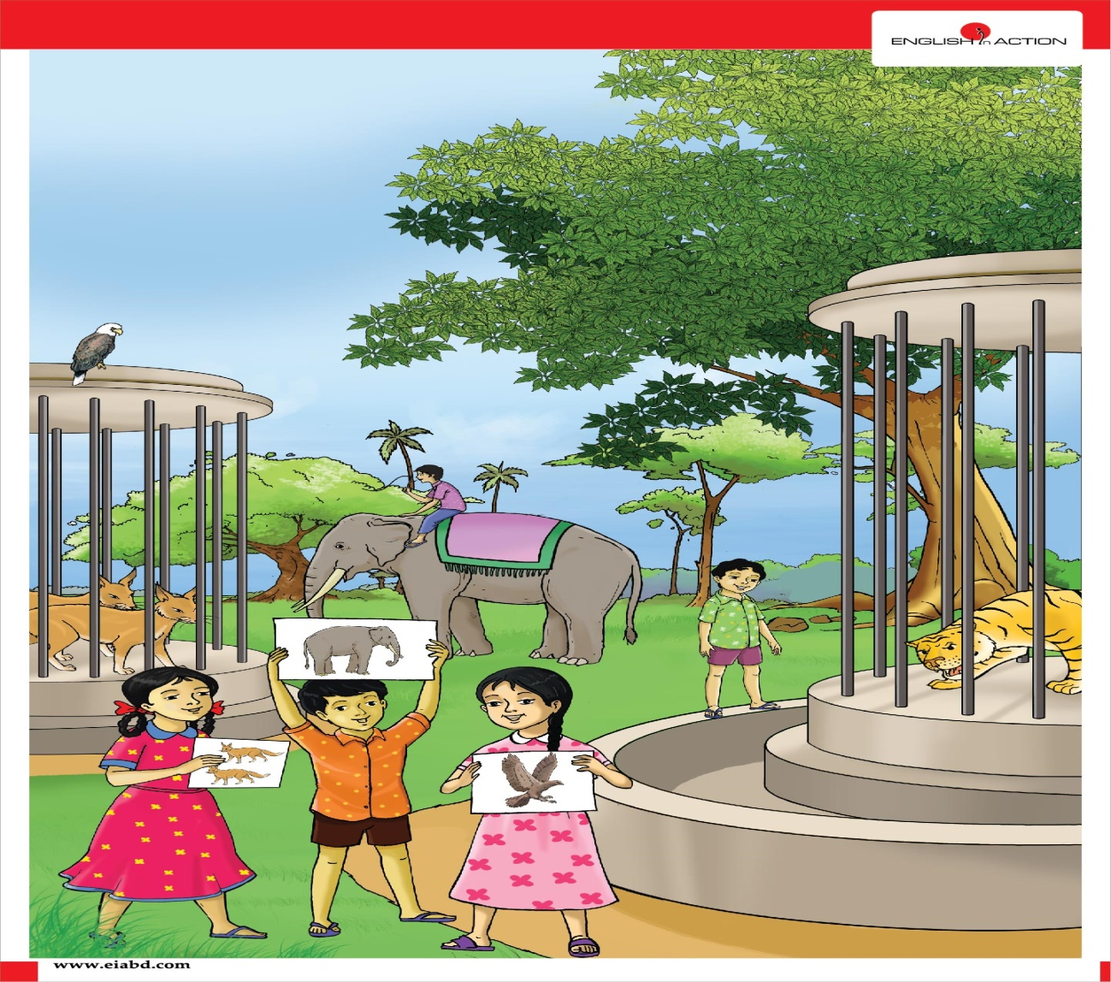
Well come all student Today lesson

Slide 2
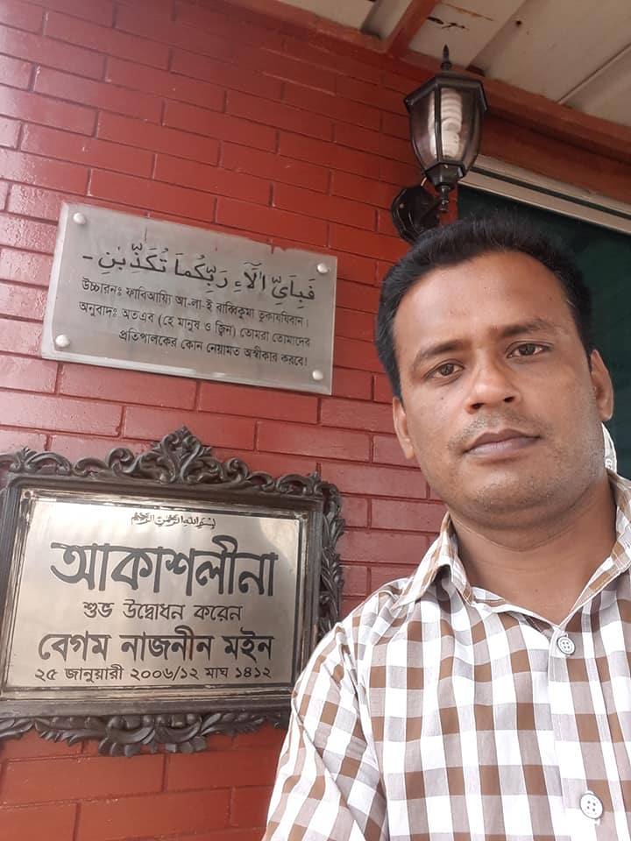
Teacher Information
Md. Sorfuddin Mridha
Assistant Teacher
41 No Laxmipur Government Primary School
Matlab South, Chandpur
Mobile- 01818-490889

Slide 3
Lesson Introduction
Class-4
Subject: English
Unit:15
Lesson: 1-3
Text: B

Slide 4
Learning outcomes
Reading:
1.4.1 :-Read words, phrases and sentences in the text.
1.5.1 :-Read words, phrases and sentences in the text with proper pronunciation, stress and intonation.
1.7.1 :-Read short paragraphs, dialogues and simple letters.
5.1.1 :- Read silently with understanding paragraphs, stories and other text materials.
Writing:
8.1.1:- Make sentences using words.

Slide 5
How are you today?
Fine, Thank you.
At first we see the video, Ok.

Slide 6
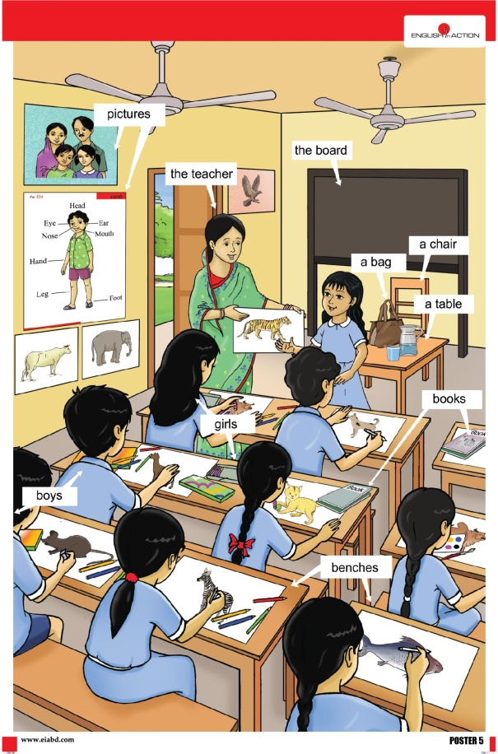
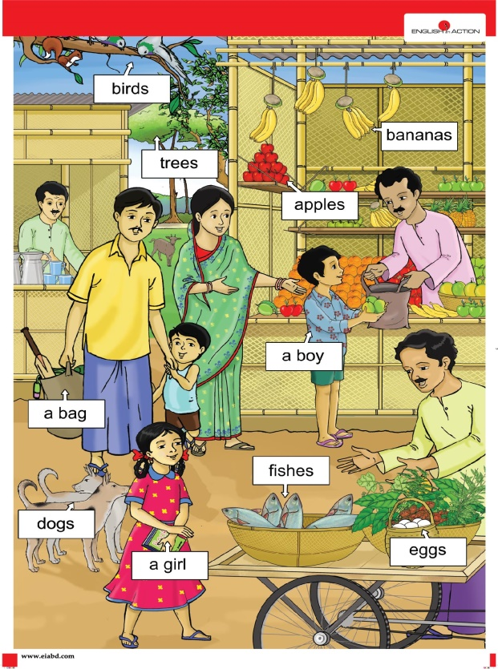
Creating a favorable environment for reading

Slide 7
One day one word
Teaching learning activities
Yesterday we learned a word, what is the word? Who can tell me?
Ans: Year
Who can tell the meaning of the word?
Year অর্থ বছর

Slide 8
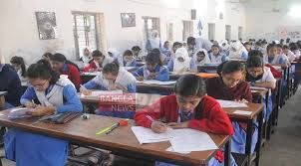
One day one word
Anyone, make a sentence with the word?
I will attend the PESC examination next year.

Slide 9
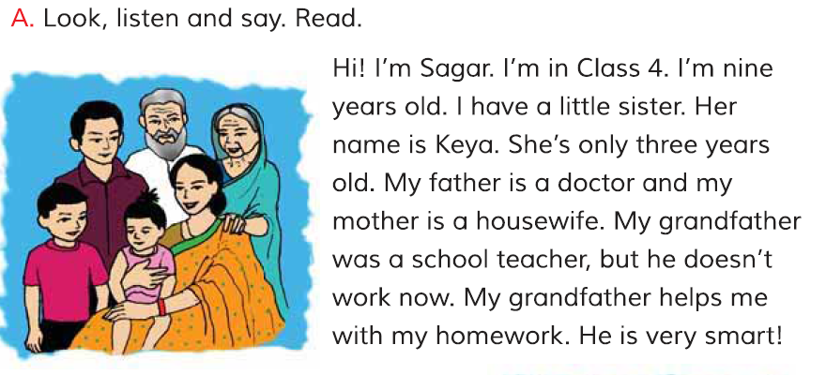
Dear student open your book, Page NO-30
Read this lesson any one.

Slide 10
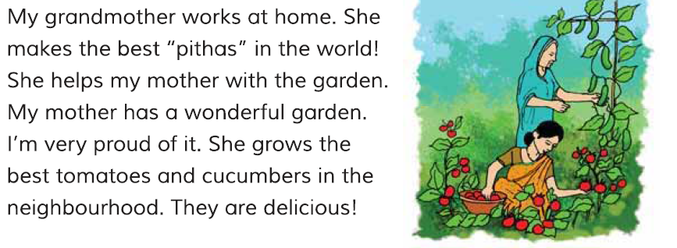
Dear student open your book, Page NO-30
Read another one of these texts.

Slide 11
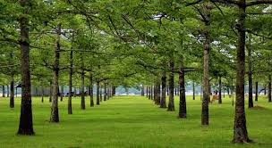
One day one word
Wonderful garden.
What means garden?
Garden অর্থ বাগান

Slide 12
One day one word
We learn today a sentence by garden.
Everyone wrote the sentence in the hand write note.
My mother has a wonderful garden.

Slide 13
INPUT
Dear student open your book, Page NO-30 And look activity B.
Now you read with me.
What
Who
Where
When
Why
How
এগুলো হচ্ছে Question Words.
প্রশ্ন বাক্য।

Slide 14
INPUT
এখন আমরা শব্দগুলোর অর্থ জেনে নেব।
What
কী?
Where
কোথায়?
Who
কে?
Why
কেন?
When
কখন?
How
কিভাবে?

Slide 15
Practice
W এর জন্য What, Who, Where, Why and When
এবং H এর জন্য How পড়বো।
Now you read the words a few times.
What
Who
Where
When
Why
How

Slide 16
Group Work
গ্রুপে ভাগ হয়ে সঠিক শব্দ বসিয়ে শূণ্যস্থান পূরণ কর?
What
Who
Where
When
Why
How

Slide 17
এখান তোমাদের খাতার সাথে মিলিয়ে নাও।
What
Who
Where
When
Why
How

Slide 18
Task/Checking Learning/Assessment
What have we learned today?
Ans: We have learned the question sentence today.

Slide 19
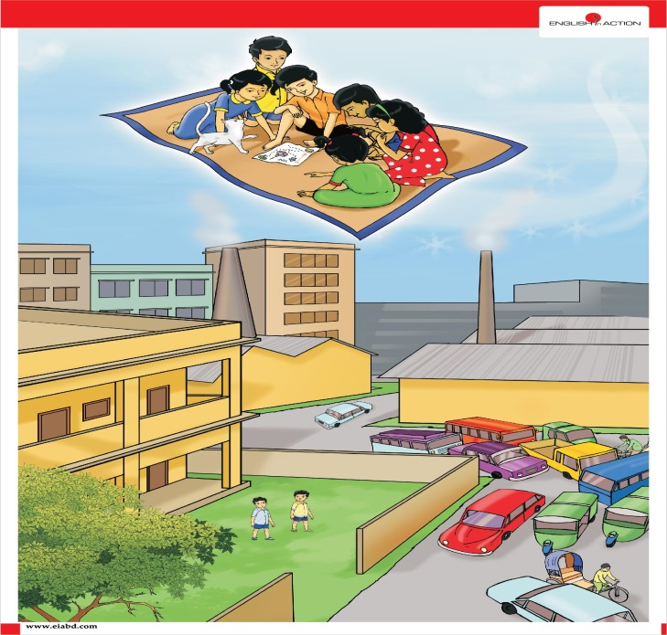
We know which words with W and which words with H?
Ans: আমরা W এর জন্য What, Who, Where and Why শব্দগুলো এবং H এর জন্য How শব্দ সর্ম্পকে জেনেছি।

Slide 20
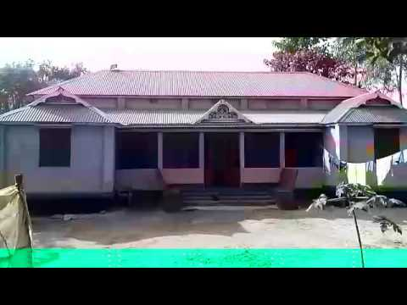
Home work
W দিয়ে ৩ টি এবং H দিয়ে ১টি প্রশ্ন তৈরি করে আনবে।

Slide 21
Thanks To All, See You Next.
Good bye
Good bye

