Slide 2
Identity
Mahfuja Khatun
Head Teacher
6 no Sujanagor Govt Primary School
Pangsha, Rajbari.
Class: two
Subject: English
Unit: 29
Lesson: 4-6 (A poor farmer …….... the egg.)

Slide 3
Learning outcomes
Students will be able to
1.1.1 repeat after the teacher simple words and phrases with proper sounds and stress.
4.2.1 enjoy simple stories.

Slide 4
Let’s watch a video

Slide 5
Story
The Golden Goose

Slide 6
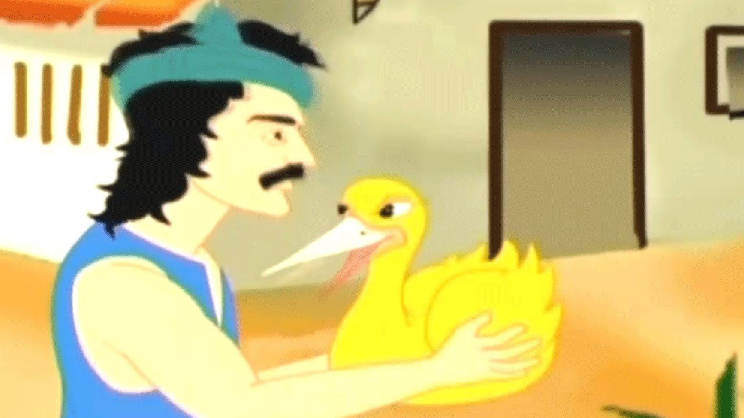
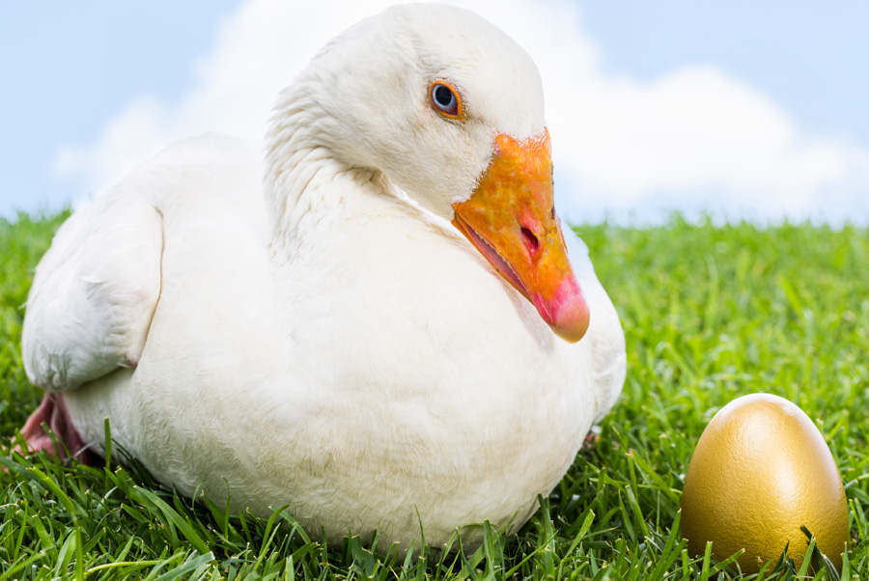
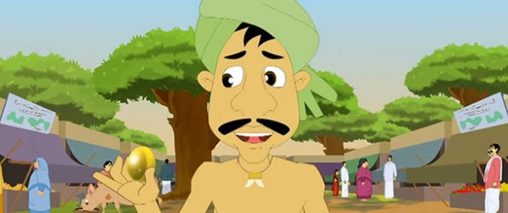
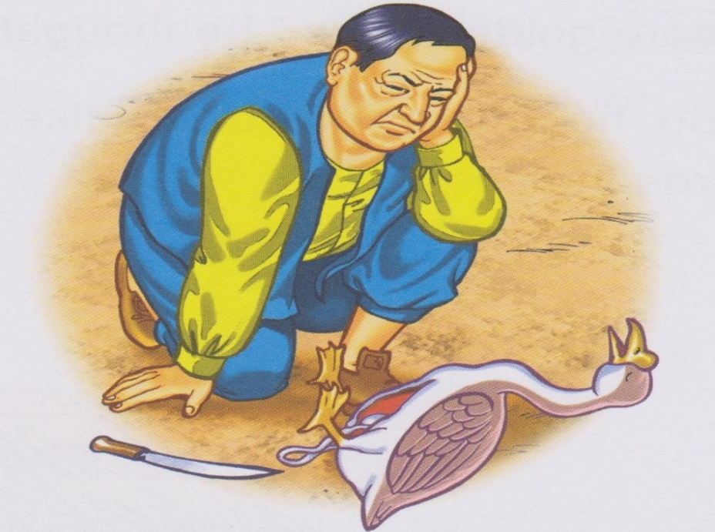

Slide 7
A poor farmer has a goose.

Slide 8
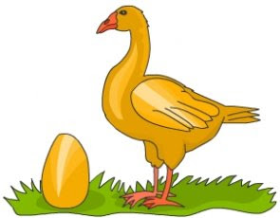
Everyday, the goose lays an egg.

Slide 9
It’s a golden egg.

Slide 10
Everyday, the farmer sells the egg.

Slide 11
Open your book at page 59

Slide 12
Teachecr’s reading
Just listen and put your finger under the words what I say.

Slide 13
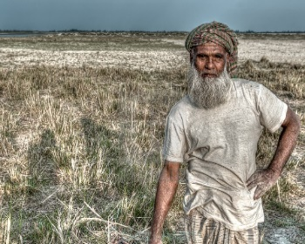
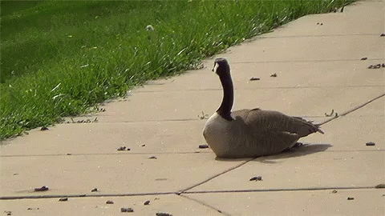
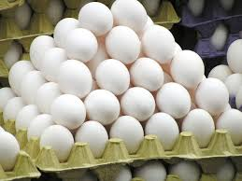
New words
Farmer
Goose
Egg
Golden

Slide 14
Students loud reading
Let’s read the text loudly in whole class and then in pair and individually.

Slide 15
Evaluation
Pronunce and say the meaning the words:
Everyday
Goose
Lay
Farmer
Egg

Slide 16
Home Work
Draw an egg and colour it golden.

Slide 17
THANK YOU

