Slide 1
Welcome

Slide 2
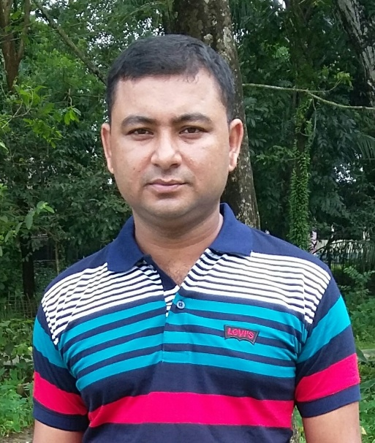
INTRODUCTION
Pankaj Datta
Asst. Teacher
Shyamnagar Govt. Primary School ,
Chhatak . Sunamgonj.
English For Today
Class:One
Lesson:4-6
Unit:2
Topic:Alphabet(A,a)

Slide 3
Learning Outcomes
Students will be able to...
say the alphabet a and A after the teacher.
read the alphabet a and A.
write the alphabet a and A.

Slide 4
Let’s see a pitcure

Slide 5
Today’s lesson
a
A
Say and read . Trace and write

Slide 6
Listen the audio
See the picture

Slide 7
Open your book at page no. 5 and read loudly with me.

Slide 8
Follow my writing….

Slide 9
Follow my writing….

Slide 10
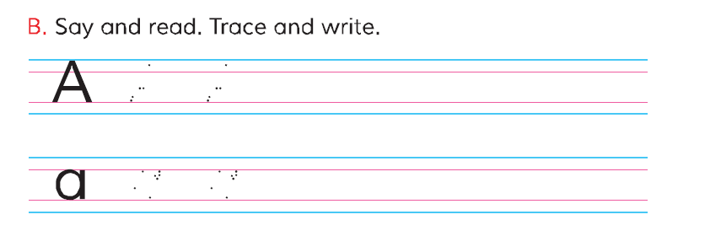
Say the letters with your group.

Slide 11
Read the letter
What is the letter?
What is the letter?

Slide 12
Write the letter
Write the letter like this.
Write the letter like this.

Slide 13
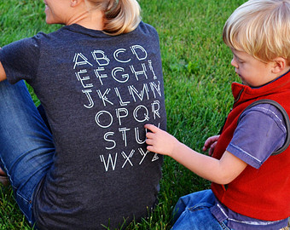
Trace the letter A and a to your partners back.

Slide 14
Write the missing letter
pple
pple

Slide 15
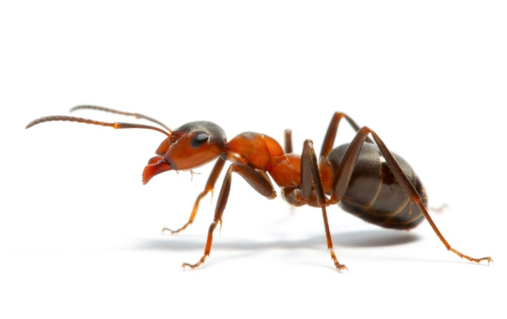
Write the missing letter
nt
nt

Slide 16
Evaluation
Write the letter A and a, then colour them.

Slide 17
Home Work
Write the begining letter of the alphabet both capital and small.

