Slide 1
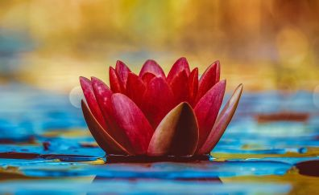
Welcome

Slide 2
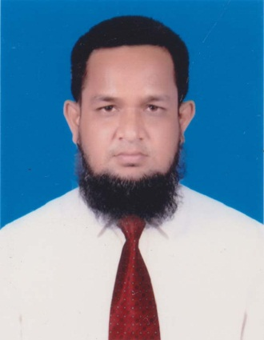
Teacher’s Identity
MD.ABDUR ROUF
Lecturer in English
Khalna Islamia Fazil(Degree) Madrasah
Patnitola,Naogaon.
rouf301285@gmail.com 01767650169

Slide 3
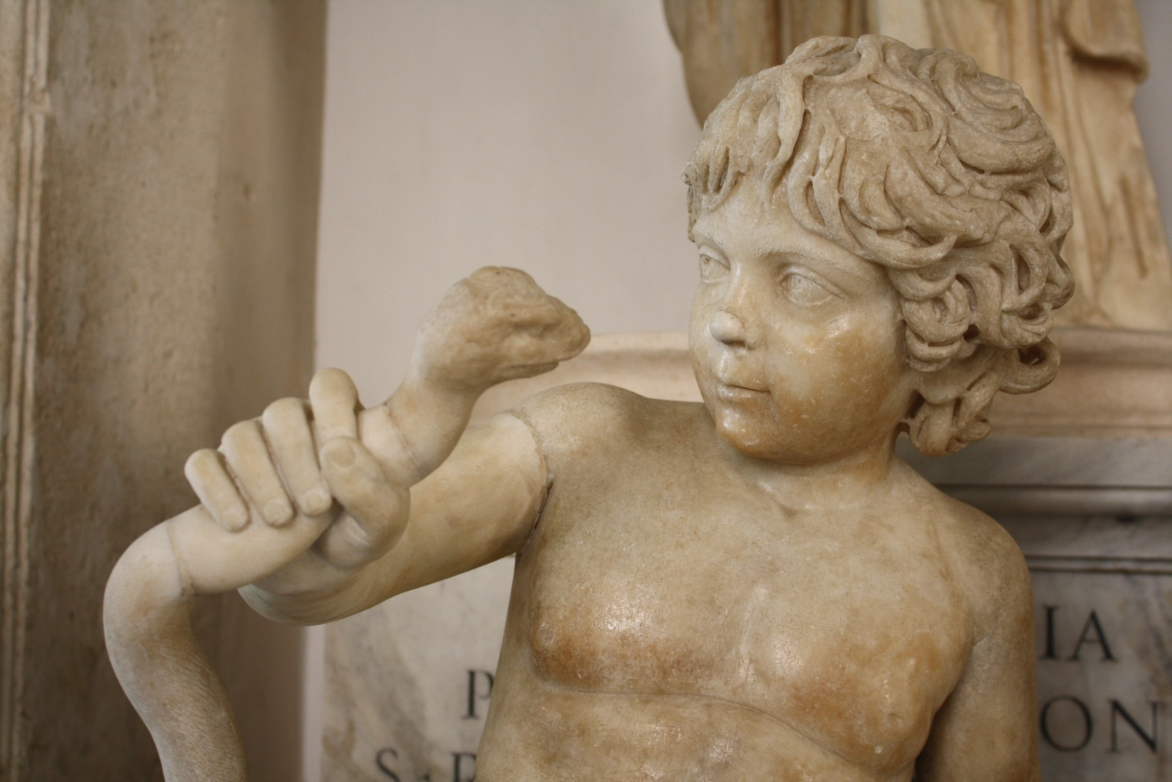
Let us watch some pictures

Slide 4
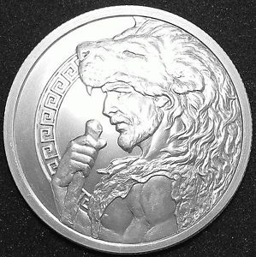

Slide 5
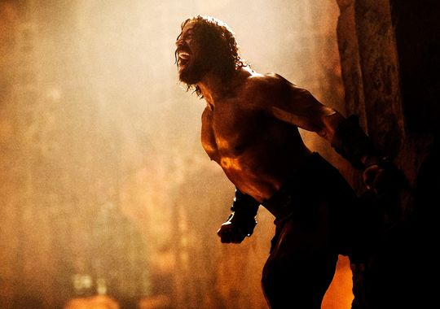

Slide 6
Announcement of the Lesson
HERCULES

Slide 7
Introduction of the lesson
English 1st Paper
Class: xi
Unit: Nine (Myths and Literature)
Lesson: 4 Time:45 minutes 15/02/2020

Slide 8
Learning outcomes
Students will be able to…….
# Tell the meaning of some words.
# Describe the” second labour” of the hero.
# Describe the reasons for calling Hercules a hero.

Slide 9
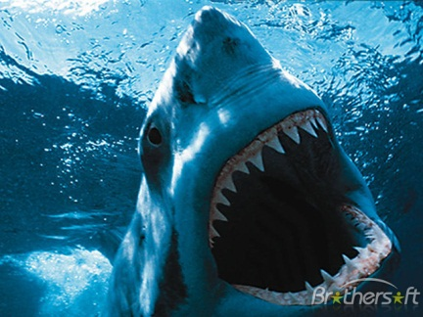
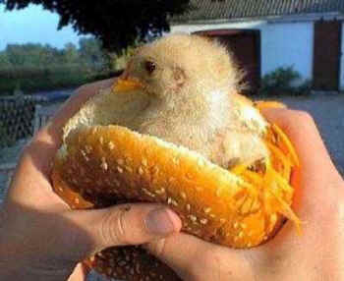
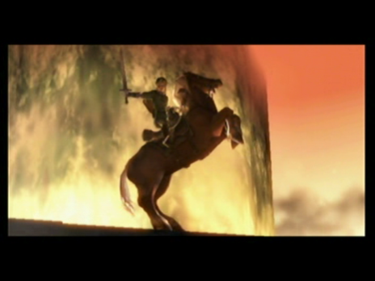
Word meaning
Terrible
Dreadful
Slay
kill
Victorious
Winner

Slide 10
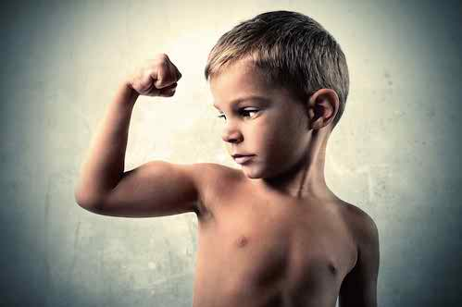
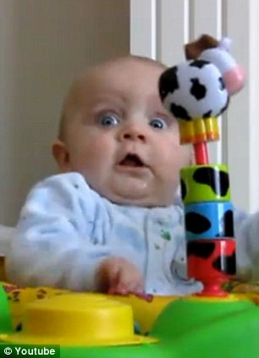
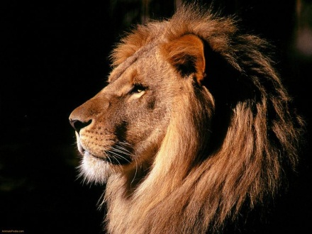
Strength
Power
Terrified
Scared
Beast
Animal

Slide 11
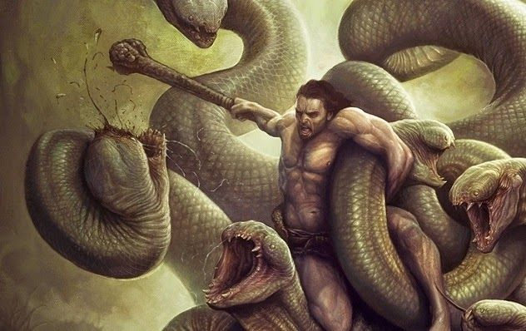
His next task was to slay a monster called Hydra that was ravaging the country of Argos.

Slide 12
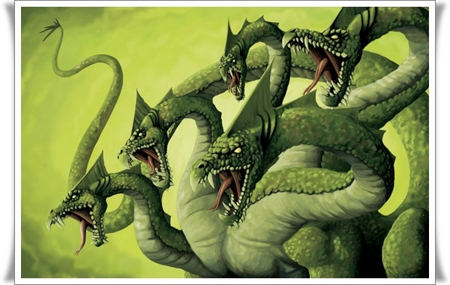
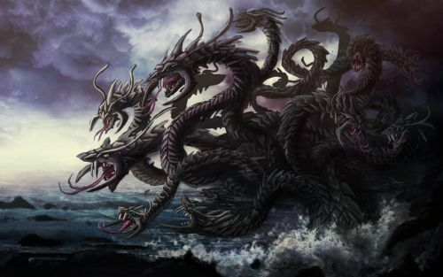
The Hydra had nine heads.
Among them the middle one was said to be immortal.

Slide 13
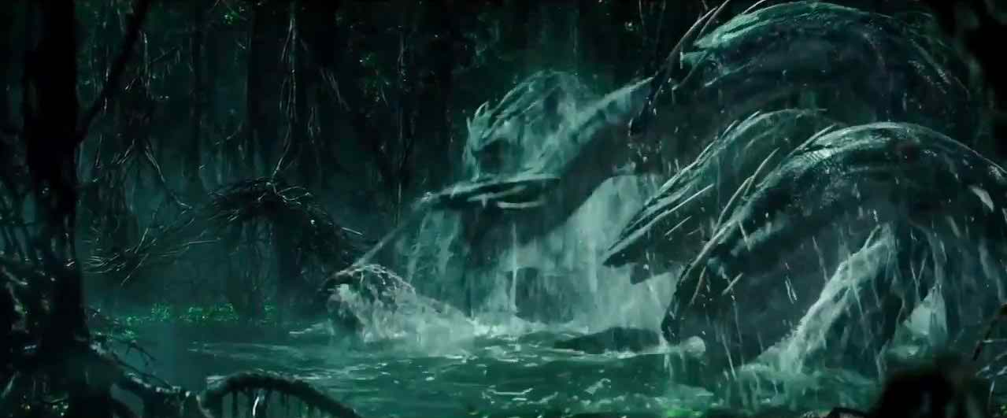
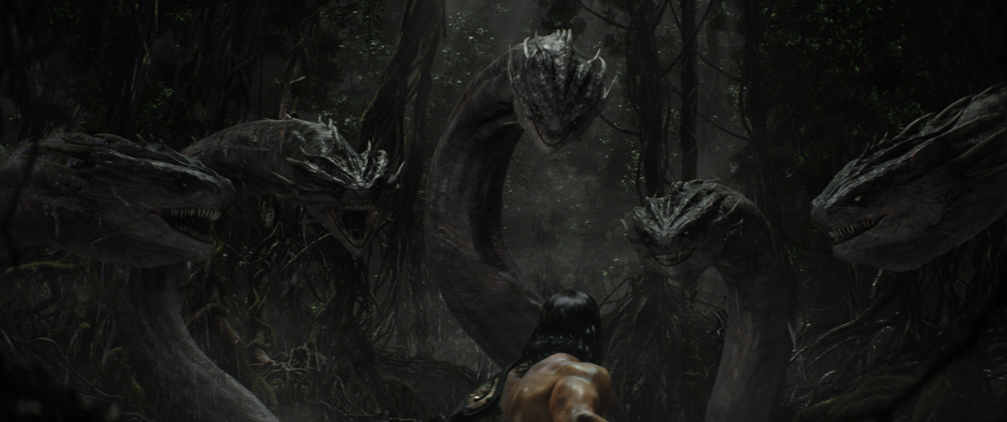
Our hero struck off its heads with his club, but whenever he knocked off a head ,two new ones erupted in its place.

Slide 14
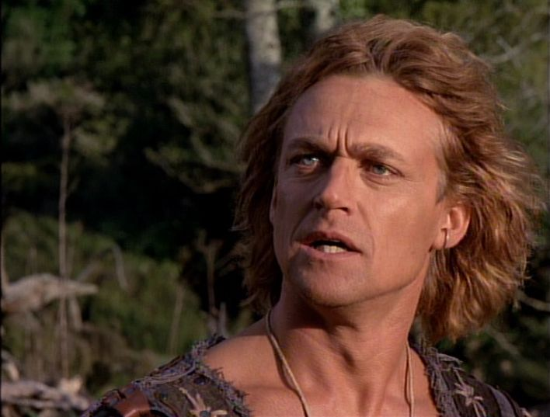
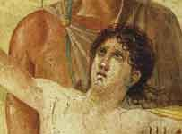
Micheal Hurst as Iolaus
Iolaus
Eventually with the help of his devoted servant Iolaus, Hercules succeeded in burning all the heads if the Hydra except the ninth or immoral one, which he decided to bury under a huge rock.

Slide 15
Single work
1.Who gave Hercules all the labours?
2.What was the second labour of Hercules?
3. How did he kill the hydra?

Slide 16
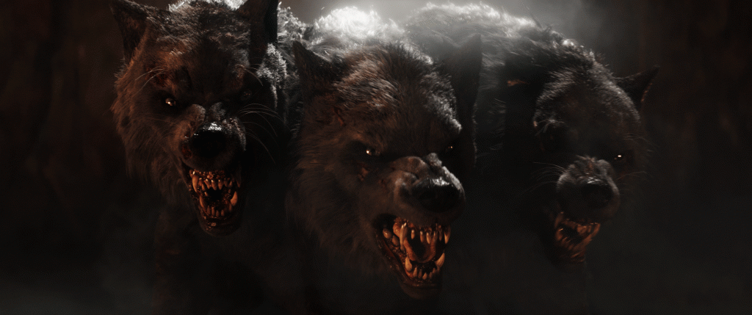
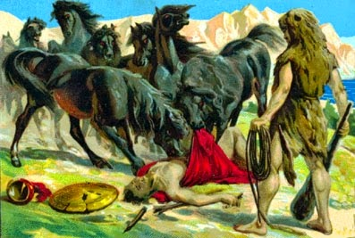
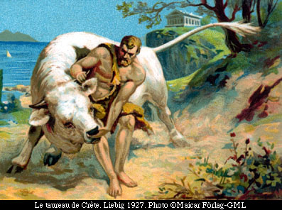
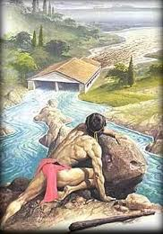
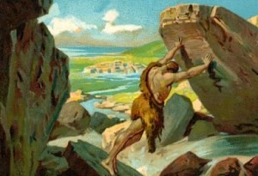
The Horses
The Hind
Hercules triumphed again and again, as he would every time he was given an impossible task by Eurystheus
The Bull
The Boar
The stable

Slide 17
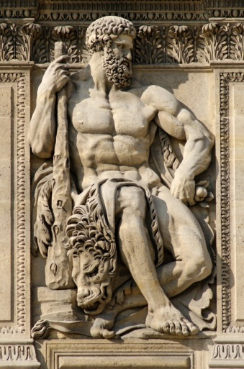
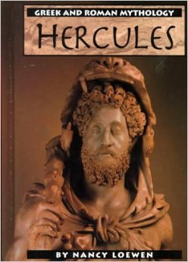
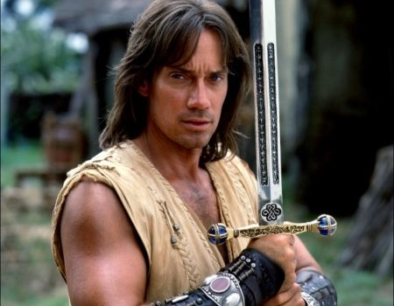
Because of twelve labours Hercules began to acquire reputation of a hero possessing immense strength throughout the world.
Kevin as Hercules

Slide 18
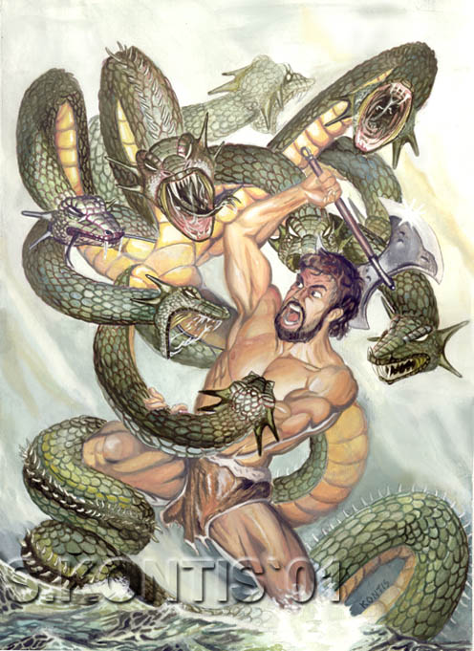
Pair work
Discuss Hercules’s second labour?
2. What did he do with Hydra’s immortal head?

Slide 19
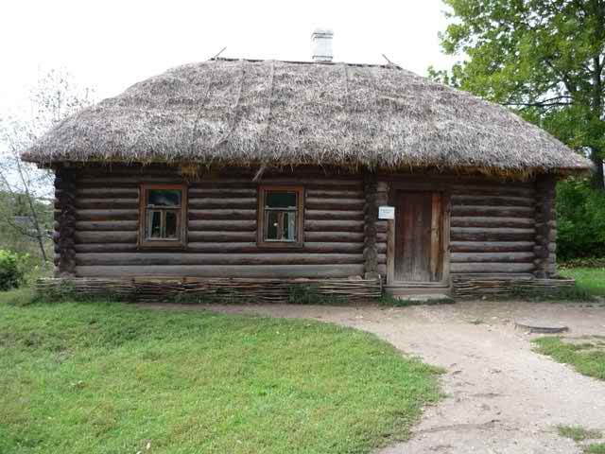
Write a paragraph on Hercules’ SECOND LABOUR

Slide 20
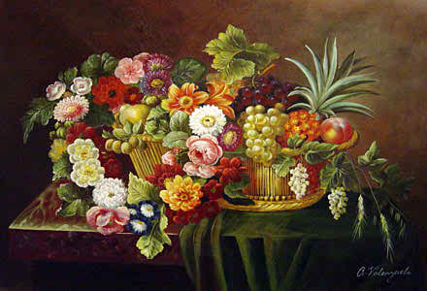
Thanks a lot

