Slide 1
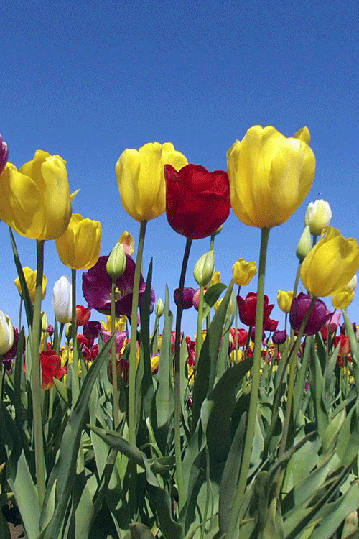
Welcome

Slide 2
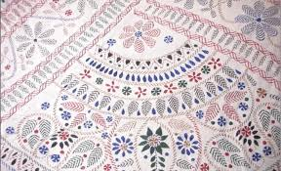
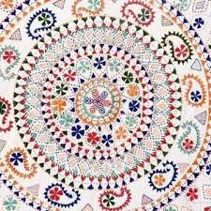
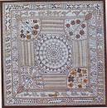
Let’s see some pictures

Slide 3
Today’s Lesson
Subject: English 1st paper
Unit: One
Lesson: 2
Introduction:
Md. Jewel Hossain
Assistant Teacher (Language)
Ramchandrapur Bahrul Ulum Islamia Alim Madrasah
Mohadebpur, Naogaon

Slide 4
Learning Outcomes:
Students will be able to-
know about Nakshi Kantha
know the history of Nakshi Kantha
know new words

Slide 5
Read the text loudly
Nakshi Kantha is a kind of embroidered quilt. The name was taken from a Bengali word `naksha’ which means artistic pattern. It is a kind of traditional craft and said to be indigenous to Bangladesh and West Bengal in India. The art has been practiced in rural Bengal for centuries. The name Nakshi Kantha become popular after the poet Jasim Uddin’s poem ‘Nakshi Kanthar Math’ was published in 1929.
Traditional kanthas are made for family use. Old or new cloth and thread are used to make this quilts. Mymensingh, Jamalpur, Ranshahi, Faridpur, Bogra and Jessore are most famous for this craft. Now it is produced commercially. You can find them in many expensive handicraft shops in cities. The quilts are now in great demand because of the colourful patterns and designs embroidered on them.

Slide 6
Some New Words
Embroidered | Decorated (cloth) by sewing pattern on it with thread.
Artistic | Having natural creative skill.
Indigenous | Originating naturally in a particular place.
Handicraft | Something made by hand.
Pattern | An ideal model of something.

Slide 7
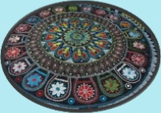
Artistic Pattern

Slide 8
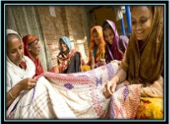
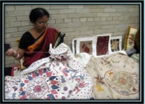
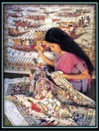
Technique of making Nakshi Kantha

Slide 9
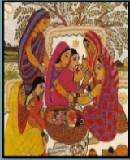
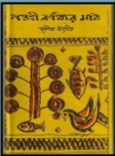
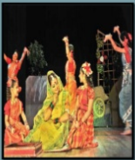
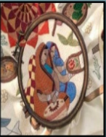
Jashim Uddin’s “Nakshi Kanthar Math”

Slide 10
Pair works
Answer the following questions:
1. What is ‘Nakshi Kantha?
2. Who was Jasim Uddin?
3. When did the name Nakshi Kantha become popular?

Slide 11
Home Work
Write a short paragraph on ‘Nakshi Kantha’.

Slide 12
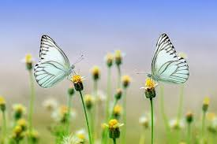
Thank You

