Slide 1
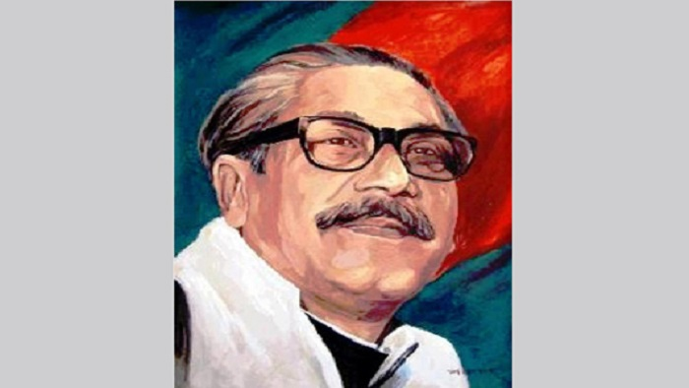

Slide 2
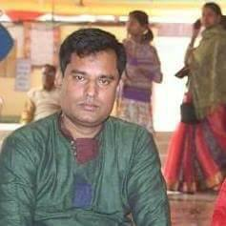
Presented by
Uttam chandra samadder
Head teacher
Kachipara Govt. Primary School

Slide 3
Class:Five
Sub :English
Knowledge about The Father of Nation.

Slide 4
Learning Outcomes
By the end of the lesson the students will be able
***To gather some knowedge about The father of nation.

Slide 5
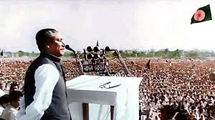
LOOK AT THE PICTURES

Slide 6
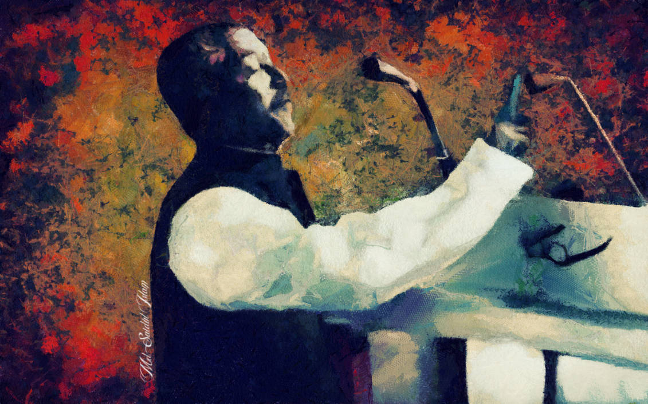

Slide 7
Ask ss Who is this person?

Slide 8
If this person not born,we can not get Independent..

Slide 9
This honourable person was The Father of Nation.

Slide 10
What is it?

Slide 11
In group ss says a cake we cut in our birthday..

Slide 12
The father of nation was born in 1920,100 years ago..
So we celebrate Mujib Borsho this year,2020.

Slide 13
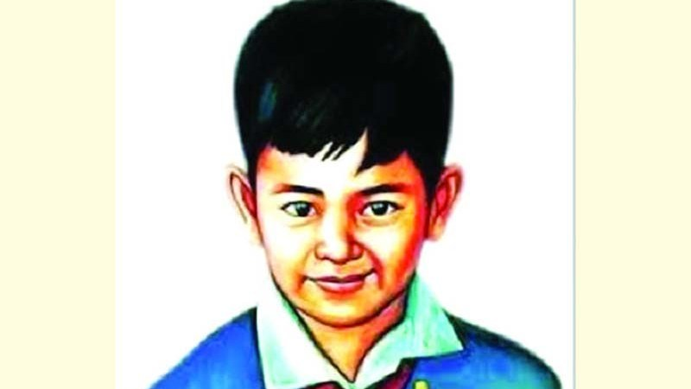

Slide 14
What was the reason they kill this innocent boy,Our love,Our future.

Slide 15
Homework
Think about this person and write 10 lines about him.

