Slide 1
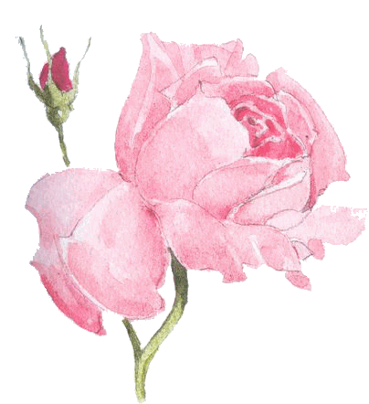
Welcome
Pankaj Datta Assistant Teacher. Shyamnogor Govt. Primary School.

Slide 2
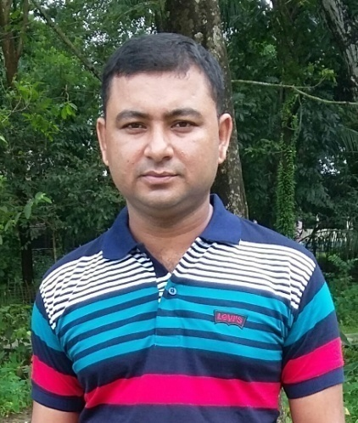
Presented by
Pankaj Datta
(Assistant teacher)
Shyamnagar Govt. Primary school.
Chhatak, Sunamgonj.
Phone :01717725265
www.pankajdattaat@gmail.com
Pankaj Datta Assistant Teacher. Shyamnogor Govt. Primary School.

Slide 3
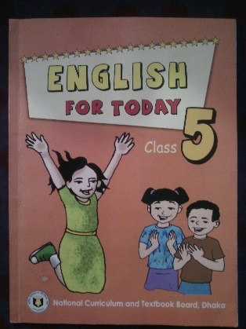
English For Today
Class-Five
Subject-English
Unit: 8
Lesson:1-2

Slide 4
Learning outcomes:
Students will be able to…
1.3.1: recognize which words in a sentence are stressed.
2.1.1: carry out simple commands and instruction.
1.1.2: say sentences with proper sound.
5.1.1: read silently with understanding paragraph.
6.1.1: read instructions and carry out them.

Slide 5
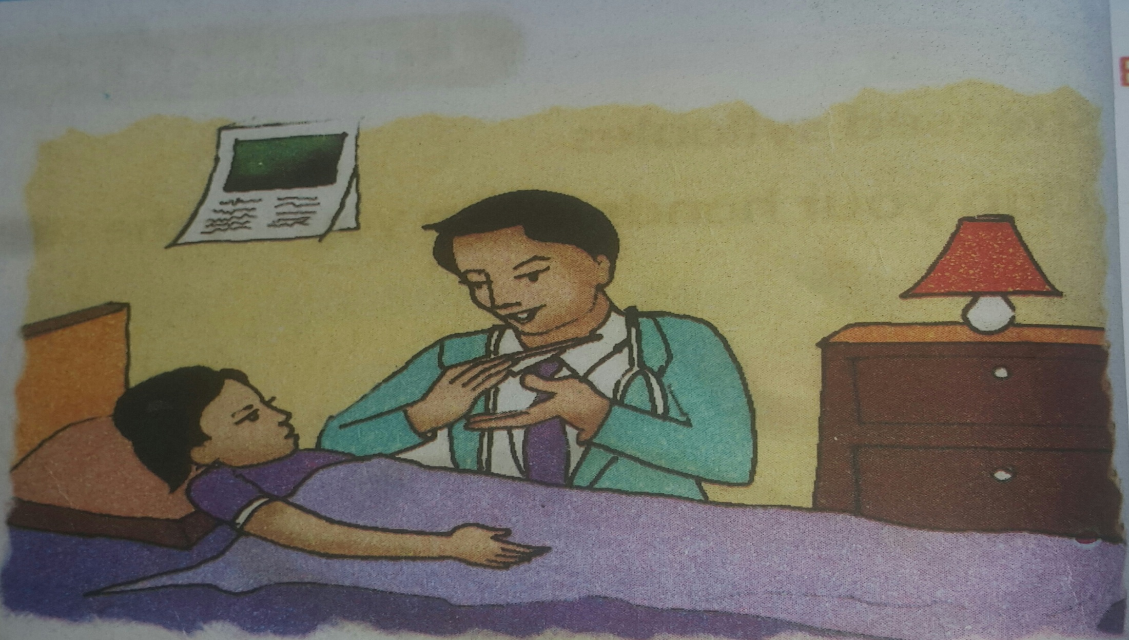
Look at the picture
Doctor
Sima

Slide 6
Declaration of the topic
Write to me soon!

Slide 7
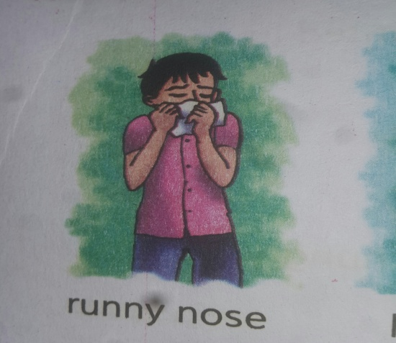
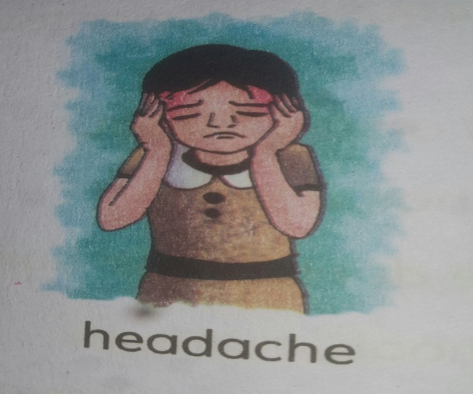
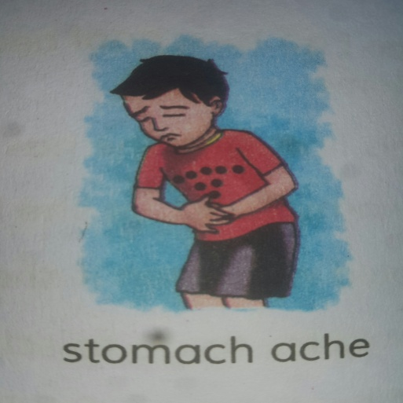
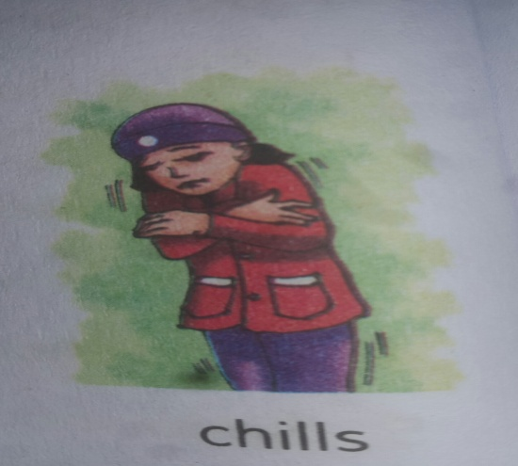
Look at the picture and talk about it
Runny nose
Headache
Stomach ache
Chills

Slide 8
Teacher reading the text loudly
Sima is at home today. She didn’t go to school because she is ill. She has a cough and a sore throat. She also feels very warm because she has a fever. She has the flu. The doctor visited Sima last night. She needs some medicine. He also told her what to do in order to get well soon.
The doctors advice
Eat foot that gives your body………………these things.

Slide 9
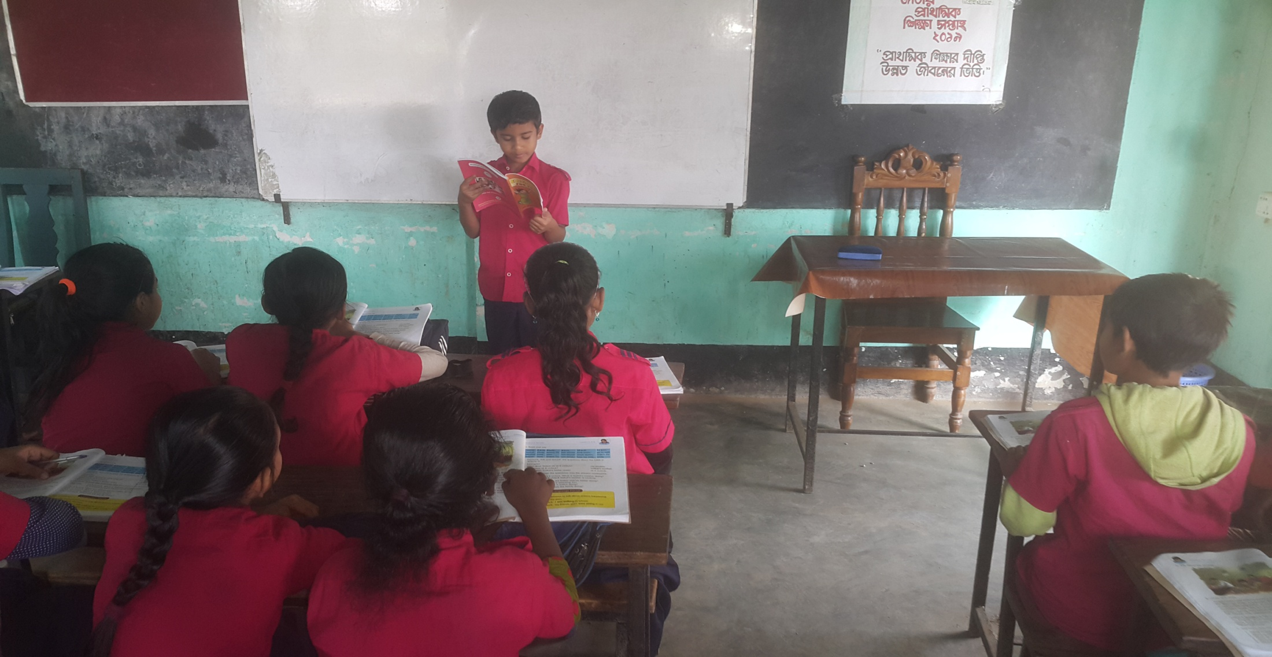
Student aloud reading the text after teacher`s reading

Slide 10
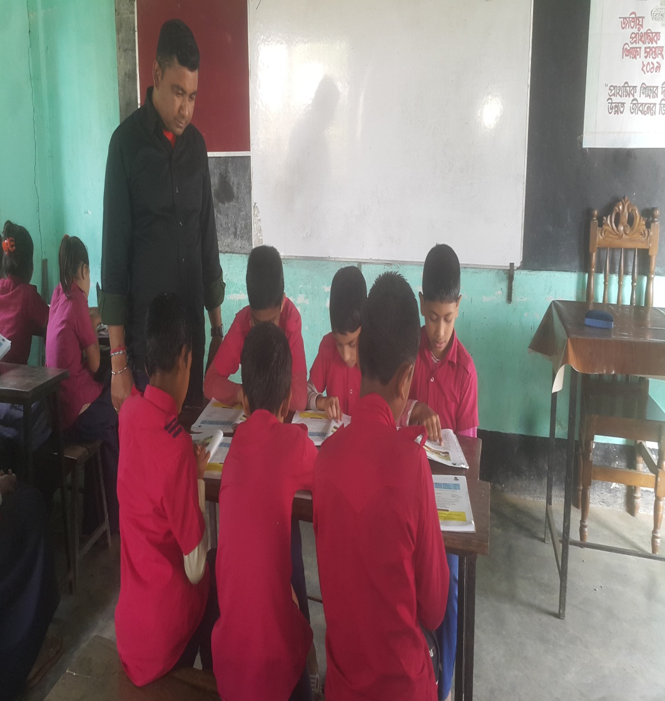
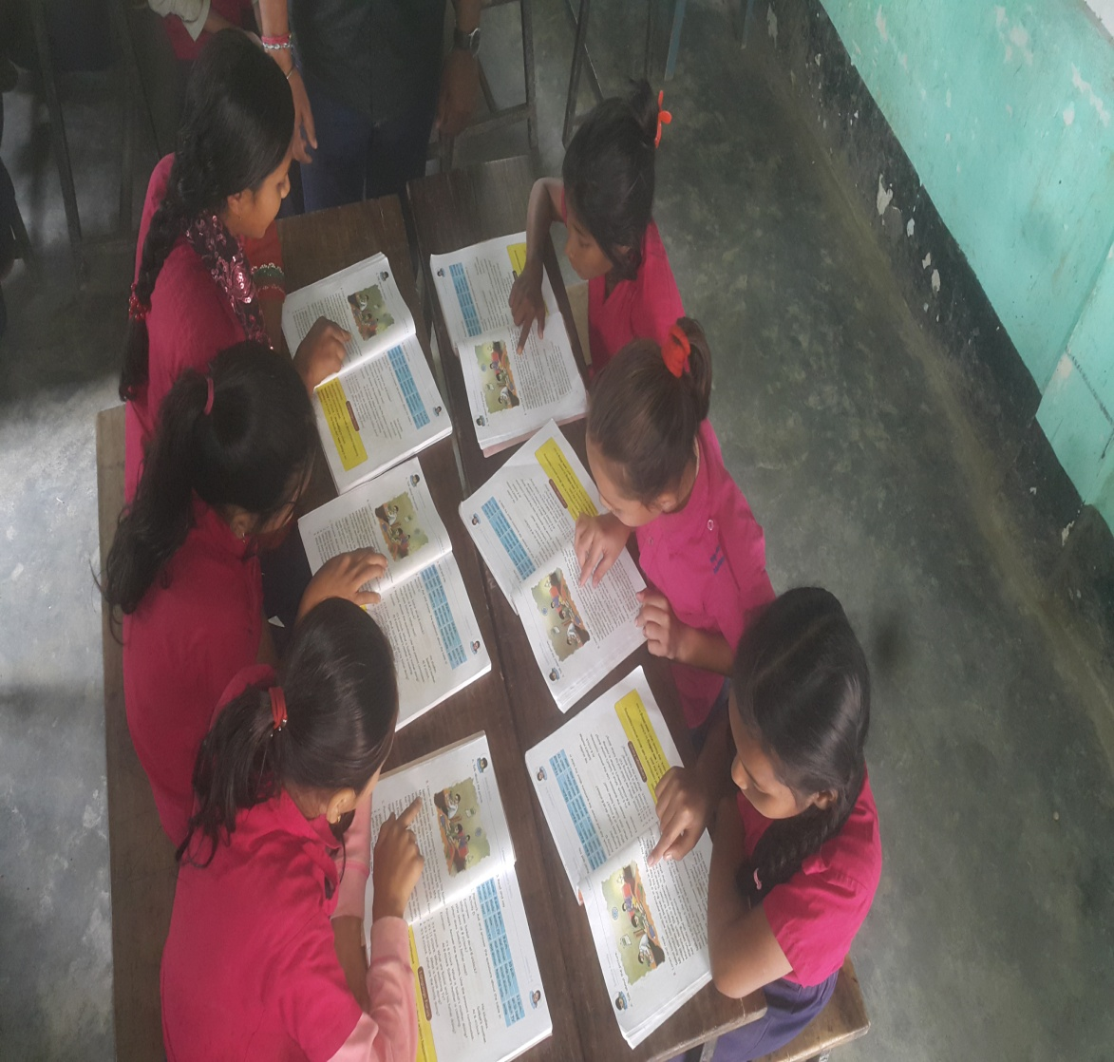
GROUP WORK

Slide 11
Group Red:
Why is Sima using a lot of tissues?
Why can’t Sima eat very much?
Group Green:
Does Sima’s doctor want her to eat?
Why can’t Sima’s friend’s visit her?

Slide 12
Matching words with meaning
Today The day before tomorrow.
Cough A kind of disease.
Energy Capacity for doing work.
Drink To take liquid into one’s mouth and swallow it.
Visit To go a place and meet people.

Slide 13
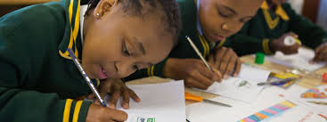
EVALUATION
What happened to Sima?
What is flu? What does flu cause?
Why is Sima at home today?
Why didn’t Sima go to school?

Slide 14
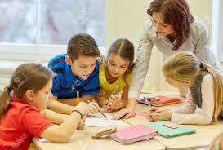
Understood the weak student by teacher

Slide 15
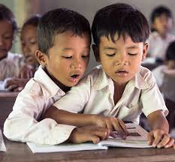
Understood the weak student by strong student

Slide 16
Pair Work
Write at least 5 sentence about Sima’s illness.

Slide 17
GOOD BYE

