Slide 1
wellcome

Slide 2
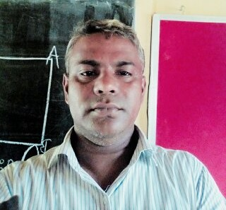
Teachers Introduction
Name:Biplab Chandra Paul
Head Teacher
Auliabad govt.primary school
bpaulhtgps@gmail.com

Slide 3
Lesson Introduction
Subject::English class: one
Lesson:unit 11 lesson1-3 Time:45 min

Slide 4
Leaarning outcome
Listening:
Speaking:
Reading:
Writing:

Slide 5
Justify previous lesson
1.Which is your left hand ?
2.Which is your right hand?
3.Which is ground
4.Which is sky?
5.Make a word with H.

Slide 6
Our today’s lesson is--
COMMANDS

Slide 7
open

Slide 8
close

Slide 9
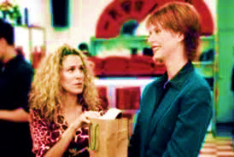
Show me

Slide 10
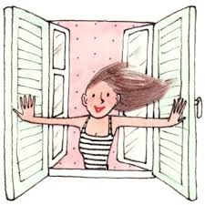
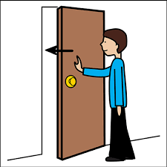
Close the door.
Show me your bag.
Open the window.

Slide 11
Open your bag.
Show me your bag.your bag

Slide 12
Show me your book.
Close your book.
Open your book

Slide 13
Say with me
Open
Close
Show me
window
door
Your bag

Slide 14
Open your note book and write them 10 time.
Open
Close

Slide 15
Open- ওপেন - খোলা

Slide 16
That’s all for today. Goodbye. See you tomorrow.

