Slide 1
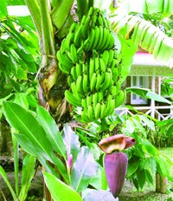
Welcome

Slide 2
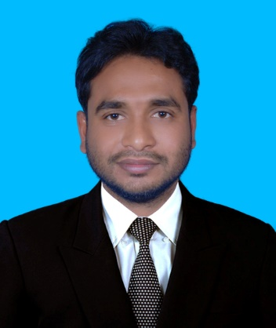
Introductions
Md.Sarwar Jahan
Assistant Teacher
Ramnagar Govt. Primary School.
Godagari , Rajshahi.
Mobile no: 01766607536
Email:sarwarjahan03@gmail.com
Subject : English
Class: Three
Unit : 36
Lessons: 1-3
Date:20.02.2020
Time:50 Minutes.

Slide 3
Learning Outcomes
Students will be able to :
1.1.1 : Repeat words, after the teacher with
proper sounds and stress;
1.1.2 : Say words with proper sounds and stress.

Slide 4
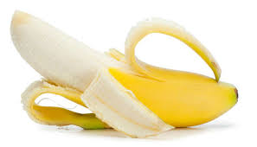
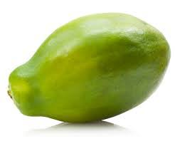
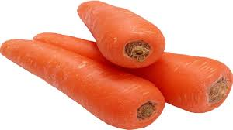
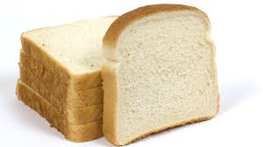
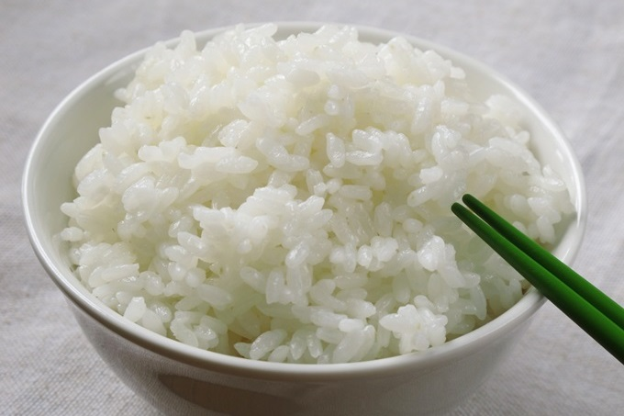
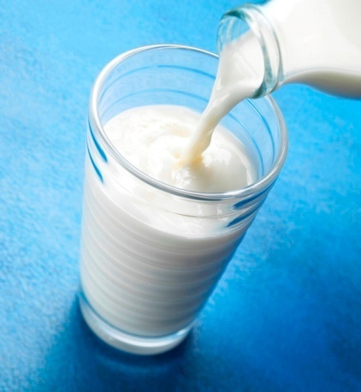
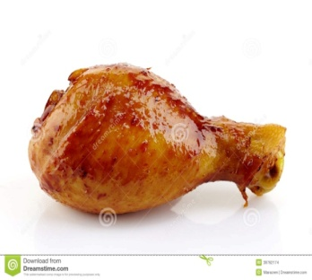
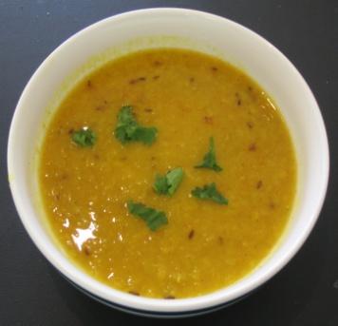
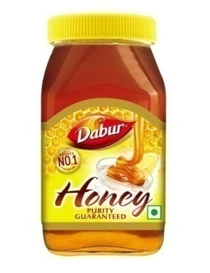
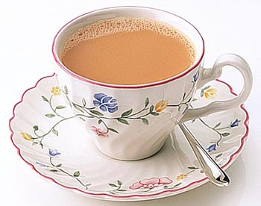
Look at the pictures
Which things can you see in this picture ?

Slide 5
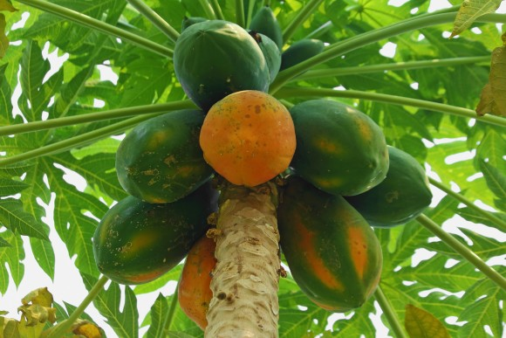
Today’s Lesson
Food we need

Slide 6
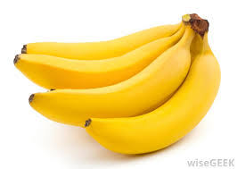
Listen and say
Look at the pictures
banana

Slide 7
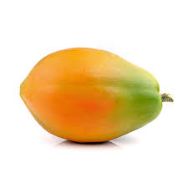
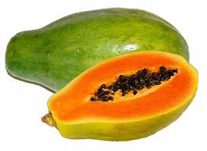
Look at the pictures
Listen and say
papaya

Slide 8
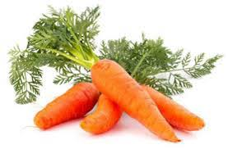
Look at the pictures
Listen and say
carrot

Slide 9
Pair work
Say the name of picture

Slide 10
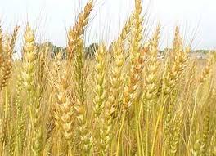
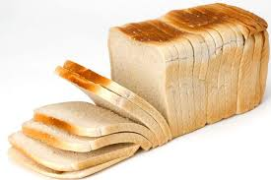
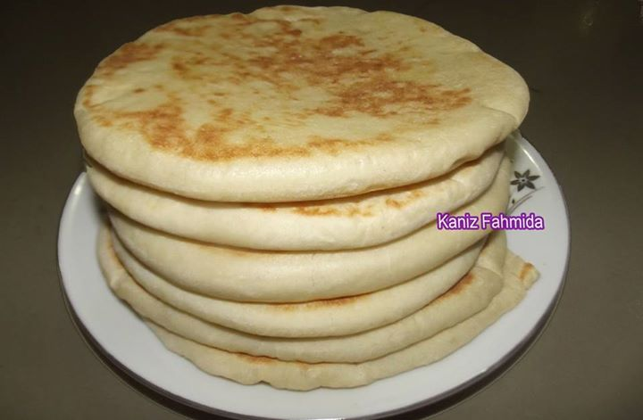
Look at the pictures
Listen and say
Ruti, Bread

Slide 11
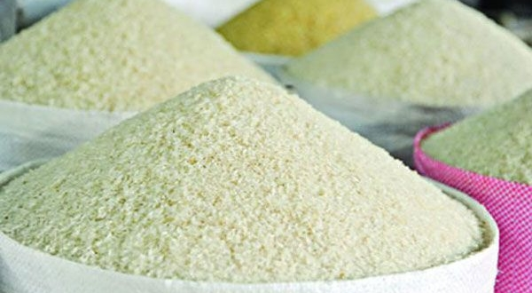
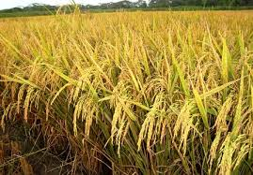
Look at the pictures
Listen and say
Rice

Slide 12
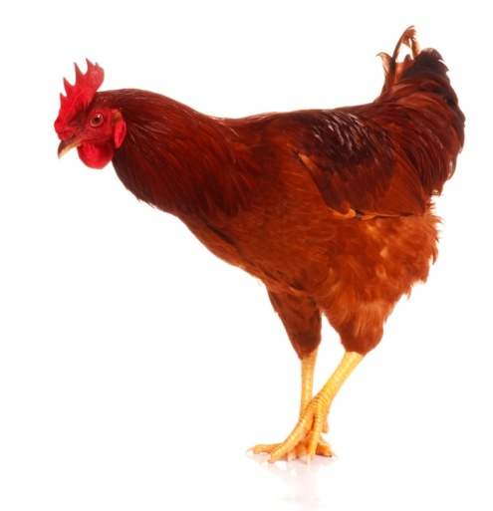
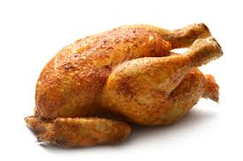
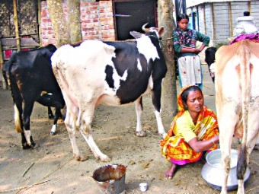
Look at the pictures
Listen and say
chicken
milk

Slide 13
Group work
What foods are from plant and trees?
What foods are from animals?
banana, papaya, carrot, chicken, milk, honey, bread,ruti, rice , juice, lentils, tea.
Food from plants and trees | Food from animals

Slide 14
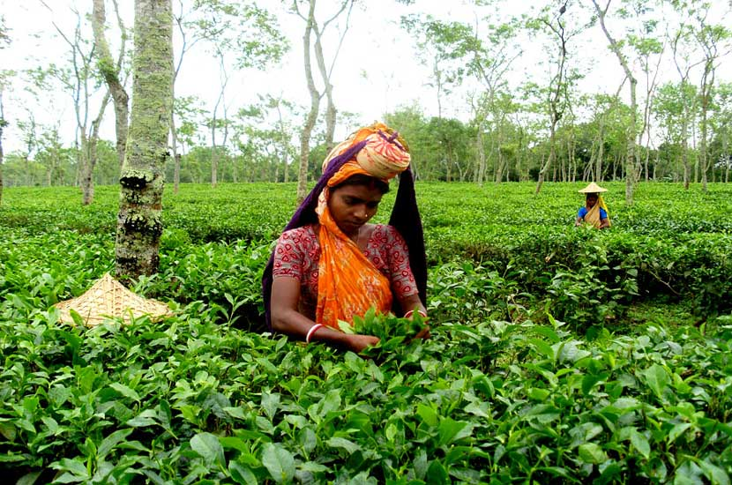
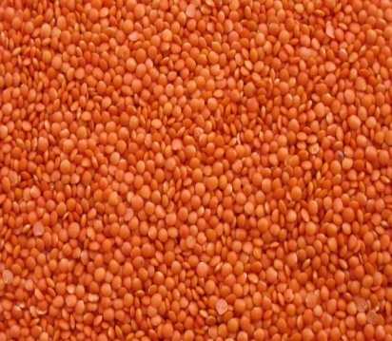
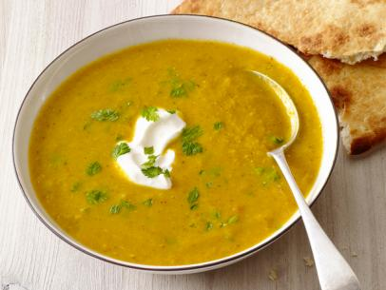
Look at the pictures
Listen and say
tea
lentils

Slide 15
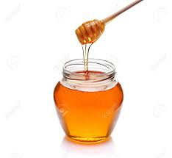
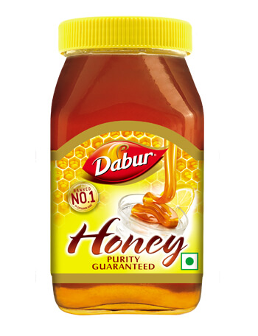
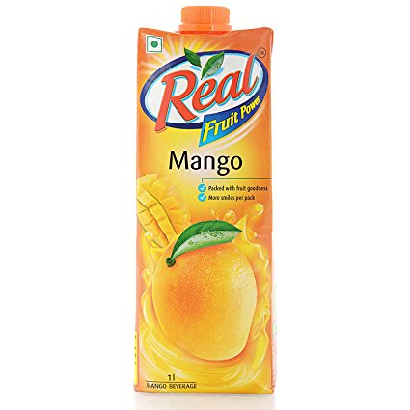
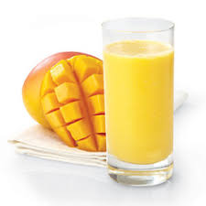
Look at the pictures
Listen and say
honey
juice

Slide 16
Evaluation
Answer the following questions
What foods are from plant and trees?
What foods are from animals?

Slide 17
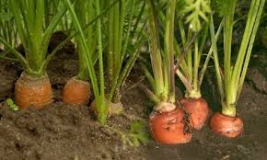
Home work
Write the name of five another foods.

Slide 18
Thanks to all

