Slide 1
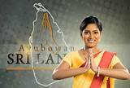
Welcome

Slide 2
Introduction of lesson
Subject: English
Class- 9-10
U-5: OUR NEIGHBOURS
L- 6: SRI LANKA
Time 45 min
ENGLISH FOR TODAY
9- 10

Slide 3
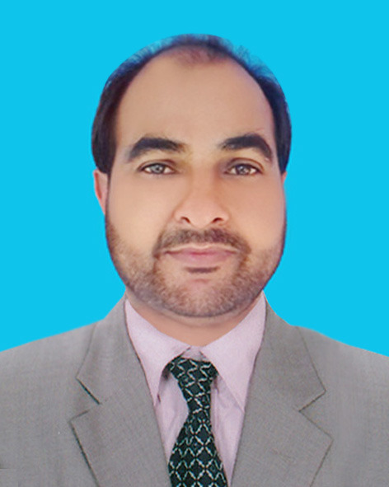
Introduction of teacher
AMZAD HUSSAIN RASEL
ASST. TEACHER
AMRIA ISLAMIA ALIM MADRASAH
MOB- 01717569526
amzadhrasel1981@gmail.com

Slide 4
Look at the flags and talk with your mates: what are the countries names of these flags?
BHUTAN
INDIA
SRI LANKA
MALDIVES
NEPAL
PAKISTAN
They are our neighboring countries.

Slide 5
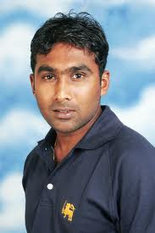
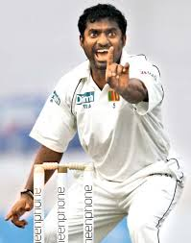
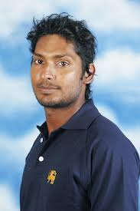
Look at the following pictures and guess who they are and what their names are.
Mahela Joybordhonay
Muttiya MuraliDharan
Kumar Sangakara
They all are Sri Lankan cricketers.

Slide 6
So today we’ll read about
OUR NEIGHBOURS
SRI LANKA

Slide 7
Learning outcomes:
After the lesson students will have .....
1. Read the passage with meaning.
2. They explain the keyword with meaning. 3. Answer the following questions.
4. Write a paragraph on the natural beauty of Sri Lanka.

Slide 8
Look at the picture and discuss with your friend :
Traditional greeting of Sri Lankan peoples
Ayubowan
Ayubowan mean: “ May you have the gift of long life”.

Slide 9
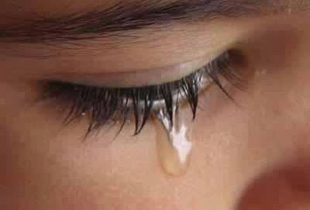
Key word
Teardrop
Meaning
A drop of water that comes from eye in sorrow and joy.
The nickname of Sri Lanka is teardrop of India.

Slide 10
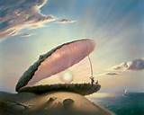
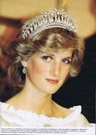
Key word
pearl
Meaning
Pearl is a hard object that grows in a shell.
Princes Diana used to wear crown made of pearl.

Slide 11
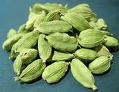
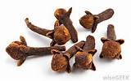
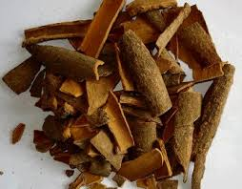
Key word
Spices
Meaning
A spice is a dried seed, friut, root, bark.
Spices make our carry delicious.

Slide 12
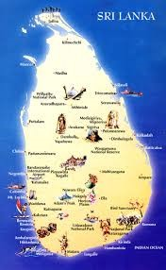
The nicknames of Sri Lanka.
Teardrop of India
Pearl of the Indian Ocean
Ceylon
Serendip

Slide 13
Land area of Sri Lanka.
Sri Lanka located in the Indian ocean just off south-eastern coast of India.
Sri Lanka measures about 415 kilometers from north to south and 220 kilo meters from east to west.
It has more than 1340 kilo meters of coastline.

Slide 14
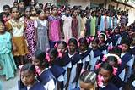
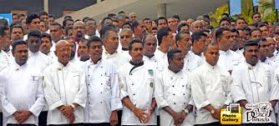
Population of Sri Lanka.
There are about 20 million people in Sri Lanka. It is multi religious, multi racial and multi lingual country.

Slide 15
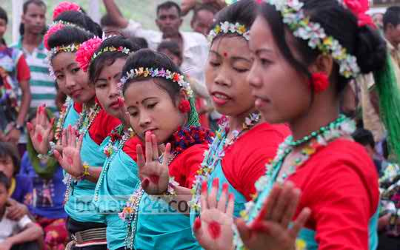
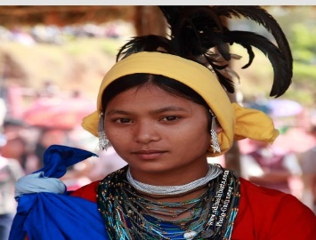
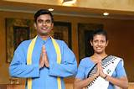
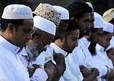
Ethnic groups in Sri Lanka
There are four major ethnic groups
Sinhalese
2. Sri Lankan Tamils
3. Indian Tamils
4. Sri Lankan Moors or muslims

Slide 16
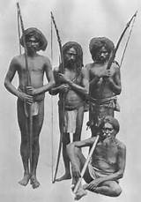
Look at the picture and guess who are they?
They are a fifth ethnic group named Veddhas, original inhabitants of Sri Lanka.

Slide 17
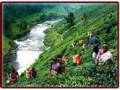
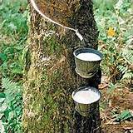
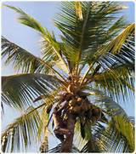
Economy of Sri Lanka
Sri Lanka Exporting crops such as.....
1. Tea
2. Rubber
3. Coconuts
4. Various Spices

Slide 18
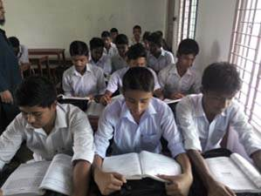
Silent Reading.
Read the passage carefully then answer the questions.
Which country is look like a tear drops?
2.Which country has the highest literacy rate in South Asia?
3. What is the name of the Ethnic groups of Sri-Lanka?

Slide 19
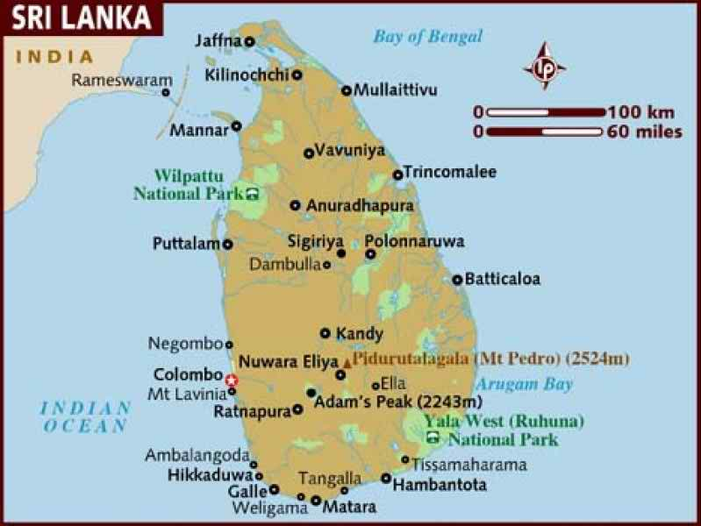
Look at the map then write down the location and shaped of Sri Lanka
Sri Lanka is located in the Indian Ocean, shaped like a teardrop.

Slide 20
Group works
Fill in each gap with a suitable word of your own based on the information from the text.
If you go to visit Sri Lanka, you will be welcomed With a traditional greeting . Sri Lanka is an island country which is situated in the Indian Ocean. Its shape is like a (b) . It is medium in size and population. Among all the ethnic groups, the Veddhas are the original (c) of the island. The ancient history of this land is depicted in (d) This island like country attracted many travellers as well as the ancient mariners and it still (e) the tourists of modern age by its enormous.
(a) Ayubowan
teardrop
Inhabitants
Ramayana
attracts

Slide 21
HOME WORK
Write a paragraph about the natural beauties of Sri Lanka.

Slide 22
Thank You

Slide 23
Acknowledgement
GOOGLE
NATIONAL CURRICULUM & TEXTBOOK BOARD, BANGLADESH.
TEACHER`S OF AMRIA ISLAMIA ALIM MADRASA.

