Slide 1
Welcome
you all
Today’s class.

Slide 2
Introduction
Class: Eight
Sub: English 1st paper
Unit: One, Lesson: 2
Total Students: 40
Present Students: 32
Date: 16 February 2020
Md. Mahbub Alalm
Assistant Teacher
Gogda Mozafarpur Dakhil Madrasah
Kendua, Netrakona.
Mob: 01721405063

Slide 3
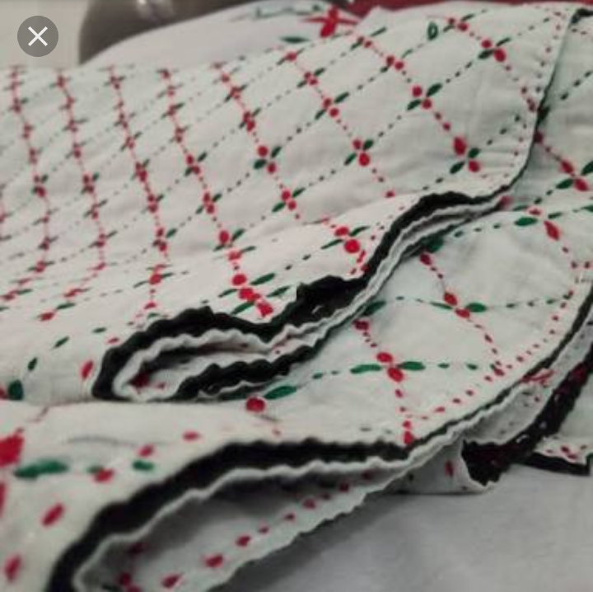
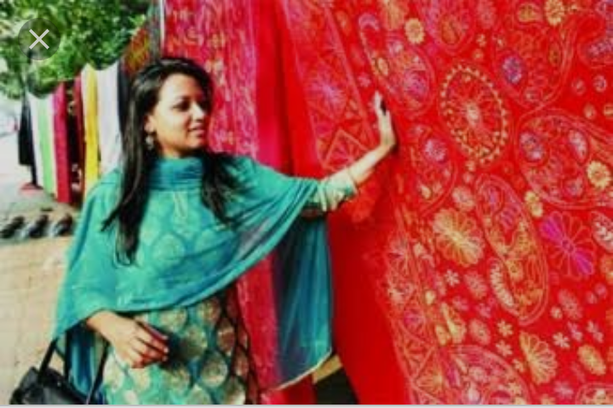
Let us see some pictures.
Nakshi Kantha

Slide 4
Our today’s Lesson is-
Nakshi Kantha

Slide 5
Learning Outcomes
After studied this lesson the students will be able to..
Be familiar with Nakshi Kantha.
Infer meaning from context.
Ask and answering some questions
Write a paragraph about “Nakshi Kantha”.

Slide 6
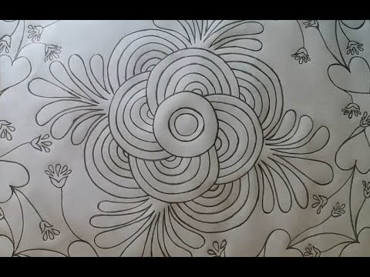
Nakshi Kanta is a kind of embroidered quilt. Old or new cloth and thread are used to make this quilt. The colorful patterns and designs embroidered on them. Specially the women in our country make Nakshi Kantha at their leisure time. It is one kind of hobby.
What is Nakshi Kantha ?

Slide 7
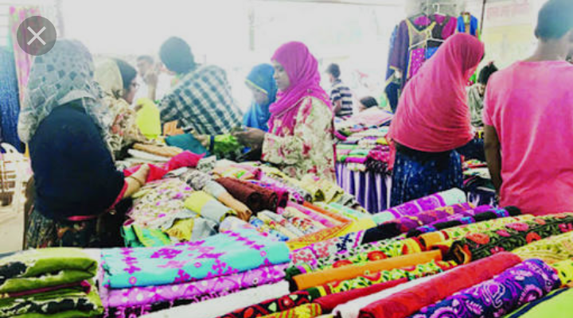
Where you find Nakshi Kantha ?
You can find Nakshi Kanta in many expensive handicraft shops in cities

Slide 8
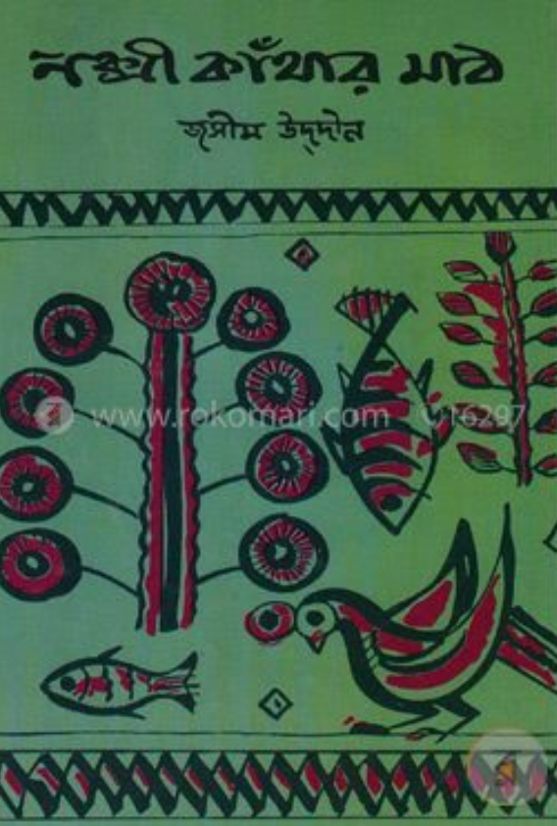
When the name “Nakshi Kanthas”became popular ?
After the poet Jasimuddin’s poem ‘’Nakshi Kanthaar Math”was published in 1929.

Slide 9
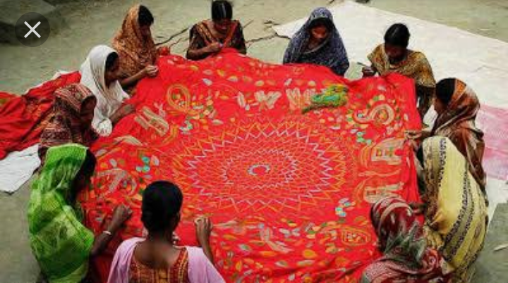
Key words and their meaning
Quilt-
Bedding made of two layers of cloth filled with stuffing and stitched together.
Handicraft-
A work produced by hand labor

Slide 10
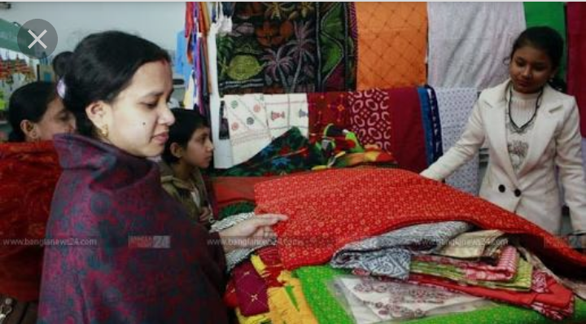
Key words and their meaning
Commercially-the activity of buying and selling.
Demand-is the amount of
Goods that people want to
Buy at a given price

Slide 11
Pair work
Read the text and answer the question below.
What is needed to make nakshi kanta ?
Where can you find nakshi kanta ?

Slide 12
Complete the sentences with given clues
Bengali patterns embroidery years fashion
art rural designs Quilt Naksha
patterns.
naksha
Naksha means artistic-------------
bengali
The name was taken from-----------word----------naksha.
rural
years
The art has been practiced in----------Bengal for--------.
fashion
Nakshi Kanthas are now sold in--------shops.
quiit
Nakshi Kanthas are a kind of --------.

Slide 13
Pair work
What is needed to make nakshi kanta ?
Where can you find nakshi kanta ?

Slide 14
Home work
Write a paragraph on ‘’Nakshi Kantha’’

Slide 15
Thank you all.

