Slide 1
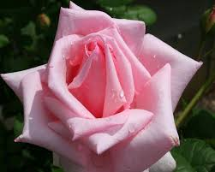
WELCOME

Slide 2
IDETITY
Rayhana khatun
Designation:Assestent
School:valluk danga government primary school
Class :Two
Subjed:English for today
Losson:4-6
Unit:16
Deat:18.2.2020

Slide 3
Learning out come
Listening:1.1.1 become familiar with English sounds by listening to common english words
Speaking :1.1.1 repeat after the teacher simple words and phrases with proper sounds and stress .
1.1.2 say simple word and phrases with proper sounds and stress .
Reading;1.4.1 read words and phrasen with the help of visual clues (about 30 new words) and simple sentences.

Slide 4
Colours
Notes:
দ

Slide 5
Teacher’s reading
red
Orange
Green
blue

Slide 6
:
indigo
yellow
violet

Slide 7
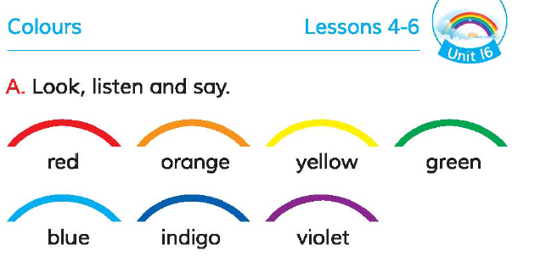
Open page 33

Slide 8
Group work
Group A:Red
Group B:green

Slide 9
Assesment
Say the name of colours.

Slide 10
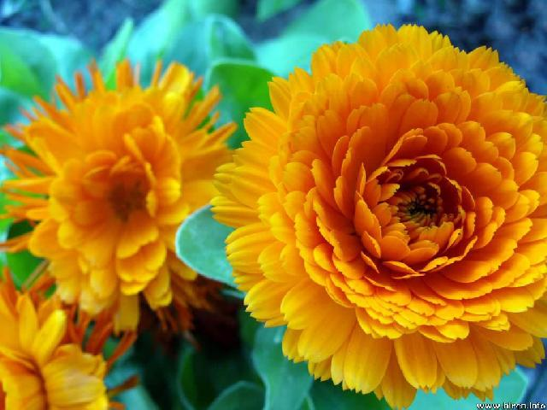
Thanks

