Slide 1

Welcome to my English Class

Slide 2


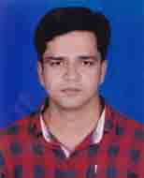
Identity
Subject : English Grammar & Composition
Class : Seven
Unit : Two
Title : Pronoun ( Indefinite pronoun)
Time : 50 min
Date : 01 February 2020
Md. Hossain Akanda
Assistant Teachetr (English)
Azim Memorial High School
Tangail

Slide 3

What can You see in the picture?

Slide 4


Slide 5


Slide 6
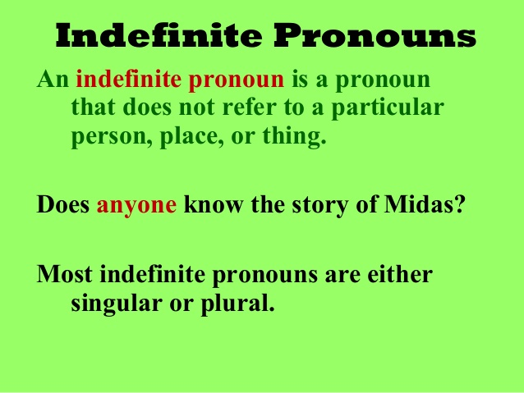

Slide 7
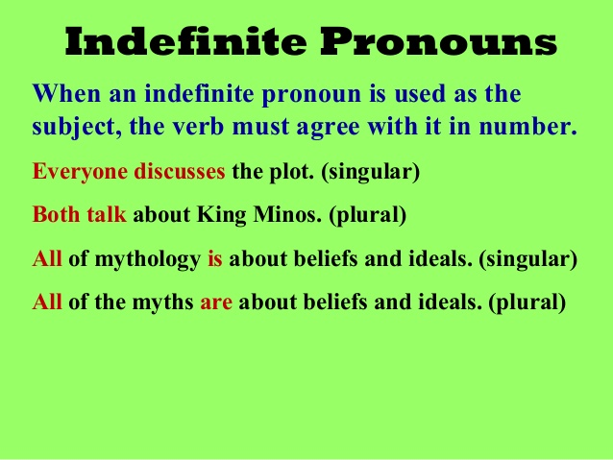

Slide 9
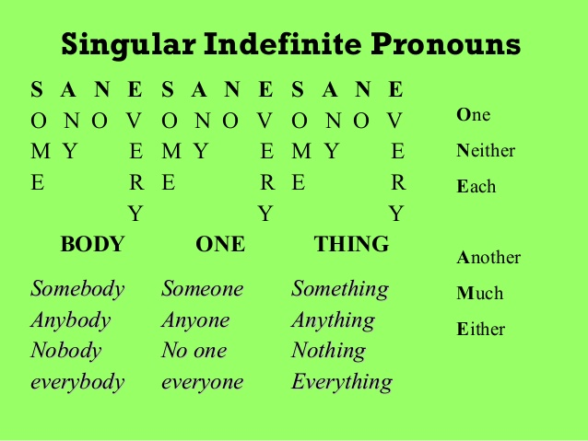

Slide 10
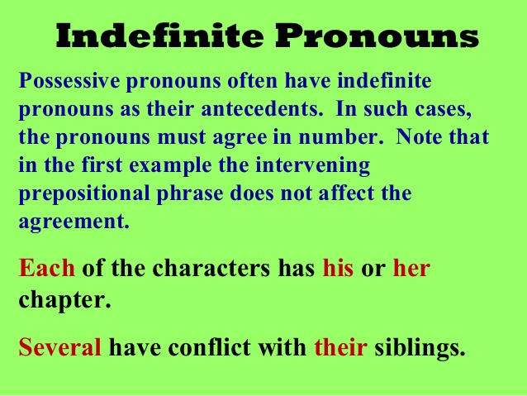

Slide 11
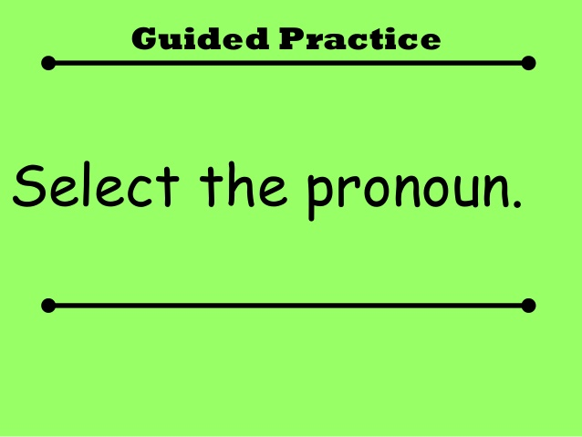

Slide 12
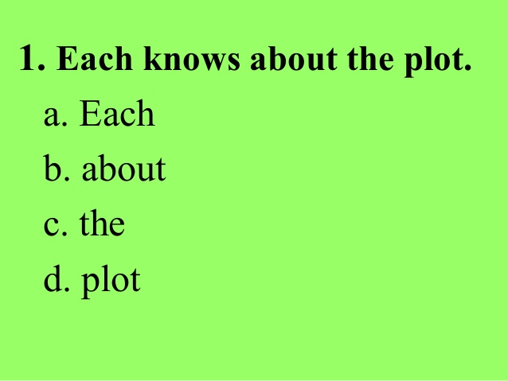

Slide 13
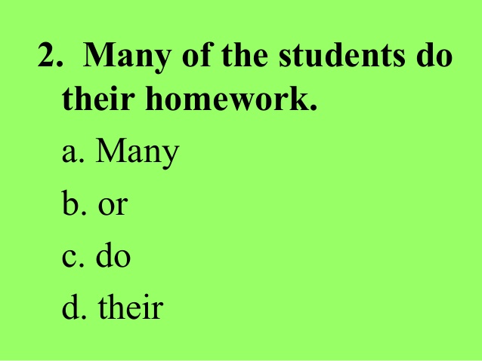

Slide 14
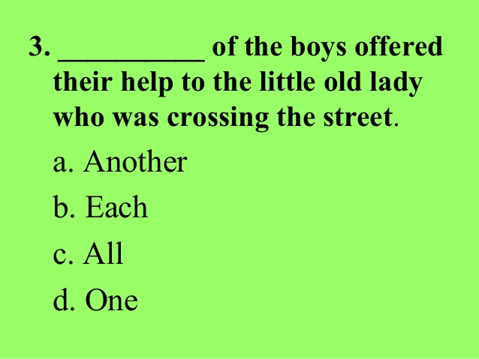

Slide 15
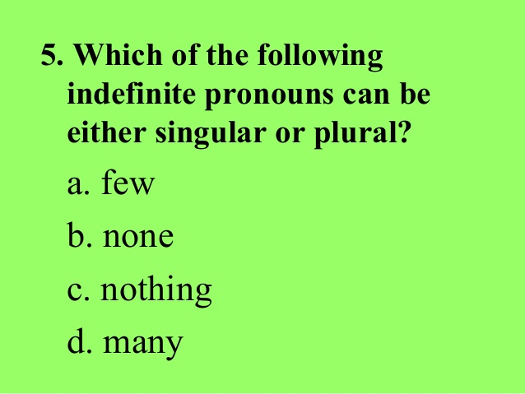

Slide 16
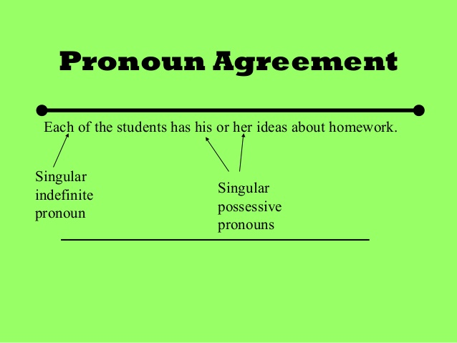

Slide 17
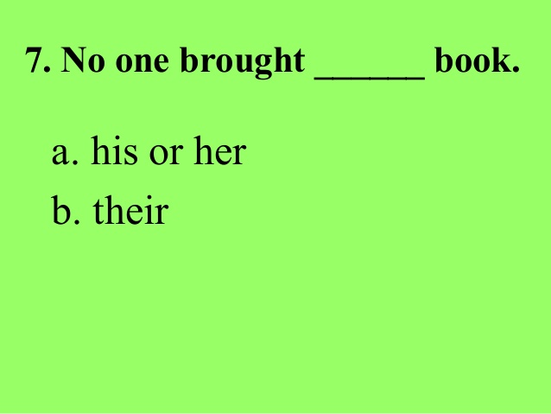

Slide 18
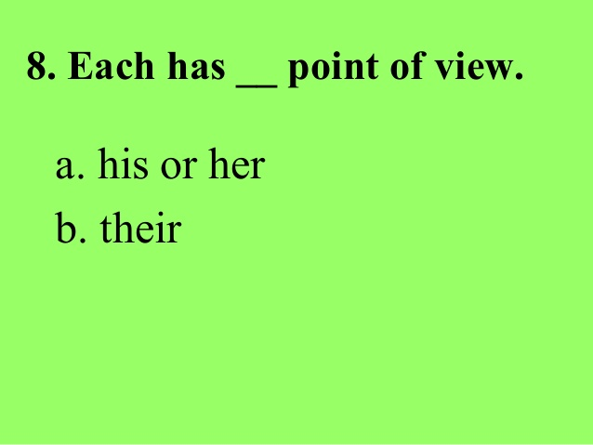

Slide 19
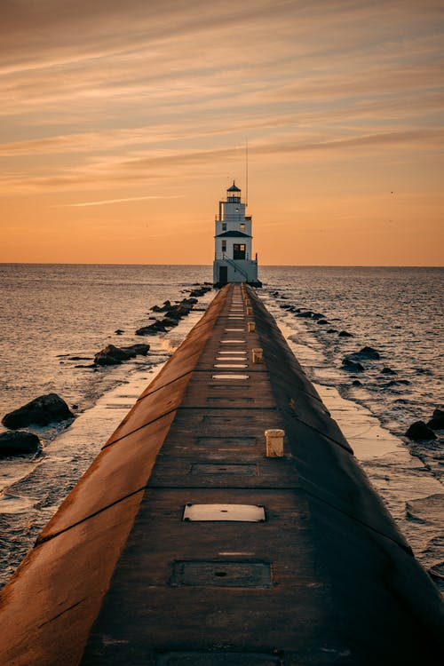
Home Work

Slide 20
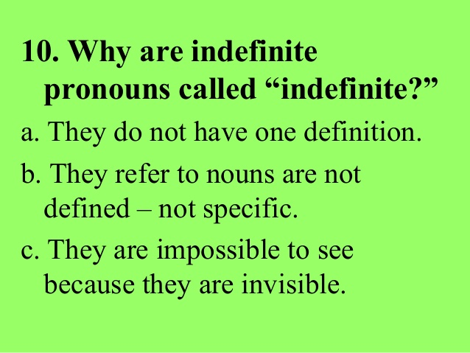

Slide 21

Thanks to all

