Slide 2
Introducing:
Subir Chandra Roy
Assistant Teacher (English)
Azim Memorial High School,
Tangail Sadar, Tangail
Class: Nine-Ten
Subject: English for today
Unit: 06
Lesson: 1-6
Time: 50 Minutes
Date: 11-1-20

Slide 3
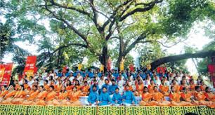
What is the picture about?
Cultural Function at Ramna Batamul,Dhaka

Slide 4
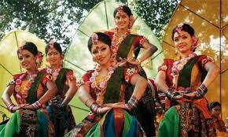
What is the picture about?
Cultural function on Pahela Baishakh

Slide 5
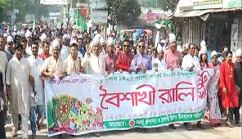
What is the picture about?
Baishakhi Rally

Slide 6
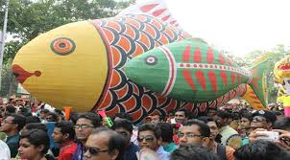
What is the picture about?
Traditional arts on the basis of Pahela Baishakh

Slide 7
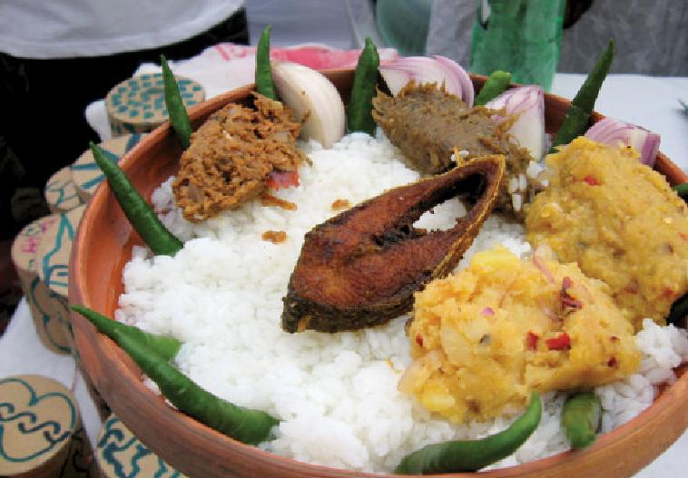
Pahela Boishakh

Slide 8
Learning out comes:
After finishing the lesson learners will be able to-
1. Answer the questions.
2. Write a paragraph.
3. Say true or false
Choose the best answer from the alternative
say the meaning of the words
Write a letter about Pahela Baishakh.

Slide 9
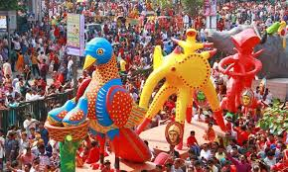
Look at the picture

Slide 10
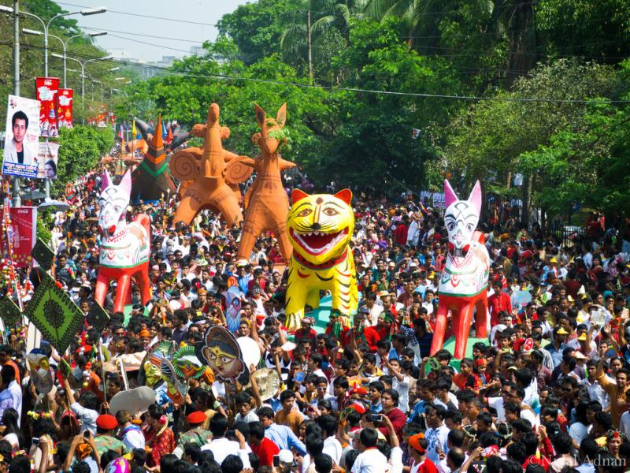
Look at the picture

Slide 11
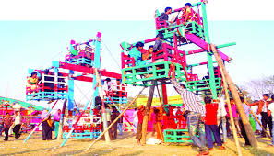
Look at the picture

Slide 12
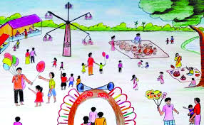
Look at the picture

Slide 13
Individual work:
What is Pahela Baishakh?
When does the day’s first programs begin?
Who organizes the day’s first programs at Ramna Batamul, Dhaka?
What do the women wear on the Pahela Baishakh?
Answers:
(1) The first day of Bangla month Baishakh.
(2) The day’s first programs begins at dawn at Ramna Batamul, Dhaka.
(3) Chhyanata, a leading cultural organization.
(4) Women wear white sarees with red borders and adorn themselves with colourful churis and flowers.

Slide 14
Peer work
Write a letter to your non- Bangladeshi friend abut the celebration of Pahela Baishakh

Slide 15
Group work:
Write the meaning of the following words:
Procession, fascinating, festivals, traditional, significance
Procession- মিছিল manifestation
Fascinating- আকর্ষণীয় attractive
Significance- তাৎপর্য importance
Festival- উৎসব convival
Traditional- ঐতিহ্যবাহী customary

Slide 16
Evaluation
Choose the best answer from the alternatives:
The first program of Pahela Baishakh begins at----- (i) dawn (ii) noon (iii) evenings (iv) all
Chhyanata is a leading --- organization. (i) political (ii) economical (iii) cultural (iv) medical
The day is celebrated (i) Only Dhaka (ii) all over the world (iii) all over the country (iv) None
The famous song “ Esho-he Boishakh , Esho Esho” is written by (i) Altab Mahmud (ii) Kazi Nazrul Islam (iii) Rabindranath Tagore (iv) Abdul Gaffar
On Pahela Baishakh, Women adorn themselves with (i) sarees and blous (ii) colourful churis and flowers (iii) Colourful dresses (iv) costly ornaments

Slide 17
Say whether the following sentences are true or false. If false give the right answer.
Pahela Baishakh is the first day of Bangla new year.
It begins at dawn at Ramna Batamul, Dhaka.
The day is celebrated all over the country.
(d) The celebration of Pahela Baishakh marks a day of cultural unity.
(e)The song’ Esho-he-Boishakh, Esho Esho is written by Kazi Nazrul Islam.
True
True
True
True
False. The song is written by Rabindranath Tagore

Slide 18
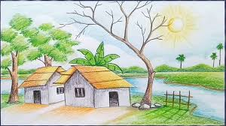
Home work
Write a paragraph about Pahela Baishakh

Slide 19
Thank you very much

