Slide 1
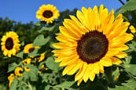
GOOD MORNING

Slide 2
Introducing:
Subir Chandra Roy
Assistant Teacher (English)
Azim Memorial High School,
Tangail Sadar, Tangail
Class: Nine-Ten
Subject: English for today
Unit: 03
Lesson: 5
Time: 50 Minutes
Date: 13-1-20

Slide 3
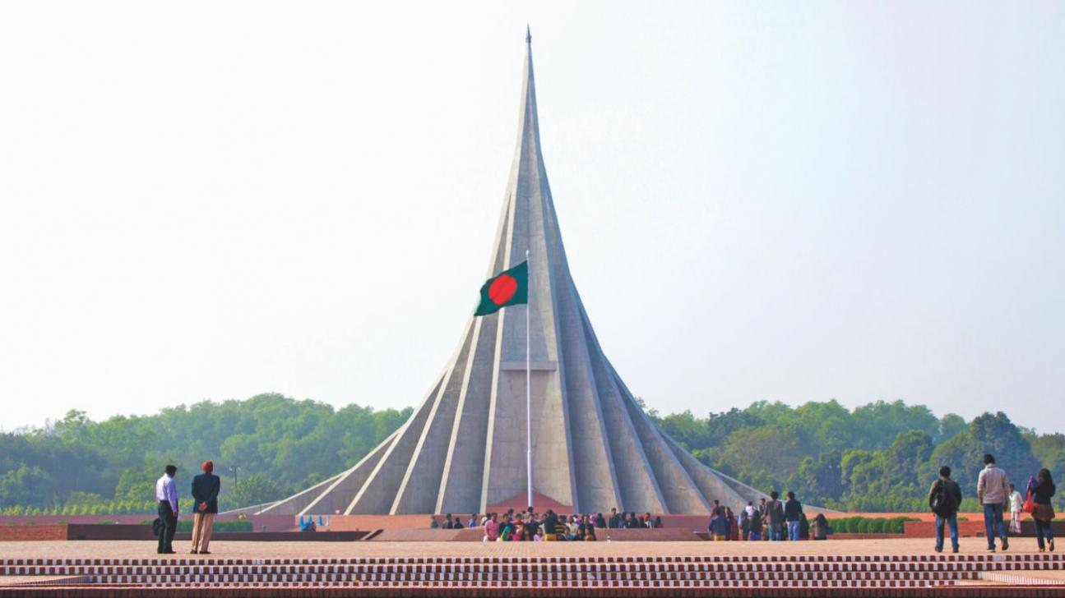
What is the picture about?
This is our National Memorial.

Slide 4
What is the picture about?
The Defense Force of Bangladesh are paying their tribute to the Freedom fighters.

Slide 5
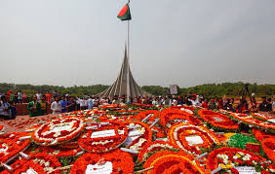
What is the picture about?
People from all walks of life are placing floral wreaths at the National Mausoleum at Savar.

Slide 6
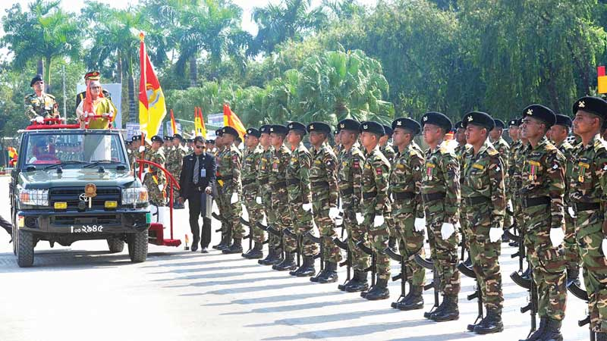
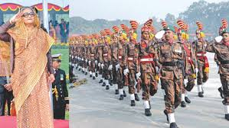
What is the picture about?
Smartly parade of the Defense force and Border Guard of Bangladesh on the Independence Day.

Slide 7
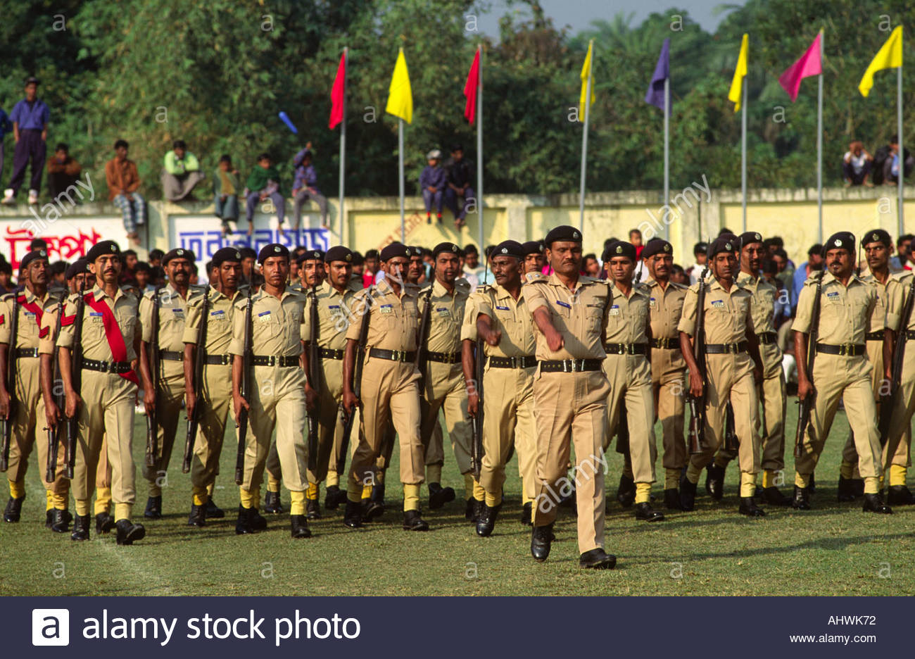
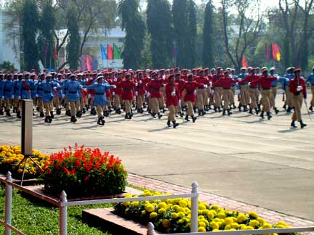
What is the picture about?
Smartly parade of the Police and Ansar on the Independence Day.

Slide 8
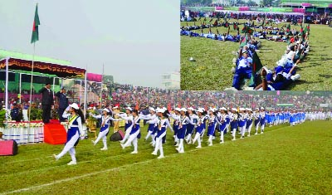
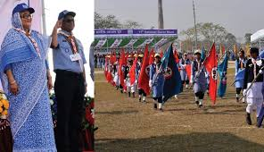
What is the picture about?

Slide 9
Learning out comes
After finishing the lesson learners will be able to-
1. Answer the questions.
2. Write a paragraph.
3. Say true or false
Choose the best answer from the alternative
say the meaning of the words
Write a letter about Independence Day.

Slide 10
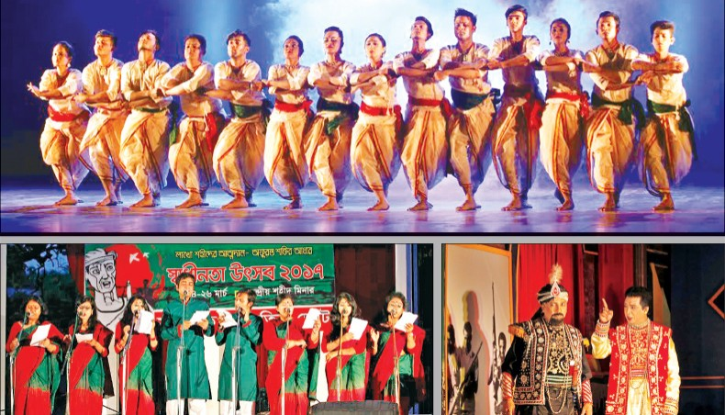
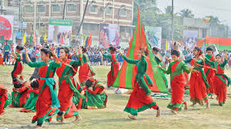
What is the picture about?
Bangla Academy, Shilpakala Academy are celebrating the Independence Day.

Slide 11
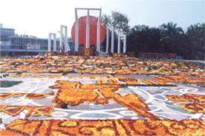
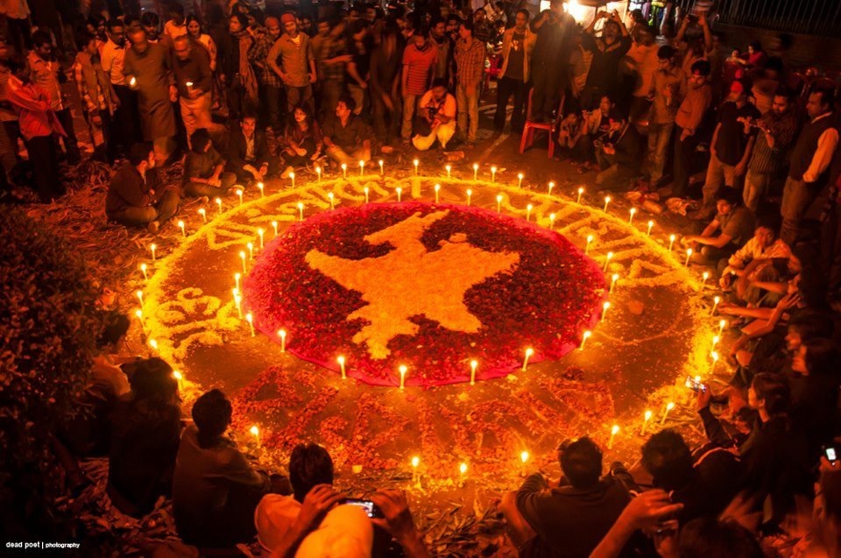
What is the picture about?
our dear motherland, Bangladesh.

Slide 12
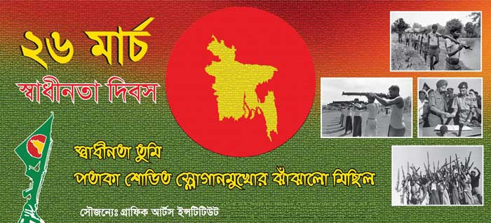
Lesson declaration
Independence Day

Slide 13
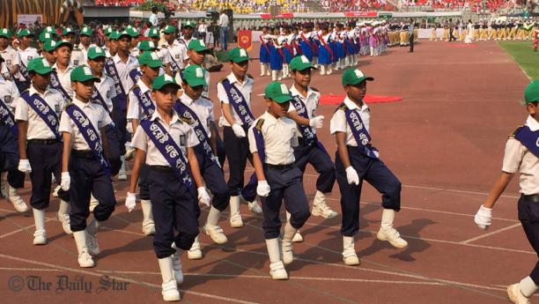
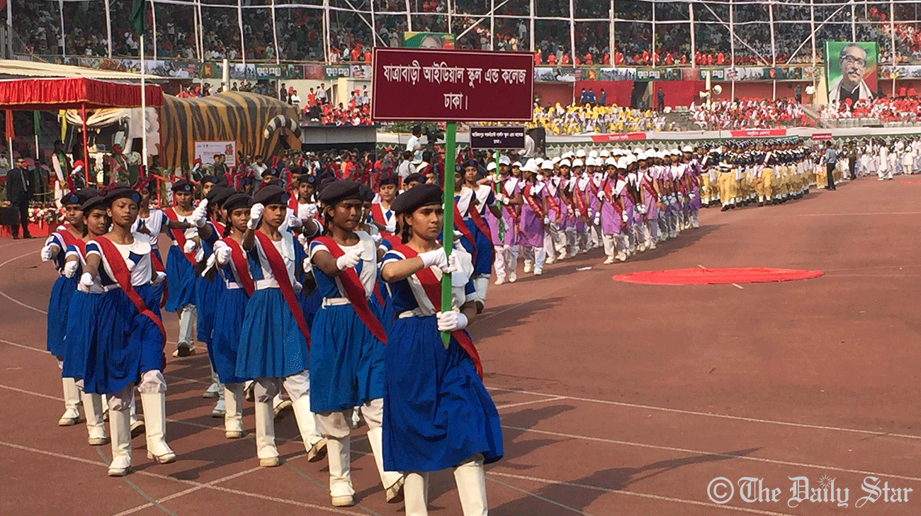
What is the picture about?
The school children are in the rally of the Independence Day.

Slide 14
Individual work:
What is Independence Day?
When did our country become independent?
How does the Independence Day begin?
Who place floral wreaths at the National Mausoleum at Savar on behalf of the nation?
Answers:
(1) The day when we become free from the occupation force .
(2) Our country became independent in 1971.
(3) The Independence Day begins with 31 gunshots.
(4) The President and the Prime Minister place floral wreaths at the National Mausoleum at Savar on behalf of the nation.

Slide 15
Peer work
Write a letter to your non- Bangladeshi friend abut the celebration of Independence Day

Slide 16
Group work:
Write the meaning of the following words:
Procession, Mausoleum, diplomats, illuminate, struggle
Procession- মিছিল manifestation
Mausoleum- স্মৃতিসৌধ Memorial
Diplomats - কূটনীতিক diplomatists
Illuminate- প্রজ্বলিত করা enkindle
Struggle- সংগ্রাম fight

Slide 17
Evaluation
Choose the best answer from the alternatives:
Our biggest state festival is ---- (i) Victory Day (ii) Shaheed Day (iii) Independence Day (iv) all.
The celebration of Independence Day begins with. (i) processions (ii) gunshots (iii) boat race (iv) none of them.
The National Mausoleum is (i) at Ramna Park (ii) on Dhaka University campus (iii) at Savar (iv) near Dhaka medical College.
On Independence Day the National Parade is held (i) at the National Parade ground(ii) in the streets (iii) in the decorated vehicle (iv) In Bangabandhu Stadium.
The day highlights the heroic struggle of (i) 1947 (ii) 1952 (iii) 1969 (iv) 1971

Slide 18
Say whether the following sentences are true or false. If false give the right answer.
The Independence Day is our national day .
It begins at dawn with 31 gunshots.
The day is celebrated all over the country.
(d) Both the President and the Prime minister place floral wreaths at the National Memorial At Savar on behalf of the nation.
(e) Several cultural programs are held all over the world highlighting the heroic struggle and sacrifice in 1971.
True
True
True
True
False. All over the country

Slide 19
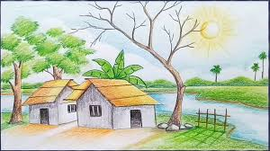
Home work
Write a paragraph about Independence Day

Slide 20
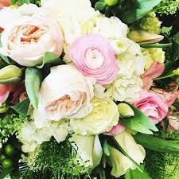
Thank you very much

